Slide 1
The European Age of Discovery
In this lesson, students will be able to define the following terms:
Motives for the European Age of Exploration
The Significance of the Compass and Moveable Rudder
Ferdinand Magellan

Slide 2
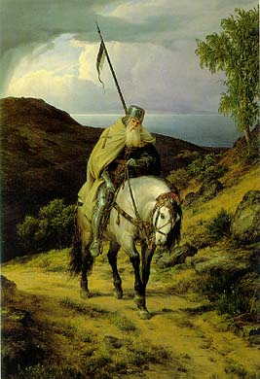
The Crusades
greatly
increased
European
interest in
goods from
the East.

Slide 3
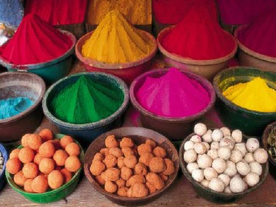
The Crusades greatly stimulated
European interest in East Asian
goods like spices, perfume, and silk.

Slide 4
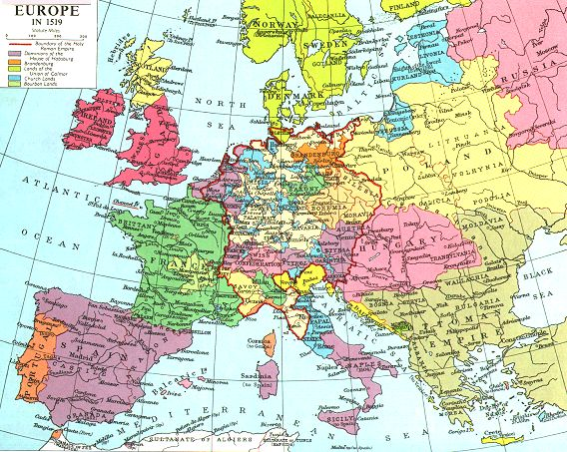
But other European countries and
kingdoms wanted to benefit from trade
with Asia. They were tired of the Italian
city-states’ monopoly of the trade.

Slide 5
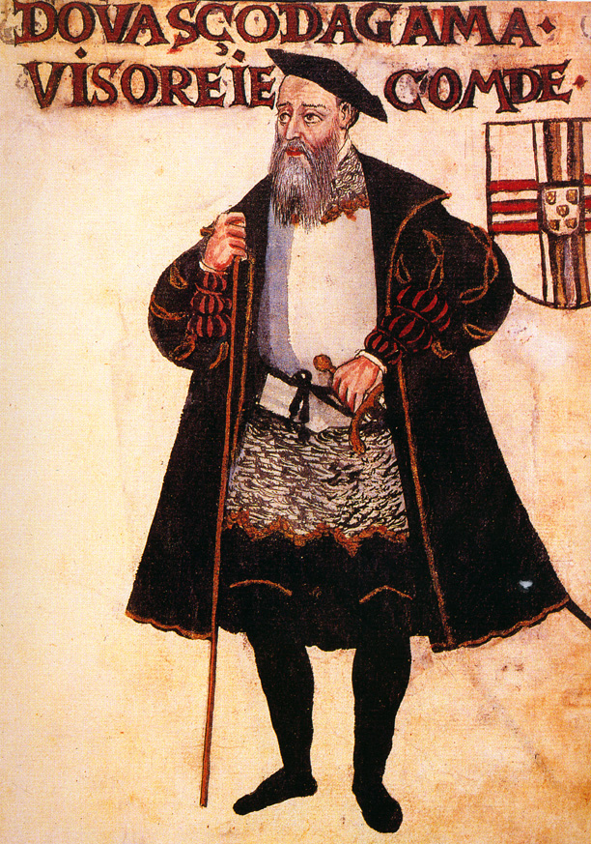
The Portuguese
explorer, Vasco
da Gama, discovered
an all-water route to
India in 1498.

Slide 6
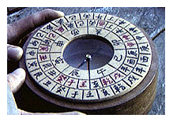
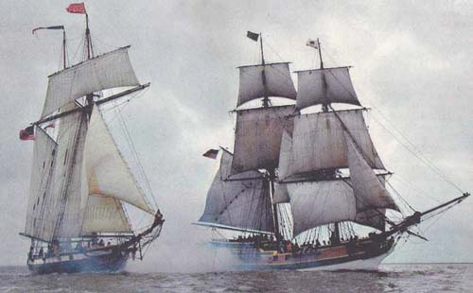
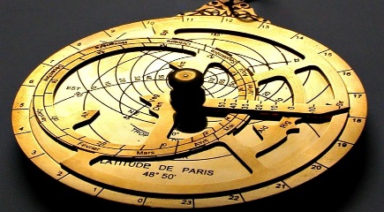
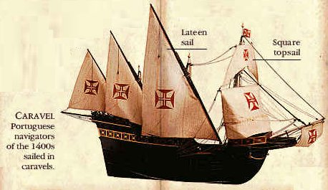
TECHNOLOGICAL ADVANCES
CARAVEL designed→ a sturdier ship with triangular sails that could sail against the wind (1400’s)
Improved navigation techniques
  Astrolabe: used to determine location - early GPS (perfected by Muslims)
  Shipboard Cannons: important in defeating Muslim fleets in Indian Ocean

Slide 7
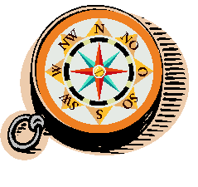
  Magnetic Compass: used to accurately track direction (Chinese invention)
The Chinese invented the compass.
The compass allowed navigators
to travel far.

Slide 8
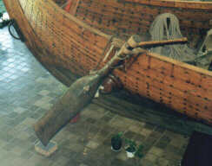
A rudder is a device used to steer
a ship.

Slide 9
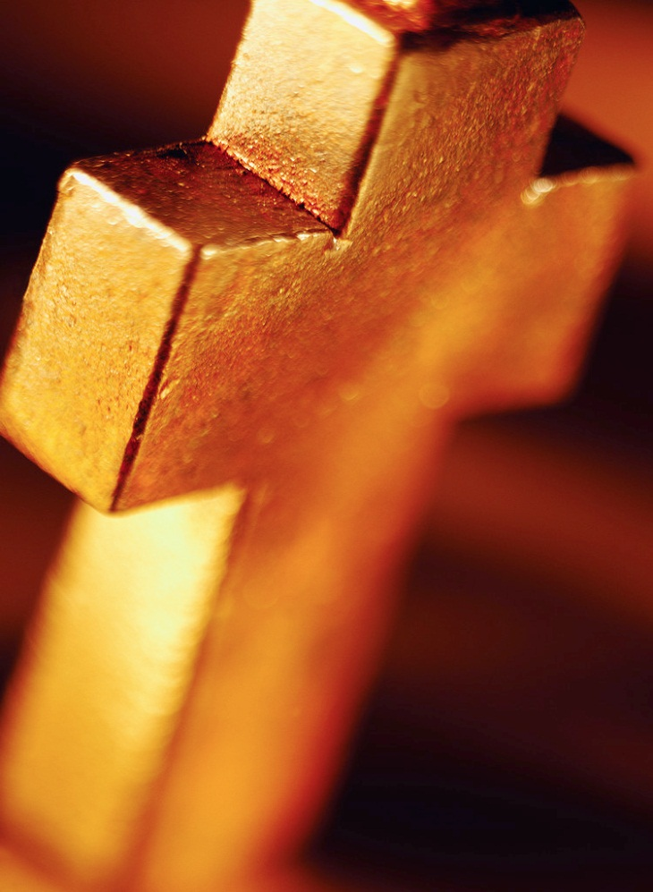
GOD
Crusades left a feeling of hostility between Christians& Muslims
Believed they had a sacred duty to fight Muslims & convert non-Christians throughout the world

Slide 10
Spreading the Gospel
European rulers wanted to spread the Christian religion.
European missionaries traveled to foreign lands to convert individuals and nations to Christianity.
The spreading of the Christian religion was another motive or reason for the European Age of Exploration.

Slide 11
Evidence
“To serve God and His Majesty, to give light to those who are in darkness.”
Bartholomeu Dias
“They (Native Americans) could be much more easily converted to our holy faith by gentle means than by force.”
Christopher Columbus

Slide 12
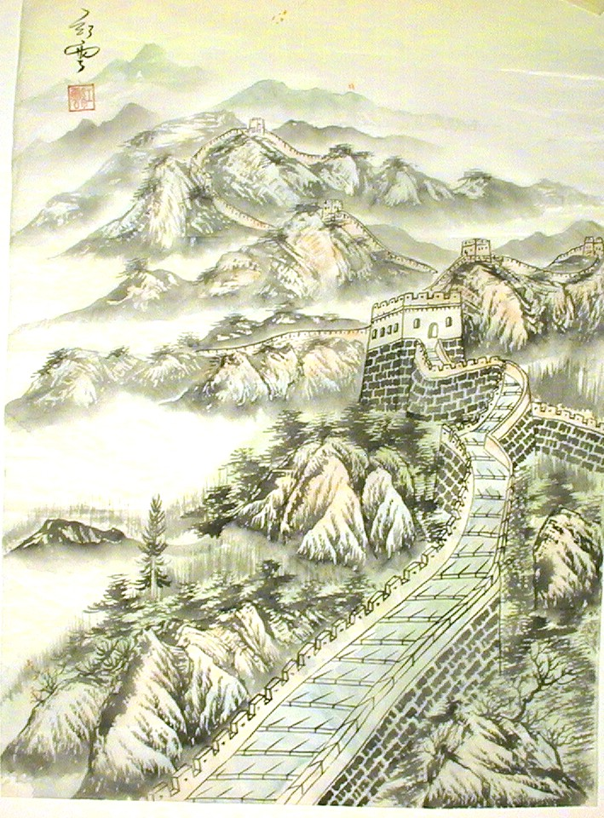
European rulers
correctly
believed that
trade with Asia
would bring
them vast
wealth.

Slide 13
Explorers
With better navigational instruments and a desire for wealth and conversion, European rulers funded exploration.
From Prince Henry the Navigator of Portugal to the King and Queen of Spain, explorers were given ships and crews to journey the vast seas.

Slide 14
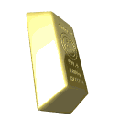
GOLD
Demand for luxury items & spices was high after the Crusades
Muslims & Italians controlled trade of goods from East to West (HIGH PRICES)
Wanted to bypass Italian Merchants→ Needed a sea route to Asia

Slide 15
Evidence
Pizzaro and his attack on the Incas
Pizzaro captured the Inca king and demanded a room full of gold and two rooms of silver in exchange for the king.
MONEY MONEY MONEY….

Slide 16
GLORY
Successful explorers command large fleets & vast wealth
Conquered great civilizations
Explorers get claims to land

Slide 17
Evidence
Amerigo Vespucci claimed to make four trips to America and be the captain of every voyage.
Today historians believe he made two trips and captained only one.
“ I was more skillful than all the shipmates of the whole world”
Amerigo Vespucci

Slide 18

PORTUGAL LEADS THE WAY
Leader in developing & applying sailing innovations
Established trading outposts along west coast of Africa
Had strong government support for exploration
Prince Henry

Slide 19
SPAIN & THE TREATY OF TORDESILLAS
Spain is jealous of Portugal’s success
Rivalry between Spain & Portugal increases→ settlement was an imaginary dividing line N-S thru the Atlantic
THE TREATY OF TORDESILLAS - All land west belonged to Spain and lands east belonged to Portugal (Line of Demarcation)

Slide 20
Questions
What did the Treaty of Tordesillas reveal about European attitudes towards Non-European lands and peoples?

Slide 21
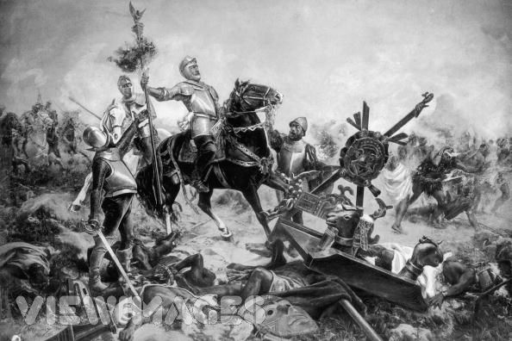
While the Age of Exploration greatly
benefited the Europeans, it greatly
harmed the Native American Indians
who lost their land, freedom, and culture.

Slide 22
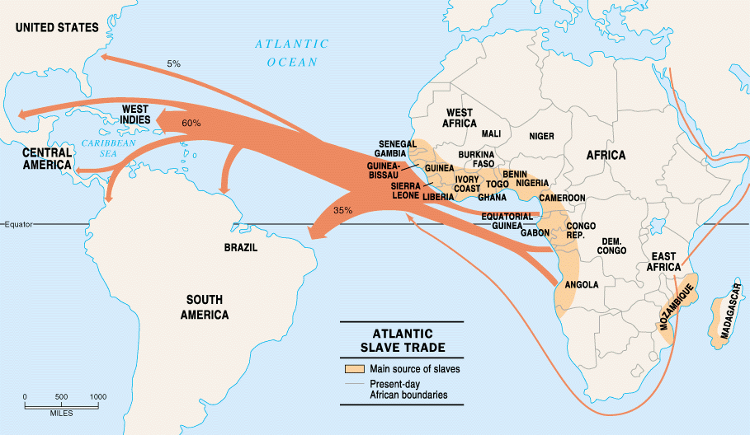
It also greatly harmed the African slaves
who were enslaved to replace a dying
Indian population in the Americas.

Slide 23
Geography Skillbuilder
Complete the Geography Skillbuilder on p.467
  Write the questions or answer them in complete sentences

Slide 24
Questions for Reflection:
List three motives for the European Age of Exploration.
List two inventions which revolutionized navigation.
Who was Christopher Columbus and what was the significance of his travels?
Who was Ferdinand Magellan and how did his journey affect future navigators?

