Slide 1
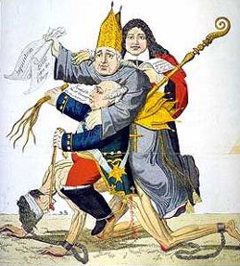
The main problem in France during the 1700s was inequality.

Slide 2
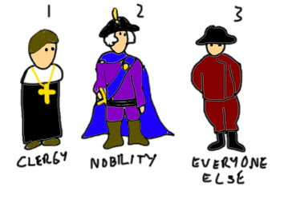
French society was divided into three groups called estates. The high-ranking clergy and nobles made up the First and Second Estates.
1st ESTATE
clergy
10% Land / 2% taxes
2nd ESTATE
Nobles
20% Land / No taxes
1st & 2nd Estates
disliked Enlightenment
ideas

Slide 3
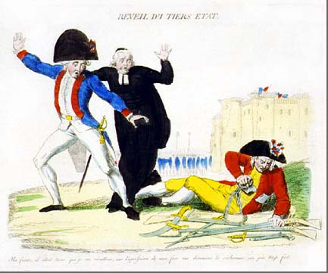
The Third Estate (professionals, peasants, and laborers) made up 97% of the French population. This group paid more than their share of taxes.
3rd ESTATE
Artisans / Merchants
Workers
Peasants

Slide 4
THIRD ESTATE
Common People
Consisted 3 groups:
Bourgeoisie —some were as wealthy as the nobles
WORKERS: cooks, servants & others– paid low wages; often out of work & frequently went hungry
PEASANTS: largest group of 3rd estate– 80% of the population; paid half of their income in dues to the nobles, tithes to the church & taxes to king’s agents

Slide 5
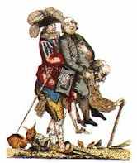
The lawmaking body of France, the Estates General, represented all three estates. But this body rarely met and each estate had only one vote even though the Third Estate had more representatives.

Slide 6
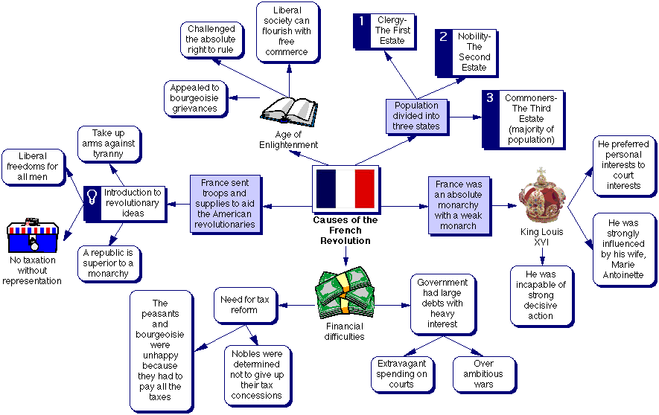
There were many causes of the French
Revolution.

Slide 7
UNDERLYING CAUSES Copy on Back of Notes
SOCIAL PROBLEMS
Growing resentment of lower class (Third Estate)
High taxes
Out of work
Hungry
Lack of social status & power
ECONOMIC PROBLEMS
Economy failing
Increased population
High taxes
High cost of living
Bad weather causes crop failures
Spending by king/queen—in debt

Slide 8
ABUSES OF THE OLD REGIME
1789
POLITICAL ABUSES
Paid for part of the American Revolution
King Louis XVI paid little attention
to the government
Queen Marie Antoinette disliked
Spent too much money
Source: kidz-labs-volcano-making-kit-l.jpg

Slide 9
OTHER CAUSES
New views about power & government are spreading among the Third Estate
People begin to question traditional society
Ideas of equality, liberty & democracy spread
Success of American Revolution
inspires the French

Slide 10
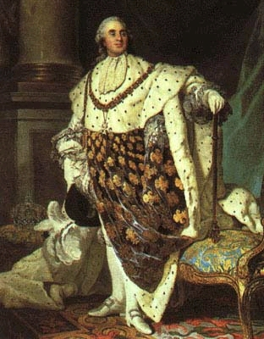
When King Louis XVI needed money, he called the Estates General into session to make the nobles pay taxes

Slide 11
IMMEDIATE CAUSES
Estates-General
(assembly of representatives)
Met for the first time in 175 years (May 5, 1789)
Source: kidz-labs-volcano-making-kit-l.jpg

Slide 12
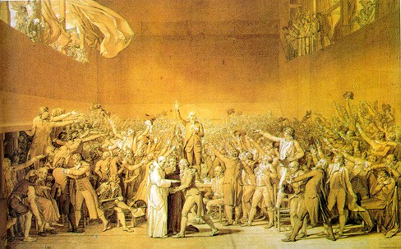
The Third Estate felt that each representative should be given a vote. When the First and Second Estates disagreed
Third Estate withdrew and formed the National Assembly.

Slide 13
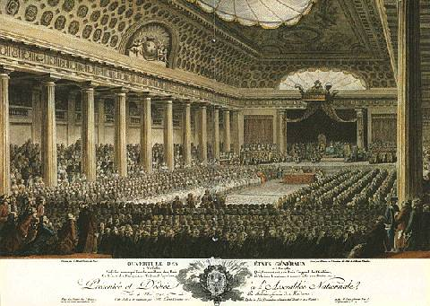
During the Estates General, the
bourgeoisie declared themselves a
National Assembly.

Slide 14
The Bastille
The king threatened to break up the Assembly because the bourgeoisie claimed to represent “the people”.
The Parisians seized a royal prison known as the Bastille. On July 14th 1789
To prevent a civil war, King Louis XVI let the National Assembly continue.

Slide 15
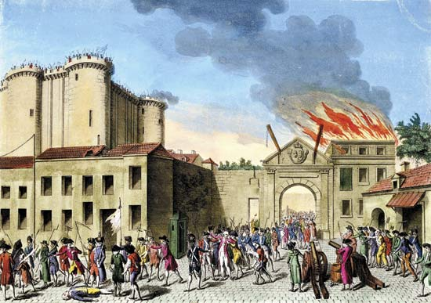
Great Fear sweeps paris and france in senseless violence and panic.
The French Revolution had begun.

Slide 16
King Louis
Forced From Versailles
Prisoner of Paris

Slide 17
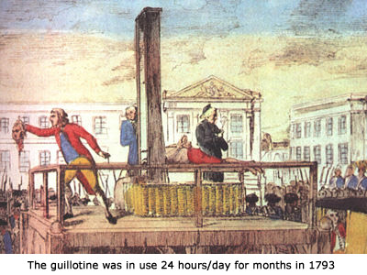
French radicals gained control of the
government. Radicals feared attempts
to restore the Monarch’s absolute power.

Slide 18
Committee of Public Safety
The new French government formed the Committee of Public Safety.
This Committee took over the French Revolution. It was led by Maximilien Robespierre.
The Committee launched a Reign of Terror in 1793 to save the Revolution.

Slide 19
A powerful extremist group called the Jacobins convinced the French people that Louis XVI had plotted with Austria and Prussia.

Slide 20
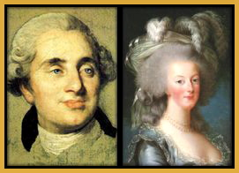
The Jacobins forced the Assembly to arrest the king and queen. The queen was Marie Antoinette, the daughter of Maria Theresa of Austria.

Slide 21
REIGN OF TERROR
Robespierre leads as a DICTATOR
Guillotine used as an efficient & “humane” means of execution.
King Louis XVI is executed
Marie Antoinette & Danton are imprisoned & executed
Members of the 3rd Estate executed if they were seen as enemies of the revolution (85% of all those killed during the Reign of Terror)

Slide 22
Execution
Suspected traitors, including nobles and priests, were executed.
Many aspects of the Old Regime, from the calendar to clothing styles, were rejected by the new government.
Ordinary citizens were armed to defend France.

Slide 23
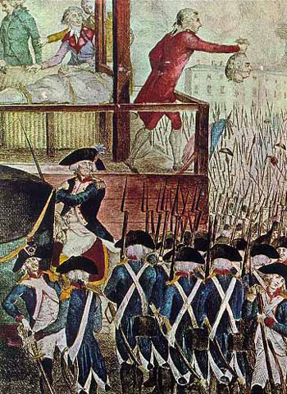
The Jacobins created a dictatorship and fostered great fear among the people while simultaneously encouraging patriotism.

Slide 24
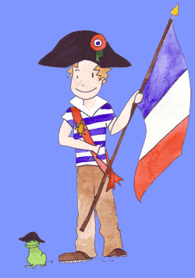
In August 1789, the National Assembly adopted the Declaration of the Rights of Man and of Citizen. It declared that “all men are born free and equal in rights.”

Slide 25
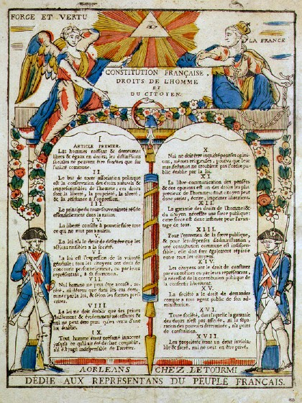
Perhaps the Assembly’s most important work was the Constitution of 1791. It reformed the government by establishing a limited monarchy.

Slide 26
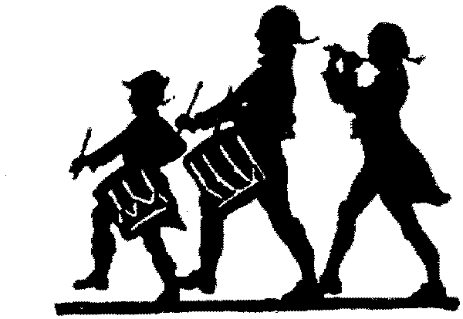
Both the American and the French
revolutions served as models for
citizens in other countries seeking
political change.

Slide 27
The ideals of
the French
revolution
inspired
citizens in
other countries.

Slide 28
Based on the information you have about the Three Estates, explain how this cartoon represents France during the Old Regime.

