Slide 2
Imperialism Focus Video – 2:30 Min
From 1850 to 1914, the strong, industrialized nations of Europe used imperialism
to seize colonies & dominate the local
gov’ts & economies in Africa & Asia

Slide 3
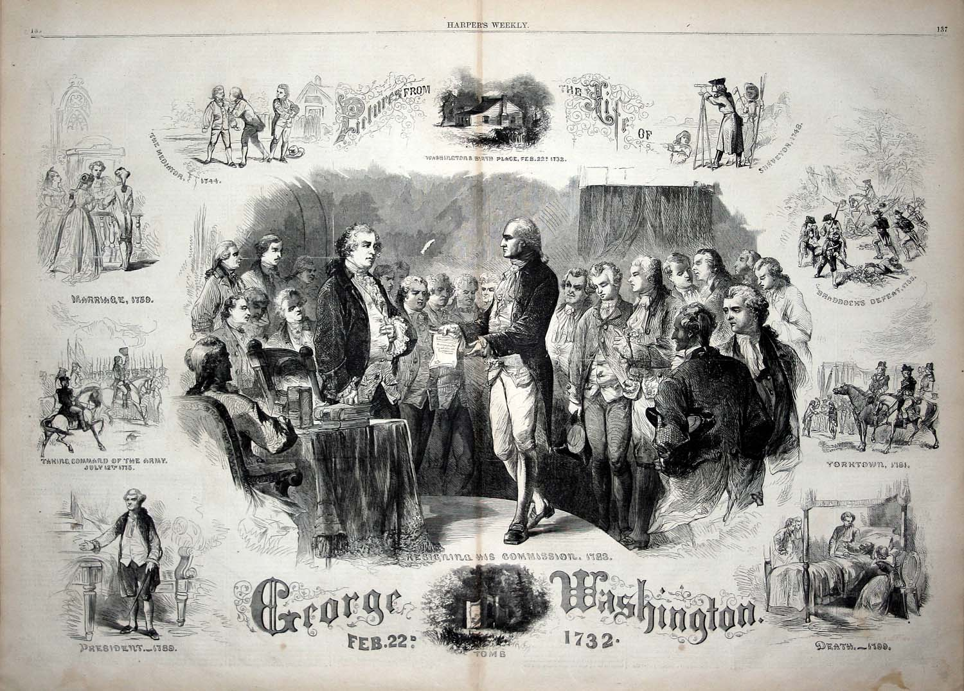
Despite the independence of the
United States and Latin America,
European imperialism continued in
Africa and Asia.

Slide 4
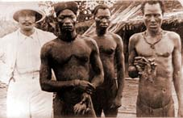
New European countries like Belgium,
Germany, and Italy wanted colonies.
In this photograph, an African is holding
a severed hand. In the Belgian Congo,
if an African did not supply enough rubber,
his hand was cut off.

Slide 5
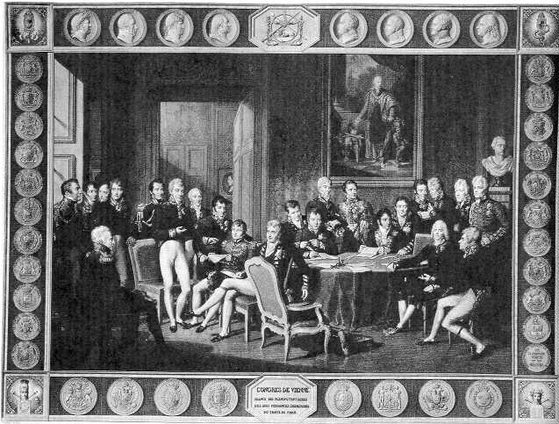
European countries also wanted to
preserve the balance of power among
themselves. When one country acquired
a colony, other countries felt the same
was necessary.

Slide 6
Motives Driving Imperialism
Imperialism: takeover of a country or territory by a stronger nation, with the intent of dominating the political, economic, or social life of the people of that nation
Racism: idea that one race is superior to others.
Social Darwinism: ideas of evolution or “survival of the fittest”

Slide 7
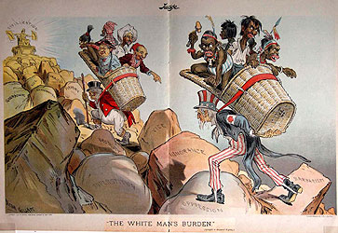
Some Europeans and Americans believed
it was their responsibility to conquer and
“improve” the conquered peoples’ cultures.

Slide 8
Forms of Imperialism
Colony: Europeans seize a territory and govern internally by sending governors.
Protectorate: a country or territory with its own internal govt. but under the control of an outside power
Sphere of Influence: An area in which an outside power claims exclusive investment or trading privileges

Slide 9
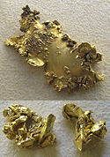
Competing European Nations
Industrial revolution stirred ambitions
Needed more resources to fuel industrial production
Competed for new markets for their goods
Africa and Asia seen as sources for raw materials and new markets

Slide 10
Motivations for Imperialism Activity Focus Video – Imperialism – 8:30 Min
■ What factors contributed to the rise of imperialism by European nations?
–Examine the 5 major motivations for imperialism on the top of your chart; Read each description & create symbol
–Visit each of the 15 stations & write a brief explanation of what you see in the chart; Match the station information with one of the 5 imperial motivations
–Be prepared to share your findings

