Slide 1
Imperialism In Africa
Cy - Ranch

Slide 3
Africa Before Imperialism
African peoples divided into hundreds of ethnic and linguistic groups - More than 1000 different languages
European travel to interior impossible before steam engine (steam powered riverboats)
Africans had trade networks and kept Europeans from controlling trade

Slide 4
Do Not Write : Not a United Front…
Huge variety of ethnic groups and languages prevented Africans from a unified stand
Wars among the Africans over water, trade rights, and land
Technological disadvantage
No weapons

Slide 6
What was desired in Africa Do no Write:
Copper and Tin found in Belgian Congo
Exploited Africa for rubber, gold, diamonds, ivory, tin, copper

Slide 7
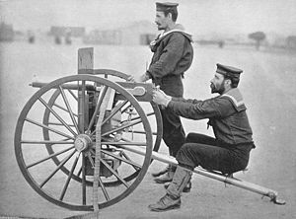
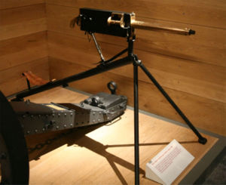
European Technological Superiority Do Not Write
Steam engine- easier travel
Steam powered riverboats
No longer confined to the African coast
Maxim Gun- world's 1st machine gun
Railroads, cables, and steamers

Slide 8
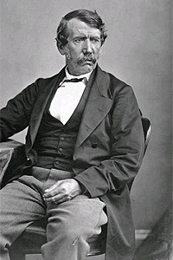
Document 1 Analysis
Dr. David Livingstone

Slide 10
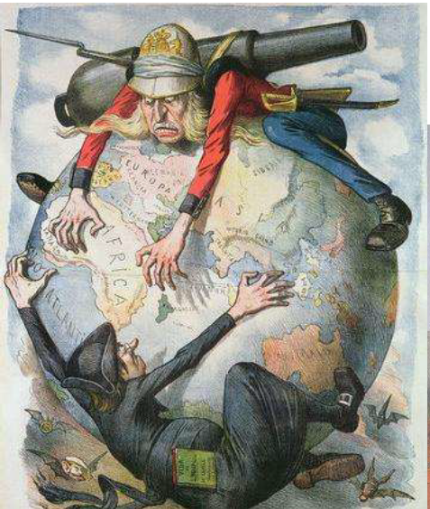
Berlin Conference 1884-1885
Agreed that any nation could claim land so long as they notified other nations of the claim (they had to show that they could control the area)
No African rulers attended the meetings
Conference sealed Africa's fate

Slide 11
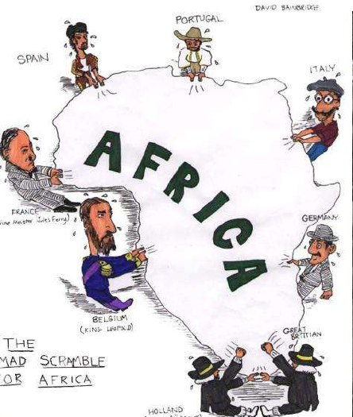
Document 2 Analysis
Berlin Conference

Slide 13
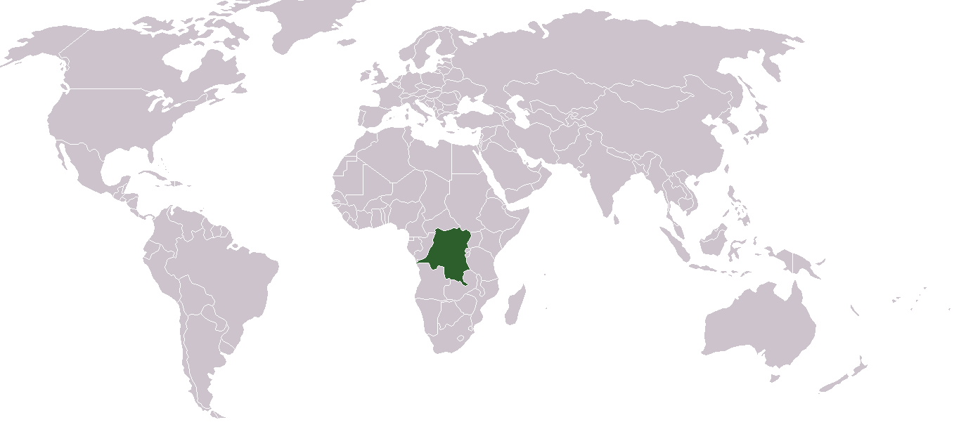
Document 3 Analysis
The Congo
Mine all Mine-
Horrors of King Leopold II of Belgium

Slide 14
OOPS!! Our Mistake : Do Not Write
European nations thought Africans would buy their goods
They were wrong
European goods were not bought
But businesses still needed raw materials from Africa
Cash-Crop plantations: grow peanuts, palm oil, cocoa, and rubber

Slide 15
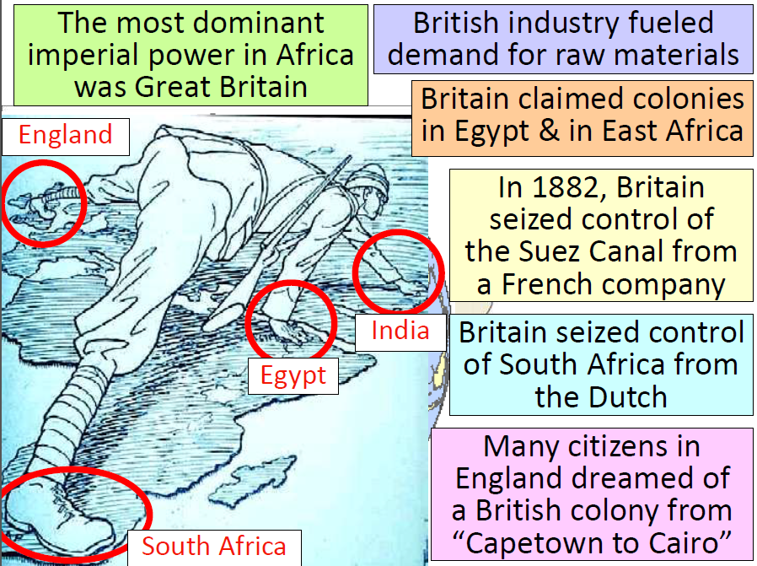

Slide 17
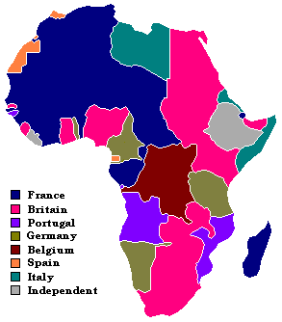
Document 4 Analysis
Rhodesia
South Africa

Slide 20
Document 5 Analysis
Ethiopia

Slide 22
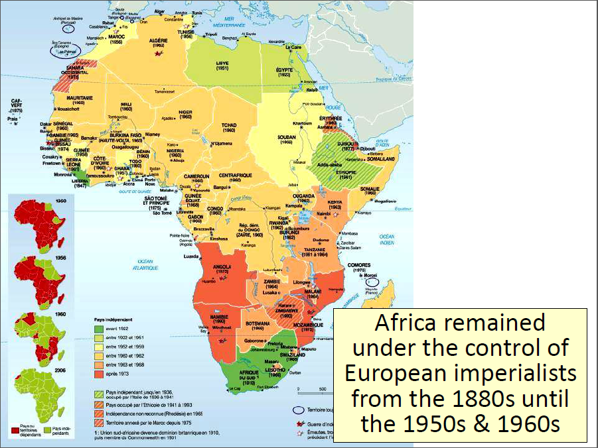

Slide 23
Document 6 Analysis
Zulu War Video
Anglo – Zulu War

Slide 24
Document 7 Analysis
Boer War

Slide 25
Clash of the 3 Nations : Don’t Write
South Africa: history of Dutch, Africans, and British
British control the Zulu by 1887
Dutch (Boers) in Cape of Good Hope 1652
Dutch and British clash over land and slaves
1830’s thousands of Boers move to escape the British
Movement known as The Great Trek

Slide 26
Diamonds, Gold, and War : - Don’t Write OH MY!!
The Boer War: 1st modern total war
Diamonds and gold discovered in south Africa-1860’s and 1880’s
“outsiders” wanted to take it from Dutch Boers
1899 Boers took arms against the British
Commando raids, guerilla tactics, by Boers against British
British burned farms and imprisoned women and children
Britain won- 1902

Slide 28
Welcome to Africa: Europeans take over Review of Information
Motives
Nationalism
Economic Competition
European Racism
Missionary impulse
Issue: Malaria
Europeans highly susceptible to malaria
Caused by mosquitoes
A dose of Quinine almost everyday will keep the malaria away ☺
Internal Forces
Variety of cultures and languages
Low level of technology
Ethnic strife
External Forces
Maxim Gun
Railroads
Steam Ships

