Slide 1
Imperialism In China
Western Imperialism in China

Slide 6
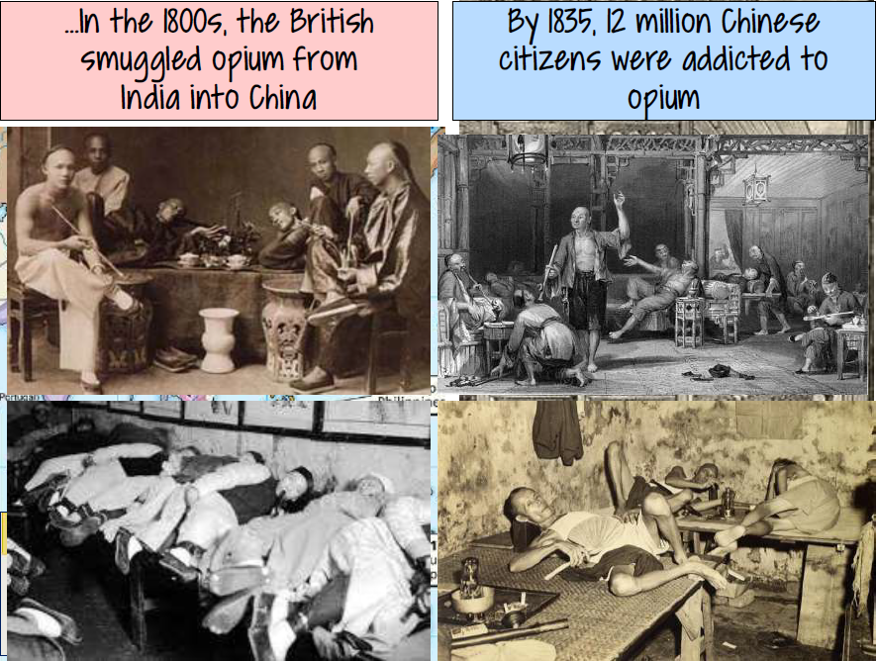

Slide 7
Opium Wars Video

Slide 8
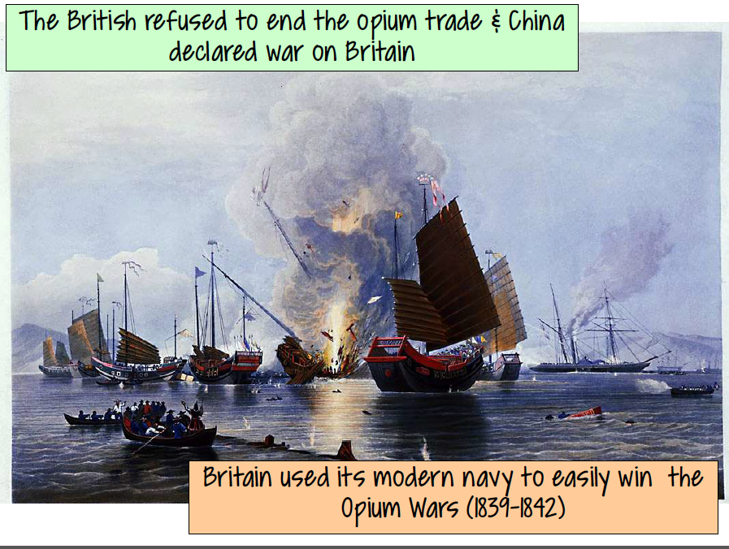

Slide 11
Video - Rebellion

Slide 12
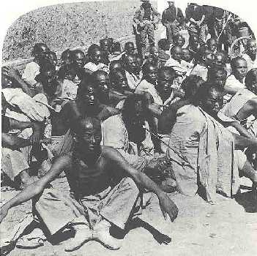
A Chinese group, known as the “Boxers", arose in rebellion in an attempt to drive
out all foreigners
from China. The
“Boxers” belonged to a secret society known as the “Righteous and Harmonious
Fists.”
Don’t Write

Slide 13
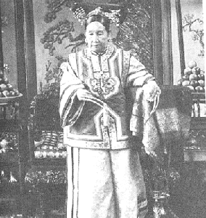
Don’t Write
The Chinese government secretly
supported the Boxers.

Slide 14
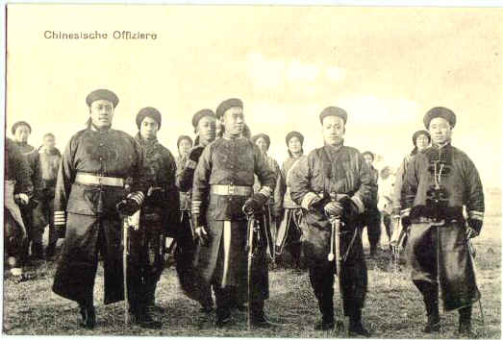
Don’t Write
Even though the Boxer Rebellion
was crushed, it served to
encourage Chinese nationalism

Slide 15
