Slide 1
Imperialism in India
Cy-ranch

Slide 4
Imperialism In India Video

Slide 8
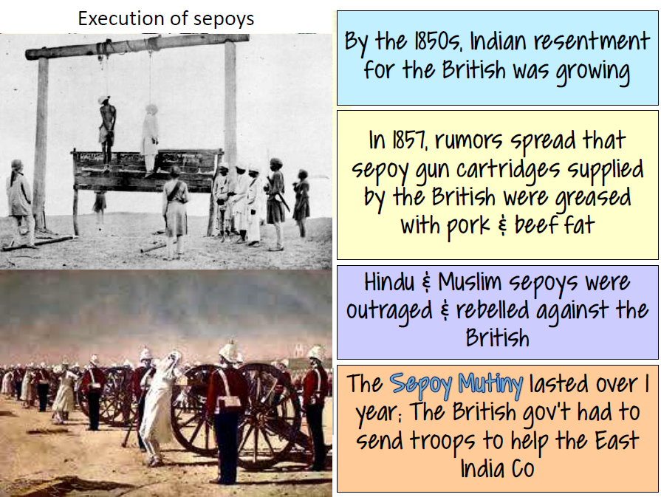

Slide 11
Effects of Imperialism

