Slide 1
The Commercial Revolution
In this lesson, students will be able to define the following terms:
The Commercial Revolution
Mercantilism
Colonies
Mother Country
Capitalism
Joint Stock Company

Slide 2
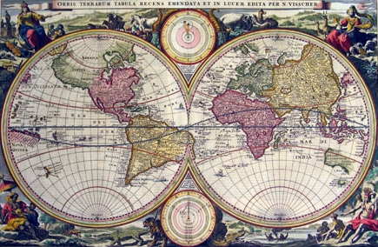
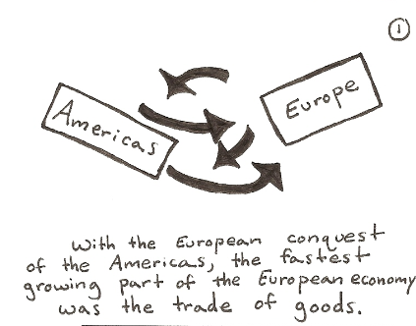
The Commercial Revolution marked
an important step in Europe from
local economies to a global economy.

Slide 3
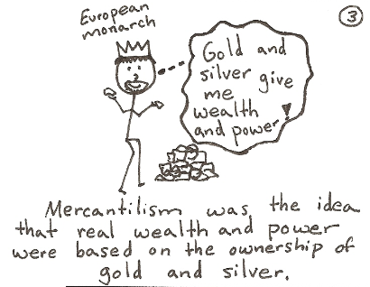
Mercantilism
In order to acquire gold and silver, European countries established overseas colonies.
Colonies provided gold and silver.

Slide 4
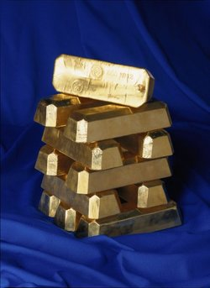
Mercantilists believed that a country’s
wealth was based on the amount of
gold and silver it acquired.

Slide 5
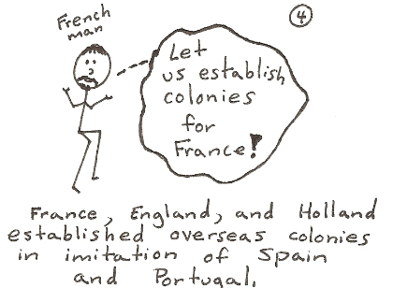
Mother Countries and Colonies
Mother countries were conquerors.
The conquered land was a colony.
In addition to mining for gold and silver, Mother countries imported natural resources or raw materials and exported finished goods.

Slide 6
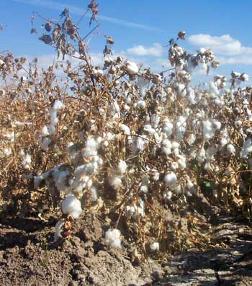
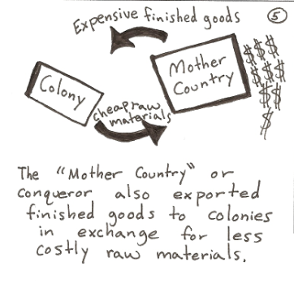
Colonies Exported cheap
raw materials like cotton and
Imported more expensive finished
goods like shirts.

Slide 7
Capitalism
Merchants and bankers laid the foundations for capitalism.
In a capitalist system, business owners risk their capital (money) to start new businesses hoping to make profits.
Individuals formed joint-stock companies.

Slide 8
Joint Stock Companies
A Joint stock company is a privately owned company that sells stock or partial ownership in the company to investors.
Investors risk their capital or money when they purchase stock.
If the company is successful, the investor receives his share of the profits.

Slide 9
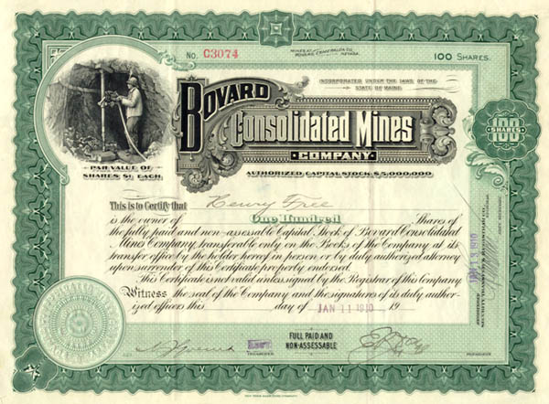
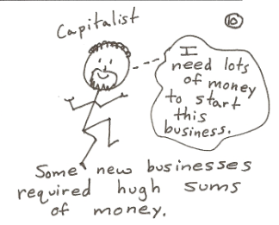
A stock certificate represents partial
ownership in a business.

Slide 10
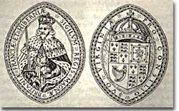
Joint stock companies were sometimes
given charters to establish settlements
in the “New World”.

Slide 11
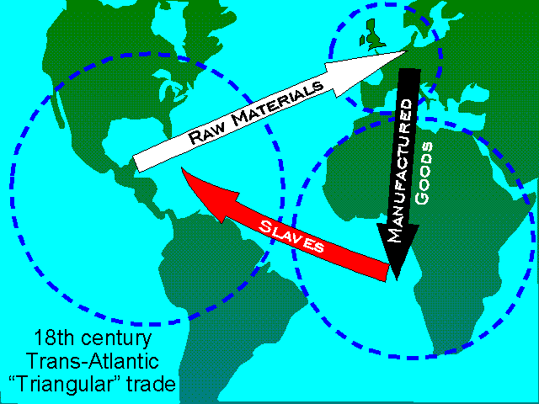
“Triangular” trade & Colombian Exchange
made some continents wealthy
while it impoverished other continents.

Slide 12
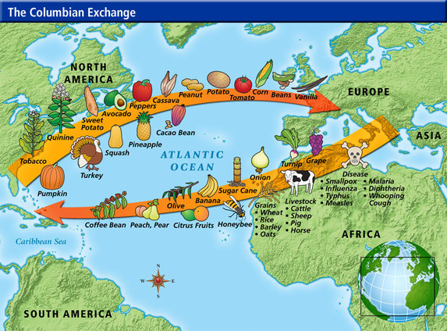

Slide 13
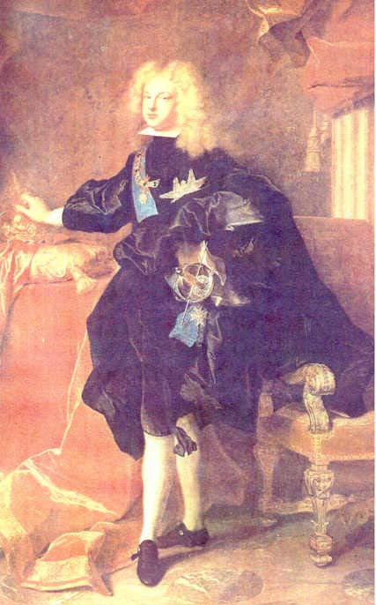
European
kings
increased
their
wealth and
power
through
conquest
and
colonization.

Slide 14
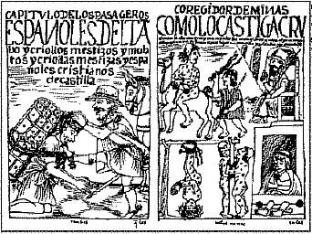
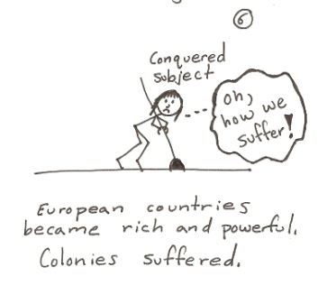
While European Kings and capitalists
increased their wealth, Native American
Indians and Africans were terribly exploited.

Slide 15
European Interest in Slaves
Native American populations declined
Europeans needed a cheap labor source for their plantation colonies in the Americas
Why Africans?
Disease resistance
Experienced farmers
Did not know the land
Skin color made it difficult to escape and hide among others

Slide 16
Cause and Effect
Disease weakened Native’s ability to resist European settlement
More European settlers arrived and planted crops
Natives enslaved to provide labor
As Natives died out, a new source of labor was needed
African Slave trade greatly increased

Slide 17
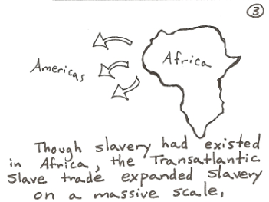
The Transatlantic Slave Trade
Europeans removed millions of Africans between the 1500s to the 1800s.
Africans were stripped of their language and culture and forced to labor on plantations in the Americas.

Slide 18
Captured Slaves -1
Slaves were traded in exchange for guns and other goods.
Captured Africans were brought across the Atlantic ocean to the Americas.

Slide 19
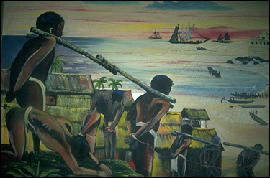
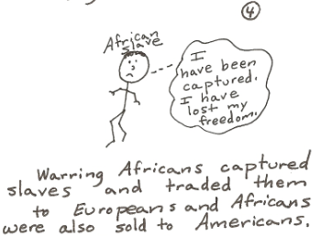

Slide 20
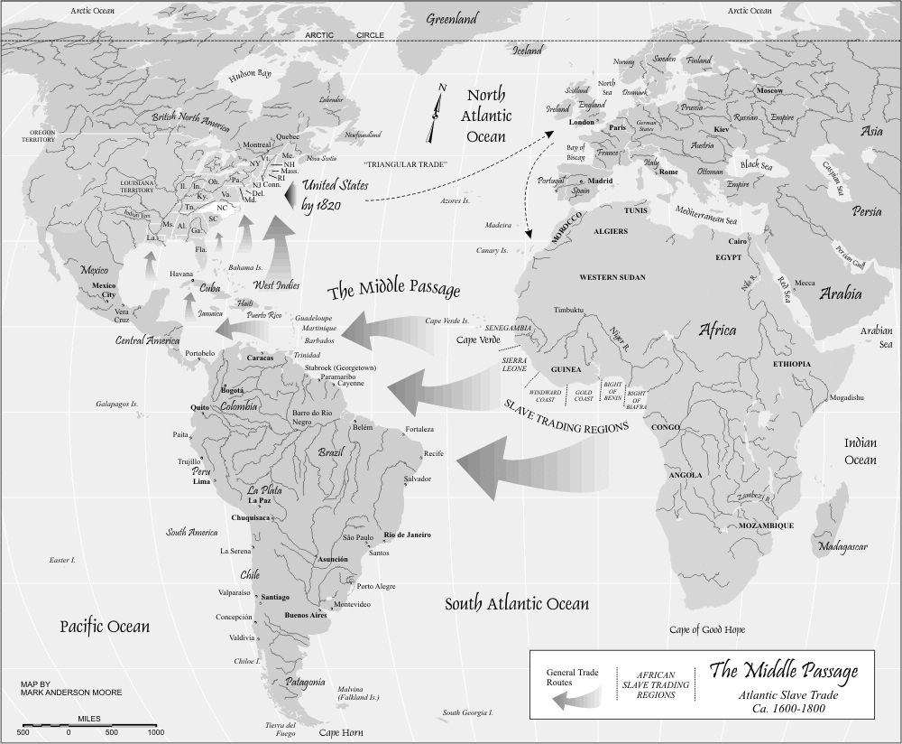
The “Middle Passage” was the voyage
across the Atlantic to the Americas. - 2

Slide 21
The Middle Passage
It was a long and brutal journey.
Many slaves died during the “Middle Passage”.

Slide 22
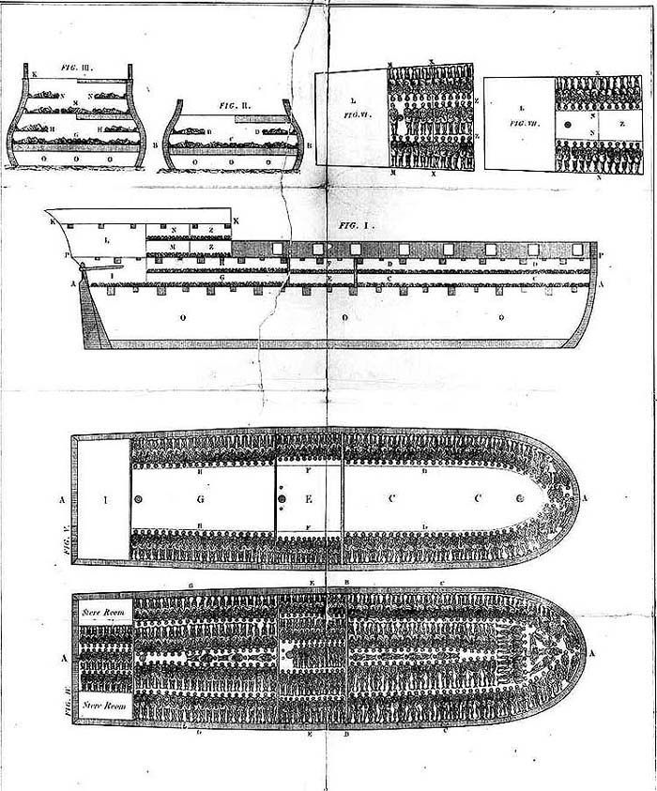
Captured
Africans
were
crammed
into
small
quarters
during the
Middle Passage.

Slide 23
African slaves were brought to
sugar plantations in the Caribbean
and large farms in Brazil.

Slide 24
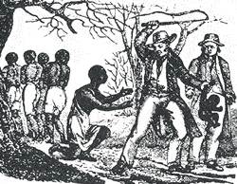
African slaves encountered
brutality and cruelty on plantations
in the Americas.

Slide 25
Consequences of Slave Trade
African communities lost their strongest workers
Families torn apart
Guns added to the cycle of violence
West Africans became dependent on European goods
Populations were cut in half in some African regions
American colonies & economic success were built upon the unwilling labor of African slaves
Africans brought cultural influences with them
Most American countries have large African-American or populations

Slide 26
Questions for Reflection:
Why did many Native American Indians die?
How did the deaths of Native American Indians affect Africans?
What was the Transatlantic Slave Trade?
Why did so many Africans die during the “Middle Passage”?
How did slavery harm Africans and Africa?

Slide 27
Questions for Reflection:
Define mercantilism.
How did European nations increase their wealth and power?
Define capitalism.
Why did individuals invest in Joint stock companies?
What was “Triangular” trade?
What was the relationship between a mother country and a colony?

