Slide 1
The Rise of Royal Power
In this lesson, students will be able to define the following terms:
Divine Right Theory
Absolute Ruler
Louis XIV
Thomas Hobbes

Slide 2
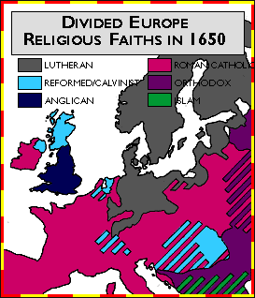
The Protestant Reformation led to conflict
between Catholics and Protestants.

Slide 3
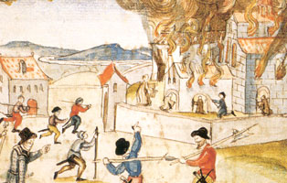
Religious wars frequently followed.

Slide 4
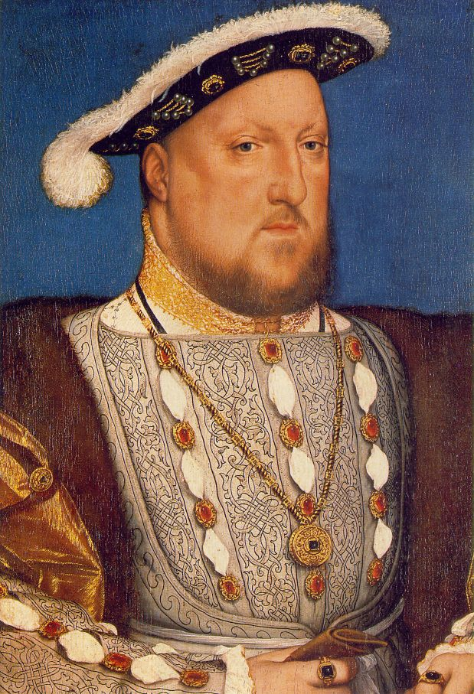
Kings were
able to
increase
their standing
armies and
increase taxation
during the
Reformation to
restore peace.

Slide 5
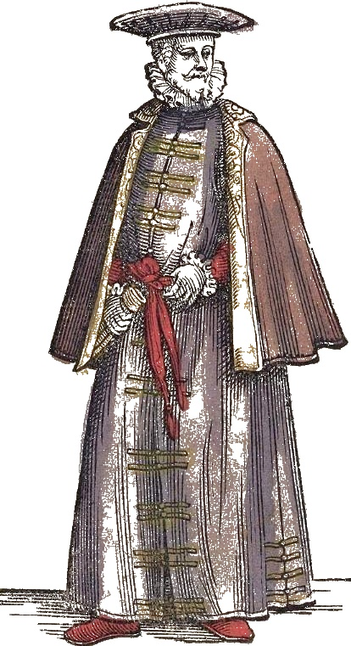
In addition to
the Reformation,
increased trade
created a new
class of people:
the Middle Class.
The Middle Class
frequently allied
with kings for
protection and stability.

Slide 6
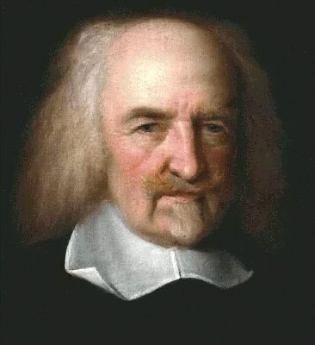
Thomas Hobbes was a British philosopher.
He wrote in the 1600s that a powerful
monarch was the best way to unify a nation.

Slide 7
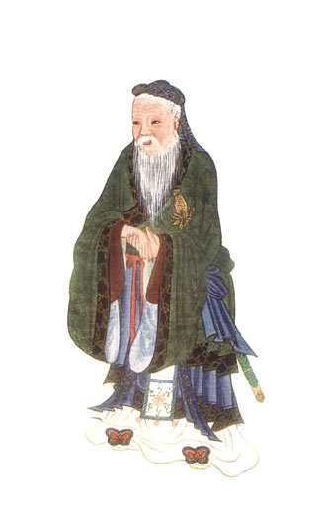
Like Confucius in
Zhou China, Thomas
Hobbes believed
that kings were
justified in assuming
absolute power
because only kings
could maintain
order.

Slide 8
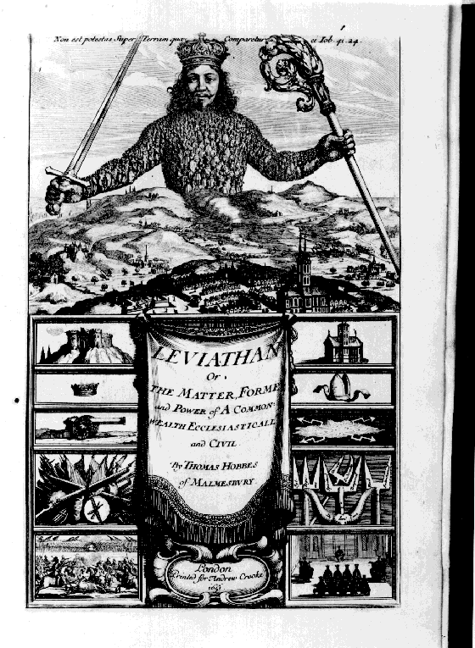
Absolutism is
a political system
where a monarch
has absolute
power over his
or her
subjects.

Slide 9
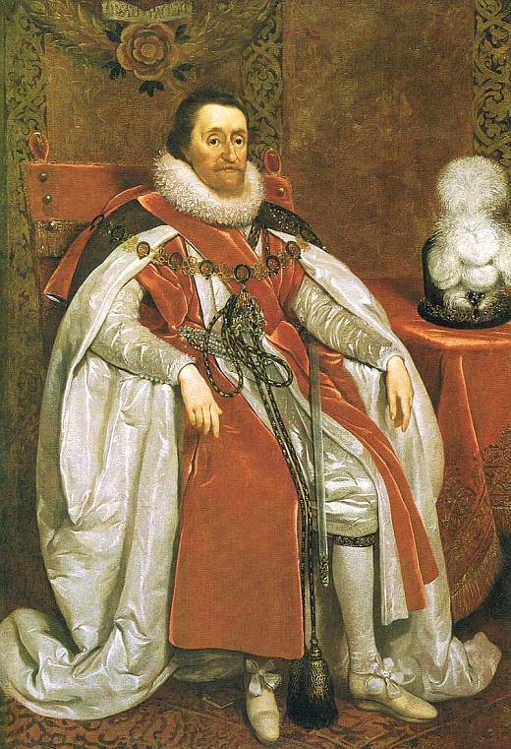
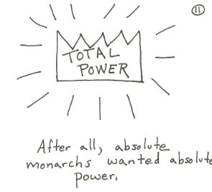
In the Age of Kings,
many monarchs had
absolute power over
their subjects.

Slide 10
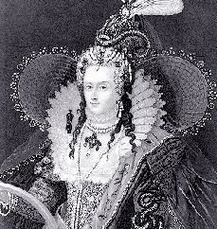
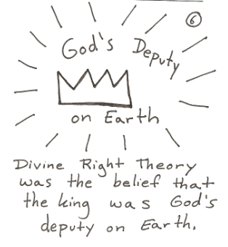
Monarchs also gained power due to
the belief in Divine Right.

Slide 11
Divine Right of Kings
Divine Right Theory was the idea that a monarch’s power came from God.
It was the belief that God had appointed the King and the people had to obey the King.

Slide 12
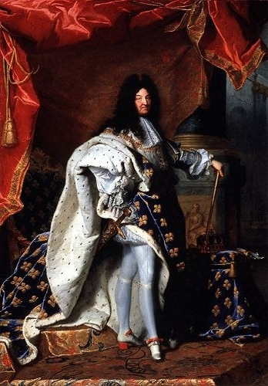
The king could
not be
questioned.

Slide 13
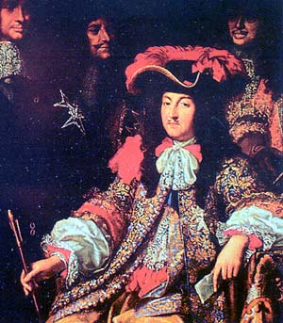
Louis XIV of France provided a model
for other absolute monarchs. Under
his rule, the king’s command was
law. As the monarch said, “L’etat
C’est moi” or “I am the state.”

Slide 14
A Centralized Government
Louis XIV centralized the French government or created one, strong government to rule France.
He appointed officials to collect taxes.
He increased the size of the French army.
Every soldier in the French army wore the uniform of France.

Slide 15
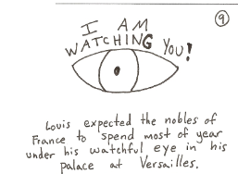
To control France’s
nobles, Louis XIV
built a huge palace
at Versailles.

Slide 16
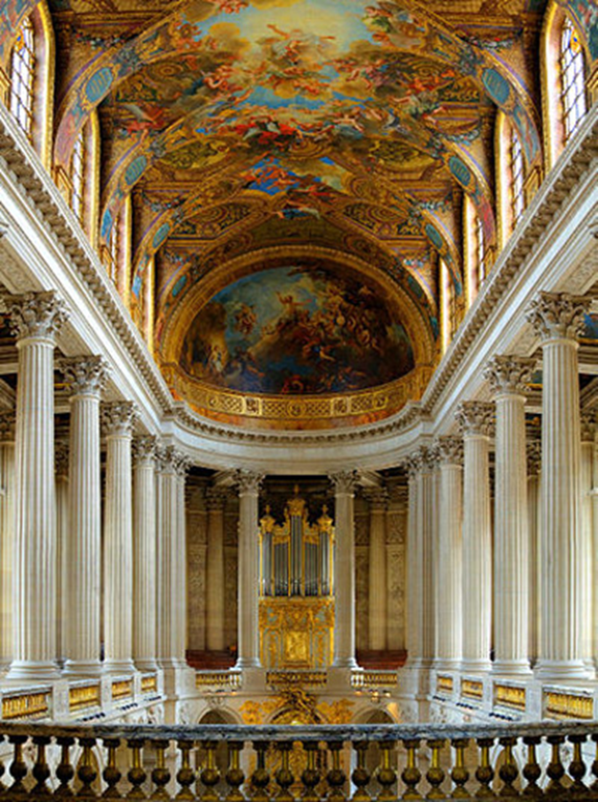
Versailles
By closely monitoring nobles, Louis XIV could try to prevent rebellions against his regime.

Slide 17
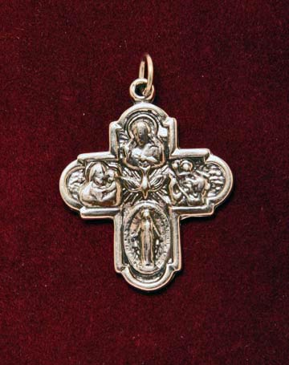
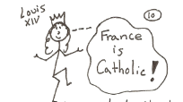
Louis XIV also demanded that French
Protestants convert to Catholicism or
leave France!

Slide 18
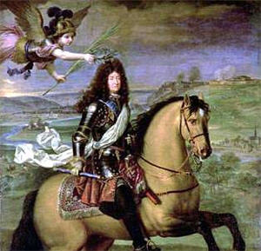
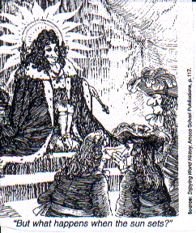
Louis XIV chose the sun as his
emblem. The sun gave life
to all things and regulated everything
as it rose and set. Like the sun,
life in France revolved around the king.

Slide 19
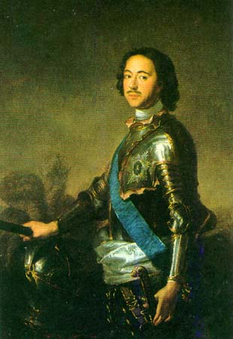
The tsars or absolute
rulers of Russia also
were absolute monarchs.
Peter the Great forcibly
westernized and
modernized Russia. Catherine the Great
continued to modernize
Russia.

Slide 20
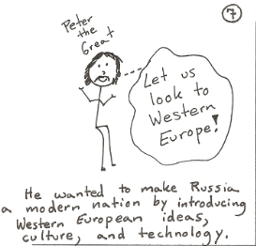

Slide 21
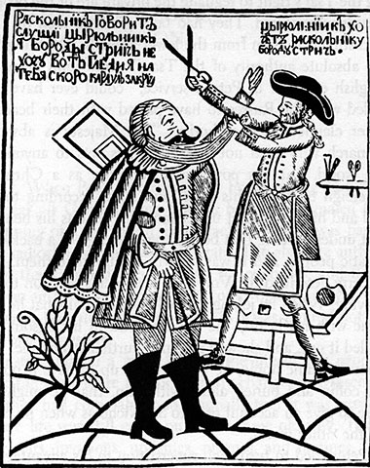
Russian nobles
were forced
to cut off
their beards!

Slide 22
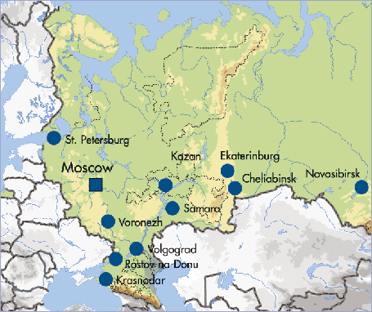
Peter the Great
He moved the capital of Russia from Moscow to St. Petersburg to have a “window on the West”.

Slide 23
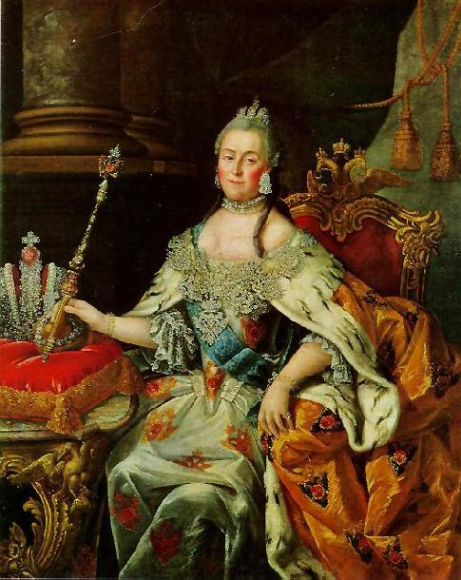
Catherine the Great
was a Russian
Tsarina or Czarina
from
1762-1796.

Slide 24
Catherine the Great
Catherine the Great continued Peter the Great’s policies of expansion and Westernization.
She also promoted limited reforms during her reign.
However, she refused to part with any of her absolute power.

Slide 25
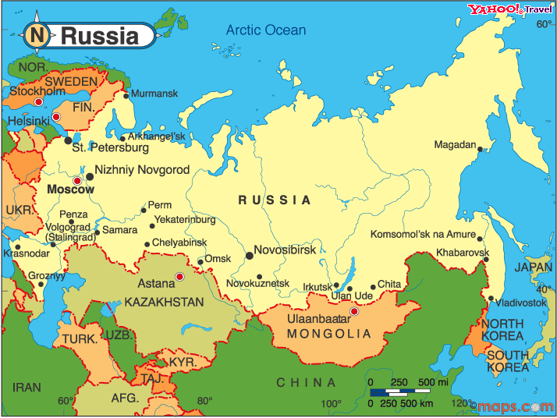
Russia is a country on two continents:
Europe and Asia. Under Peter and
Catherine, Russia turned towards Europe.

