Slide 1
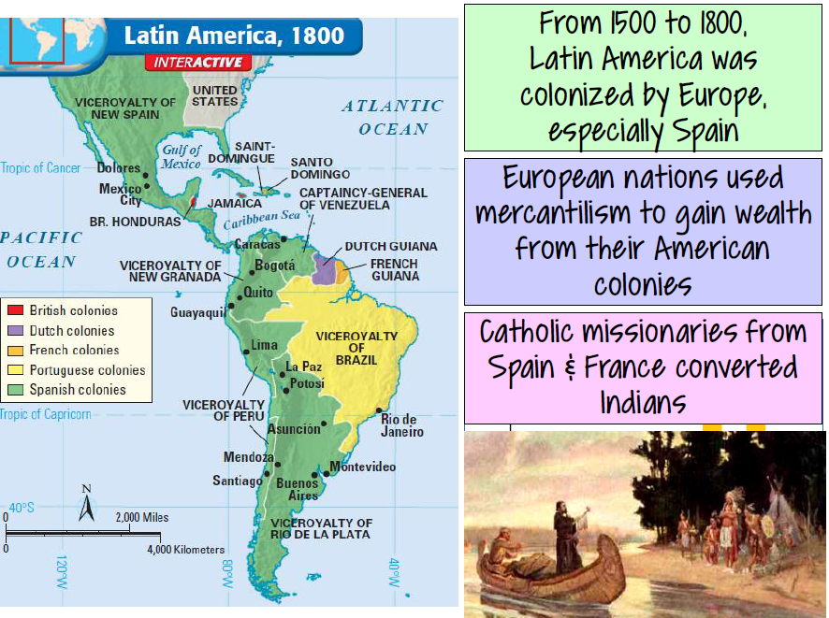

Slide 8
Why did Latin American colonies want independence?
Creoles (American born whites in colonies) began to question European colonial policies.
The non-Creole, non-European majority resented European colonial government.
But due to class differences, actual movements in Latin America do not begin until movements in Europe prompt action in the colonies.

Slide 10
Causes of Political Change
The American Revolution,1776-1783, provided the model of how colonies could break with the mother country.
The French Revolution, 1789, provoked great interest in Latin America, and its slogan “liberty, equality, fraternity” appealed to the lower class colonial population..
French invasion of Portugal and Spain led to ongoing fighting on the Iberian Peninsula and of course this led to temporary “juntas” ruling in the place of the deposed royalty. This would lead to controversy between true supporters of royal officials and those who wanted to gain independence.

Slide 11
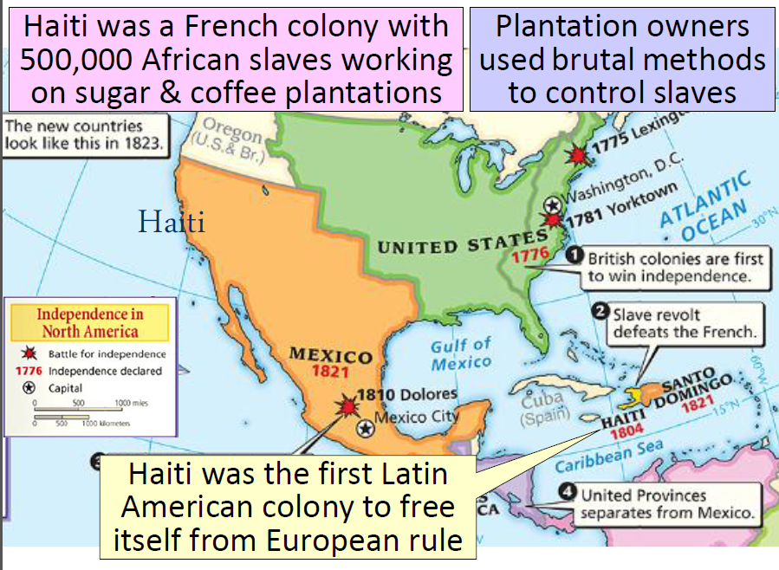
St. Dominique, France’s sugar colony, slaves and free blacks rebelled against whites and gained independence thus the emergence of Haiti

Slide 12
Haiti
St. Dominique was a sugar plantation island in the Caribbean controlled by France
Internal turmoil mirrored the conflict in going on in France and led to slave rebellion in 1791
Under the leadership of Toussaint L’Overture and others, attempts by French elites to regain control of the island failed.

Slide 13
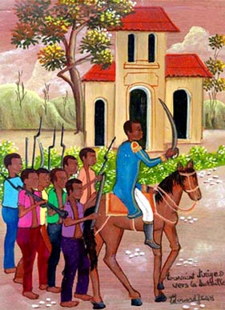
By 1804 – the independent republic of Haiti was proclaimed and it became a symbol of freedom and hope for slaves and free people of color in the Americas. Was the first independent state in Latin America.
"In overthrowing me, you have cut only the trunk of the tree of liberty. It will spring again from the roots for they are numerous and deep.“
Toussaint L'Ouverture, 1802
Edouard Jean. Toussaint Dirige Vers la Bataille

Slide 14
Toussaint L’ouverture
A former slave, he became a brilliant general and capable administrator, defeating British, Spanish, and French troops, emancipating the slave population, and overseeing the country's initial attempts at reforming its political and social structure.

Slide 15
Similarities of Spanish American Revolution and Haitian Revolution
People of color were oppressed by the White class superior elite rulers
The revolutionary movement began when a leader called upon the social minorities to unite against the foreign rule, be it Spanish or French rule
First leaders, Toussaint Louverture and Father Hidalgo were killed by the leaders of the country that had control of the colony
Helped by the fact that Spain was having trouble fighting against Portugal, Haitians helped by French seeking foreign territory, fight British

Slide 18
Simon Bolivar
Government and military figurehead that sought to lead Venezuelan independence and combine six South American countries into the Gran Columbia

Slide 19
Francesco de Miranda
Venezuelan general that traveled and brought Enlightenment ideas to Latin America, led creation of First Venezuelan Republic, but tried to flee and was turned into Spanish

Slide 20
Goals of the Venezuelan Revolutionaries
To abolish the restrictive mercantilism laws by the monarch
To revolt against the French acquisition of the crown by Joseph Bonaparte
To unite the factions created by the power vacuum caused by the dissolution of the Spanish monarch

Slide 21
Results of the Venezuelan Revolution
800,000 Venezuelans were killed
The formation of the Gran Columbia gave suit to the Republic of Venezuela after two Republics of Venezuela were created
The resulting government still lent itself to dictatorships by elected presidents, which lead to more conflict

Slide 22
Similarities between Venezuelan Revolution and American Revolution
Formed a union of many nations (Gran Columbia) and then received pressure to split.
Fought against Spain with the mentality that all of them were Venezuelans and not Spanish, similar to what the American colonists practiced.
Did not grant equal rights to women, like the American revolution.

Slide 23
Differences between Venezuelan Revolution and American Revolution
Broke up from the Gran Columbia to the several nations, including the independent Venezuela.
Deep political instability in Venezuela after the war, unlike the Us.
The Venezuelan Republic had fallen multiple times before declaring its final independence, while America did not.

Slide 25
Brazil
After France invaded Portugal, the Portuguese royal family fled the country and sailed to Rio de Janeiro and set up court.
Brazil was raised to equal status as Portugal with all government functions emanating from the colony.
Ports of Brazil opened up to world commerce via trade with England – pleasing Brazilian elites.
After a period of reinforced colonial relationship, the son of the King was left in control. Ultimately, he declared Brazil independent from Portugal and became the constitutional emperor in 1822.
Brazil’s independence did not upset existing social organization nor radically change the political structure.

Slide 26
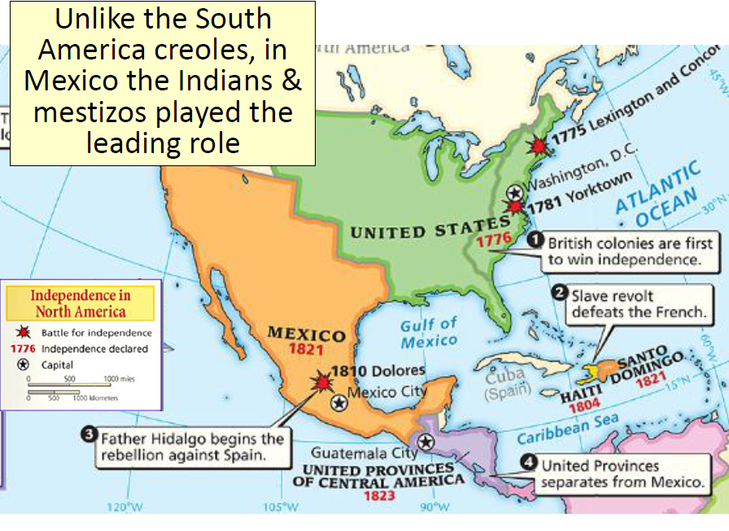

Slide 28
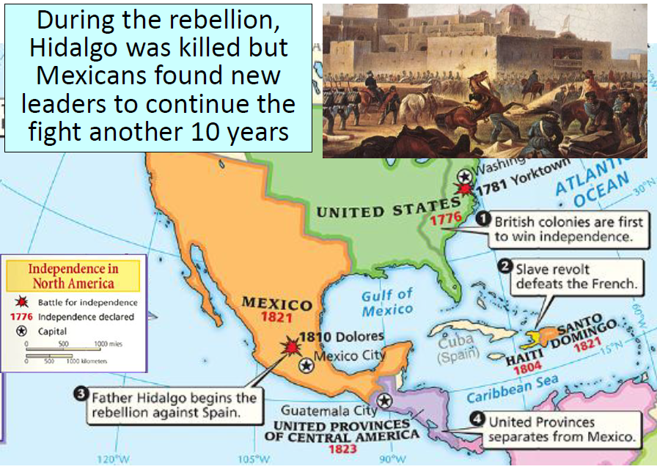
However, fearing social equality he lost Creole support and was executed.

Slide 29
Mexico
By 1820 Creoles were willing to work for independence with remnants of the revolutionary forces. Under the leadership of Augustin de Inturbide, combined forces gained control of Mexico City by 1821 and declared independence.
Starting as a monarchy, Mexico would eventually become a republic in 1824.

Slide 30
Mexican Independence

Slide 31
Results of Mexican Revolution
King Iturbide was ousted as King of Mexico, and a Republic was created one year after he took the throne.
Popular sovereignty was victorious over the monarch, but it did not extend to the peasants or the other lower class citizens.
While women did help Mexico win its independence, women still were disenfranchised.
500,000 to 1,000,000 people were killed as a result
There were still many conflicts and wars even after the revolution was won.

Slide 32
Mexican Territorial Disputes

Slide 33
Mexican Revolution

Slide 34
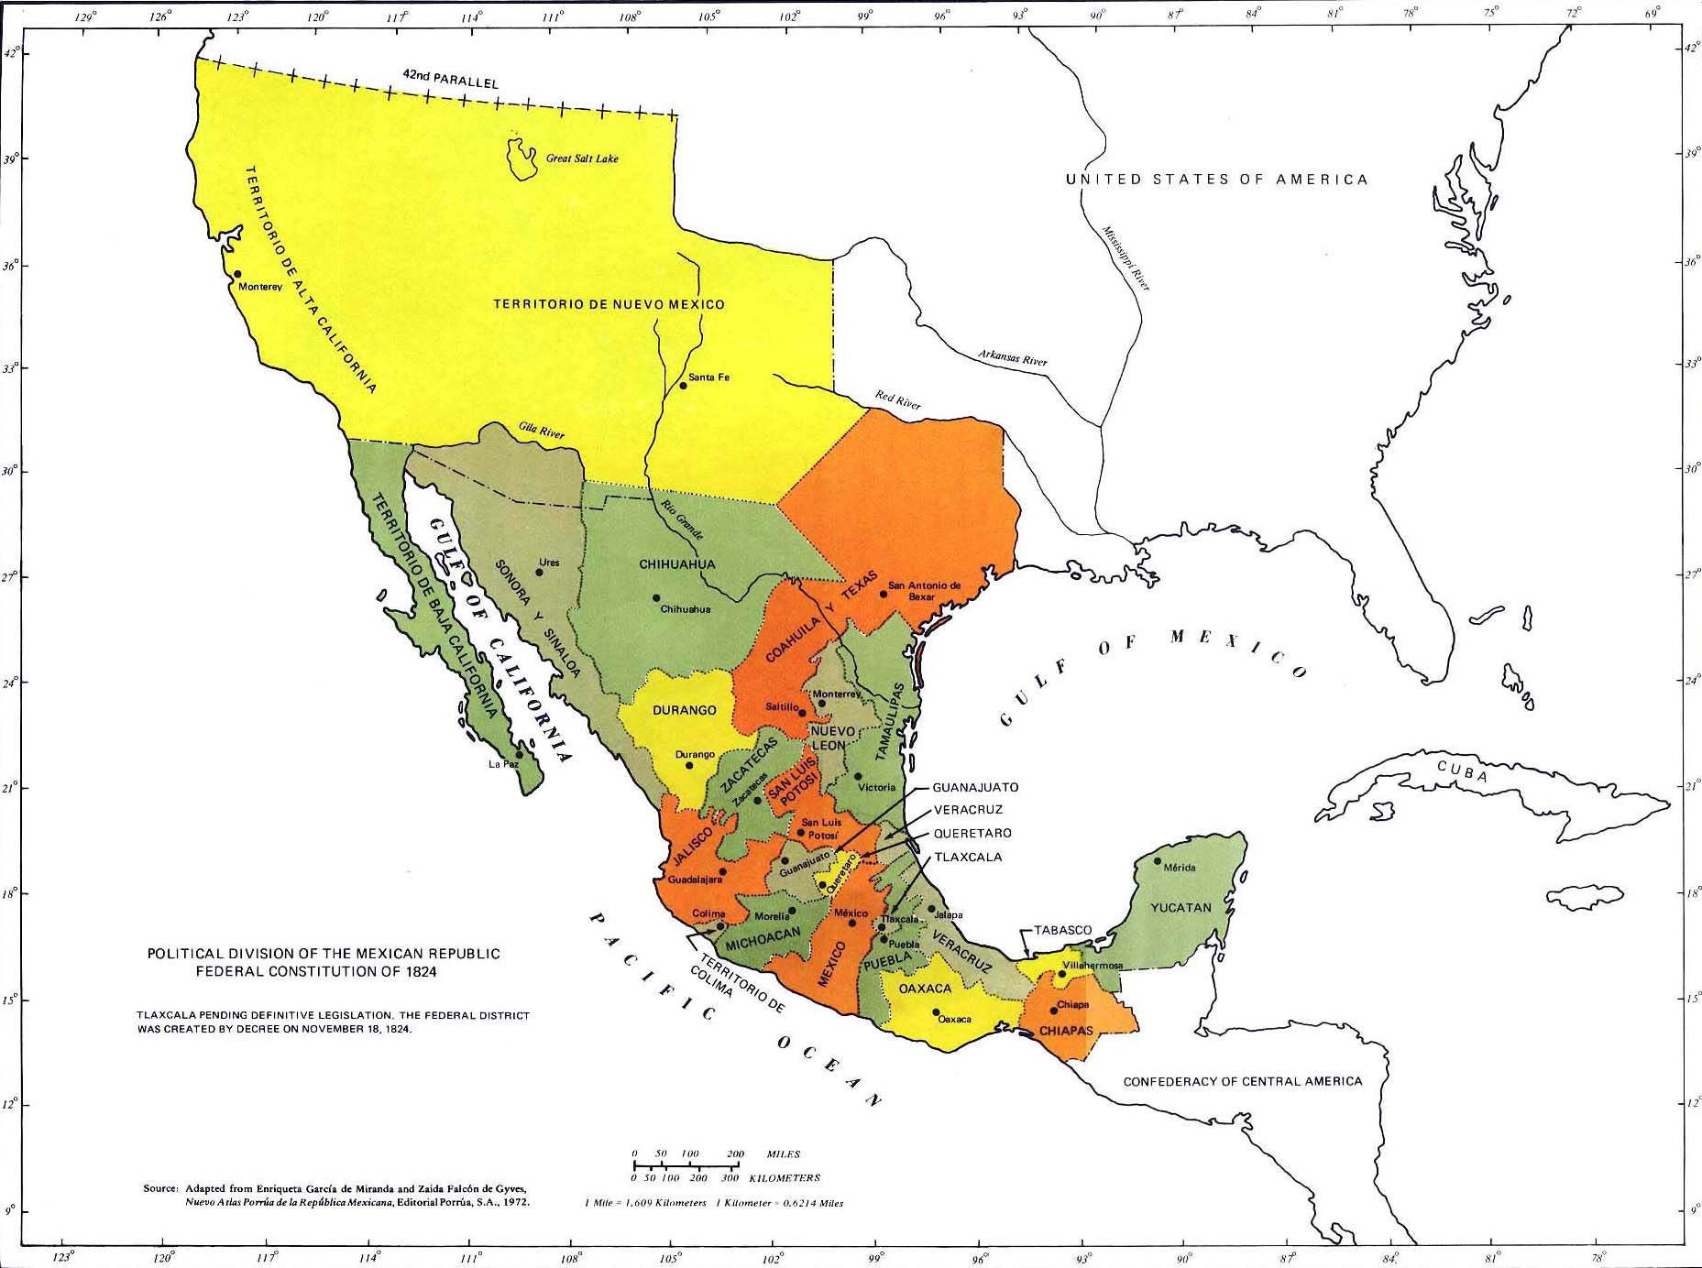

Slide 35
Similarities between Mexican Revolution and American Revolution
Both fought against high taxes
Both did not grant women equal rights
Both did create a Republic
Both feared common citizens from ruling, only property owning men could vote.

Slide 36
Differences between Mexican Revolution and American Revolution
Mexico did not weaken the power of the church, leaving the Catholic church a prominent power in government
The US had already created a shadow government before the start or the end of the war, while Mexico had to oust its new King of Mexico
Rather than diminishing its tax on mixed race people and Native Americans, Mexico continues to tax them for revenue, as the US removed the government’s ability to tax in the beginning.

Slide 37
Differences between Spanish American Revolution and Haitian Revolution
Haitians fought against French rule, South American revolutions were fought against Spanish rule
Bolivar and the Spanish American revolutions did not just free Venezuela, but five other countries, did not unite together like the groups in the Haitian revolution
Haitian revolution was primarily a slave revolt, Spanish American revolts were from the lower classes of society, such as African Americans and Native Americans
Hidalgo and Mexican revolution also meant to achieve land lost by forefathers to Spanish, Haitians were slaves that wanted freedom

Slide 38
Similarities of Spanish American Revolution and French Revolution
The lower classes were of peasants were suppressed by taxes
Both inspired by the ideals of the American Revolution and Enlightenment
Third Estate resented the upper Estates of social class in France, while African Americans, Mulattos, and Native Americans had little social status in Latin America
Leaders of rebellion were killed during the revolution

Slide 39
Differences between Spanish American Revolutions and French Revolution
French Revolution was internal disagreement over leadership of the country, decide course of country’s policy, while Spanish American Revolutions were against foreign rule
Initial leaders of the French Revolution were killed or replaced by further generations of French Revolutionaries, while Spanish American Revolution only sought to remove the Spanish from power
France was strengthened by revolution, Spain was weakened by revolution

Slide 40
Problems facing the New Nations
Social Inequalities – Creoles, Indians, Mestizos, Mulattoes, Slaves all equal? Women?
The role of the Catholic Church – Inclusion of other religions? Control of church over society?
Political Representation – Republic or not? Centralists, Federalists, Liberal, Conservative?
Regionalism – 18 Separate Nations
Economic Stagnation – Dependency upon foreign markets reinforcing colonial dependency?
Foreign Intervention – Europeans and the United States? What were their reasons?

Slide 42
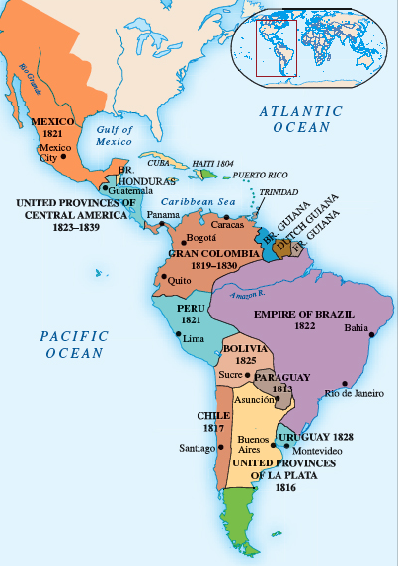
Independent States of Latin America in 1830

Slide 43
 | Haiti | Mexico | Brazil
Political | Political upheaval and revolutionary model were disdained by all other Latin American colonies | Political Instability by caudillos and autocrats Santa Anna, Benito Juarez, Emperor Maximilian (Austrian) Warfare disrupts economy such as the Mexican American War | Liberalism to Monarchist Regional revolts Bloodless revolt in 1889 deposes Emperor to a republic
Economic | Colonial economic dependency – cash crops | Misdistribution of land Vast numbers of poor in the approx. 7 million people | Economic hardships in backlands Misdistribution of land Fazendas – coffee plantations
Social | Reversal of social class structure! | Social status of Indians Problems with education Power of the Catholic Church | Intensification of slavery, not outlawed until 1888 Immigration from Europe

Slide 44
