Slide 1
Agriculture & Industrialization
Cy - Ranch

Slide 2
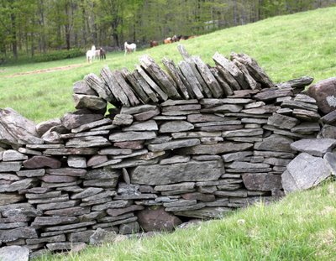
The Enclosure System:
During the 1700s, the open-field system of cultivation gave way to enclosed farms. Fields were fenced off and planted with crops that could be sold for large profits. Peasant farmers had less access to land.

Slide 3
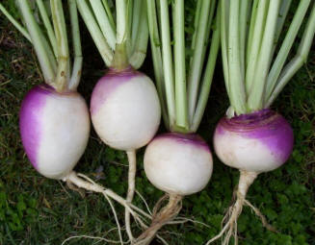
No More Fallow Fields:
When turnips and clover were planted, the soil was replenished. So, rather than letting a field lay fallow, farmers could periodically replace wheat and barley crops with turnips and clover.

Slide 4
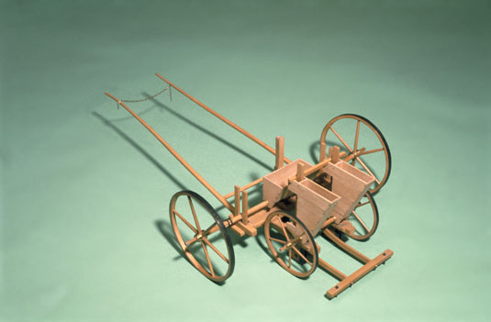
The Seed Drill:
Scattering seeds on the ground was wasteful. Some seeds did not take root. The seed drill was invented in 1701. It allowed farmers to sow seeds in well-spaced rows. This invention led to the

Slide 5
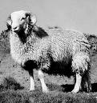
Stock Breeding:
Agriculturalists wanted to improve the breeding of sheep and oxen. By improving the breeding of animals, healthier animals were born. This increased the production & quality of meat and wool.

Slide 6
Increased Production and a Decreased Need for Agricultural Workers:
As agricultural production increased due to new inventions and new methods of farming, the need for agricultural workers decreased.
New inventions allowed machines to replace hand-made production. With Great Britain’s raw materials, labor, and capital, a new day was dawning.

