Slide 1
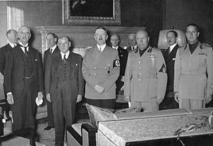
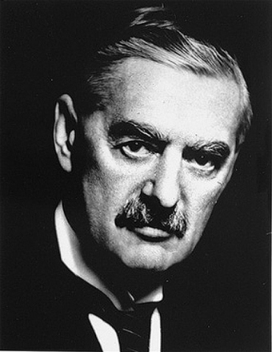
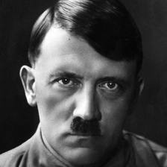
Appeasement and the Munich Conference
Patten/ Kempton/ Augugliaro

Slide 2
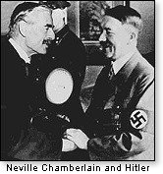
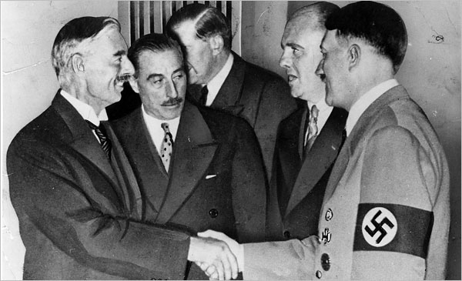
Appeasement
Appeasement- To give into someone’s demands in the hopes that they will be content and go away. Before World War II, Britain and France attempted to appease Hitler.

Slide 3
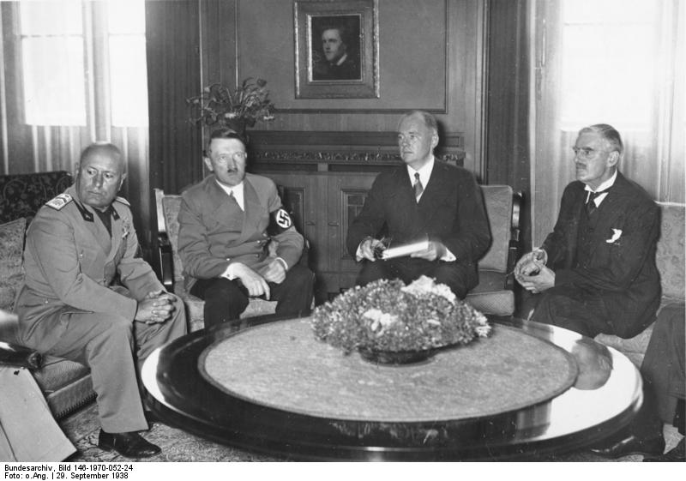
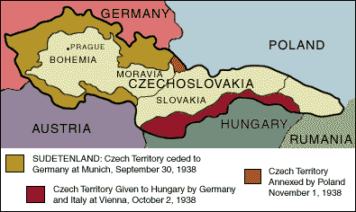
Munich Conference
Munich Conference- Meeting held in Munich, Germany in 1938 to decide the fate of Czechoslovakia. At the conference Germany was awarded control over the Sudetenland and Czechoslovakia ceased to exist.

Slide 4
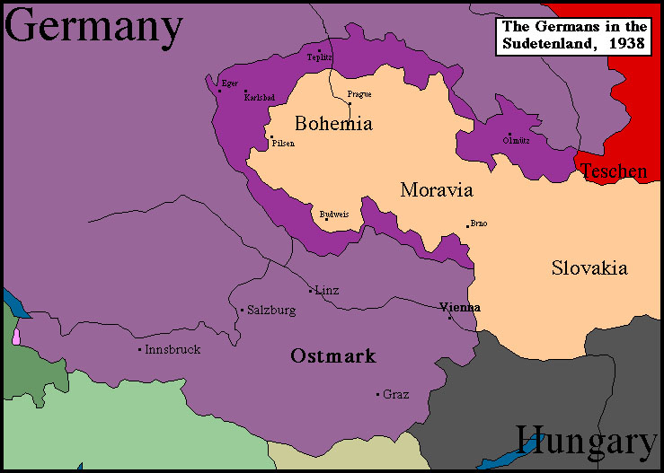
Sudetenland
Sudetenland- An area of Czechoslovakia on the border with Germany with a large German population

Slide 5
Appeasement Cartoons

Slide 6
Appeasement Cartoons

Slide 7
Appeasement Cartoons

Slide 8
Appeasement Cartoons

