Slide 1
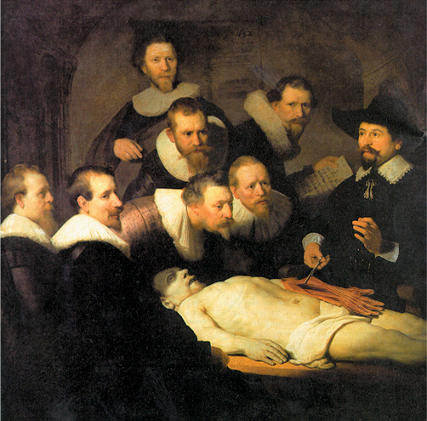
Autopsy of the Gunpowder Empires
The Anatomy Lesson of Dr. Nicolaes Tulp, Rembrandt

Slide 2
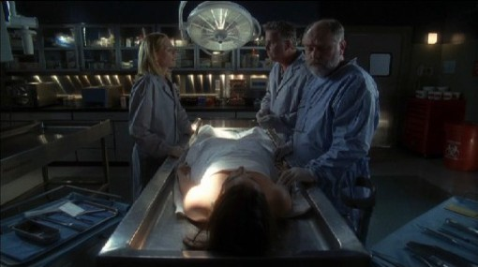
Autopsy
Inspection and dissection of a body after death, as for determination of the cause of death; postmortem examination.

Slide 3
One feature of this unit is the decline and fall of the Gunpowder Empires. You will do the autopsy on one.
In your “Medical Examiner’s Notes” you’ll explain on the various “causes of death” of your “individual.”
Outline one of your partners on the paper.
Name the individual on the poster (be creative and appropriate).
What weakened the individual? What led to their demise? Internal and external characteristics.
Is there a connection between our empires?
Address each part of SPEC as appropriate.

Slide 4
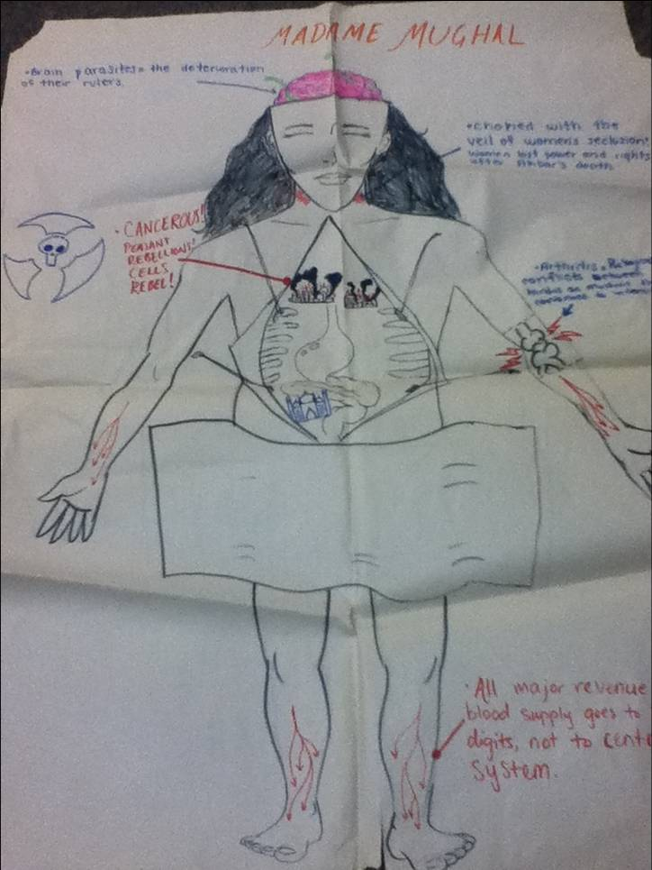
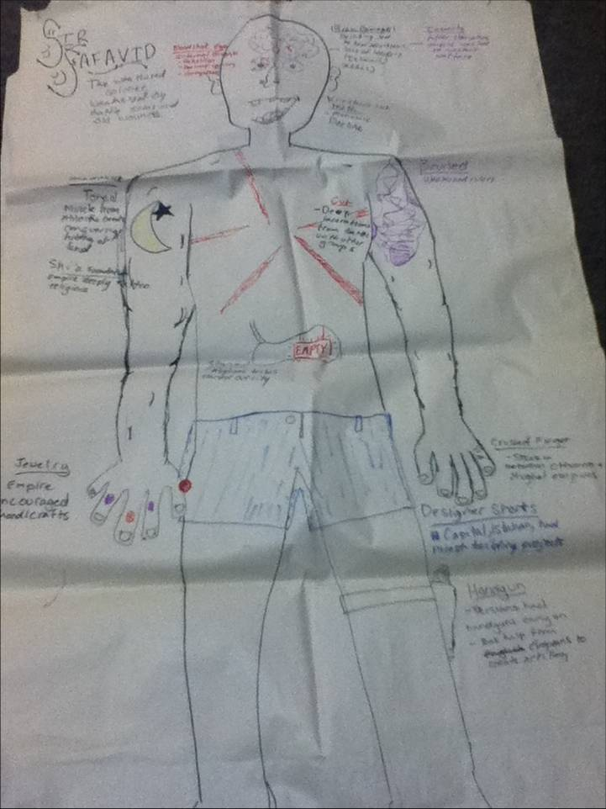
Examples (note the modesty)

