Slide 1
The COLD WAR and BEYOND

Slide 2
NATO
North Atlantic Treaty Organization
European and American countries make an alliance together to protect one another militarily in the event of an attack

Slide 3
Warsaw Pact
The Soviet Union retaliates by forming it’s own alliance with the satellite states surrounding the country

Slide 5
Atomic Weapons
The United States used Atomic warfare to bring an end to the Pacific Theater in World War II
First and only country to use Atomic weapons in War

Slide 6
Atomic Weapons
The Soviet Union continues research after World War II and is able to detonate it’s own atomic weapon in 1949

Slide 7
Truman’s Response
The H-Bomb was authorized by Truman and created in January 1950
1000 times more powerful than the atomic bomb
Click on the picture to view video on the Tzar Bomba from folder
Time 4 min.
Notes:
The H-Bomb was designed to fuse atoms together rather than split them as in the atomic bomb

Slide 8
Atomic Weapons
In August of 1957, the Soviet Union develops the first ICBM (Intercontinental Ballistic Missile), capable of traveling great distances and not having to be dropped by plane

Slide 9
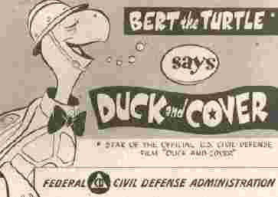
http://www.youtube.com/watch?v=L_tKAg5KIuQ
Time 3 min.

Slide 10
Space Race
October 4, 1957 the Soviet Union uses an ICBM to launch the first satellite- Sputnik into space

Slide 11
How did the Cold War affect your school life?
Thank the Cold War for the level of math and science that you take today.
“Scientists and engineers warned Congress that the cold war was being fought with slide rules, not rifles. In response Congress passed the National Defense Education Act in 1958. . .”
NY Times When Science Suddenly Mattered, in Space and in Class Cornelia Dean

Slide 12
Space Race
1961- First person in space- Yuri Gagarin

Slide 13
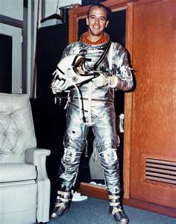
Space Race
Shortly after, first American in space- Alan Shepard
US pulls ahead in the Space Race with the only men ever to step foot on the moon. First was Neil Armstrong in 1969
Click on picture below for audio of moon landing
Notes:
The Christmas presents were a jab against the Communist occupation as they are not supposed to have religion under Communism.

Slide 14
STAR WARS
No, not that Star Wars

Slide 15
STAR WARS

Slide 16
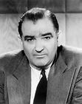
Joseph McCarthy
http://www.youtube.com/watch?v=FtVJFBSMXDk
Time: 4:19 min.

Slide 17
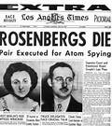
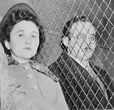
The Rosenberg’s
http://www.youtube.com/watch?v=s-6BfCbrvuM
Time: 2:30 min.

Slide 18
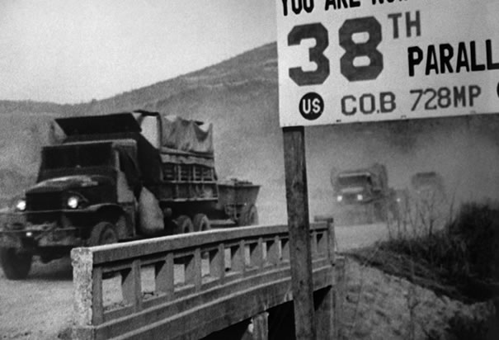
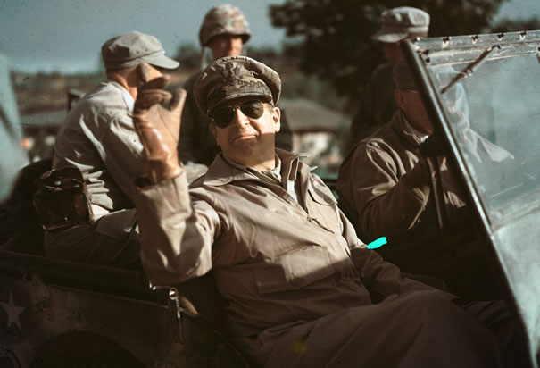
The Korean War

Slide 19
The Korean War Video Time: 6:59 min

Slide 20
Korea Time: 15:24

Slide 21
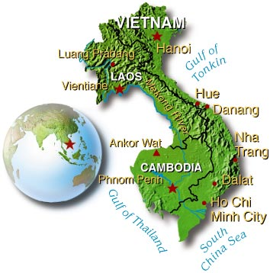
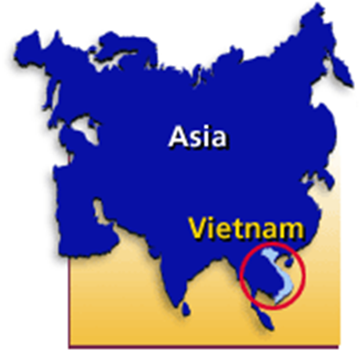
Vietnam

Slide 22
The Vietnam War – The Things They Carried Time: 3:03 min.

Slide 23
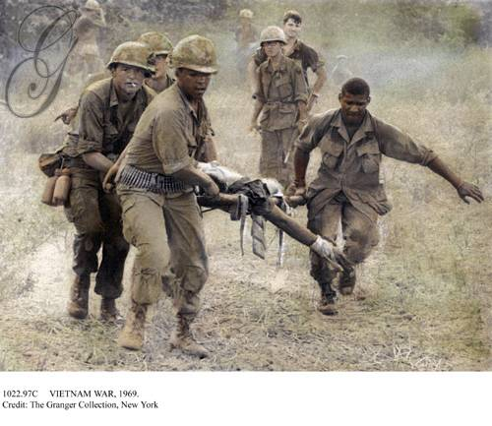
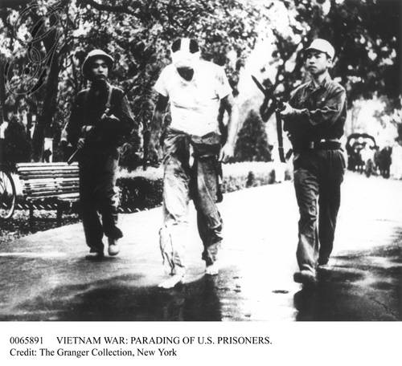
VIETNAM WAR. Parading of U.S. prisoner, with bandaged face, walking barefoot between two Vietcong guards.
VIETNAM WAR, 1969. An American soldier, wounded by an exploding land mine, being carried to a helicopter by his comrades: oil over a photograph, 1969.

Slide 24
Vietnam War – America and Vietnam Time: 5:27 min.

Slide 25
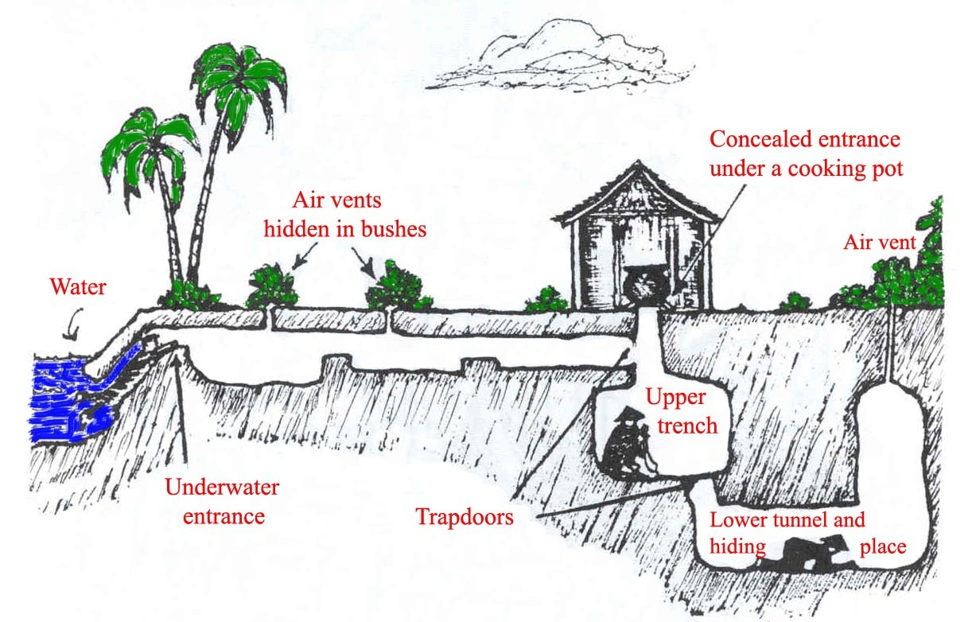

Slide 26
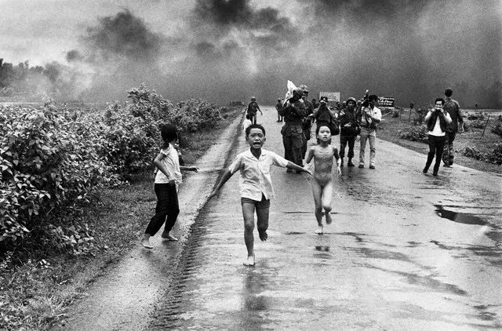
Children Flee From Their Homes Vietnamese children flee from their homes in the South Vietnamese village of Trang Bang after South Vietnamese planes accidently dropped a napalm bomb on the village, located 26 miles outside of Saigon. Twenty-five years later, the young girl running naked from her village, Phan Thi Kim Phuc, was named UNESCO goodwill ambassador.

Slide 27
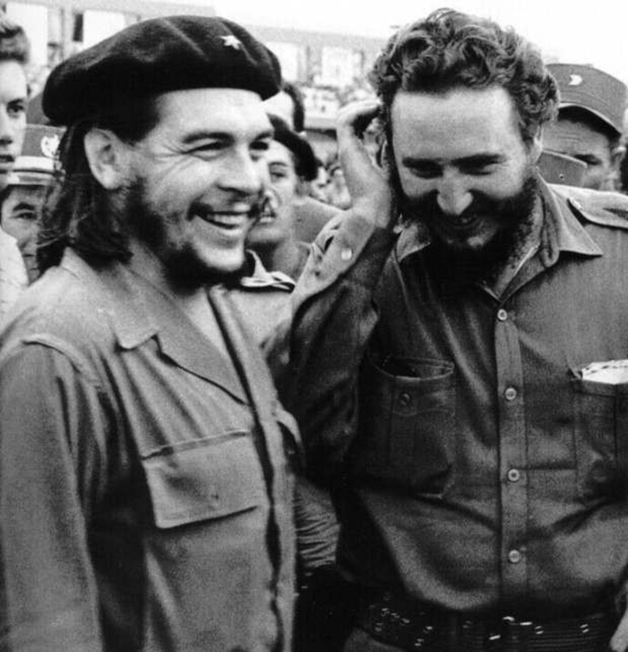
Cuba and Castro
A young Fidel Castro (no hat) with Ernesto “Che” Gueverra (hat). Leaders of the Communist take over of Cuba.

Slide 28
Castro and the United States Time: 7:52 min

Slide 29
Bay of Pigs Invasion

Slide 30
Castro and the Bay of Pigs Time: 6:14 min

Slide 31
Missiles in Cuba

Slide 32
Cuban Missile Crisis Time: 6:10 min

Slide 33
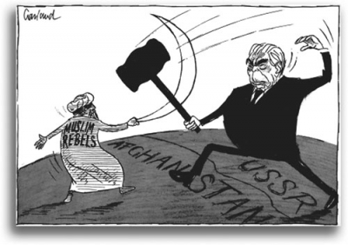
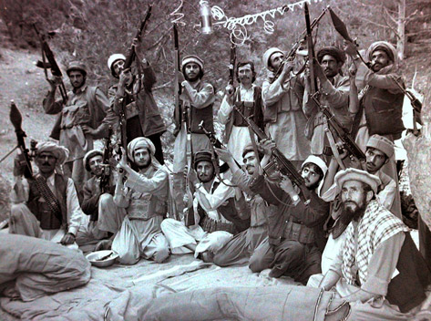
War in Afghanistan
http://www.youtube.com/watch?v=B565SrNkghw
Time: 1:44 min

Slide 34
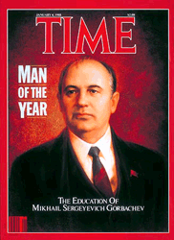
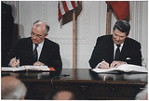
Mikhail Gorbachev
http://www.youtube.com/watch?v=028gd8Sn3m0
Time: 4:46 min

Slide 35
Billy Joel – “We Didn’t Start the Fire” Time: 4:44 min

