Slide 1
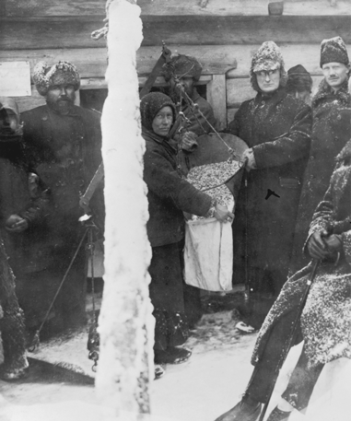
There was discontent in Russia.

Slide 2
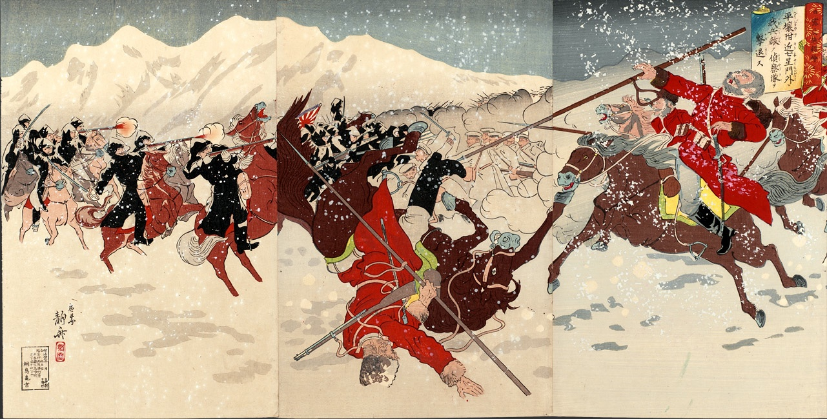
Russia was defeated by Japan in the Russo-Japanese War of 1905.

Slide 3
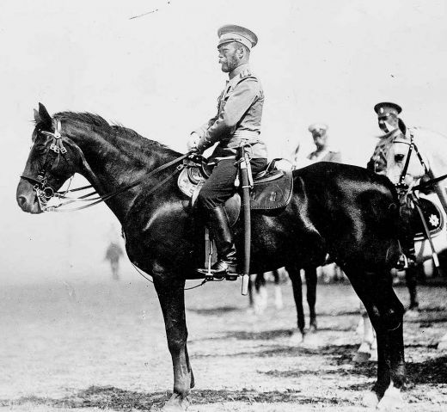
The Tsar was an autocratic ruler.

Slide 4
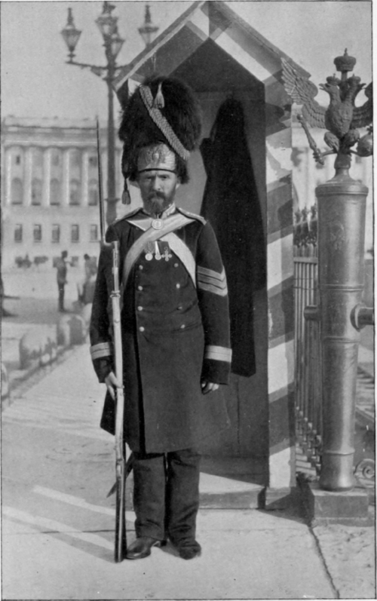
And the Tsar’s palace guards had fired on unarmed protesters in 1905 killing hundreds.

Slide 5
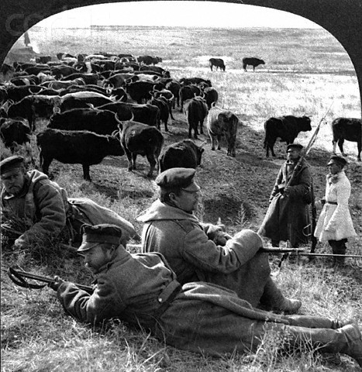
Russia’s involvement in the World War I
only added to the country’s problems. Russia suffered defeats and losses. Food shortages worsened.

Slide 6
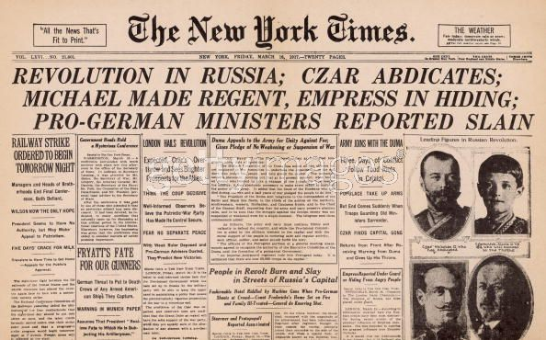
By March 1917, a revolution had begun
in Russia. The tsar was driven from his
home.

Slide 7
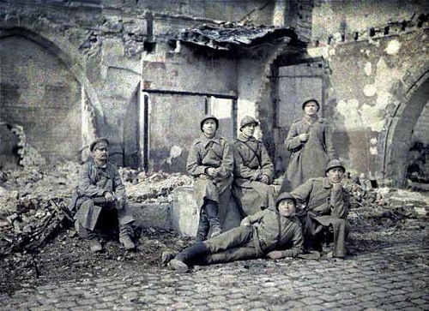
Moderate leaders took control of the
government but they stayed in the war.

Slide 8
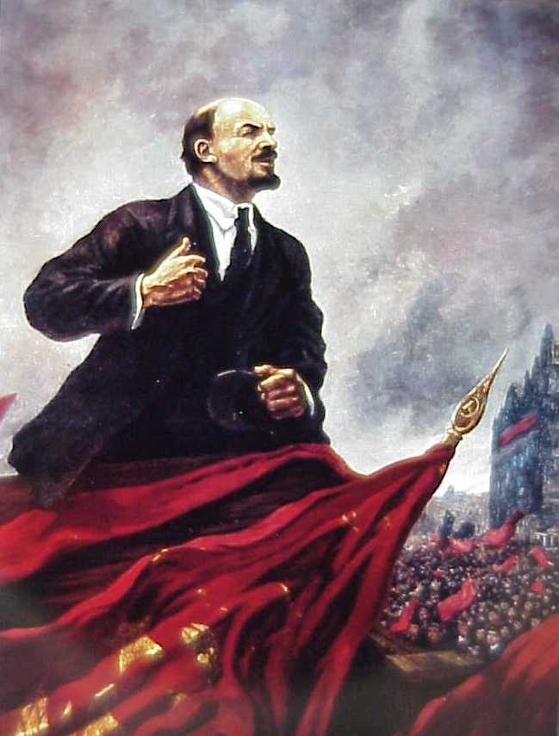
The Russian people were tired of war.
The Communists promised an end to
war.

Slide 9
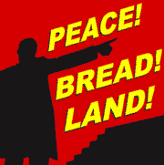
Vladimir Lenin and the Bolsheviks promised peace, bread, and land to a hungry, tired, and poor Russia.

Slide 10
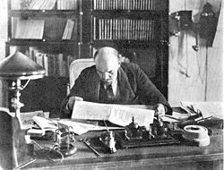
In November 1917, a second revolution
occurred in Russia. Lenin and the Bolsheviks won. They took Russia out of the war.

Slide 11
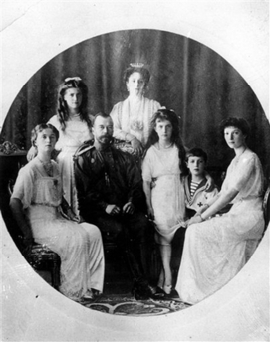
The Bolsheviks ordered the execution of the Tsar and his family.

Slide 12
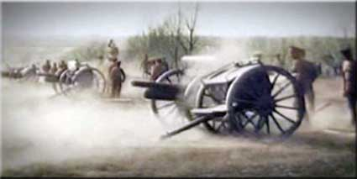
A bloody civil war between the Reds and the Whites began.

Slide 13
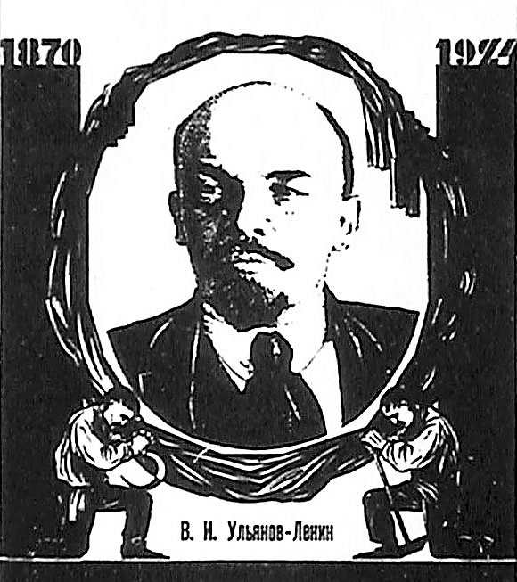
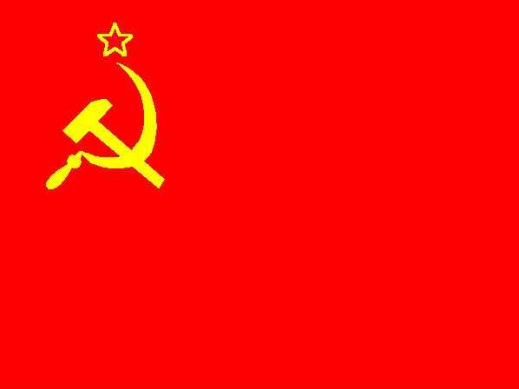
The Reds won and Russia became known as the Soviet Union. Having
experienced the first communist revolution in 1917, the Russian Revolution changed world history.

