Slide 1
WWII Causes

Slide 2
Treaty of Versailles
Negotiated treaty by WWI Allies, June 28, 1919
Harsh punishment of Germany
Guilt for WWI
$33 billion in reparations
Restricted military
Lost territory

Slide 3
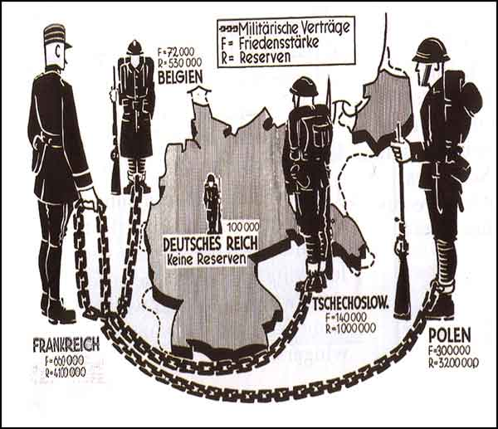
1919

Slide 4
Global Depression
Nations in debt following WWI
1929 collapse of U.S. economy sets off chain reaction around the globe
Millions unemployed

Slide 5
Unstable Democracies
Parliamentary governments fall
Lack of democratic experience
economic hardships
Totalitarian governments rise
Fascism in Italy (Mussolini)
Nazism in Germany (Hitler)
Militarists in Japan (Hirohito)
Russian Communists (Stalin)

Slide 6
FASCISM & NAZISM
Fascism (Italy-Mussolini)
Emphasized loyalty to the state
Obedience to leader
Goal was to restore national pride
Nazism (Germany-Hitler)
German brand of Fascism
Included racist ideology against “non-Aryan races”—specifically targeted the Jews, Slavs & Gypsies

Slide 7
Japanese Aggression
Planned a Pacific empire →included conquering China
invades Manchuria in 1931
Invades China in 1937

Slide 8
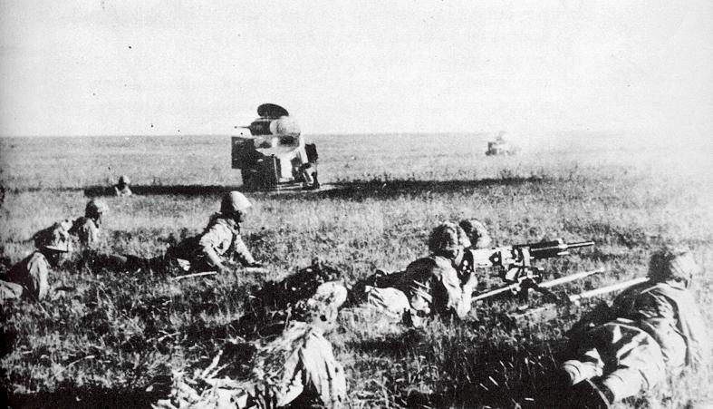
September 1931
Japanese claim they want friendly relations with China
Japan attacks Manchuria.
South Manchuria falls to Japanese control.

Slide 9
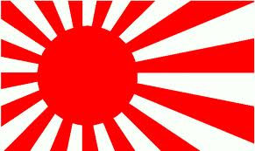
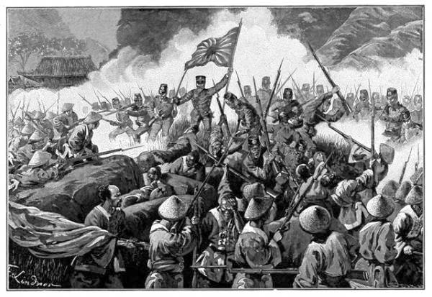
1937
Japan invades Nanjing, China
“Rape of Nanjing” Japanese military murdered over 300,000 Chinese citizens.

Slide 10
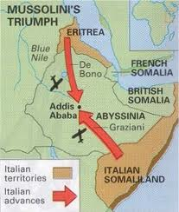
1935
Mussolini and Italy invade Ethiopia while the League of Nations fails to react.

Slide 11
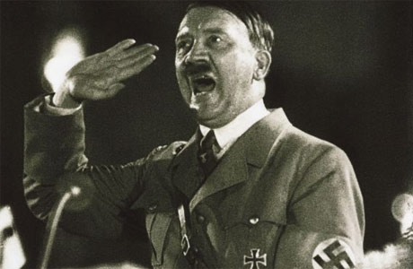
January 30, 1933
Hitler Speaks Out!
Click Here to Listen!
Adolph Hitler takes power in Germany, renouncing Versailles and promising to rebuild Germany into a world power.

Slide 12
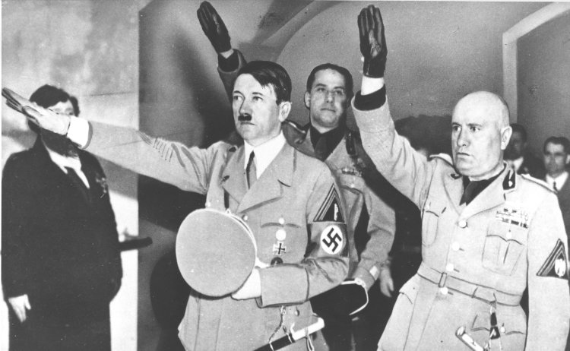
January 26, 1934
Hitler withdraws Germany from League of Nations and all disarmament pacts.
Hitler signs a 10 year non-aggression pact with Germany’s neighbor Poland.
Adolf Hitler
Benito Mussolini

Slide 13
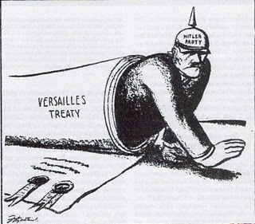
1935
Hitler announces to the world the existence of a German military and air force, both violations of the Treaty of Versailles.

Slide 14
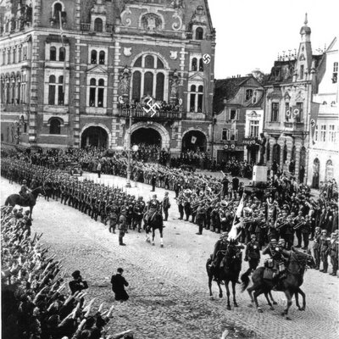
March 7, 1936
Hitler re-occupies the Rhineland.
Rhineland- area owned by Germany that they could not put troops in.
Violated the Treaty of Versailles
“The Nazis are Coming, The Nazis are Coming!”

Slide 15
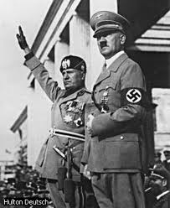
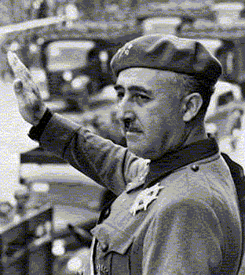
1936
Hitler and Mussolini join to help Franco in Spain.
Franco received aid during the Spanish Civil War.
Hitler and Stalin used this war as a testing ground for modern warfare technology.
Mussolini, Hitler,
& Francisco Franco

Slide 16
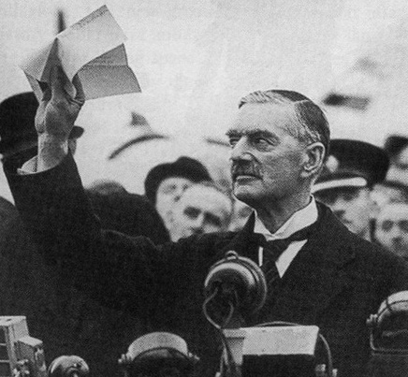
When Hitler annexed
or took Austria
and then claimed part
of Czechoslovakia,
the British Prime
Minister Chamberlain
tried appeasement.
Appeasement is a
policy of granting
concessions to an
aggressor hoping
to avoid war.

Slide 17
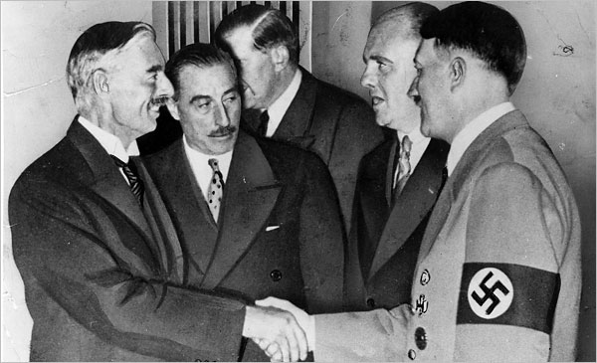
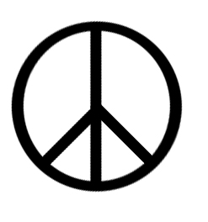
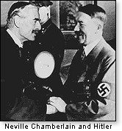
Appeasement
Appeasement- To give into someone’s demands in the hopes that they will be content and go away. Before World War II, Britain and France attempted to appease Hitler.

Slide 18
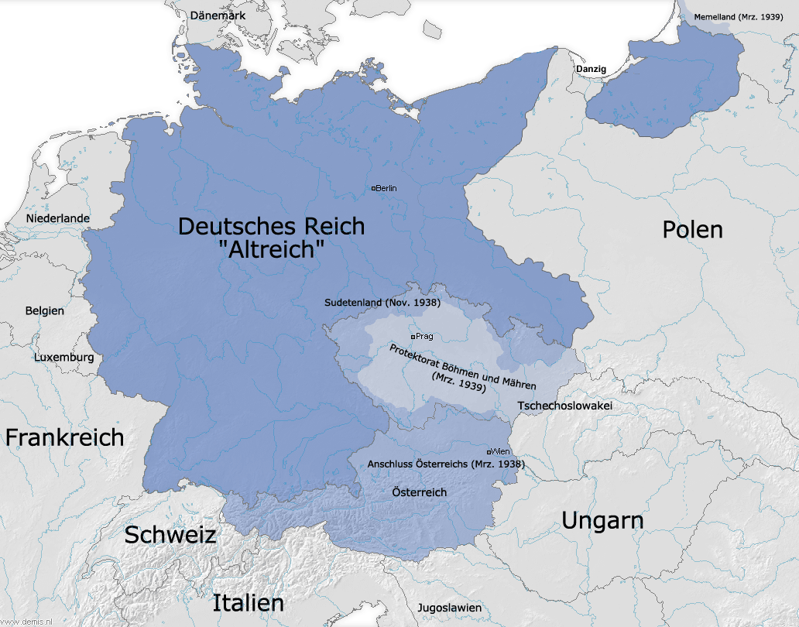
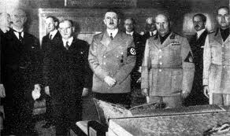
1938
The Munich Agreement
Hitler is appeased by France and Britain.
He is given control of Austria and Czechoslovakia

Slide 19
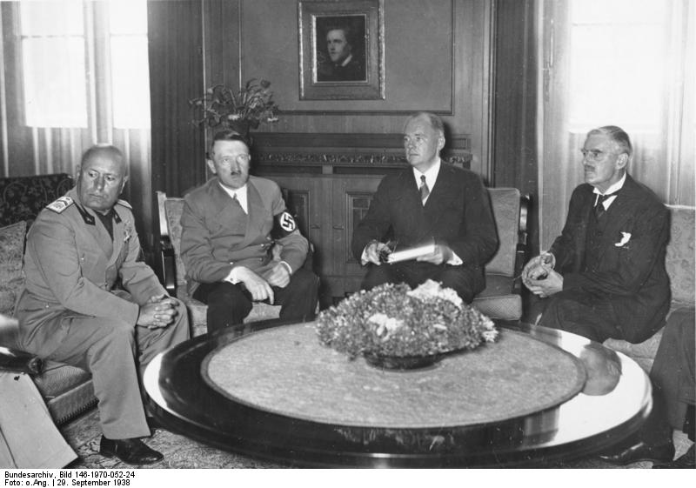
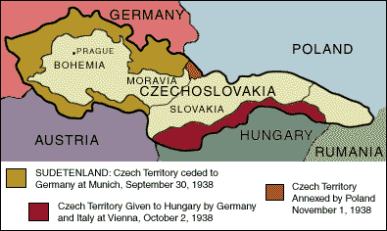
Munich Conference- Meeting held in Munich, Germany in 1938 to decide the fate of Czechoslovakia. At the conference Germany was awarded control over the Sudetenland and Czechoslovakia ceased to exist.

Slide 20
Sudetenland- An area of Czechoslovakia on the border with Germany with a large German population

Slide 21
Failure of Appeasement
Hitler begins taking territories in the 1930’s
Rhineland (1936), Austria (1938), Czechoslovakia (1938-39)
At every act of aggression, western powers choose APPEASEMENT, giving in to keep peace
Munich Conference--1938
Russo-German Nonaggression Pact--1939

Slide 22
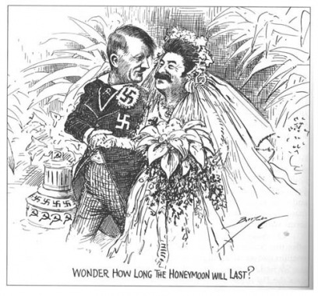
August 23, 1939
Nazi’s sign a “non aggression pact” with the Soviet Union.
(Soviet-Nazi Pact)
Committed the two to remain neutral should either one be attacked by a third party

Slide 23
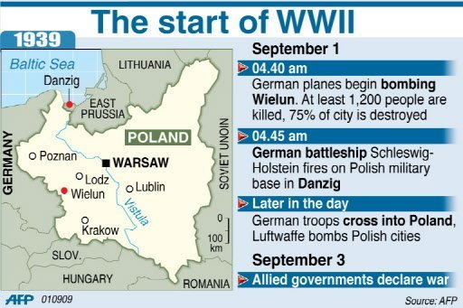
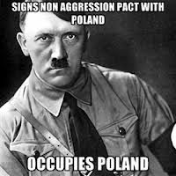
September 1, 1939
September 1st, 1939 Hitler invades Poland.
September 3rd, 1939 Britain and France declare war on Germany.
World War II Begins

Slide 24
U.S. Isolationism
Most people in the U.S. felt that they should not get involved
U.S. refuses to participate in the League of Nations
Neutrality Acts passed in Congress between 1935-37

Slide 25
IMMEDIATE CAUSES-EUROPE
September 1939
Germany invades Poland
Great Britain & France declare war on Germany

Slide 27
IMMEDIATE CAUSES-United States
December 1941
Japan attacks Pearl Harbor
U.S. declares war on Japan
Germany & Italy declare war on the United States

Slide 28
THE ALLIANCES
AXIS POWERS
GERMANY
ITALY
JAPAN
ALLIED POWERS
GREAT BRITAIN
FRANCE UNITED STATES SOVIET UNION

