Slide 1
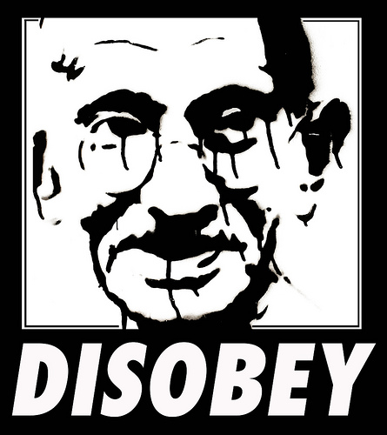
Civil Disobedience

Slide 2
Armed Resistance
Date | Location | Event | Result
1842 | China | Opium Wars | China is defeated by England
1857 | India | Sepoy Mutiny | Sepoys defeated by England
1870’s | America | Indian Wars | Indians defeated by the U.S.
1879 | Africa | Zulu Wars | Zulus defeated by England
1899 | China | Boxer Rebellion | Boxers defeated by England

Slide 3
Civil Disobedience
Throughout history native peoples have tried armed resistance against imperialist forces and time and again the native peoples were defeated.
Civil Disobedience: People demonstrate their unhappiness with authority by challenging the authority in a civilized manner without resisting officers of the law.

Slide 4
Rules for Civil Disobedience
1) You must be sure that your position is morally superior to that which you oppose.
2) You must be certain that your opponent, despite their actions, supports the same morality that you do.
3) You must be 100% committed to your action.
4) You must be willing to suffer for your convictions.
5) You must be ready to accept the consequences of your actions.

Slide 5
Forms of Passive Resistance
Sit Ins
Letter Writing, Campaigns and Petitions
Hunger Strikes
Economic Boycotts
Marches and Rallies
Civil Disobedience tries to defeat the morality of your opponent by appealing to his or her conscience.

Slide 6
Passive Resistance
The British force Indians to buy only British clothing. Gandhi leads a movement of Indians who spin their own cloth at home circumventing the British law. Gandhi is arrested and only released after a lengthy hunger strike.
RESULT: Britain changes the law.

Slide 7
Passive Resistance
The British passes making all Indian industry illegal. Ex. All Indians must buy Salt manufactured in England. Gandhi leads a march to the sea where Indians make sea salt. Gandhi is arrested and only released after a lengthy hunger strike.
RESULT: Britain changes the law.

Slide 8
Passive Resistance
Montgomery Alabama does not allow black citizens to sit in the front section of the bus. Rosa Parks an African American woman refuses to give up her seat in the front of the bus. The Montgomery bus boycott ensues where thousands of citizens of Montgomery refuse to use the buses until the policy is changed.
RESULT: The bus company allows black citizens to ride in all sections of the bus.

