Slide 1
Collapse of Chinese Imperial Rule
The Rise of Maoist Communist China
Video Introduction

Slide 2
1. In 1912 Sun’s Revolutionary Alliance Overthrows the Qing Dynasty.
Causes
Many Chinese believed that China needed to modernize and nationalize.
They wanted to end years of humiliation under the Qing when foreigner imperialist countries controlled China’s trade & economic resources.

Slide 3
Effects: Sun Yixian created the new Republic of China based on 3 principles and increased Chinese nationalism.

Slide 4
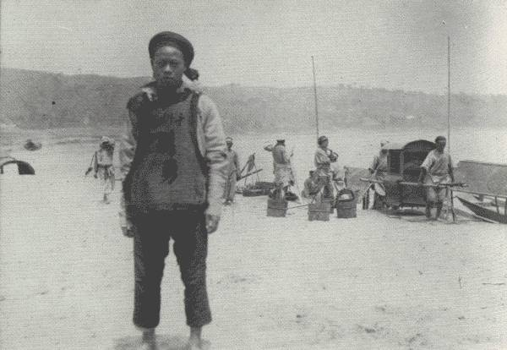
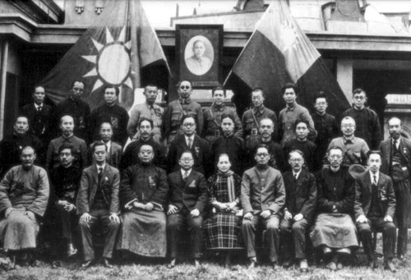
Kuomintang – (the Nationalist Party) – pushed for modernization and nationalization in China

Slide 5
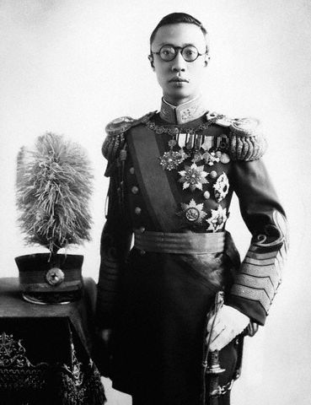
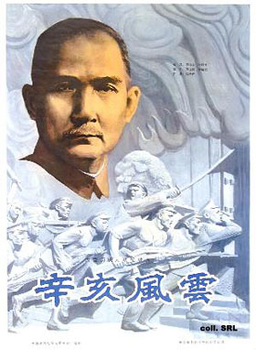
Sun Yixian – the first great leader of the Kuomintang succeeded in overthrowing the Last Emperor from China and became President of the Republic of China (1912)

Slide 6
Sun’s “Three Principles of the People”
1. Nationalism: end to foreign control
2. Democracy: civil rights for the people
3. People’s Livelihood: economic security for all the people.

Slide 7
2. Sun turns presidency over to Yuan Shikai.
Causes:
Sun lacked the authority & military support to secure nat’l unity.

Slide 8
Effects: By 1913Yuan betrayed the democratic ideals of the revolution and ruled as a dictator which sparked local revolts.
By 1916 power fell to the warlords again and chaos reigned. Roads & bridges fell into disrepair, crops were destroyed, and many starved to death.

Slide 9
3.1919- The May Fourth Movement begins.
Causes:
Outrage over the Treaty of Versailles which gave to Japan territories & privileges in China that had belonged to Germany.

Slide 10
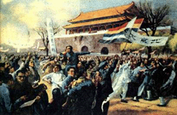
After WWI, China thought they’d get some land back from foreign control. When they didn’t, The May 4th Movement occurred.
May 4th Movement – demonstrations against European Imperialists, the Japanese, and Western democracy

Slide 11
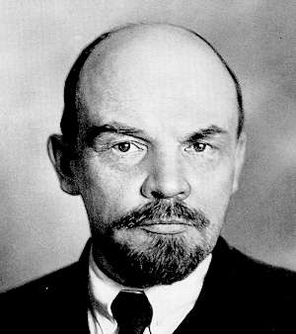
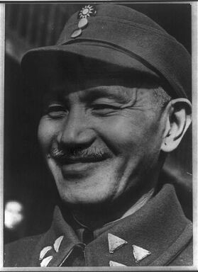
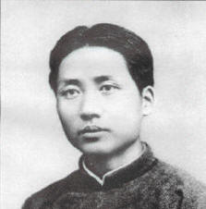
Sun Yixian started seeking support from Chinese Communists (including Mao Zedong) and Lenin from the Soviet Union
After Sun died in 1925, Jiang Jieshi was put in charge of the Kuomintang

Slide 12
Effects:
Chinese people are committed to making China stronger.
Young Chinese intellectuals turn against Sun’s beliefs in Western democracy and toward Lenin’s brand of Communism.
They formed the Chinese Communist Party in 1921.

Slide 13
Mao’s Marxist Communism
Mao believed that China’s revolution of the workers would not be in the cities among factory workers like Lenin’s Communism, but all the rural peasants would rise up. Then China would be an agrarian worker’s paradise led by Mao and based on Marxist socialism.

Slide 14
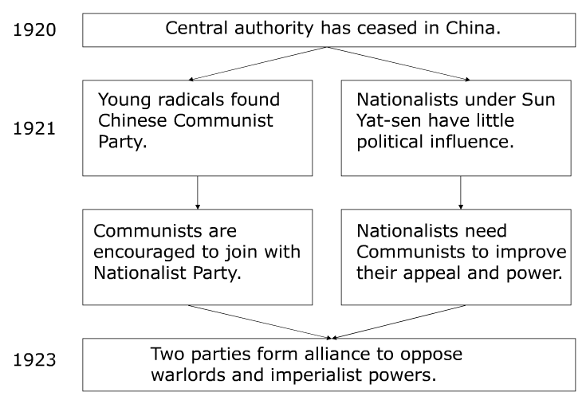
Nationalist-Communist Alliance

Slide 15
4. Nationalist forces move into Shanghai in April,1927.
Causes:
The Kuomintang (the Chinese nationalist party) feared that Chinese Communists would create a Marxist Socialist Economy.

Slide 16
4. Nationalist forces move into Shanghai in April,1927.
Effects:
They purged most of the Communist Party members. Then Britain & U.S. formally recognized the Nationalist gov’t. in 1928. Jiang is named President. Civil war broke out-Kuomintang vs. the Chinese Communists.

Slide 17
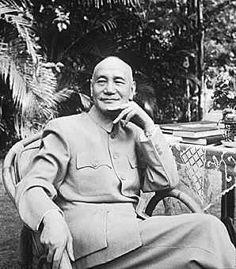
Jiang initially cooperated with Communists to defeat the warlords, but then turned on the Communists shortly before becoming President of the Nationalist Republic of China (1928)

Slide 18
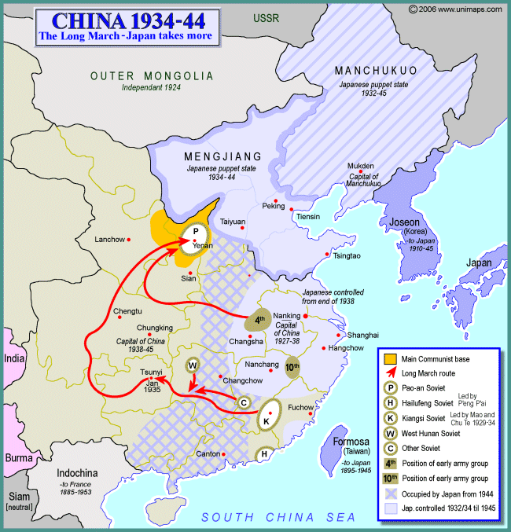
5. In 1934, Communists begin the Long March.
Causes: Mao Zedong leads 100,000 communist Chinese on a 6,000 mile journey to escape the nationalist armies of Jiang Jieshi.

Slide 19
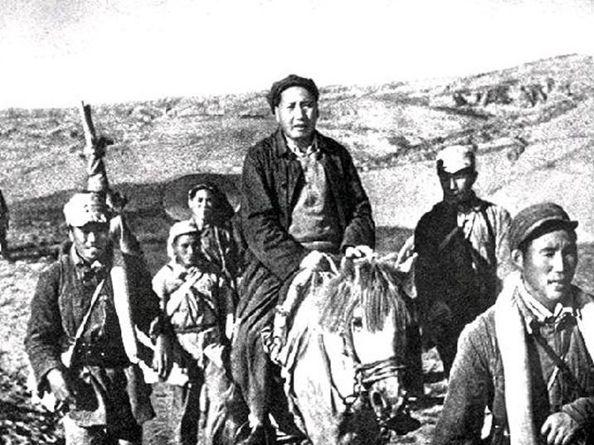
5. In 1934, Communists begin the Long March.
Effects: Mao and his leaders with 10,000-30,000 followers make it to safety in NW China. They attract more followers and civil war continues.

Slide 20
6. Japan Invades Manchuria in 1931, and again in 1937.
Causes: Japan took advantage of the weakened state of China which was involved in civil war.

Slide 21
Summation video

Slide 22
6. Japan Invades Manchuria in 1931, and again in 1937.
Effects-Thousands of Chinese die; their farmland is destroyed. The Nationalists and the Communists temporarily cease fighting and unite against Japan. This invasion marks the beginning of World War II in Asia.

Slide 23
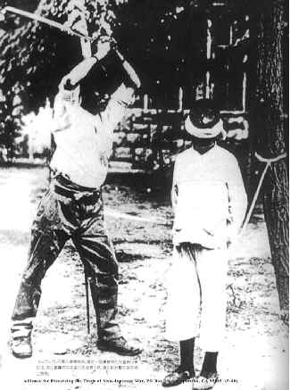
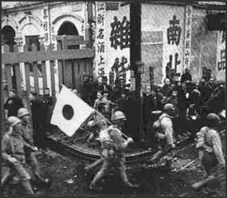
The Chinese Civil War was put on hold when the Japanese launched a full-out invasion of China. Temporarily, Jiang’s Nationalists and Mao’s Communists declared a truce

Slide 24
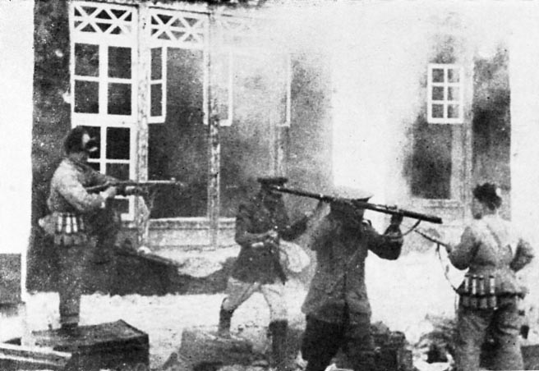
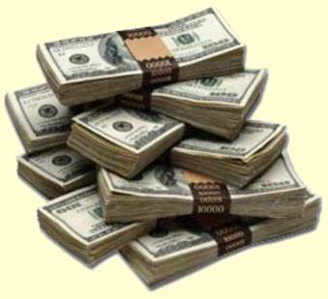
Mao’s Communists used guerilla warfare against the Japanese in Northeast China
Jiang’s Nationalists, protected by rugged mountains in southwestern China fought few battles against the Japanese, but received $1.5 Billion from the U.S.

Slide 25
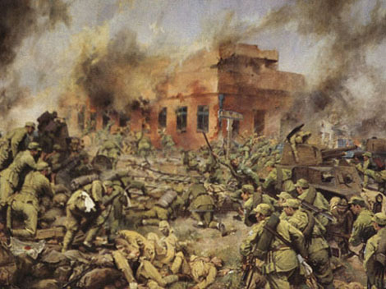
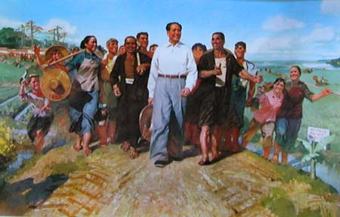
After WWII ended, the civil war started back up. The U.S. offered $2 Billion more in aid to the Nationalists to fight the Communists
Mao’s promise of land reform led many peasants and Nationalists to switch to his side

Slide 26
Mao Zedong
Video File

Slide 27
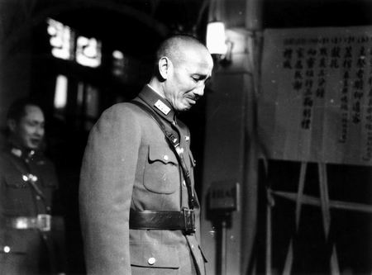
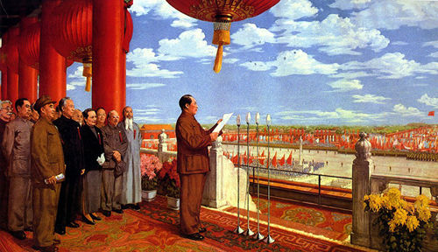
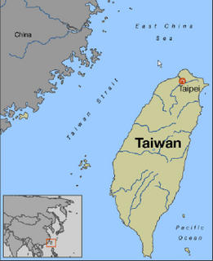
In 1949 Mao gained control of the country and named it the People’s Republic of China
Jiang fled to the island of Taiwan and proclaimed it Nationalist China, in effect creating Two Chinas

