Slide 1
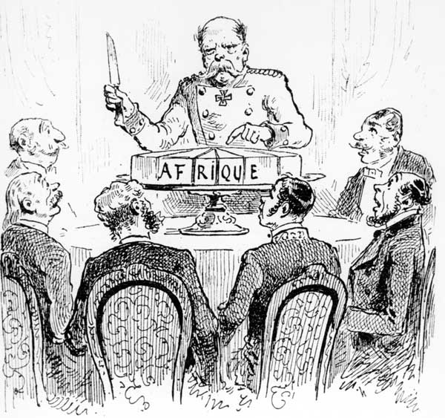
The Berlin Conference of 1884 –1885
established
rules for
the conquest of
Africa.

Slide 2
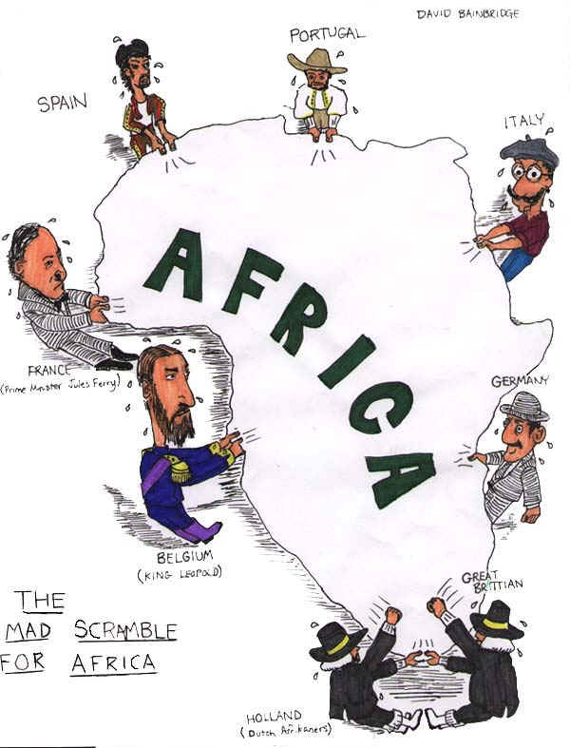
The Berlin
Conference led
to a Scramble
for Africa as
European
nations rushed
to claim land.

Slide 3
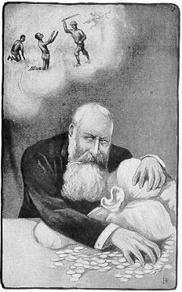
European
imperialism
harmed
Africans as
Europeans
exploited the
people and land.

Slide 4
Africans wanted independence.
They wanted to benefit from
their land and resources. They
wanted to control their own
destinies.

Slide 5
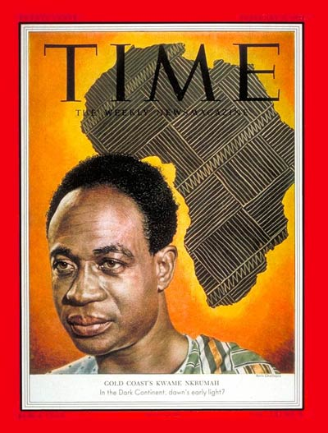
Kwame Nkurmah
was an African
nationalist. He
led the people
of the Gold Coast to
freedom.

Slide 6
In 1957, the Gold Coast was the first African colony to gain its freedom. With freedom came an
African name: Ghana!

Slide 7
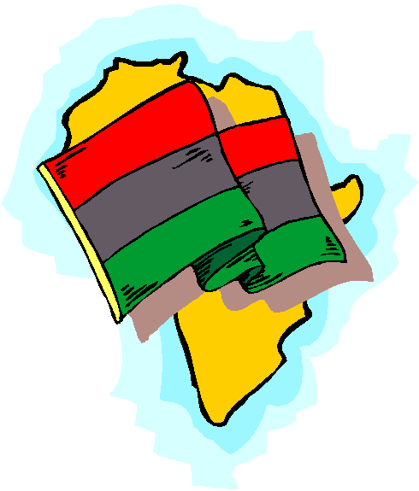
Nkrumah promoted the idea of
African unity or Pan-Africanism.
Africans needed
to work together for the benefit of Africa.

Slide 8
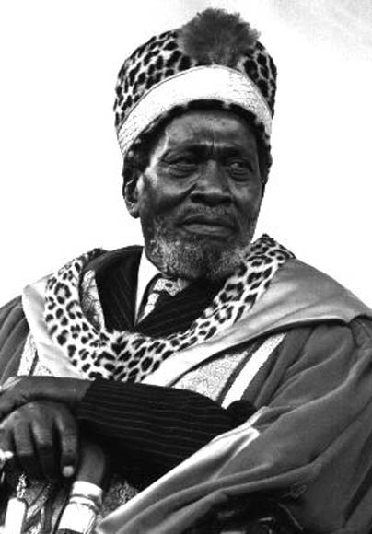
Jomo Kenyatta was another
important African nationalist.
He led Kenya to freedom in
1963.

Slide 9
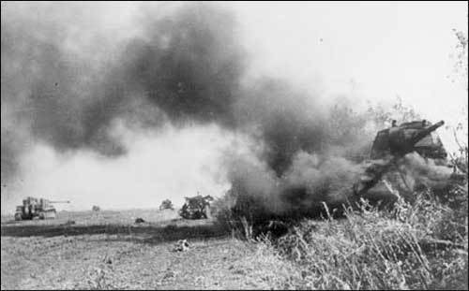
While independence solved
some problems, it created
other problems.

Slide 10
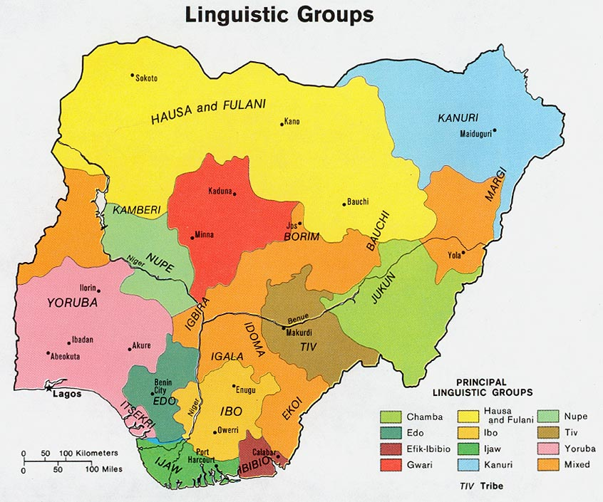
The old colonial boundaries
became the boundaries of
the newly independent
nations.

Slide 11
Borders created tensions.
Sometimes hostile ethnic groups
shared the same nation.
Civil Wars resulted.

Slide 12
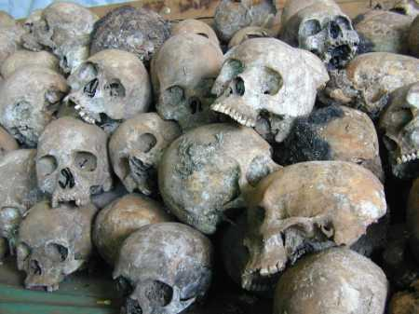
Ethnic tensions sometimes led
to human rights violations and
even genocide.

Slide 13
Yes, independence brought
its own set of problems but
it also brought possibilities.

Slide 14
Founded in 1963, the
Organization Of African Unity
promoted cooperation among
all African states and sought
to eradicate all forms of
colonialism.

Slide 15
The road to freedom was not
an easy one but with the
talent and resources of the African people and continent,
freedom was gained.

