Slide 1
Decolonization of India

Slide 2
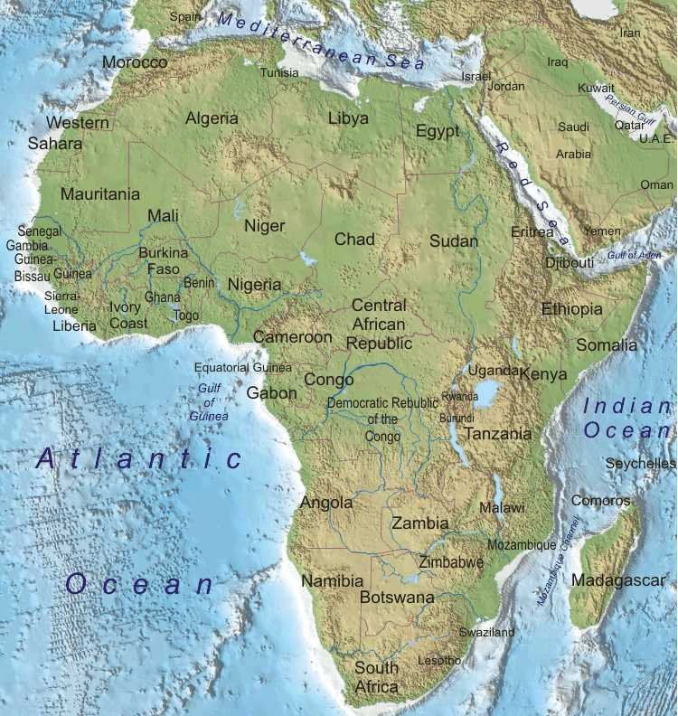
Decolonization
The movement for European countries to grant independence to their colonies in Africa and Asia after World War II.

Slide 3
Financial Pressure
The high economic cost of World War II left a large debt in the British treasury. The debt combined with diminishing profits from the Indian colony pushed Britain toward giving India independence.

Slide 4
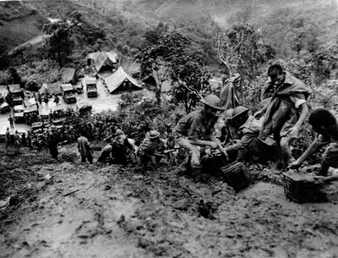
Moral Pressure
Following World War II many in Britain began to question the morality of Imperialism.
Many Britons also felt that India had earned its independence by fighting on the allies side during both World Wars.

Slide 5
A Test Case
In many ways independence for the Indian subcontinent would serve as an example as other colonial lands began to demand independence.

Slide 6
Should India receive Independence from England? Why or why not?

