Slide 1
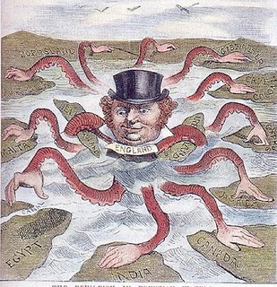
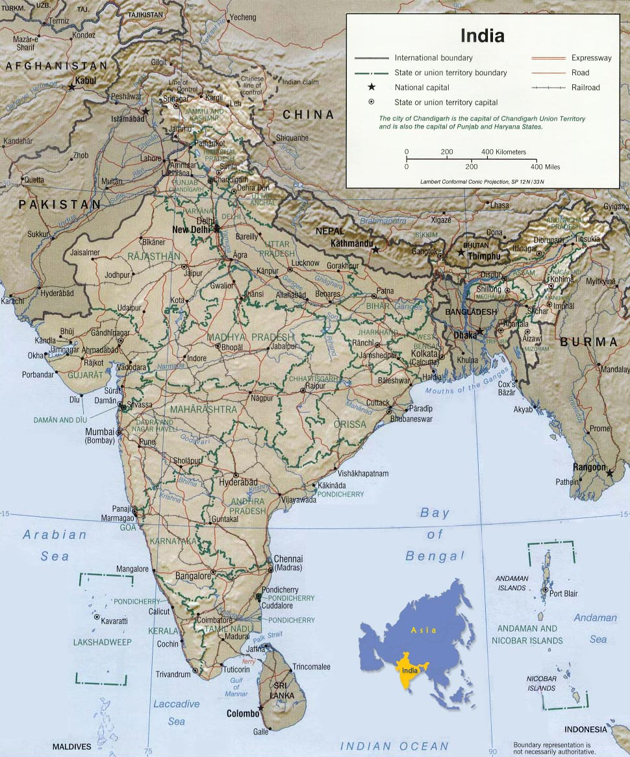
The Effects of Imperialism on India

Slide 2
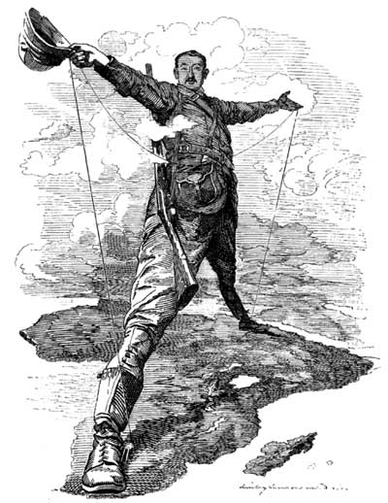
Imperialism
When a strong country takes over another country or region, in search of raw materials and markets, and exploits the conquered territories resources.
Examples…
The British in India
The French in Southeast Asia
The Europeans in Africa

Slide 3
Impact of Imperialism on the Mother Country
The mother country gains wealth and resources taken from the colony.
Examples include…
cotton and spices for Britain from India
rubber from the Congo for Belgium
peanut oil for France from the Ivory Coast.

Slide 4
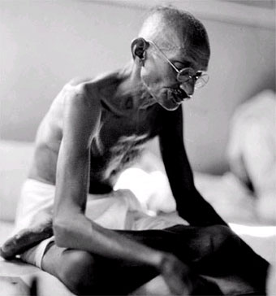
Positive Effects on the Colonized Country
Advanced technology
(Railroads, Printing Press)
Advanced Institutions
(Government, Schools, Hospitals)
Law and Order
Lessening of tensions between the ethnic groups
(In India for example Muslims and Hindus made peace with each other and focused on getting the British to leave)

Slide 5
Negative Effects on the Colonized Country
Loss of independence
Loss of native culture
(In India Britain outlawed Indian practices the British disapproved of)
De-industrialization
(Local industries are closed and natives are forced to work to produce resources for the mother country)

Slide 6
Who Benefits for Imperialism? Why?

