Slide 1
Effects of World War II

Slide 2
Effects of WWII
Defeat of Fascist leaders in Europe and Japan
Devastation and loss of life in Europe and East Asia
Development of nuclear weapons and atomic energy
Recognition of the Holocaust and Nuremberg Trials
Rise of the United States and Soviet Union as Super Powers – COLD WAR

Slide 3
Social Effects
Approximately 75 million people died
38 million Europeans
22 million Soviets

Slide 4
Social Effects
Refugees
Homeless or displaced persons

Slide 5
Social Effects
Heightened awareness of horrors and atrocities of war
The Holocaust

Slide 6
Social Effects
Art, literature, and media became more political in nature

Slide 7
Economic Effects
WWII was the most costly war ever…
Cities, towns, countryside, roads, railroads, & bridges were completely destroyed by bombings

Slide 8
Economic Effects
WWII was the most costly war ever…
Nations had to care for wounded, displaced & displaced people
Industry & factories had to be rebuilt and nations had to switch from military industry to consumer industry

Slide 9
Political Effects
Differences between western powers and Soviet Union became cause for tension
Ideologies, broken promises, how to treat Germany
Led to Cold War

Slide 10
Political Effects
Two superpowers emerged
United States vs. Soviet Union
Older European powers declined in global power and leadership

Slide 11
End of WWII:A Divided Germany
They were accused of starting two world wars and Britain and France did not want to be invaded again.
The solution was to divide Germany, but how?
Germany was divided into Eastern (Communist) and Western Germany (Democracy).=Berlin Wall.

Slide 12
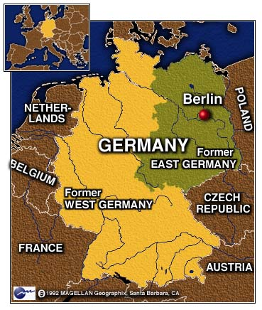
End of WWII: East & West Germany

Slide 13
End of WWII: East & West Berlin
The capital of Germany was Berlin, and once they divided the nation, it fell on the Soviet controlled East Germany side.
As a compromise, the city of Berlin was divided into East and West Berlin.
West Berlin was controlled by the U.S.A.
East Berlin was controlled by the Soviet Union.

Slide 14
Political Impacts
Commitment by USA- the Truman Doctrine, Marshall Aid

Slide 15
The Truman Doctrine
To promote democracy around the world and fight the spread of oppressive regimes in which a minority controls the majority.
“One of the primary objectives of the foreign policy of the United States is the creation of conditions in which we and other nations will be able to work out a way of life free from coercion.”

Slide 16
The Truman Doctrine
To help Greece and Turkey resist the rebellion of an armed minority.
“Should we fail to aid Greece and Turkey in this fateful hour, the effect will be far reaching to the West as well as to the East…the seeds of totalitarian regimes are nurtured by misery and want. They spread and grow in the evil soil of poverty and strife. They reach their full growth when the hope of a people for a better life has died.

Slide 17
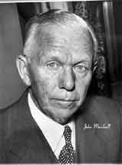
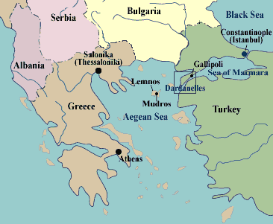
The Marshall Plan aided Western Europe.
Greece and Turkey not the only countries who needed aid from U.S.
World War II left many countries in ruins.
Secretary of State, George Marshall argued that the U.S. needed to do something fast.

Slide 18
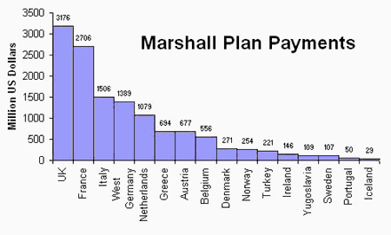
The Marshall Plan aided Western Europe.
Marshall presented a plan to offer extensive economic aid to all nations of Europe in June 1947. (Speech)

Slide 19
United Nations
Created in 1945 to replace the League of Nations
Main purposes are:
Maintain world peace
Develop good relations between countries
Promote cooperation in solving the world’s problems
Encourage respect for human rights
Was more successful because it included more nations than the League

Slide 20
Political Effects
Recognition of crimes against humanity and the responsibilities of military personnel
Nuremburg Trials

Slide 21
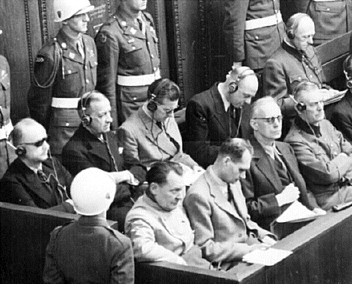
Nuremberg Trials: NAZI LEADERS CHARGED WITH “CRIMES AGAINST HUMANITY” NAZIS HELD ACCOUNTABLE FOR HOLOCAUST
TWELVE SENTENCED TO DEATH BY HANGING BODIES CREAMATED AT DACHAU (concentration camp)

Slide 22
Political Effects
New countries created (Israel)
Independence movement by European colonies

Slide 23
Political consequences
Poland saw its border shifted westwards- lost 179,000 sq.km in the east and gained 104,000 sq.km from German territories
Yalta Conference- decided Poland’s boundaries
Poland, Hungary, Bulgaria and Czechoslovakia one party regime under Stalin’s control.

Slide 24
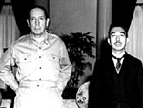
Japan Enemy becomes a friend
Emperor Hirohito admits he is not a god
U.S.A. HELPS JAPAN BECOME A DEMOCRACY
U.S. Occupying General Douglas MacArthur & Emperor Hirohito

Slide 25
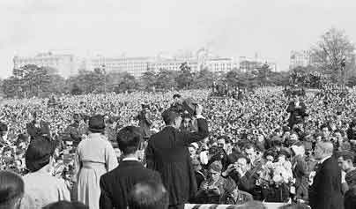
A new constitution made Japan one
of the most democratic nations in the
world. War was renounced, and the
constitution removed power from the
emperor. Control of the government
was placed in the hands of the Japanese
people.

Slide 26
SOVIET UNION ALLY becomes an ENEMY
United States and Soviet Union become the two Super Powers after WWII.
Containment: A policy directed by the United States to prevent Soviet expansion of Communism

Slide 27
Cold War
The Cold War was a time period when non-cooperation between the two major world Superpowers, the USA and the Soviet Union, that caused a fear of nuclear war.

Slide 28
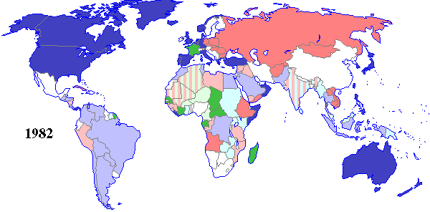
The COLD WAR (1960-1991)
U.S.A. AND ALLIES SOVIET UNION

Slide 29
NUCLEAR THREAT
1949 SOVIET UNION EXPLODED ITS OWN ATOMIC WEAPON
U.S.A AND SOVIET UNION BEGIN AN ARMS RACE THAT LAST FOR 40 YEARS
Both develop ICBM (missiles) to deliver nuclear warheads

Slide 30
Cold War
With the two superpowers at odds, the rest of the world felt the pressure to take sides.
There became a clear division between the non-communist nations of NATO and the communist nations that became members of the Warsaw Pact.
These two organizations (NATO and the Warsaw Pact) were alliances between countries on either side.

Slide 31
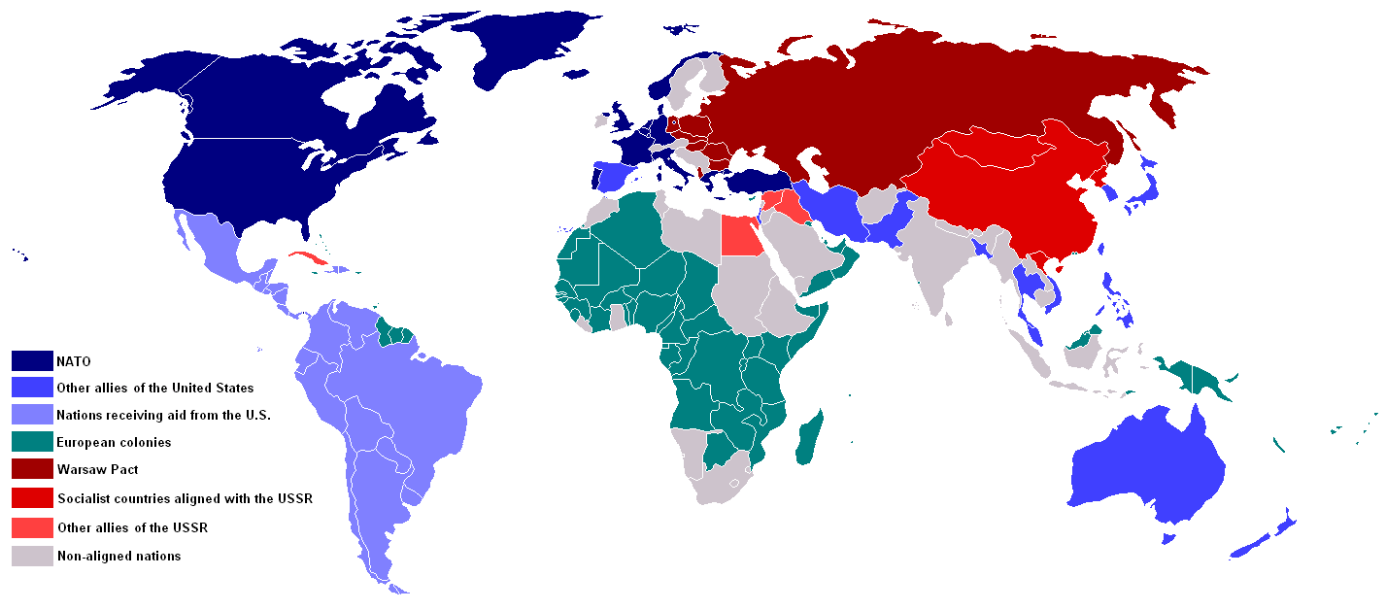
Cold War: The World Takes Sides

Slide 32
Cold War: Politics
West Germany developed a capitalist economy and a democratic government modeled after the U.S.A.
East Germany developed a communist economy and government modeled after the U.S.S.R.

Slide 33
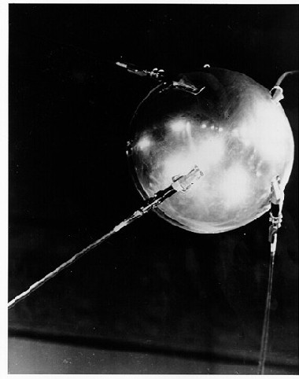
THE SPACE RACE
SPUTNIK, THE FIRST SATTELITE was launched by the Soviet Union on October 4th, 1957
United States and Soviet Union use missiles or rockets to explore space

Slide 34
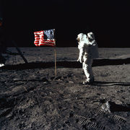
MAN ON THE MOON
JULY 20, 1969, THE U.S.A. PLACES THE FIRST MAN ON THE MOON
“GIANT LEAP FOR MANKIND”
BUZZ ALDRIN

Slide 35
Economic Effect
Cost of the escalating Cold War
Arms race
Space race

