Slide 1
Explorer’s Review

Slide 2
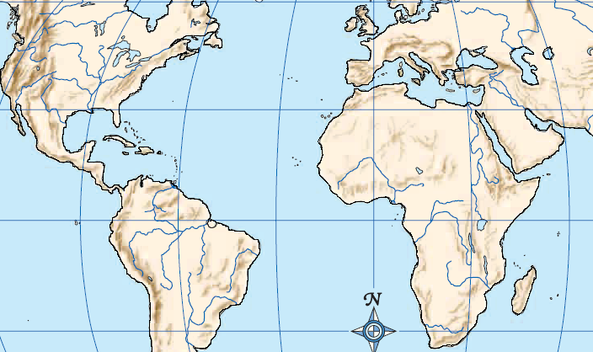
Dias
Sailed for Portugal
From 1487-1488
First to sail around the tip of Africa (Cape of Good Hope) into the Indian Ocean

Slide 3
Columbus
Sailed for Spain
Left in 1492
Thought he had reached East Indies
Landed in Bahamas
Opened the “new world” up to colonization and trade

Slide 4
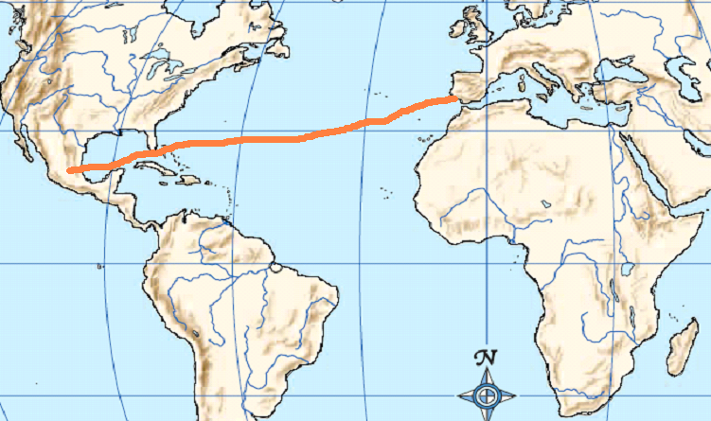
Cortes
From Spain
Sailed in 1519
Landed on the shores of Mexico and conquered the Aztecs

Slide 5
Pizarro
From Spain 1519 +
Traveled with another crew to the Americas but went on his own to explore South America
Conquered the Incas

Slide 6
Magellan
Sailed for Spain
Sailed from 1519-1522
Part of his crew was 1st to circle the earth. (circumnavigate)
He went thataway!
Are we there yet?
It really is round!
How did we end up over here?

