Slide 1
Genocide

Slide 2
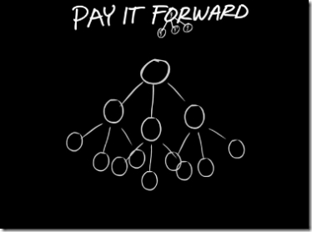
Pay It Forward

Slide 3
recall a time when you stood by silently while an injustice was occurring.

Slide 4
Questions:
Did you consider intervening to stop the injustice while it was happening?
What prevented you from intervening?
What did you feel as you witnessed the injustice?
If you were in the victim’s shoes, what would you have wanted from a bystander/witness?
How did you feel afterwards?
What did you do?
If you could go back in time, what would you change about your reaction to the situation?
How do you plan to respond to similar situations in the future?

Slide 5
April 7th marks the anniversary of the start of the genocide in Rwanda. nearly one million innocent people were systematically slaughtered in a period of just under 100 days.

Slide 6
How would you define Genocide?

Slide 7
Genocide
Genocide is the systematic extermination of a group of people on the basis of a defining characteristic.
  Acts committed
  With the intent
  To destroy (in whole or in part)
  A group of people
  Based on a specific characteristic of the group (such as race, religion, ethnicity)

Slide 8
Genocide in the 20th century

Slide 9
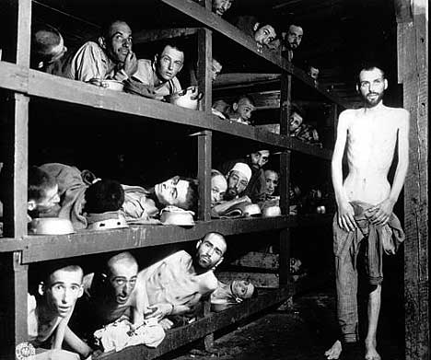
The Holocaust

Slide 10
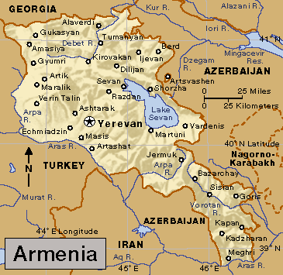
Armenia

Slide 11
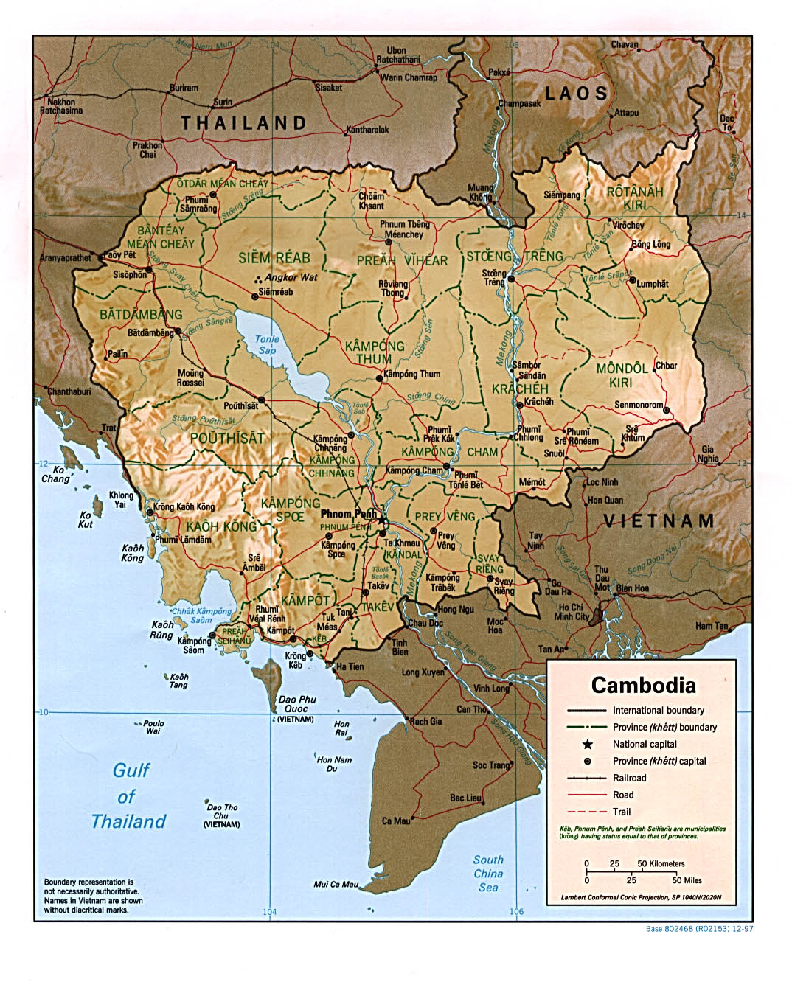
Cambodia

Slide 12
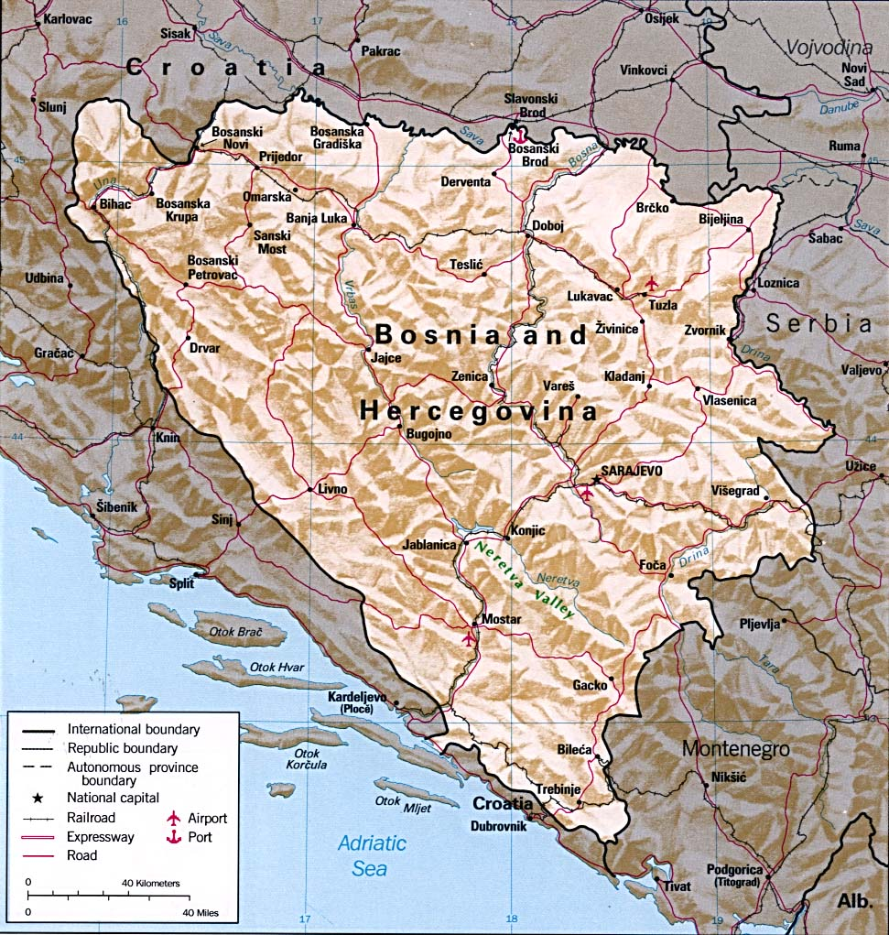
Bosina

Slide 13
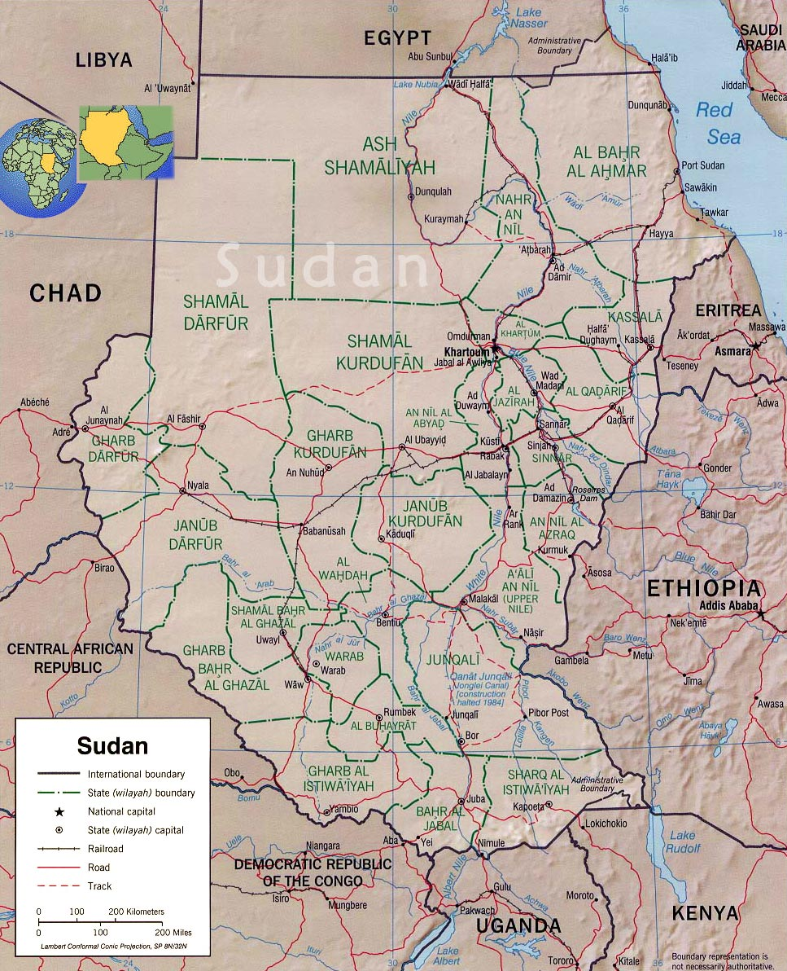
Sudan

Slide 14
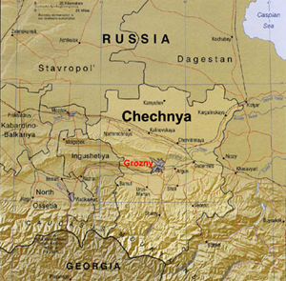
Chechnya

Slide 15
Genocide Convention 1948
After World War II and the Holocaust in which 6 million Jews were systematically murdered in concentration camps by the Nazis, the international community decided that this should never happen again.
They adopted the Genocide Convention in 1948 which gives a legal definition of genocide and which obligates the countries that sign the treaty to intervene to stop genocide when it is occurring.

Slide 16
Genocide Convention 1948
“[A]ny of the following acts committed with intent to destroy, in whole or in part, a national, ethnical, racial or religious group, as such:
  Killing members of the group;
  Causing serious bodily or mental harm to members of the group;
  Creating living conditions of the group with the intent to bring about its physical destruction in whole or in part
  Imposing measures intended to prevent births within the group;
  Forcibly transferring children of the group to another group”
~ Convention on the Prevention and Punishment of the Crime of Genocide, Article 2

Slide 17
Exit Questions
From the Holocaust: Have We Learned Our Lessons?
Why does Genocide occur?
What is the International Community’s Responsibility for Preventing Genocide?

