Slide 2
Gunpowder Empires
What is a “gunpowder empire”?
An empire formed by outside conquerors who unified regions largely based on the mastery of firearms.

Slide 3
What were the effects of the trade and spread of gunpowder and firearms?
Growth of large empires
Made existing castles obsolete
Use of horses and cavalry in battle became less important
Armies became much larger
Power of aristocracy declined
War casualties (soldiers & civilians) much higher

Slide 4
Growth of large empires
Firearms and similar weapons were expensive. and complex. Only wealthy states could afford them
The trade in these weapons became a monopoly of centralized states.
These states used their advanced weapons and power to take over surrounding states.
Many of these states are referred to as “gunpowder empires”.

Slide 8
Void left by Mongols taken up by Ottomans
Cavalry, Jannisaries dominate

Slide 9
Adopted firearms readily – easily defeated Muslim rivals, Hungary
Initially they had superior technology

Slide 10
15th Century - Build navy to ward off Europeans, gain control of Mediterranean (Significance?)

Slide 13
400 Years of Decline
Military victories bring about decline, how?
Had to constantly guard gains

Slide 14
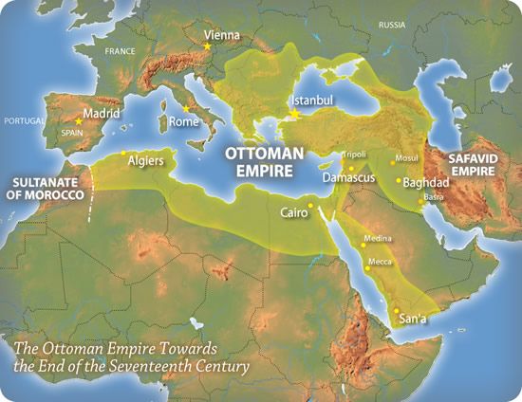

Slide 15
400 Years of Decline
Conservative Islam focused on tradition, spirituality
Turks did not have the resources, forethought to modernize army
Trade imbalance
Middle class heavily taxed (why relevant?)
Numerous ineffective leaders

Slide 17
Rise of Mughal India
Rise of power swift, easily conquered and controlled Northern India. (map)
Akbar solidified power, made social changes
Created a new religion with elements of Hinduism and Islam - unsuccessful
Eliminated jizya tax on Hindus
Allowed Hindus to build temples again
Promoted Hindus in the gov’t
Outlawed Sati, discouraged child marriage

Slide 18
Mughal Military Power
Massive armies, cavalry, artillery, no navy
Firearms purchased from Europeans, limited local production
Troops poorly trained – conscripted from poor

Slide 19
Mughal Decline
Public works (including the Taj Mahal) drain budgets

Slide 20
Mughal Decline
Wars to conquer Southern India depleted reserves, distracted emperor from internal problems (uprisings and revolts), and incursions from Persian and Afghan warriors bands

Slide 21
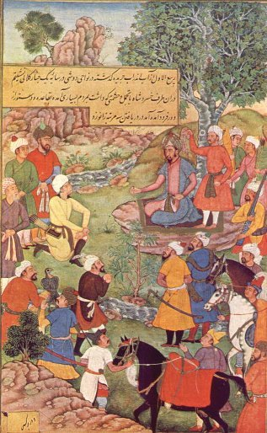
Mughal Decline
Repressive tax system, with few benefits seen by poor
Extensive bureaucracy allowed large scale corruption
Later emperors refused to integrate Hindus into the gov’t (80% of population)
Military technology unable to match European development – modernization plan – Why?
Notes:
(Mughals didn’t need to because they could easily defeat their Asian rivals).

Slide 22
