Slide 2
Gunpowder Empires
What is a “gunpowder empire”?
An empire formed by outside conquerors who unified regions largely based on the mastery of firearms.

Slide 3
What were the effects of the trade and spread of gunpowder and firearms?
Growth of large empires
Made existing castles obsolete
Use of horses and cavalry in battle became less important
Armies became much larger
Power of aristocracy declined
War casualties (soldiers & civilians) much higher

Slide 4
Growth of large empires
Firearms and similar weapons were expensive. and complex. Only wealthy states could afford them
The trade in these weapons became a monopoly of centralized states.
These states used their advanced weapons and power to take over surrounding states.
Many of these states are referred to as “gunpowder empires”.

Slide 13
Tokugawa Shogunate
Jesuits converted over 300,000, Japan felt must consolidate under a powerful shogun, Tokugawa Ieyasu
1606 Christianity outlawed, executed
Japanese forbidden to travel overseas
Europeans not allowed in (except Dutch)
Guns virtually banned
Agriculture flourished
Power in hands of Samurai class
Capital at Edo, now Tokyo

Slide 14
Under Tokugawa
To maintain control, Daimyos had to go to Edo every other year (this meant the Tokugawa had direct control over 50% always)
Needed permission to marry or build
Class structure (4 classes)
Samurai (with Daimyo) – sword and topknot
Farmers – made food
Artisans – made stuff
Merchants – lowest, made nothing

Slide 19
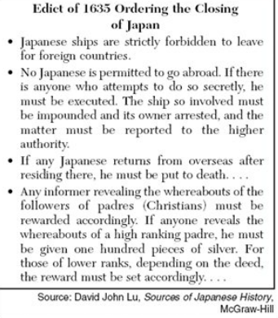

Slide 21
Ming 1368-1644, replaced Yuan, brought peace and stability
______________
China mostly closed to foreigners
______________
Scholar-gentry and civil-service exams returned

Slide 22
Expansion under Qing

Slide 23
Junks – Zheng He, to show off wealth and power of Middle Kingdom
Pirates kept them out of the ocean
Repaired Great Wall and Canals

Slide 26
Gunpowder Empires
Create a SPEC (Social, Political, Economic, Cultural) Chart for EACH of the flowing Empires.
Be sure to include dates, important leaders, and AT LEAST 5 pieces of information for EACH letter!
France (under Louis XIV)
Russia (under Peter and Catherine the Great)
Tokugawa Japan
Qing Dynasty China
the Ottoman Empire
the Mughal Empire

