Slide 1
Comparative Essay (aka Compare & Contrast)
Honors World History

Slide 2
Compare and Contrast
Part C
(Suggested planning and writing time – 35 minutes)
Percent of Section score – 33 1/3
Directions: You are to answer the following question.
You should spend 5 minutes organizing or outlining your essay.
Write an essay that:
Has a relevant thesis and supports that thesis with appropriate historical evidence.
Addresses all parts of the question.
Makes direct relevant comparisons.
Analyzes relevant reasons for similarities and differences.
These directions will be the same for EVERY comparative essay.

Slide 3
The Comparative Essay
…will ALWAYS require BOTH Similarities AND Differences
Whether it says:
“Compare and Contrast”
“Similarities and Differences”
Or even just “compare A and B”
“Compare” means “BOTH similarities and differences”

Slide 4
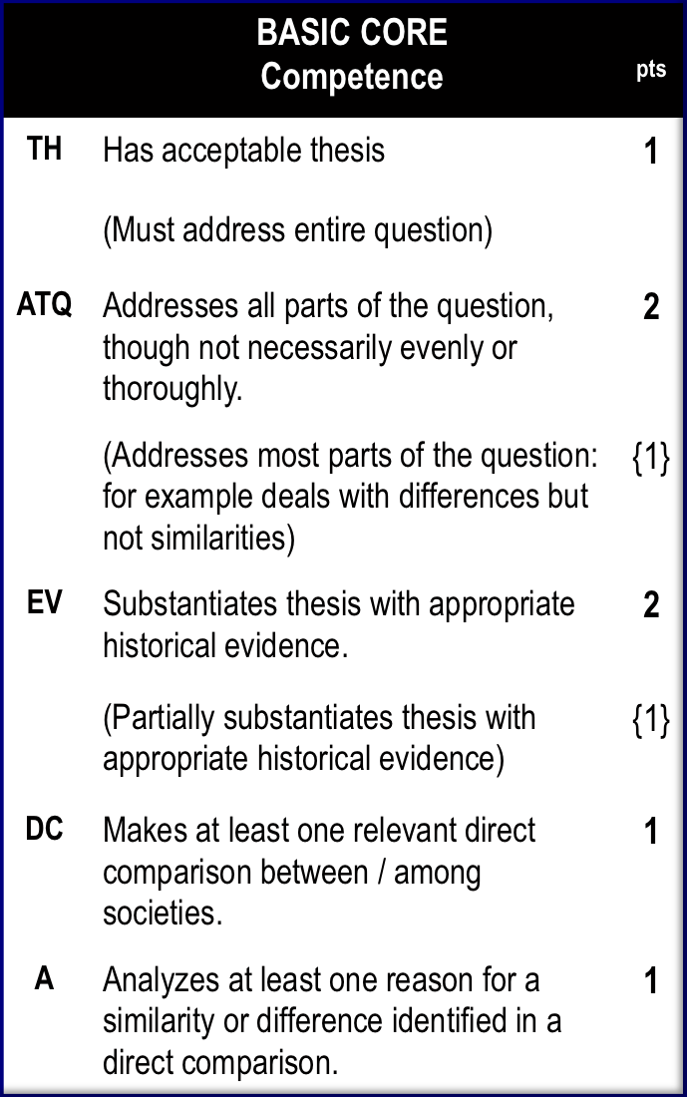
Core Rubric
Notice, there are only 5 aspects of your essay that are graded.
TH – Thesis
ATQ – Addresses all parts of The Question
EV – Evidence (9 for 2 points, 6 for 1 point)
DC – Direct Comparison
A – Analysis of a Direct Comparison

Slide 5
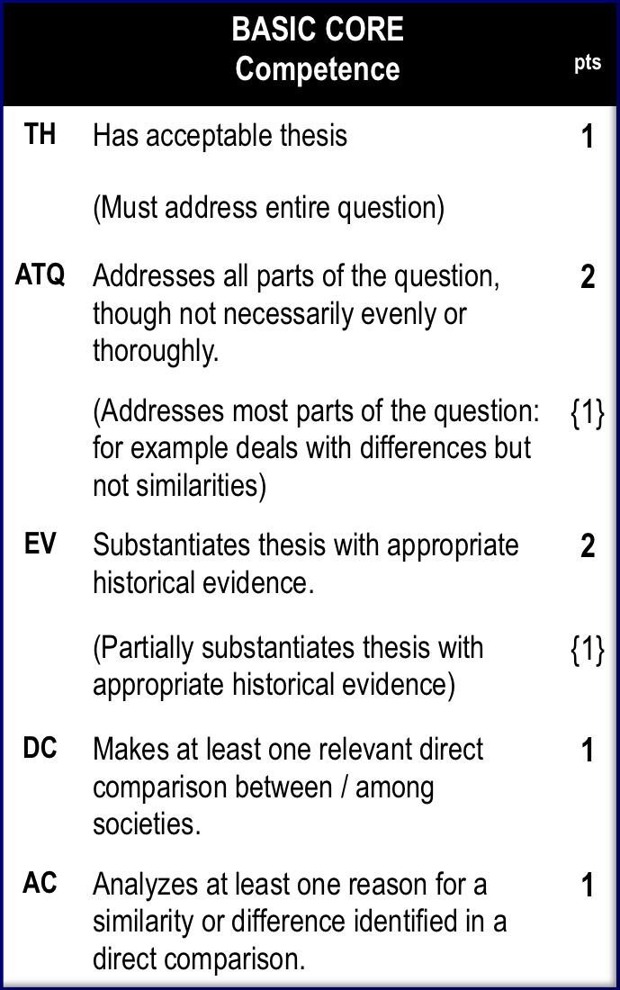
Thesis
1
MUST
Address all theme(s)/topic(s) asked about in the question
State the two societies being compared by name.
State the time period given
Include at least 1 sim & 1 diff
be in first or last ¶
SHOULD NOT
(A + B) were similar and different (not clear which is which)
TIPS:
Start with While/Although/Despite… A + B were similar, A was THIS, but B was THAT].

Slide 6
Thesis
1
MUST
Address all theme(s)/topic(s) asked about in the question
State the two societies being compared by name.
State the time period given
Include at least 1 sim & 1 diff
be in first or last ¶
SHOULD NOT
(A + B) were similar and different (not clear which is which)
TIPS:
Start with While/Although/Despite… A + B were similar, A was THIS, but B was THAT].
THESIS KILLERS:
VAGUE TIME: Back in the day, long ago
VAGUE SUBJECTS: The people (who?), they/them/their (who?)
VAGUE!! Things, Lots / A lot, Stuff, Very, Really, Huge, Many, Aspects
ABSOLUTES: Never, Always, Only
NO 1st PERSON: I, I think, I’m going to tell you, In this essay I will

Slide 7
Thesis

Slide 8
Thesis

Slide 9
Thesis

Slide 10
Thesis

Slide 11
Thesis

Slide 12
Thesis

Slide 13
Addresses the Question
2
MUST
Address BOTH similarities AND differences
SHOULD NOT
Address only one and not the other

Slide 14
Evidence
3
MUST
Give 8 specific evidence (2 pts)
Give 5 specific evidence(1 pt)
Evidence includes any support, facts, dates, examples, quotes, etc. that helps to prove the topic sentence (and therefore your thesis)
Evidence must be RELEVANT and ACCURATE
Follow the “Rule of 3”
3 solid topic sentences (SIM & DIF)
3 Evidence supporting each topic sentence

Slide 15
Direct Comparison
4
MUST
Attempt AT LEAST 2 relevant, specific, direct comparisons.
Must have connecting phrase to show comparison
CUE words:
Also, as well, both, shared, in addition, like, similarly, too, however, on the other hand, conversely, differently, in contrast, either, neither, in opposition to, unlikely, in contrast to, unlike, while…
DO NOT:
Just make Parallel / Indirect Comparisons
ie. This happened here. This happened there.

Slide 16
Analysis
5
MUST
EXPLAIN THE REASON for a similarity / difference… WHY?!?
Make AT LEAST two attempts at the analysis point.
CUE words:
because, …led to, … caused by,
affected, impacted, came from,
was due to, in order to
Follow up your topic sentence with BECAUSE… and explain a reason WHY they were similar or different
CUE words:

Slide 17
Core Rubric
Comparison means to say what is the same and what is different.
If it says “at LEAST one” … if you know your stuff, you should try THREE.
Rule of 3!
Analyze means to say why.
Why is there a difference or similarity?

Slide 18
The Question
Notes:
*

Slide 19
Brainstorm

Slide 20
Formatting the Essay
You only get points for pointing out the similarities and differences.
Organization is very important!
Consider the following examples……

Slide 21
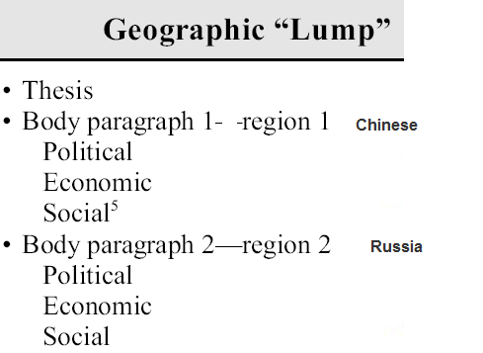
Example #1
This is not a good idea.
What is bad about this example?
ANSWER:Where are you going to compare and contrast?

Slide 22
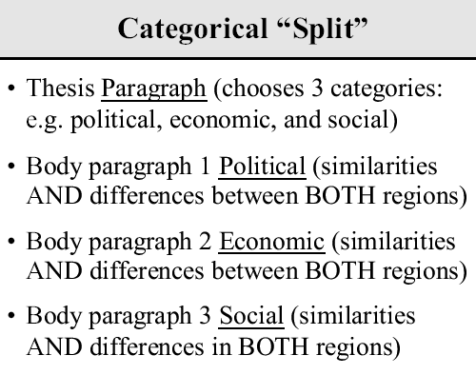
Example #2
This requires a lot of prewriting.
If you have time, it can work for you. but do not use very broad categories, and don’t get lost in the details
With this format, you are setting yourself up to need THREE sim’s, and THREE diff’s

Slide 23
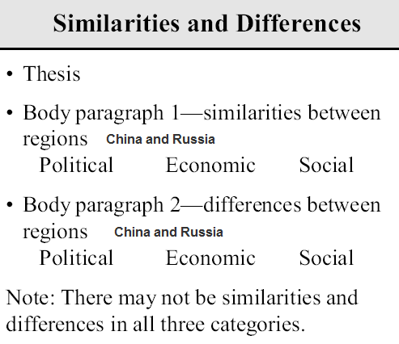
Example #3
This can work!!
Set up similarities in 1 paragraph
Set up differences in another 1 paragraph
Note: If you use this format, you should shoot for 2 SIM and 2 DIF

Slide 24
My Personal Favorite
Thesis:
Address entire question, include time period if noted, give defining categories.
Similarity #2
Similarity #1 Goals and Outcomes
Difference #1 Goals and Outcomes
Or
Difference #2
3-4 Evidence
3-4 Evidence
3-4 Evidence
Brief Conclusion: Restate thesis (2nd try), and finish with 1 sentence that puts your essay topic in a wider historical context
Notes:
*

Slide 25
Common Problems
Describing the two societies or events separately (w/ plenty of evidence) but never comparing and/or contrasting.
You will not earn any points for describing.
Confusing dates, people, and places
Running out of time and not finishing

Slide 26
General Problems for all essays
Not addressing the entire prompt.
Similar but not different.
Rambling or Losing focus.
Giving up.
Never, never, never give up!

Slide 27
DIRECT COMPARISON Statements

Slide 28
What are Direct Comparisons?
Think about it….its very simple, but not always easy to spot.
It’s a comparison of two things in statement form.
So what is so hard? The two must be CONNECTED by the words you use – cannot be two separate statements.

Slide 29
How are Direct Comparisons written?
Example A:
“The British ruled their empire through local intermediaries. France created a bureaucracy staffed by French soldiers and civilian servants.”
Example B:
“The British ruled their empire through local intermediaries, where as France created a bureaucracy staffed by French soldiers and civilian servants.”
Do you notice the difference?

Slide 30
How are Direct Comparisons written?
Example A:
“In Mesopotamia, women had very few legal rights. In Egypt, women had the right to own property, and to propose a marriage or divorce.”
Example B:
Women in Mesopotamia had fewer legal rights than women in Egypt. For example women in Egypt were allowed to own property, but in Mesopotamia, only men could own property.
Do you notice the difference?

Slide 31
ANALYSIS Statements

Slide 32
What is ANALYSIS?
Definition:
The separating of any material or abstract entity into its constituent elements.
So, what does that mean to you?
You need to analyze/explain WHY these societies are similar… or different.
… BECAUSE…

Slide 33
What do I do if I know I am going to run out of time?
NEVER GIVE UP!!!
Focus on the essentials, be sure you’re not wasting time adding unrelated details
Trim or cut the conclusion (Beware: this means you only get the one shot at the thesis point)
Learn from this mistake, and plan better for next time.

