Slide 1
Humans Early Civilization

Slide 2
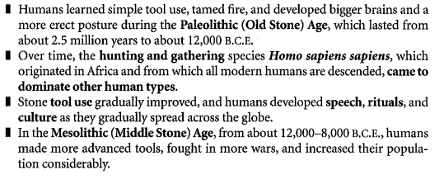
Humans Life Before Agriculture

Slide 3
Neolithic Revolution 1

Slide 4
Neolithic Revolution 2

Slide 5
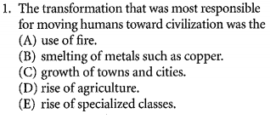
Neolithic Revolution

Slide 6
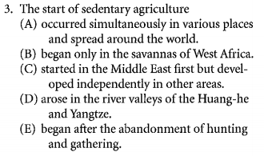
Civilization

Slide 7
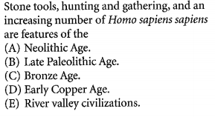
M. C. Question

Slide 8
Civilization

Slide 9
Heritage of River Valley Civilizations

Slide 10
First Civilizations

Slide 11
