Slide 1
Imperialism In Africa
Cy - Ranch

Slide 2
“Dr. Livingstone, I presume”
Dr. David Livingstone- 1860’s traveled deep into central Africa
Searching for the source of the Nile- He went missing for years
Reporter Henry Stanley found him in 1871
In 1882 Stanley signed treaties with local chiefs

Slide 3
Mine all Mine- Horrors of King Leopold II of Belgium
King Leopold Belgium had personal control of new lands (abolish slavery???)
claimed his motive for colony was to abolish slave trade
brutally exploited the Africans
Forced labor, excessive taxation, and severely abused the Congolese
1908 Belgium government took over
80 times larger than Belgium

Slide 4
Africa Before Imperialism
African peoples divided into hundreds of ethnic and linguistic groups
Traditional beliefs
More than 1000 different languages
Large empires to small villages
European travel to interior impossible before steam engine (steam powered riverboats)
Africans had trade networks and kept Europeans from controlling trade

Slide 5
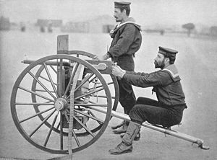
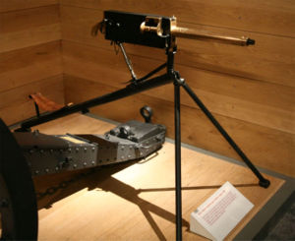
European Technological Superiority
Steam engine- easier travel
Steam powered riverboats
No longer confined to the African coast
Maxim Gun- world's 1st machine gun
Railroads, cables, and steamers

Slide 6
Welcome to Africa: Europeans take over
Motives
Nationalism
Economic Competition
European Racism
Missionary impulse
Issue: Malaria
Europeans highly susceptible to malaria
Caused by mosquitoes
A dose of Quinine almost everyday will keep the malaria away ☺
Internal Forces
Variety of cultures and languages
Low level of technology
Ethnic strife
External Forces
Maxim Gun
Railroads
Steam Ships

Slide 7
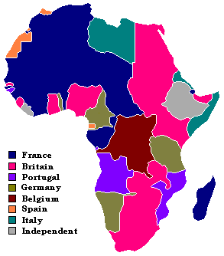
By 1914

Slide 8
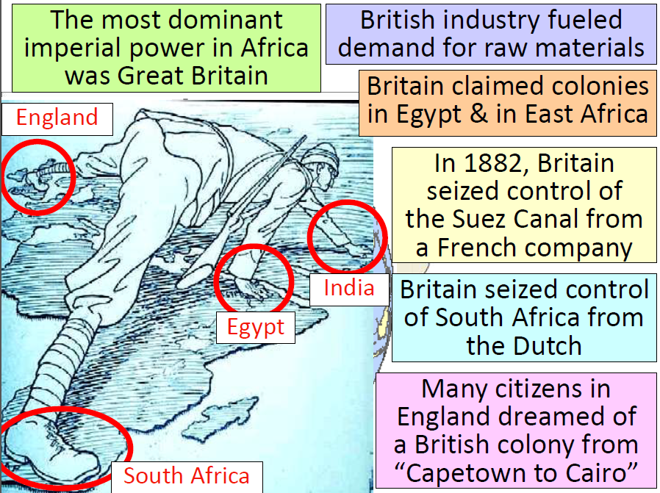

Slide 10
Scramble for Africa:
1880- is when it all began…
Copper and Tin found in Belgian Congo
no one wanted to be left out of the race and the scramble for Africa began
Exploited Africa for rubber, gold, diamonds, ivory, tin, copper
Fierce competition of European nations

Slide 11
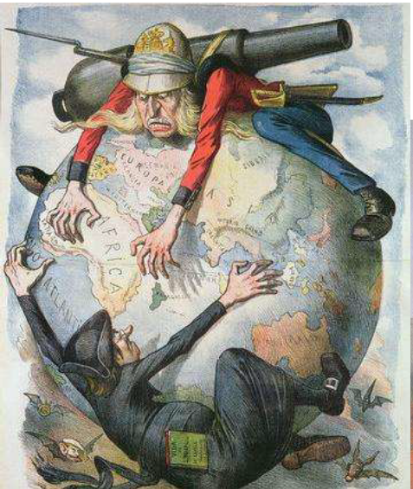
Berlin Conference 1884-1885
To prevent fighting 14 nations called a conference
Goal was to lay down rules for the division of African lands
Agreed that any nation could claim land so long as they notified other nations of the claim (they had to show that they could control the area)
No African rulers attended the meetings
Conference sealed Africa's fate

Slide 12
Not a United Front…
Huge variety of ethnic groups and languages prevented Africans from a unified stand
Wars among the Africans over water, trade rights, and land
Technological disadvantage
No weapons

Slide 13
OOPS!! Our Mistake
European nations thought Africans would buy their goods
They were wrong
European goods were not bought
But businesses still needed raw materials from Africa
Cash-Crop plantations: grow peanuts, palm oil, cocoa, and rubber

Slide 14
Clash of the 3 Nations
South Africa: history of Dutch, Africans, and British
British control the Zulu by 1887
Dutch (Boers) in Cape of Good Hope 1652
Dutch and British clash over land and slaves
1830’s thousands of Boers move to escape the British
Movement known as The Great Trek

Slide 15
Diamonds, Gold, and War OH MY!!
The Boer War: 1st modern total war
Diamonds and gold discovered in south Africa-1860’s and 1880’s
“outsiders” wanted to take it from Dutch Boers
1899 Boers took arms against the British
Commando raids, guerilla tactics, by Boers against British
British burned farms and imprisoned women and children
Britain won- 1902

