Slide 1
Imperialism in India
Cy-ranch

Slide 2
Jewel in the Crown
most valuable of all of Britain’s colonies
Britain established the East India Company taking complete control politically and economically

Slide 5
Sepoy Rebellion
Sepoys- Indian’s that were hired and trained by the British to protect companies and British rights

Slide 6
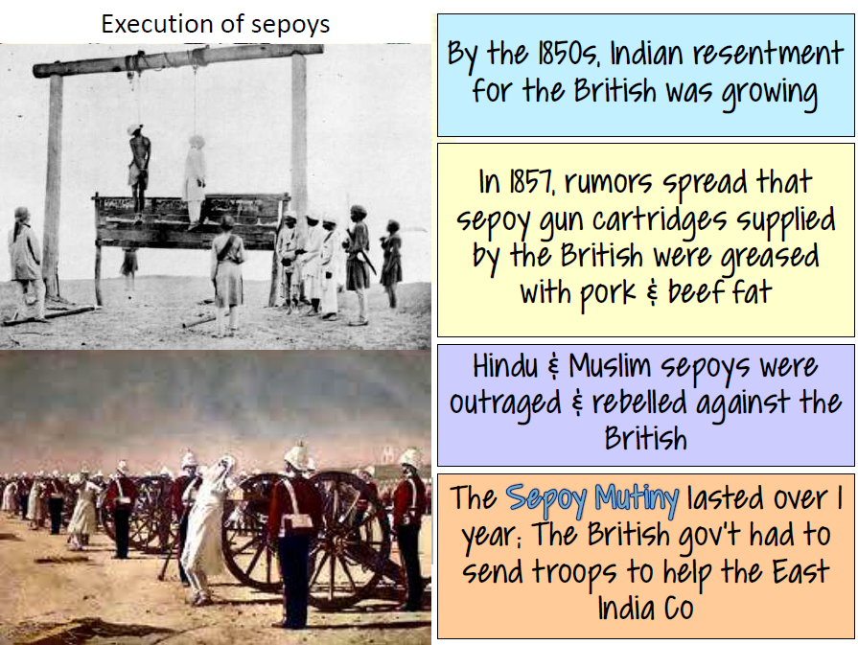

Slide 9
It took Britain more than one year to gain back control of the country
As a result of the rebellion the British government took DIRECT command of India

Slide 10
Ottoman Empire

Slide 11
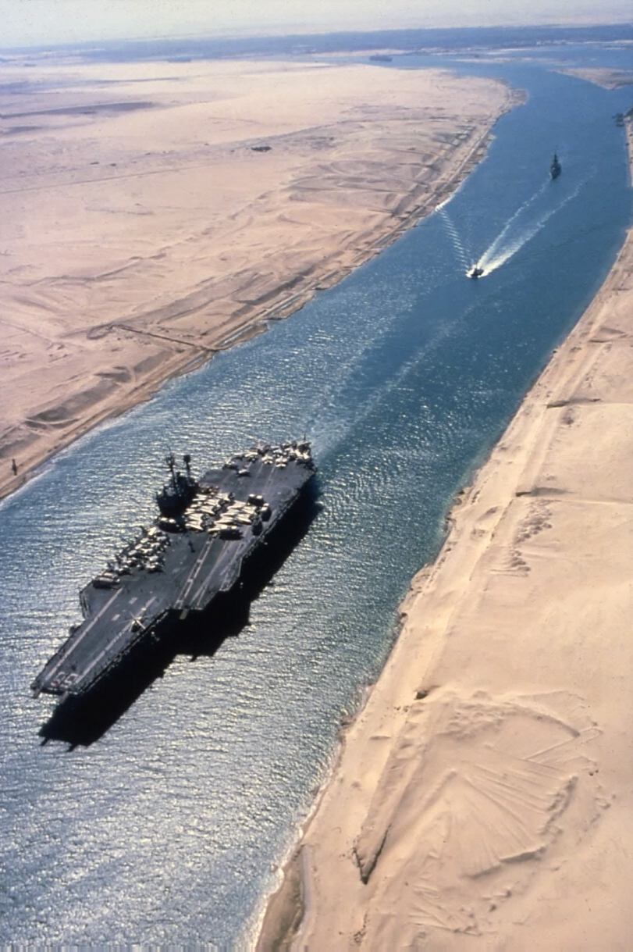
Suez Canal

Slide 12
Suez Canal
Built by Egypt in attempts to modernize
Connected the Mediterranean Sea to the Red Sea
Saved over 5,000 miles and 2 weeks travel
Put Egypt $450 million in debt
The British took financial control of the Suez Canal, and in 1882 occupied Egypt when they couldn’t repay the debt

Slide 13
Southeast Asia

Slide 14
Quest for the Pacific Rim
Dutch control Sumatra, Borneo, Celebes, the Moluccas and Bali
British Take over the Malayan Peninsula
French control Indochina
U.S. acquires the Philippines, Puerto Rico, and Guam after the Spanish-American War in 1898. U.S. annexes Hawaii
Siam (Thailand) maintains it’s independence

Slide 15
Effects of Imperialism

