Slide 2
The
Industrial
Revolution

Slide 3
https://www.youtube.com/watch?v=3Efq-aNBkvc

Slide 5
The Industrial Revolution
led to an increased demand for clothing, furniture, and other goods
provided a large labor force
The increase in population

Slide 6
How did the Agricultural Revolution help the Industrial Revolution?
Crop Rotation, Enclosure Farms, Selective Breeding
One year plant wheat, next year plant turnips, return nutrients to soil

Slide 7
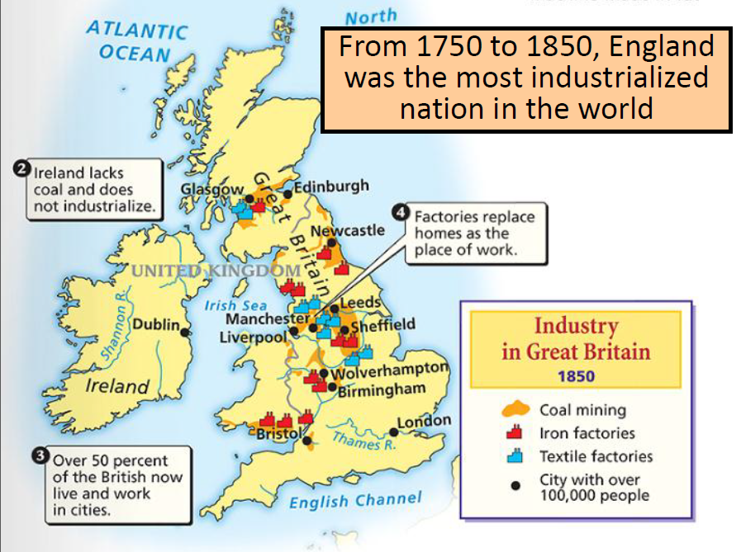
Where did the Industrial Revolution Begin? Why?
England -
Natural Resources
Political Stability
Economic Strength

Slide 8
Extensive Natural resources
water power and coal to fuel new machines
iron ore to construct machines, tools, and buildings
rivers for inland transportation
harbors from which merchant ships set sail

Slide 9
had an expanding economy to support industrialization
businesspeople invested in the manufacture of new inventions
highly developed banking system-availability of bank loans to invest in new machinery and expand operations
growing overseas trade

Slide 10
Factors of production
land-natural resources
labor- workers
capital- money/funding
What is Capital?
What is an entrepreneur?

Slide 12
Effects of Industrial Revolution
What are
textiles?
Products became cheaper & quicker to produce
The 1st industry to undergo mechanization was the TEXTILE industry.
Owners of small plots were force to become tenant farmers or give up farming to move to the city.
a. Tenant farming- farming system where farmers pay rent in return for the use of agricultural land.

Slide 13
Textile Factory Workers in england
1813 | 2400 looms | 150, 000 workers
1833 | 85, 000 looms | 200, 000 workers
1850 | 224, 000 looms | >1 million workers

Slide 14
Factory Production
Concentrates production in one place [materials, labor].
Located near sources of power [rather than labor or markets].
Requires a lot of capital investment [factory, machines, etc.] more than skilled labor.
Only 10% of English industry in 1850.

Slide 15
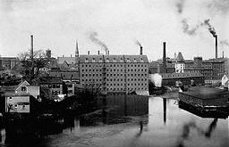
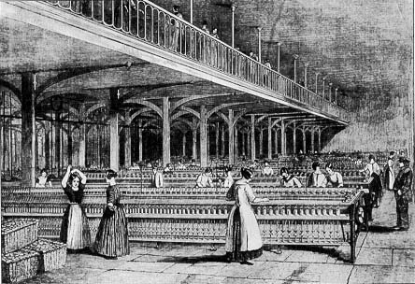
The Factory System
Rigid schedule.
12-14 hour day.
Dangerous conditions.
Mind-numbing monotony.

