Slide 1
Urbanization
the Social & Economic impacts of Industrialization

Slide 2
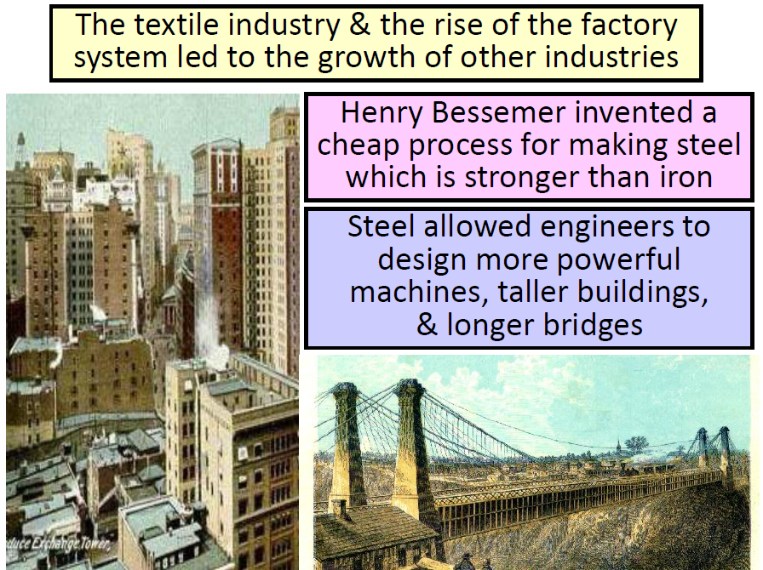

Slide 3
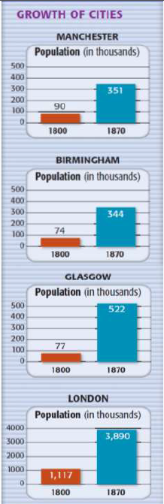
Urbanization
With improvements in farming there were less people needed on the family farms.
Brand new towns sprung up around mills, mines, and factories.
Those needing work turned to the cities with their new factories as a way to make a living.

Slide 4
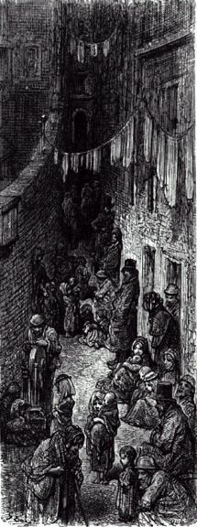
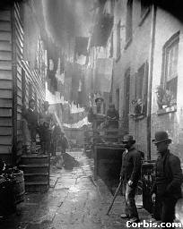
Negative Impacts of Industrialization
Slums grew to house these poor workers - unsanitary conditions were a constant problem

Slide 5
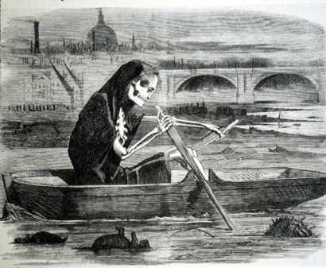
Negative Impacts of Industrialization
Pollution, crime and overcrowding were constant problems
The Silent Highwayman - 1858

Slide 6
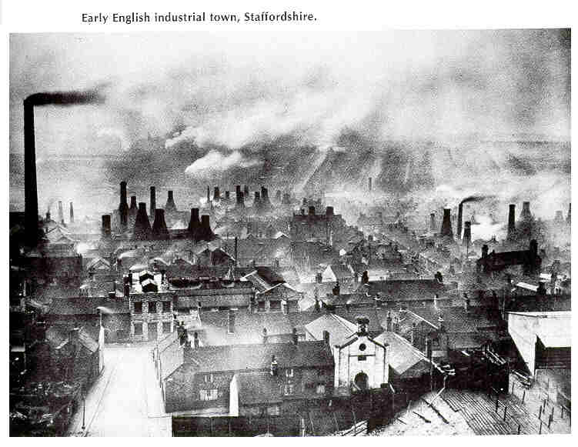
Negative Impacts of Industrialization
Cities became crowded and dirty

Slide 7
Yeah!!! We have jobs… but what’s up with all the people everywhere!!!
Women & children are forced to work long hours for less pay.
Coal mines because of frequent accidents, damp conditions, constant breathing of coal dust became the worst industries to work in.

Slide 8
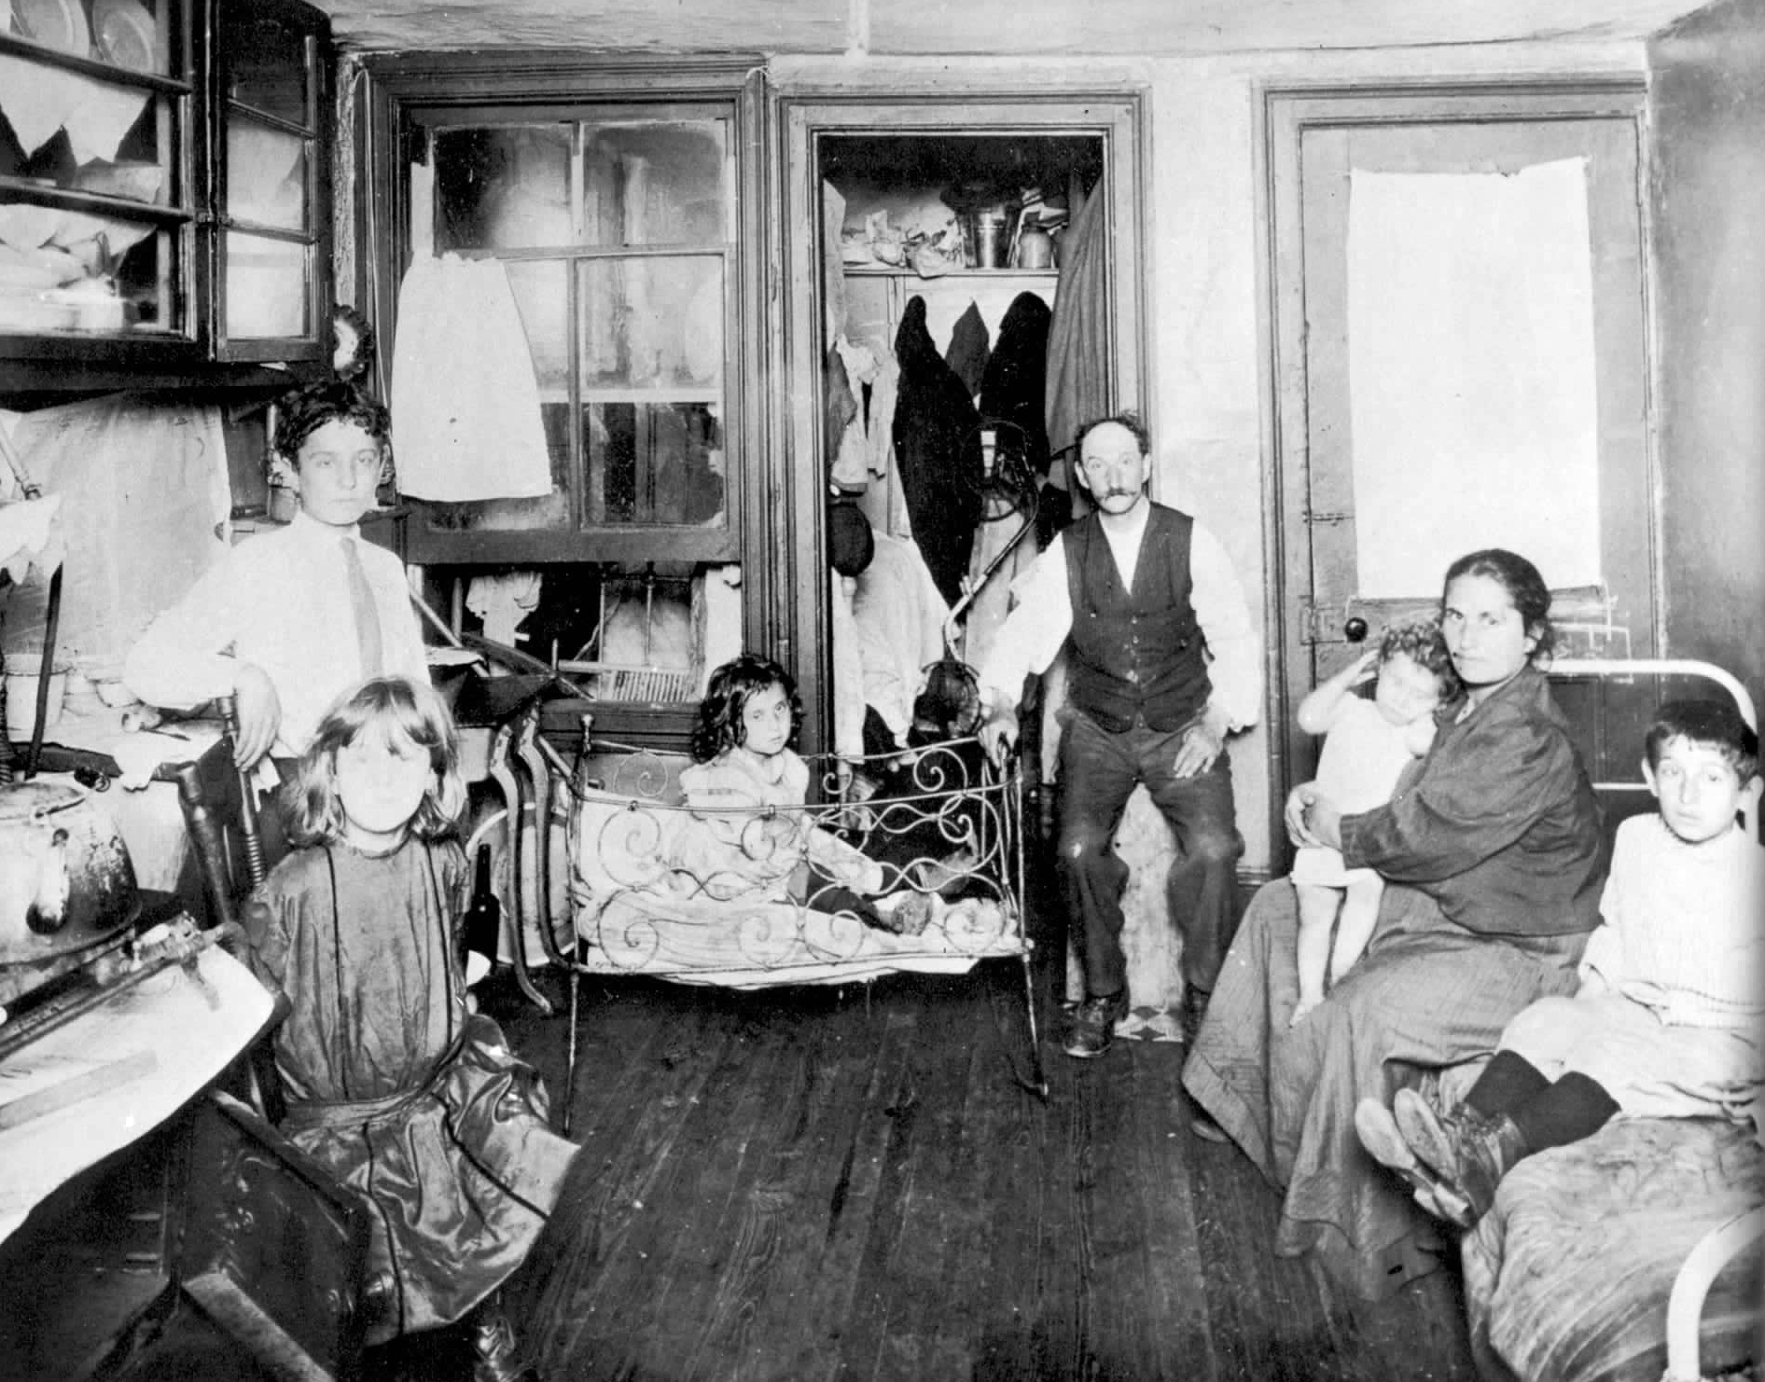
Living quarters for factory workers

Slide 9
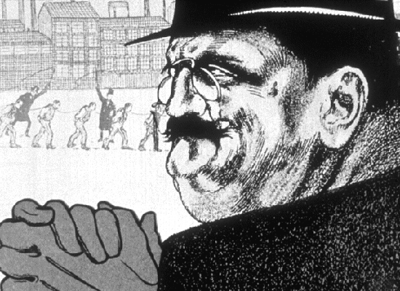
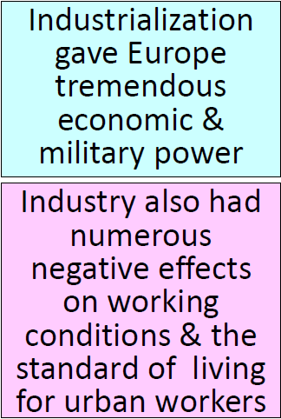
Stereotype of the Factory Owner
Factory owners had absolute control!!!
Remember, Europe’s population had grown rapidly b/c of the Renaissance (SOOO labor is cheap & plentiful).

Slide 10
Working environments
Early factories were unsafe and unpleasant places
Machines were left unprotected and a hazard to work around
Workers put in long hours with little pay
  They had no leverage in dealings with the company
If a person was injured or was unable to work they could be fired without notice

Slide 11
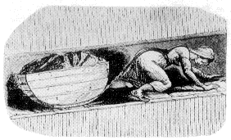
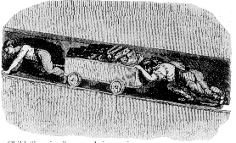
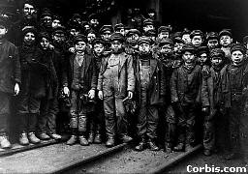
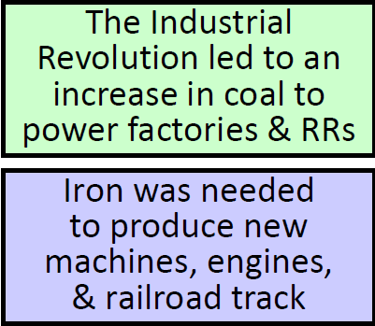
Young Coal Miners
https://www.youtube.com/watch?v=KHmqEqJN59o

Slide 12
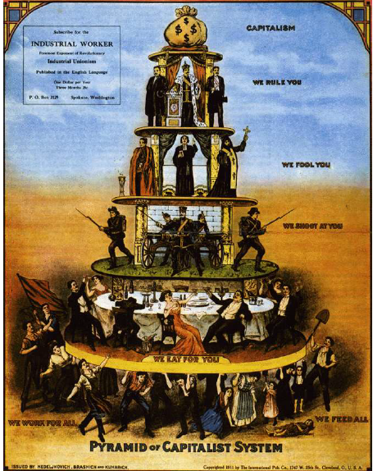
The "Haves":
Bourgeois Life
Thrived on the
Luxuries of the
Industrial Revolution

Slide 13
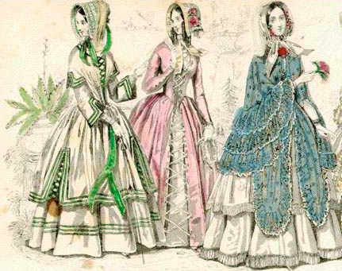
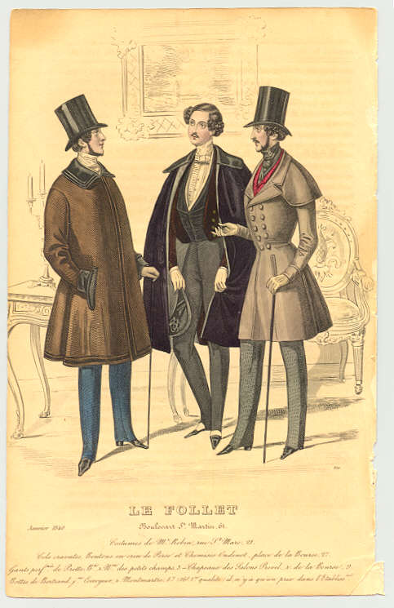
19^{c} Bourgeoisie:
The Industrial Nouveau Riche

Slide 14
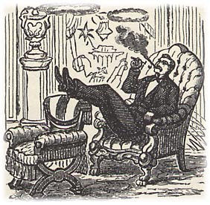
A new middle class of capitalists emerged.
They developed laissez-faire capitalism
or a free market where the government
does not intervene in the market.

Slide 15
The "Have-Nots":
The Poor,
The Over-Worked,
& the Destitute

Slide 16
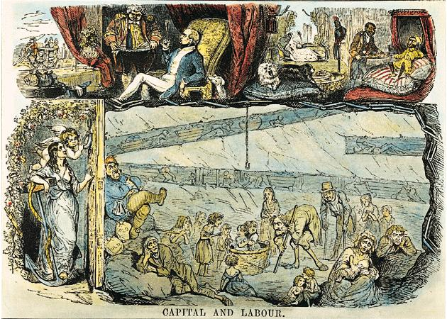
“Upstairs”/“Downstairs” Life

Slide 17
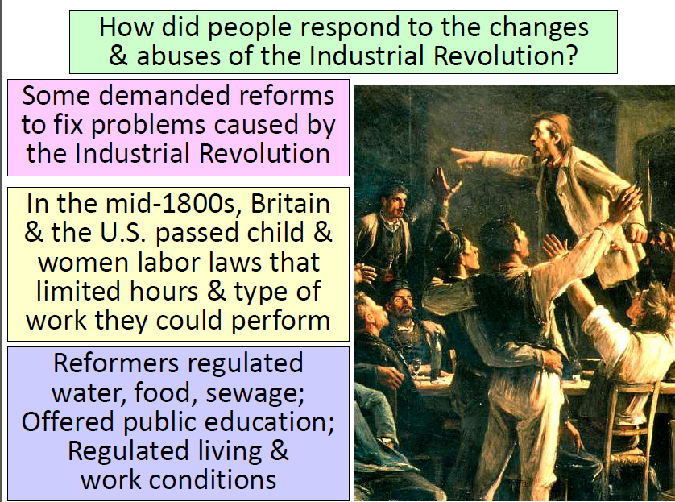

Slide 18
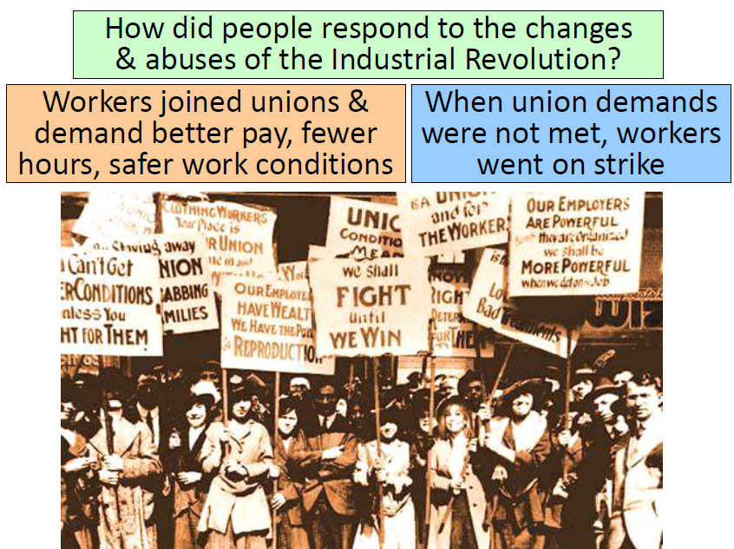

Slide 19
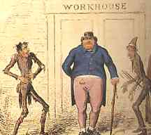
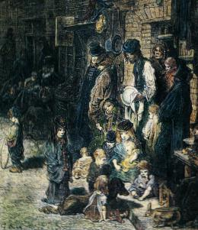
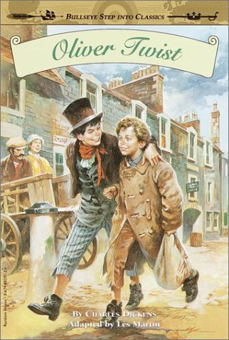
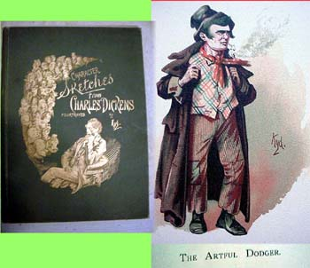
The Life of the New Urban Poor: A Dickensian Nightmare!

Slide 20
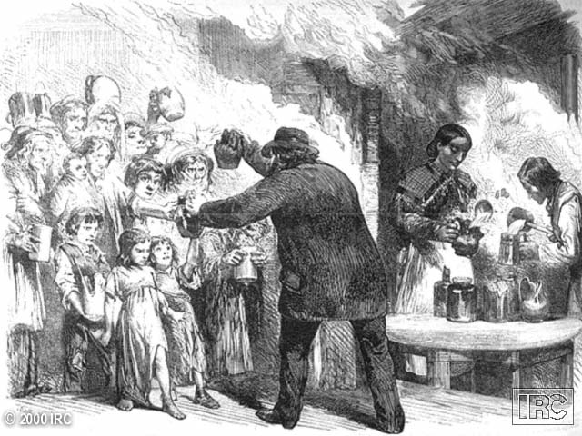
Private Charities: Soup Kitchens

Slide 21
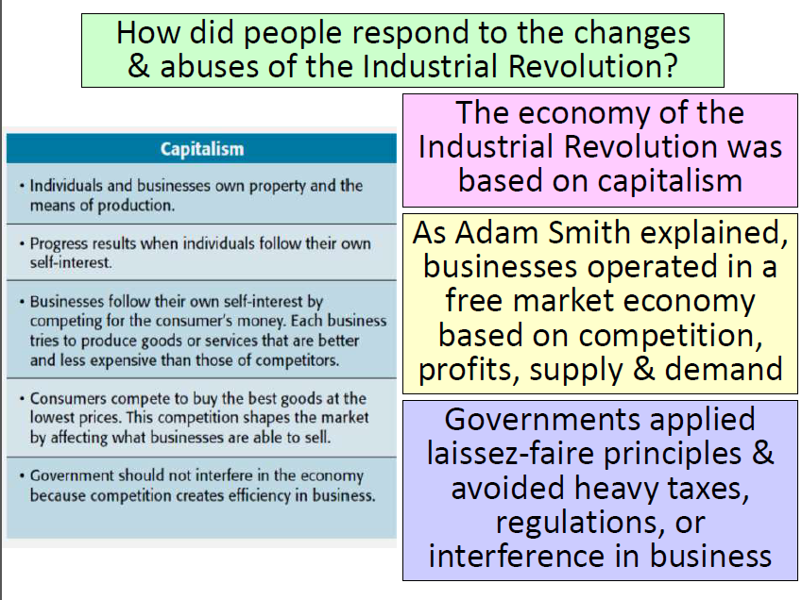

Slide 22
