Slide 1
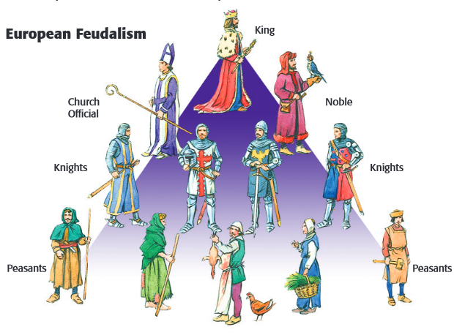
Feudalism
Form of government based on
landholding
Few Promises in Feudalism
Alliances between lords and vassals
Oaths of loyalty in exchange for land and military service
Ranking of power and authority

Slide 2
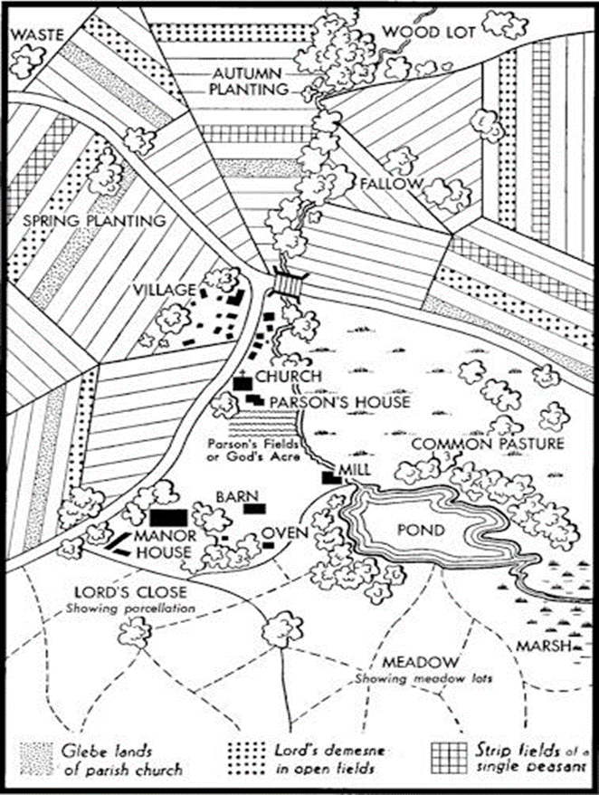
Manorialism
Set of rights and obligations between serfs and lords
Manor Lord’s estate
M – Manor
E- Economically
S- Self
S- Sufficient

Slide 3
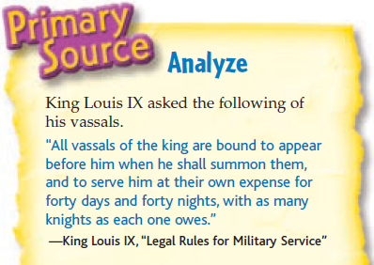
Vassal
Person receiving a fief
Who pledges allegiance to the lord and is protected by them in return.

Slide 4
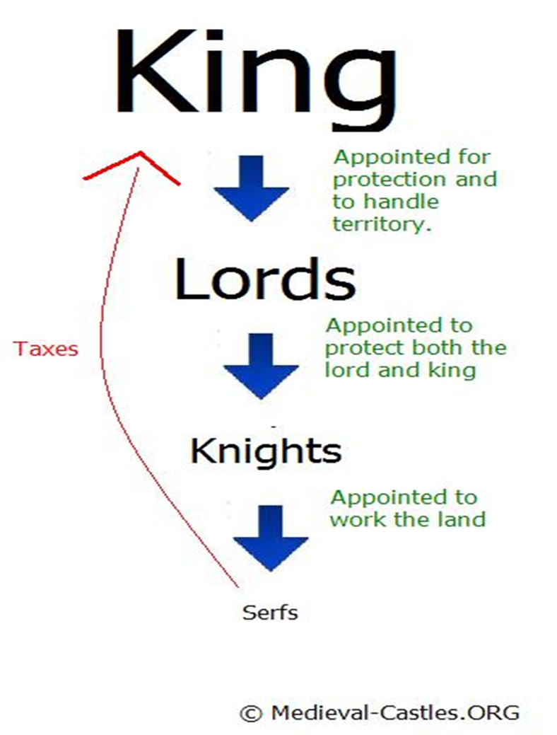
Lord
Lived on manors in castles
Included powerful clergy
Hunted, defended manor, oversaw serfs, & settled legal disputes

Slide 5
Serf
Freeman paid lord for use of land called a fief
Serfs worked the land for the lord
Serfs were poor & prisoners of the manor
Not slaves but bound to the land

Slide 6
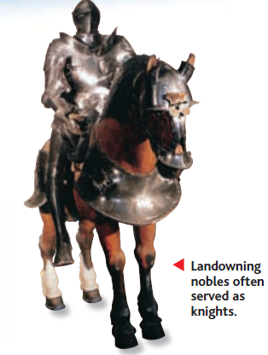
Knight & Chivalry
defend the “3 masters”
your Lord God,
your feudal lord,
and your lady;
- protect the weak / poor.
Warriors - Follow Code of Chivalry
Trained warriors who studied warfare from the age of 7
Exchanged military service for fief (an estate granted by a lord)

Slide 7
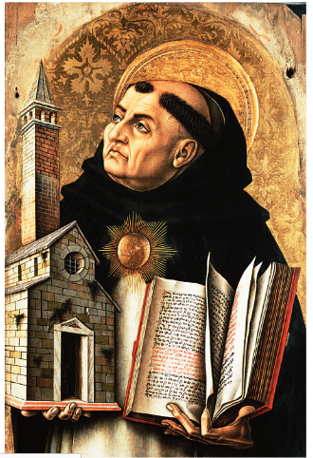
The Roman Catholic Church
Unifying force of Christian Faith
Power over people’s everyday lives
Involvement in political affairs
Central Government had collapsed but the church remained strong.

Slide 8
Sacraments
Religious ceremonies – offered through the Roman Catholic Church
Rites paved the way for achieving salvation
ex. baptism

Slide 9
Secular
Worldly concerns rather than concerns with spiritual matters
Power involved in politics

Slide 10
Lay investiture
Ceremony in which kings and nobles appointed church officials

Slide 11
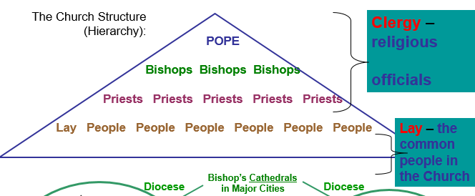
Clergy
Religious officials

Slide 12
Canon Law
Laws of the Christian Church
- Two types of punishment:
Of an individual = Excommunication
Of a community / region = Interdict

Slide 13
Crusade
In 1095, Pope Urban II called for a crusade, or HOLY WAR, against the Muslims to re-obtain the Holy Land.
For almost 200 years – from 1096 to 1291-
European crusaders went to the Holy Land

Slide 14
Reconquista
Effort by the Christians leaders to drive Muslims out of Spain
Lasting from 1100s until 1492

Slide 15
Inquisition
Tribunal held by the church to suppress heresy
Heretics were people whose religious beliefs differed from the teachings of the Church.

Slide 16
guild
Guilds: association of people who worked at same occupation

Slide 17
Vernacular
Everyday language of the burghers ( town dwellers) and other scholars and writers during the middle ages

Slide 18
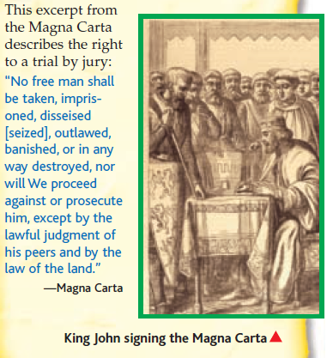
Magna Carta
King John -Raised taxes to pay for wars
Nobles forced John to sign the Magna Carta in 1215
First time a king’s power was limited
Guaranteed basic rights to citizens
no taxation without representation, a jury trial, and the protection of the law

Slide 19
Hundred years war
Why? - England’s Edward III claimed the throne of France
Who? – English vs. French
English won because of long bows and archers
End of chivalric warfare / Rise of Nationalism

Slide 20
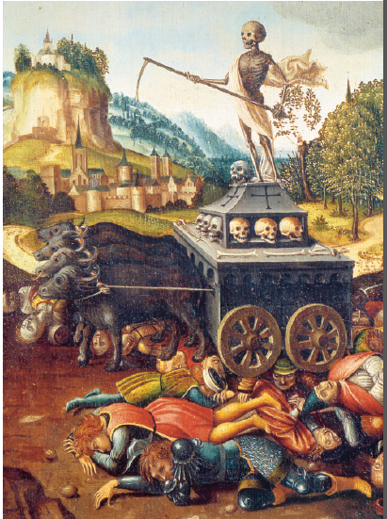
Bubonic Plauge
Began in Asia – Spread to Europe over the silkroad by Fleas and rats that were carried by merchants
1/3 population died, 25 million
Jews were blamed

