Slide 1
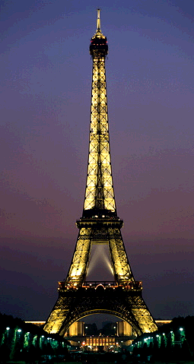
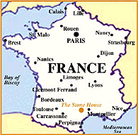
ABSOLUTISM IN FRANCE
By the late 1600s, France had replaced Spain as the most powerful European nation.

Slide 2
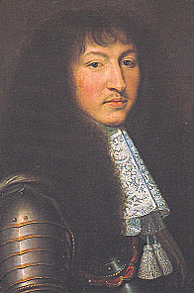
Louis XIV
Country: France
Years: 1643 – 1715 (72 years!)
Achievements: Called himself the “Sun King” and said “I am the state.” Strengthened the monarchy, expanded bureaucracy, built palace of Versailles, strongest army in Europe, made France a wealthy cultural center.
Downfalls: He used the wealth for his own benefit, peasants starved, numerous wars, never called Estates General. The French monarchy would not survive long after Louis’ death.

Slide 3
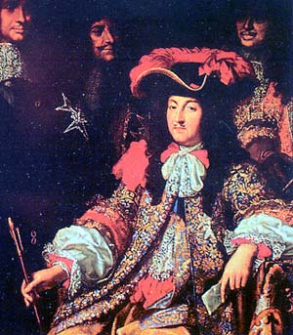
Louis XIV of France provided a model
for other absolute monarchs. Under
his rule, the king’s command was
law. As the monarch said, “L’etat
C’est moi” or “I am the state.”

Slide 4
A Centralized Government
Louis XIV centralized the French government or created one, strong government to rule France.
He appointed officials to collect taxes.
He increased the size of the French army.
Every soldier in the French army wore the uniform of France.

Slide 5
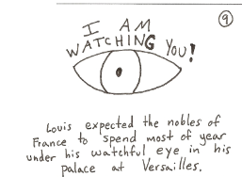
To control France’s
nobles, Louis XIV
built a huge palace
at Versailles.

Slide 6
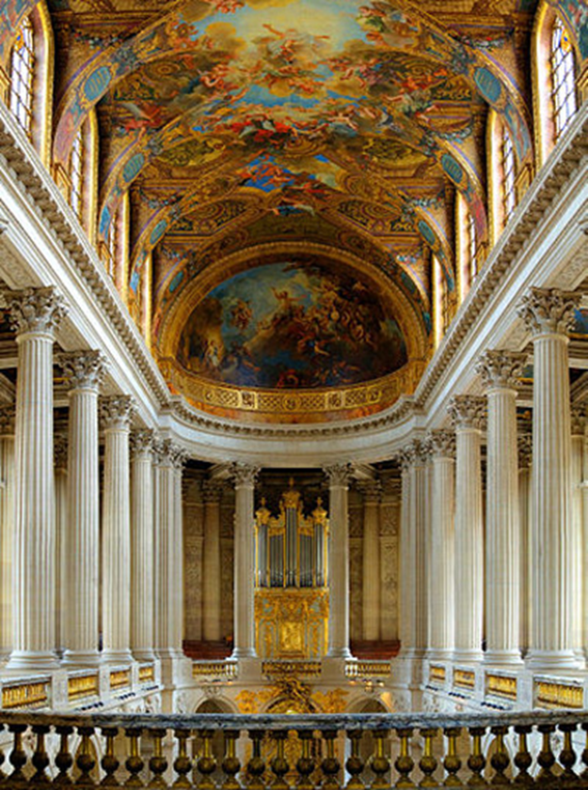
Versailles
By closely monitoring nobles, Louis XIV could try to prevent rebellions against his regime.

Slide 7
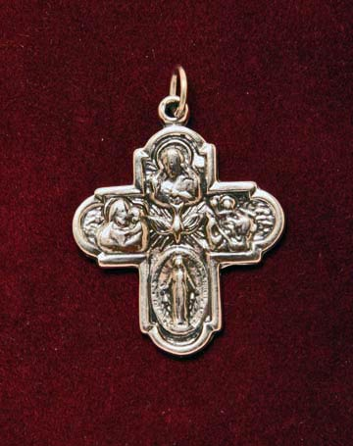
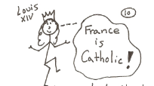
Louis XIV also demanded that French
Protestants convert to Catholicism or
leave France!

Slide 8
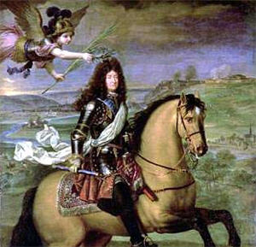
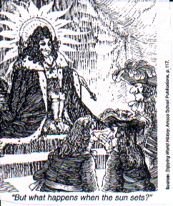
Louis XIV chose the sun as his
emblem. The sun gave life
to all things and regulated everything
as it rose and set. Like the sun,
life in France revolved around the king.

