Slide 1
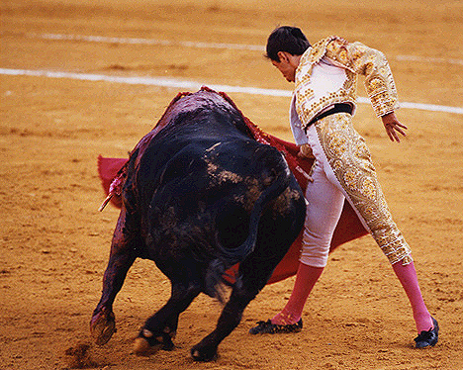
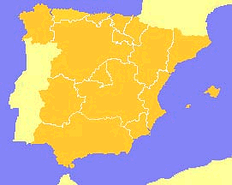
ABSOLUTISM
IN SPAIN
In the 1500s Spain was the most powerful nation in Europe.

Slide 2
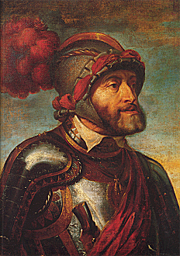
Charles V
Country: Spain (Holy Roman Empire)
Years: 1519 - 1556
Achievements: Ruled over Spain, Austria and the Netherlands as Holy Roman Emperor.
Downfalls: Large diverse empire with many threats: Turks, French, and German Protestant princes. Exhausted, he gave up his titles and divided his empire in 1556. His brother Ferdinand became Holy Roman Emperor, and his son Philip II ruled Spain, the Netherlands, and the vast Spanish overseas empire.

Slide 3
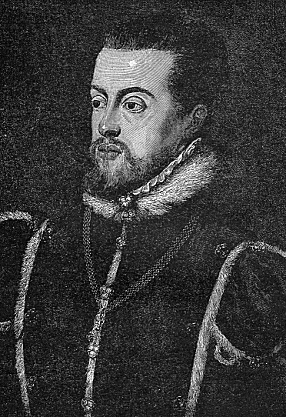
Phillip II
Country: Spain
Years: 1556 - 1598
Achievements: Hard-working ruler who ushered in the Golden age of Spain – the most powerful nation. He also Helped the Catholic Church persecute Protestants during the Counter-Reformation.
Downfalls: Spanish armada defeated by England. After Philip II Spanish power slowly declined as rulers taxed people too much and spend money on overseas wars.

