Slide 1
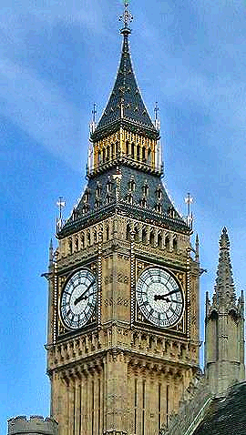
ABSOLUTISM
IN ENGLAND
While other nations turned to absolutism in the 1500s and 1600s, England’s Parliament resisted the throne.

Slide 2
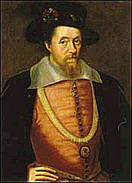
James I
Country: England
Years: 1603 - 1625
Achievements: Translated the bible, the famous King James version.
Downfalls: Had difficulties with Parliament – he needed money for his wars and extravagant lifestyle. He eventually dissolved Parliament and imposed his own taxes. Fought with the Puritans, who were seeking to purify the Church of England.

Slide 3
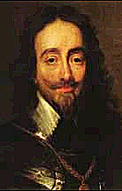
Charles I
Country: England
Years: 1625 -1649
Achievements: Strong army, seized nations.
Downfalls: He put his enemies in prison without trials, high taxes, angered Puritans, he dissolved Parliament and had to call them back because he needed the money. This led to the English Civil War. He was put on trial and beheaded by Parliament in 1649.

Slide 4
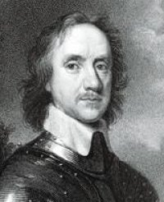
Oliver
Cromwell
Cromwell was the skilled military commander who won the civil war and captured Charles I. Charles I was the first king ever to be tried and executed by his own subjects. This event shocked other European monarchies and signified that absolutism would not be tolerated in England.

Slide 5
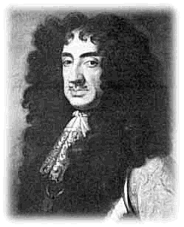
Charles II
Country: England
Years: 1660 - 1685
Achievements: Was asked to take the throne after several years of Puritan rule. He reopened theatres, dancing, and music.
Downfalls: Obeyed Parliament, limited monarchy, limited power.
Limited Monarchy - a government in which a legislative body limits the monarch’s powers.

Slide 6
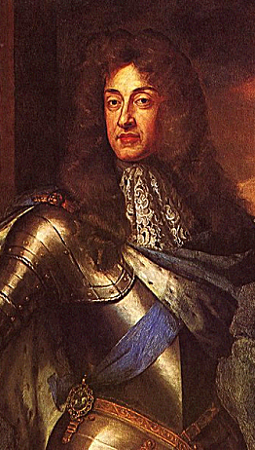
James II
Country: England
Years: 1685 - 1688
Achievements: reinstated absolutist policies.
Downfalls: Parliament feared a return to Catholic dominance and asked James’ daughter and son-in-law, William and Mary, to take the throne. When they arrived from France James II fled, completing a bloodless transfer of power, known as the Glorious Revolution.

Slide 7
James II
English Bill of Rights – a set of acts passed by Parliament to ensure its superiority over the monarchy. It stated:
King must work with Parliament
House of Commons has financial control
Abolished excessive fines and cruel and unusual punishment
Affirmed habeas corpus – no person could be held in jail without first being charged with a crime.
Toleration Act of 1689 – Granted Protestant dissenters, such as Puritans and Quakers, limited toleration (not for Catholics though).

