Slide 1
Mohandas Gandhi
In this lesson, students will be able to define the following terms:
Gandhi’s Policy of Nonviolence
Civil Disobedience
The Salt March
The Boycott of British Cloth
The Creation of Pakistan

Slide 2
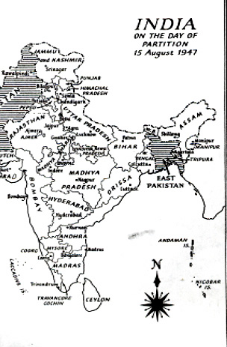
India was the first
major country to
achieve
independence in
the post-war period.
Indians had long
been resisting
British rule.

Slide 3
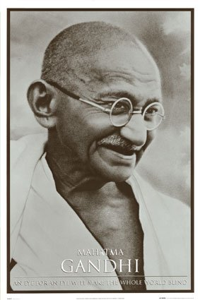
Mohandas Gandhi was
the leader of India’s
independence
movement. He was
an Indian lawyer who
had been educated in
England. Having the
unique ability to appeal to
ordinary citizens and the
educated elite,
he united many Indians.

Slide 4
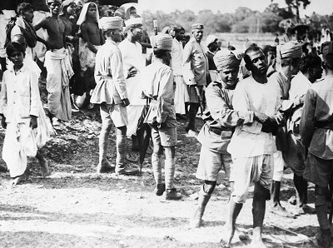
Gandhi believed that British imperialism
was wrong and that Indians should refuse
to cooperate with the British imperialists.
However, he also believed that violence
was wrong. He encouraged his followers
to engage in nonviolent protests.

Slide 5
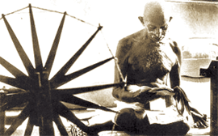
Gandhi encouraged a policy of nonviolent
noncooperation. By refusing to obey the
unjust laws of the imperialists and refusing
to buy British products, Indians could
change the policies of imperialists.
As Gandhi said, “Real noncooperation is
noncooperation with evil and not the
evildoer.”

Slide 6
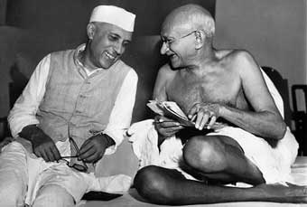
Gandhi believed that the use of violence
was always wrong. He believed that
the only way to change a wrongdoer
was to show the wrongdoer the error of
his ways. As Gandhi said, “An eye for
an eye and the whole world is blind.”

Slide 7
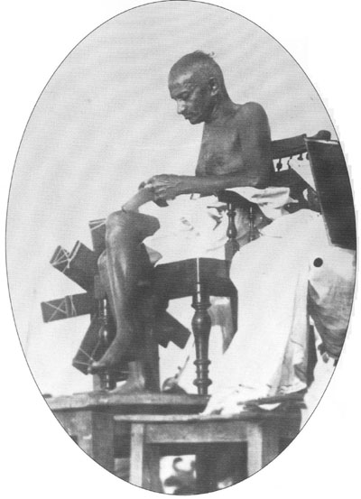
Gandhi encouraged
Indians to boycott or
refuse to buy British-
made cotton goods or
cloth. He encouraged
Indians to make their
own homespun cloth.
He wanted Indians to
support the Indian
economy not the British
economy.

Slide 8
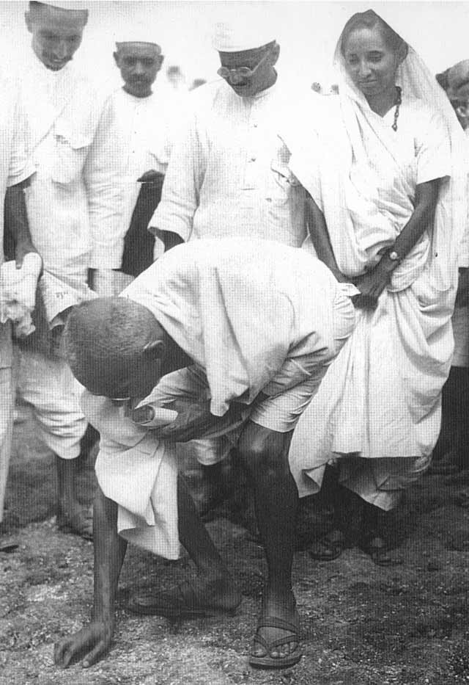
Gandhi also urged
Indians to disobey
unjust British laws.
The refusal to obey
unjust laws and the
willingness to face the
consequences is called
Civil Disobedience.
The making of illegal
salt was an example
of Civil Disobedience.

Slide 9
Of course, it is difficult to govern
a colony where the colonial
subjects refuse to obey the laws.

Slide 10
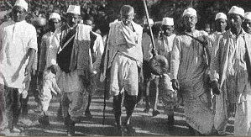
The British taxed salt production in
India. In 1930, Gandhi led the Salt
March to protest the British salt tax.
Indians illegally made salt. They
refused to obey the
law.

Slide 11
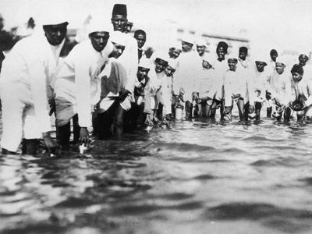
During the Salt March, Gandhi
and his followers marched to
the sea.

Slide 12
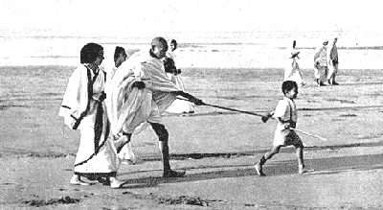
They marched to the sea to
make salt. It was against the
law to make salt.

Slide 13
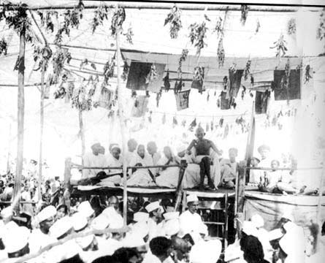
Thousands of Indians were
imprisoned.

Slide 14
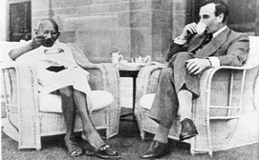
Slowly, the British began to
realize that it was time to
leave India.

Slide 15
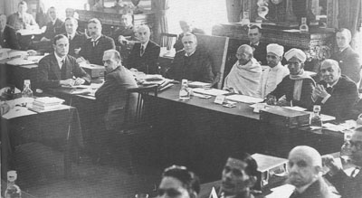
Gandhi’s vision for an independent
India included justice for all. He
wanted to improve the lives of
untouchables. He wanted to raise
the standard of living. He wanted
all Indians to live together in harmony.

Slide 16
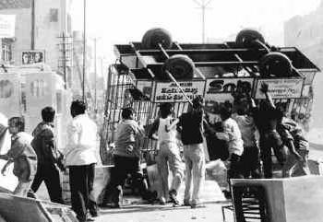
The British delayed granting independence
because of the threat of violence between
India’s Hindu and Muslim populations.
When independence was finally granted,
India was partitioned or divided into two
separate nations: India became a Hindu
nation, while Pakistan became a home
for Muslims.

Slide 17
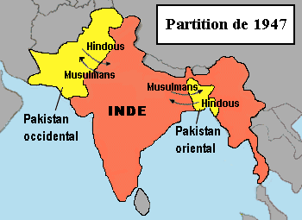
Because there were large Muslim
populations in both the east and west
of British India, Pakistan became a
divided nation-separated by over
a thousand miles.

Slide 18
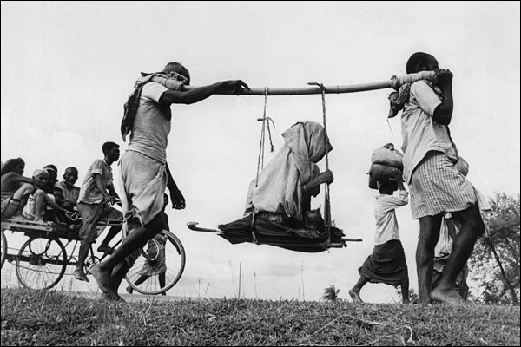
India gained its independence in 1947
but the massive exchange of population
that took place led to violence and death.
Gandhi’s vision of a peaceful, free India
was not fully realized.

Slide 19
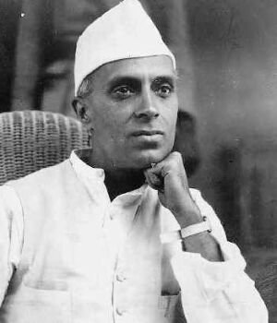
Jawaharlal Nehru became the
first prime minister of an
independent India.

Slide 20
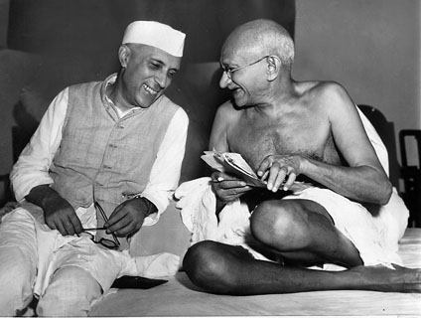
Nehru pursued a policy of
nonalignment or neutrality
during the Cold War.

Slide 21
Questions for Reflection:
Who was Mohandas K. Gandhi and what did he believe?
What is nonviolent noncooperation?
How did the boycott of British cloth hurt British imperialists?
What is civil disobedience and provide an example of civil disobedience?
What happened to India upon achieving independence?

