Slide 1
Napoleon
In this lesson, students will be able to define the following terms:
Napoleon Bonaparte
Invasion of Russia
Waterloo
Napoleon’s Impact

Slide 2
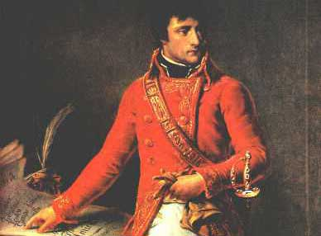
Napoleon Bonaparte (1769-1821)
came from a family of lower nobility
but was sympathetic to the ideals of
the French Revolution.

Slide 3
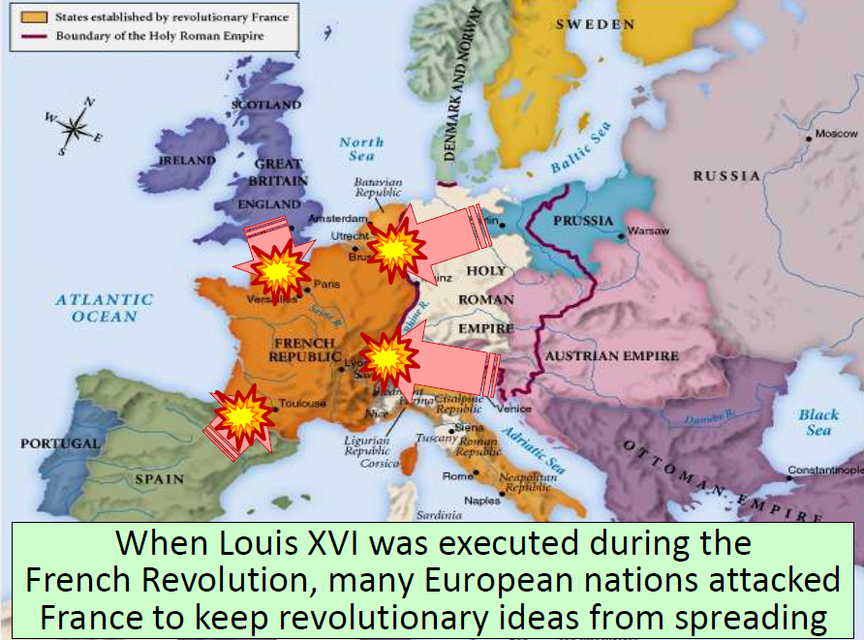

Slide 8
Power
Napoleon came to power at the end of the Revolution, when France was still at war.
Napoleon was a gifted general. Under his command, French armies defeated many enemies.
In 1799, Napoleon became a dictator of France and eventually crowned himself emperor.

Slide 9
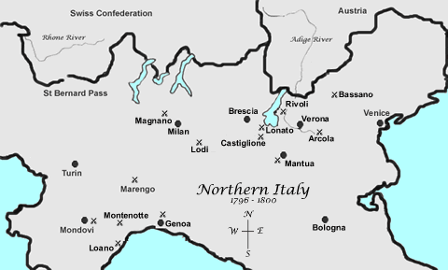
Napoleon’s Rise to Power
Earlier military career → the Italian Campaigns:
1796-1797 → he conquered most of northern Italy for France, and had developed a taste for governing.
In northern Italy, he moved to suppress religious orders, end serfdom, and limit age-old noble privilege.

Slide 10
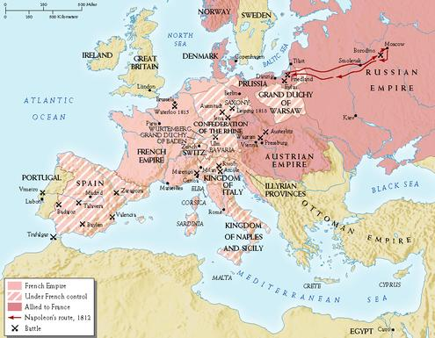
Napoleon had defeated all of the other
European powers except England, and
had created a French empire covering
much of Europe.

Slide 12
Napoleon
sold the
Louisiana
Territory
to the
United
States in
1803.
He also
weakened
Spain.

Slide 13
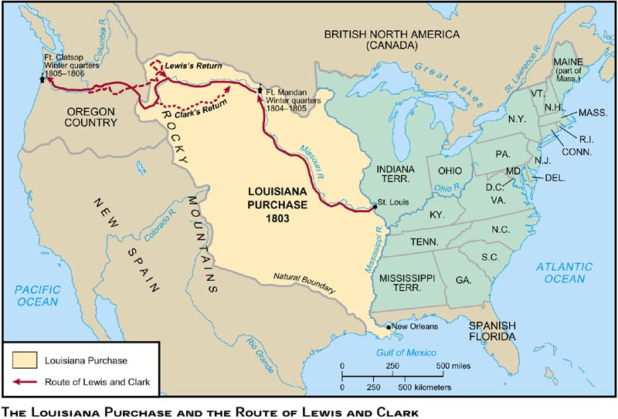
Louisiana Purchase, 1803
$15,000,000

Slide 14
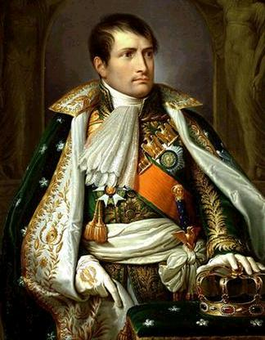
Napoleon Bonaparte tried to combine
the social reforms of the French Revolution
with his own absolute power.

Slide 15
Napoleon’s Impact
The Code of Napoleon, a law code, favored social equality, religious tolerance, and trial by jury.
Napoleon introduced the ideas of the French Revolution to the lands he seized.
French rule encouraged nationalism. Spain lost its Latin American empire.

Slide 16
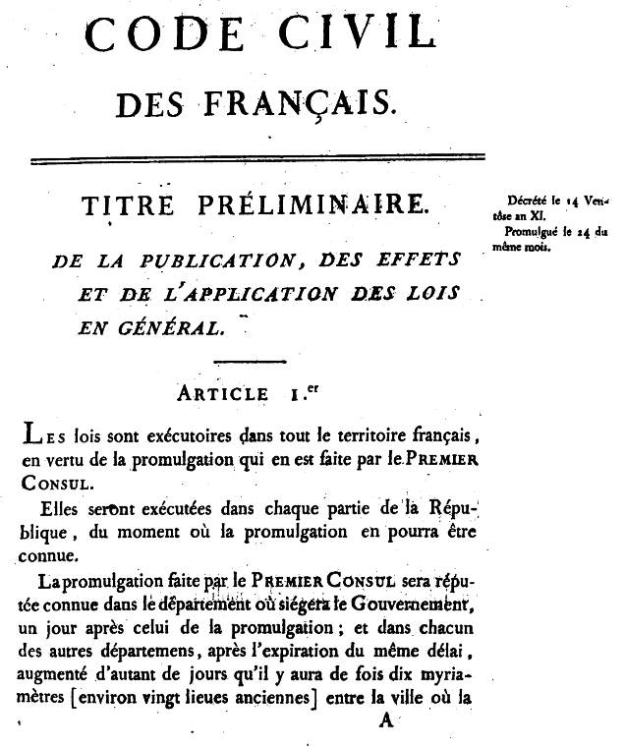
Code Napoleon, 1804
It divides civil law into:
Personal status.
Property.
The acquisition of property.
Its purpose was to reform the French legal code to reflect the principles of the Fr. Revolution.
Create one law code for France.

Slide 18
United Against Napoleon
Napoleon’s ambition united Europe against him.
In 1812, Napoleon invaded Russia with an army of half a million men.
The Russians burned their own crops and buildings as they retreated, depriving the invaders of food and shelter.

Slide 19
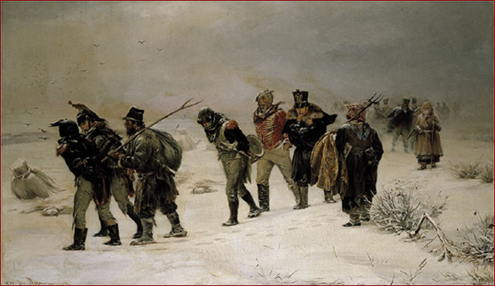
By the time Napoleon reached Moscow,
he found the city in ruins, set on fire
by the Russians.

Slide 20
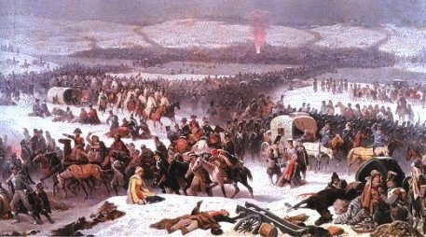
In bitter winter weather, Napoleon’s
army retreated. Less than one in ten
men survived the homeward march.

Slide 21
The Downfall of Napoleon
After Napoleon’s defeat in Russia, the other European powers combined to overthrow him.
After invading France, the foreign powers brought the old French royal family back to power in 1814.

Slide 22
Napoleon Abdicates!
Allied forces occupied Paris on March 31, 1814.
Napoléon abdicated on April 6 in favor of his son, but the Allies insisted on unconditional surrender.
Napoléon abdicated again on April 11.
Treaty of Fontainbleau → exiles Napoléon to Elba with an annual income of 2,000,000 francs.
The royalists took control and restored Louis XVIII to the throne.

Slide 23
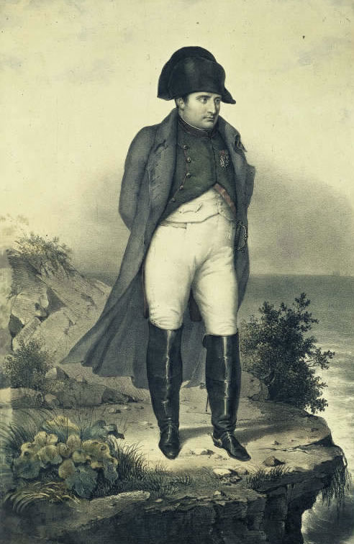
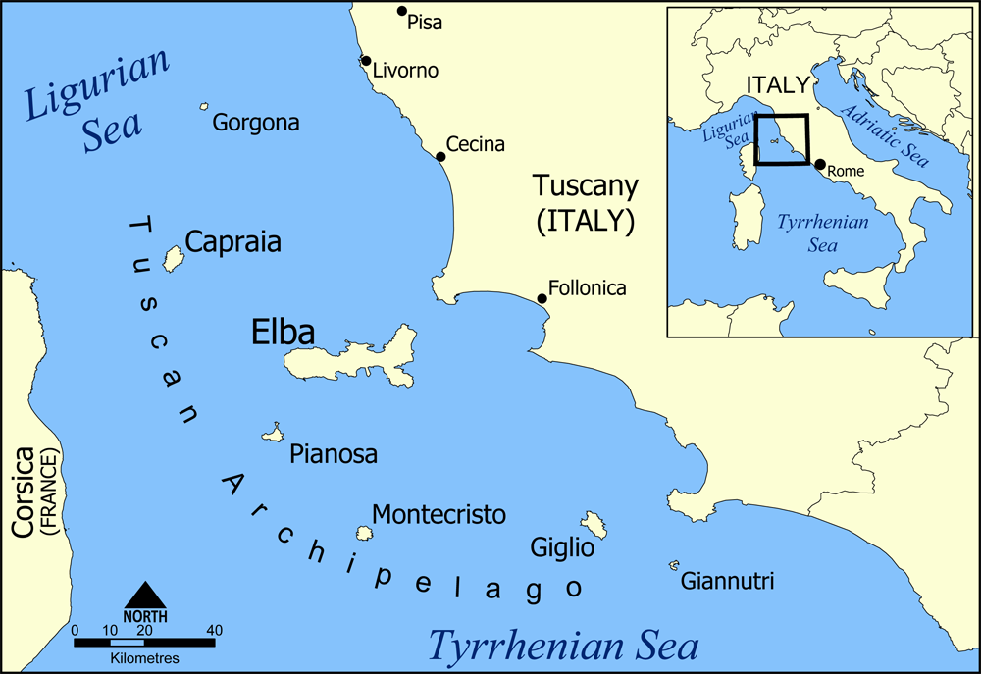
Napoleon in Exile on Elba

Slide 24
The
"Hundred Days"
(March 20 - June 22, `1815)

Slide 26
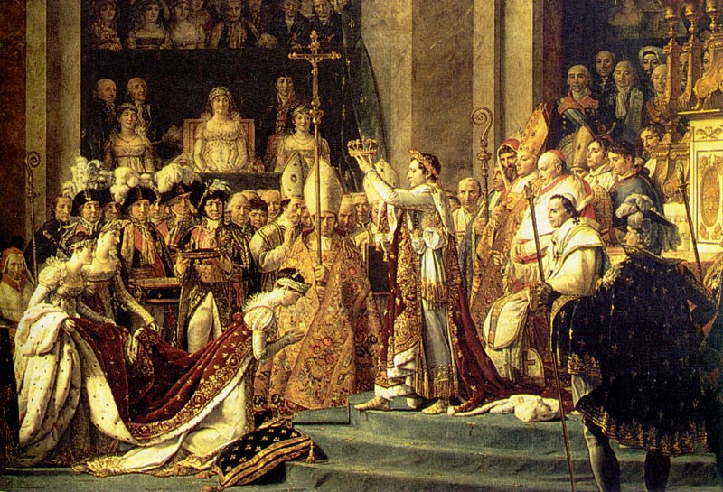
Although Napoleon had ruled France for
only fifteen years, he had an enormous
impact on France and the rest of the world.

Slide 28
Questions for Reflection:
Who was Napoleon Bonaparte and how did he rise to power?
What were the achievements of Napoleon Bonaparte?
Why did his invasion of Russia fail?
What was the Battle of Waterloo and what was its significance?
How did Napoleon’s political career alter world history?

