Slide 1
New Inventions of the
Industrial Revolution

Slide 2
The Spinning Jenny—James Hargreaves
Could spin up to eight threads at time
Turn a crank to spin thread
Much faster than the spinning wheel
First invention to be used in textile factories
Notes:
2

Slide 3
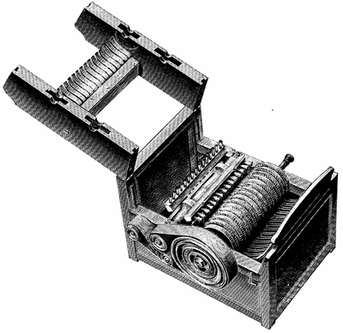
The Cotton Gin—Eli Whitney
Removed seeds from raw cotton
Multiplied amount of cotton that could be cleaned

Slide 4
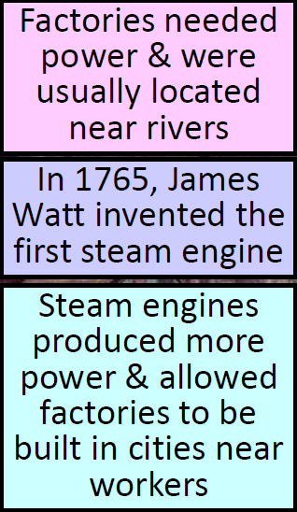
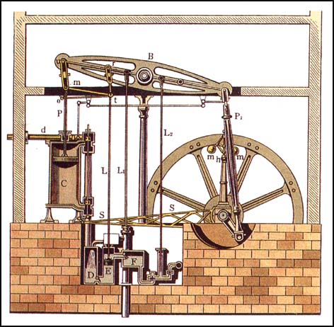
The Steam Engine- James Watt
Ran faster, more efficiently while burning less fuel

Slide 5
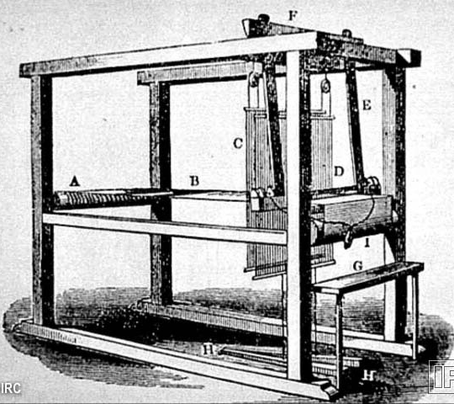
Flying Shuttle—John Kay
Key invention in weaving
Allowed for automatic machine looms and wider materials

Slide 6
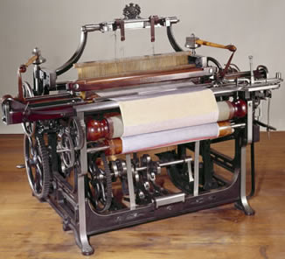
The Power loom- Edmund cartwright
Run by water power.
Sped up weaving

Slide 7
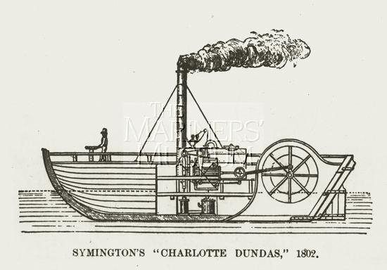
The steam ship-
Robert Fulton

Slide 8
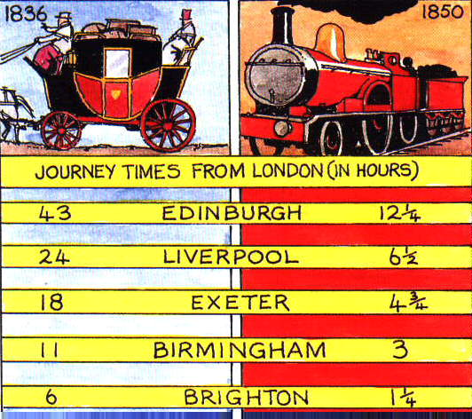
The Steam locomotive – Richard trevithick

Slide 9
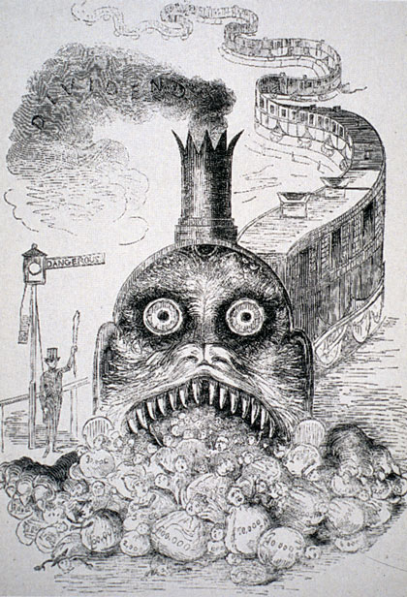
Railroads of England revolutionized society:
Cheap way to transport goods
new job opportunities for railroad workers and miner
boosted fishing and agriculture
easier travel
changed peoples lives- commuting to work

Slide 10
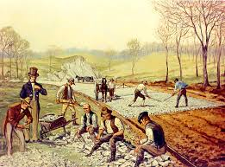
Macadam roads turnpikes
– John McAdam
Large stones for drainage topped with smooth layer of crushed rock
Even in rainy weather heavy wagons could travel without sinking in the mud
Notes:
10

