Slide 1
The Cold War

Slide 2
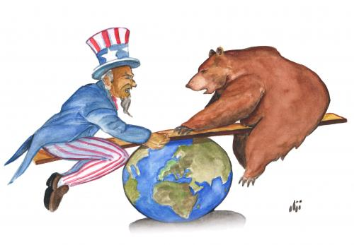
By the end of World War II, the
United States and the Soviet Union
were the most powerful nations in
the world.

Slide 3
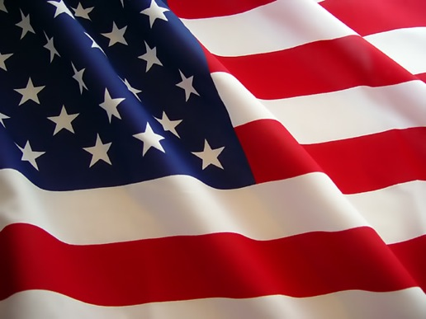
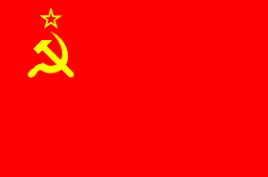
The U.S.A. and the U.S.S.R.
were the world’s superpowers.

Slide 4
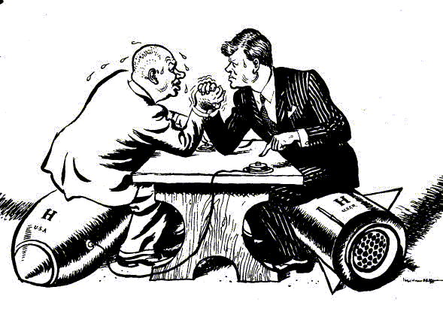
However, these two nations
were founded on opposing
ideologies.

Slide 5
Crumbling Alliances

Slide 6
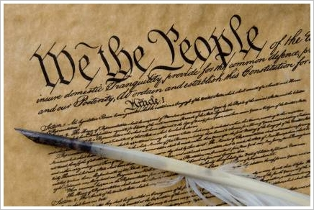
Americans advocated democracy
and free trade developing
capitalist economies modeled
After the U.S.A.

Slide 7
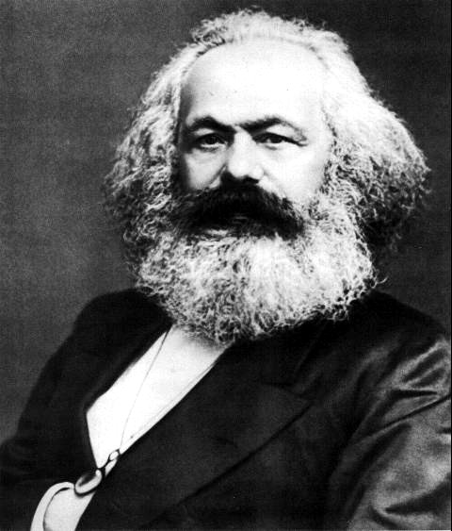
The Soviet Union advocated
communism and the ideas of Karl Marx and developed a government modeled after the U.S.S.R.

Slide 8
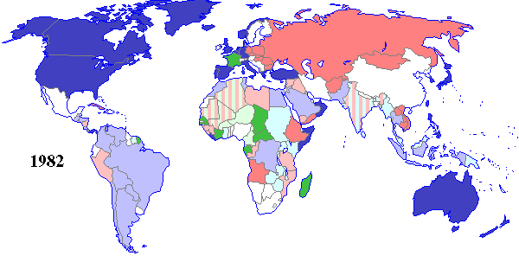
The COLD WAR (1960-1991)
U.S.A. AND ALLIES SOVIET UNION

Slide 9
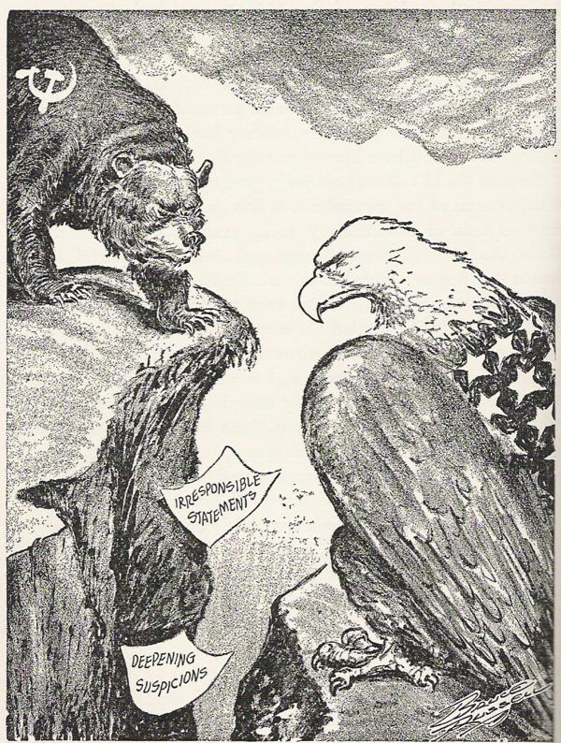
Origins of the Cold War
http://www.youtube.com/watch?v=HpYCplyBknI
Start of the Cold War
Time: 9:55 min.

Slide 10
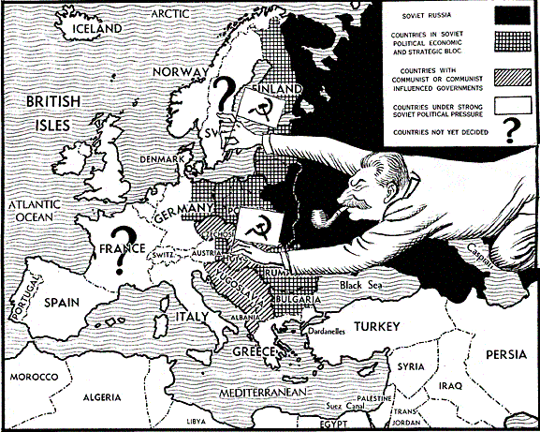
The Soviets wanted to spread
communism. They created
communist regimes in Eastern Europe.

Slide 11
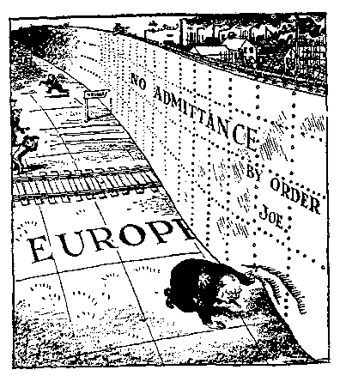
The Soviets were accused of
building an
“iron curtain” that
forced Eastern Europeans to
adopt communism.

Slide 12
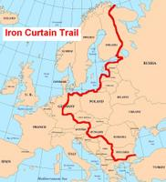

Slide 13
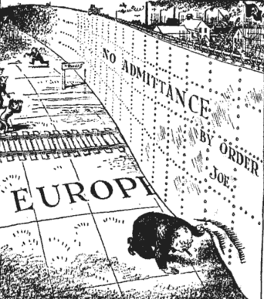
Cold War Heats Up
http://www.youtube.com/watch?v=S2PUIQpAEAQ
Churchill Iron Curtain Speech
Time: 3:11 min.

Slide 15
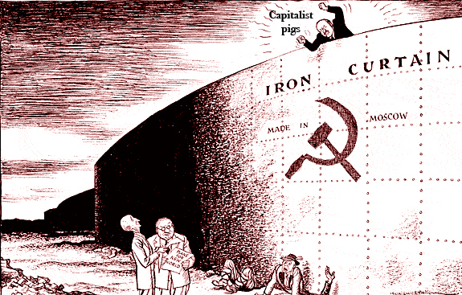

Slide 16
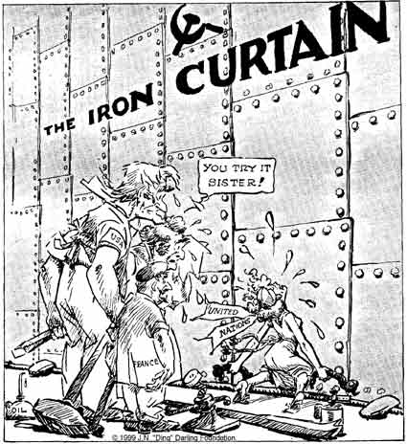

Slide 17
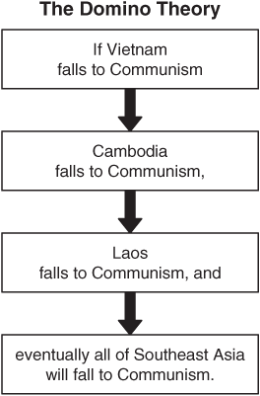
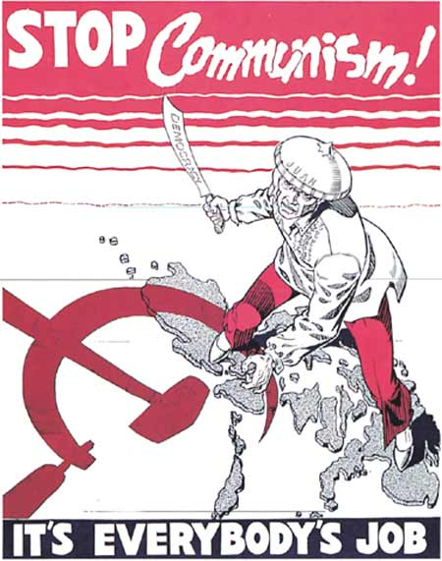
American officials believed
that they had a responsibility
to stop the spread of
communism.

Slide 18
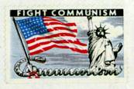
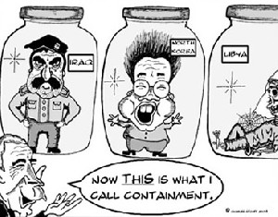
Containment was an American
policy to contain communism
or to prevent its spread.

Slide 19
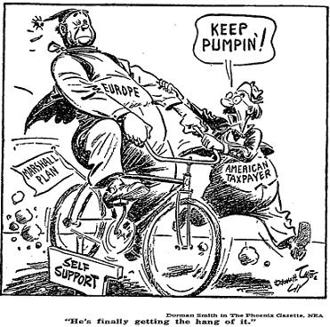
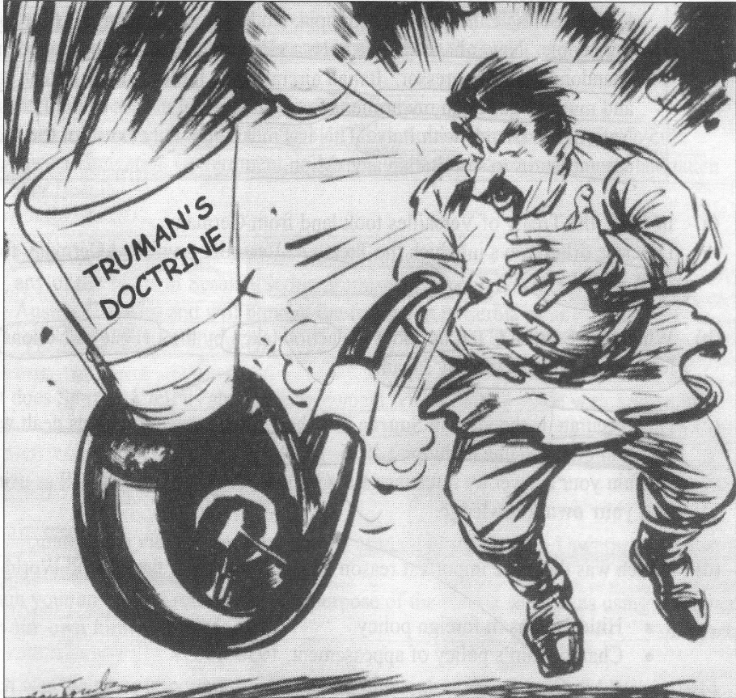
Of course, to stop the spread
of communism, Americans
needed to rebuild war-torn
Western Europe.

Slide 20
The Truman Doctrine
To promote democracy around the world and fight the spread of oppressive regimes in which a minority controls the majority.
“One of the primary objectives of the foreign policy of the United States is the creation of conditions in which we and other nations will be able to work out a way of life free from coercion.”

Slide 21
The Truman Doctrine
To help Greece and Turkey resist the rebellion of an armed minority.
“Should we fail to aid Greece and Turkey in this fateful hour, the effect will be far reaching to the West as well as to the East…the seeds of totalitarian regimes are nurtured by misery and want. They spread and grow in the evil soil of poverty and strife. They reach their full growth when the hope of a people for a better life has died.

Slide 22
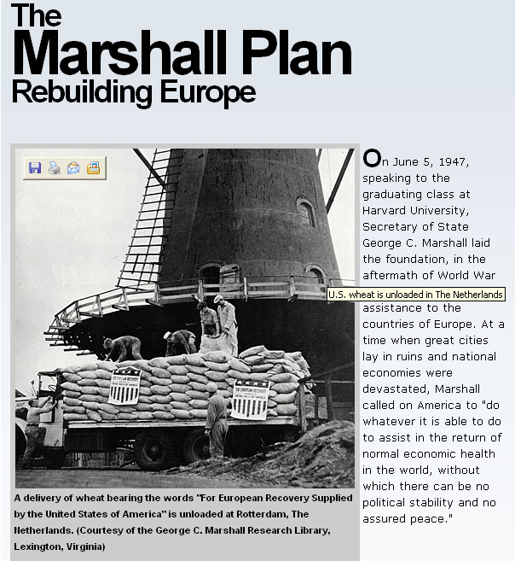
The U.S. Marshall Plan gave
aid to war-torn Europe. It
gave aid to rebuild Europe.

Slide 23
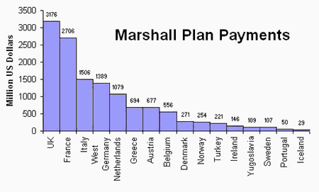
The Marshall Plan aided Western Europe.
Marshall presented a plan to offer extensive economic aid to all nations of Europe in June 1947. (Speech)

Slide 24
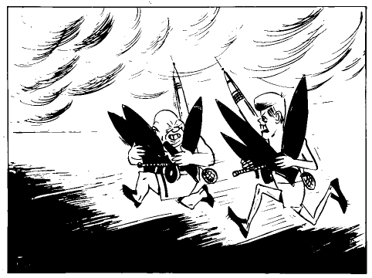
As American and Soviet distrust
of each other grew, an
arms race followed.

Slide 25
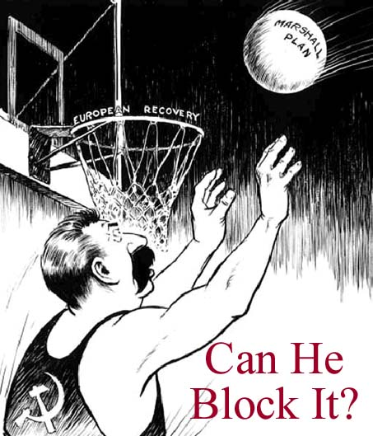
But even with the danger of
nuclear annihilation, conflicts
kept developing.

Slide 26
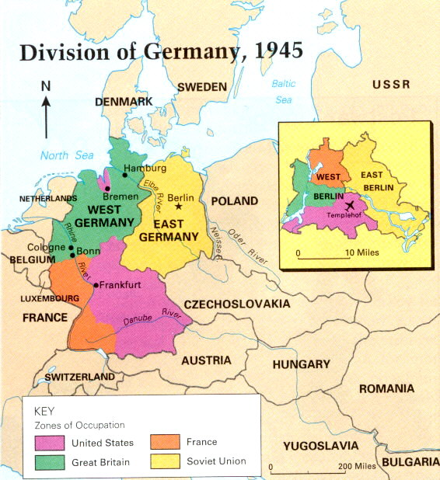
Germany, which had been
divided after the war,
became a source of conflict.

Slide 27
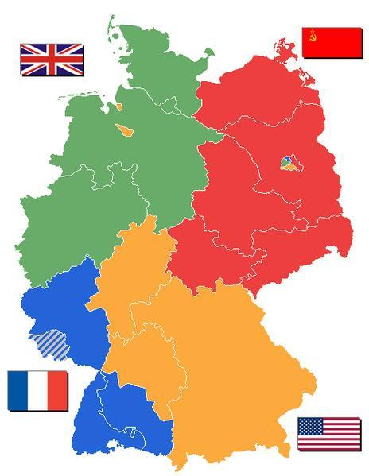

Slide 28
Cold War:A Divided Germany
They were accused of starting two world wars and Britain and France did not want to be invaded again.
The solution was to divide Germany, but how?
Germany was divided into Eastern (Communist) and Western Germany (Democracy).

Slide 29
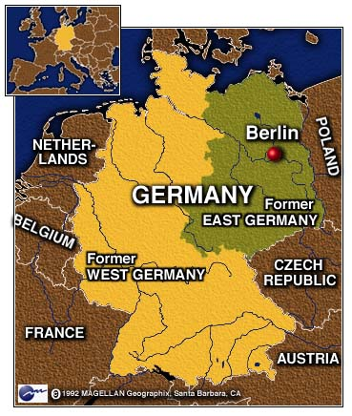
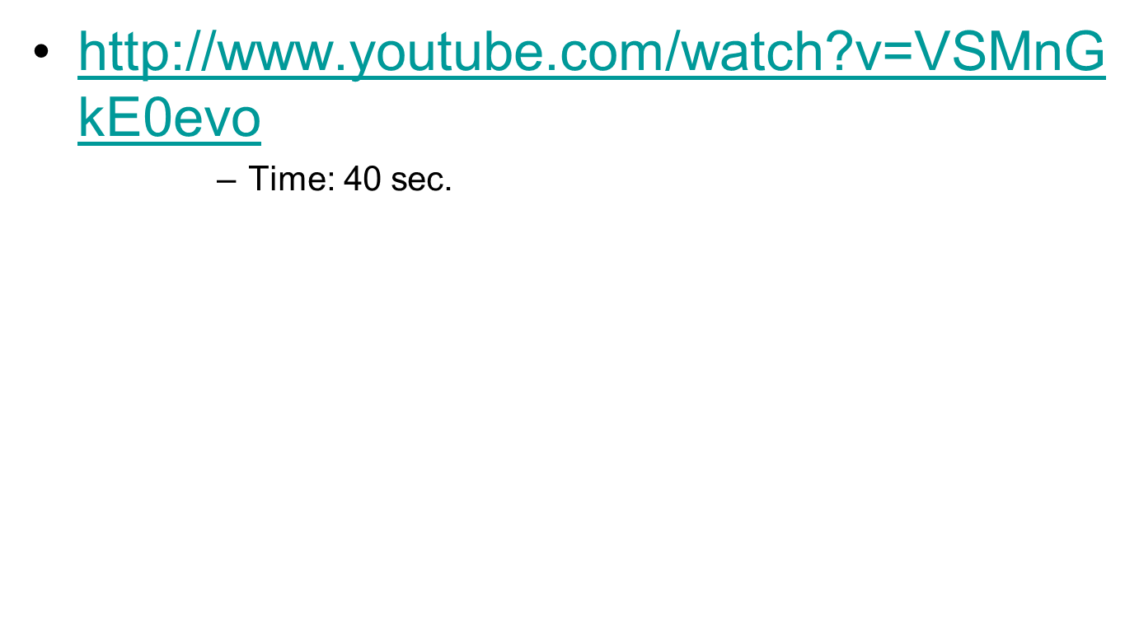
East Germany became a
communist nation and
West Germany was democratic.
As a compromise, the city of Berlin was divided into East and West Berlin.
West Berlin was controlled by the U.S.A.
East Berlin was controlled by the Soviet Union.

Slide 30
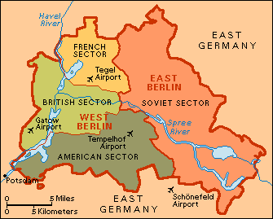
Even Berlin was divided although
it was located in East Germany.

Slide 31
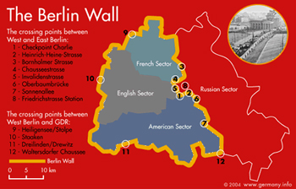

Slide 32
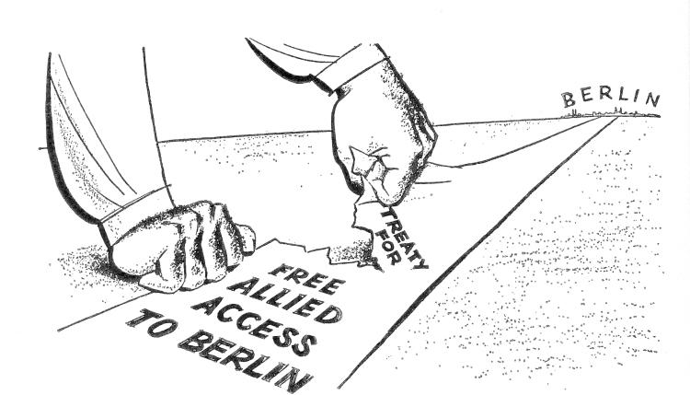
The Soviets blockaded
West Berlin in 1948 and 1949.
http://www.youtube.com/watch?v=ExOYvW5vCj4
Time: 3:33 min.

Slide 33
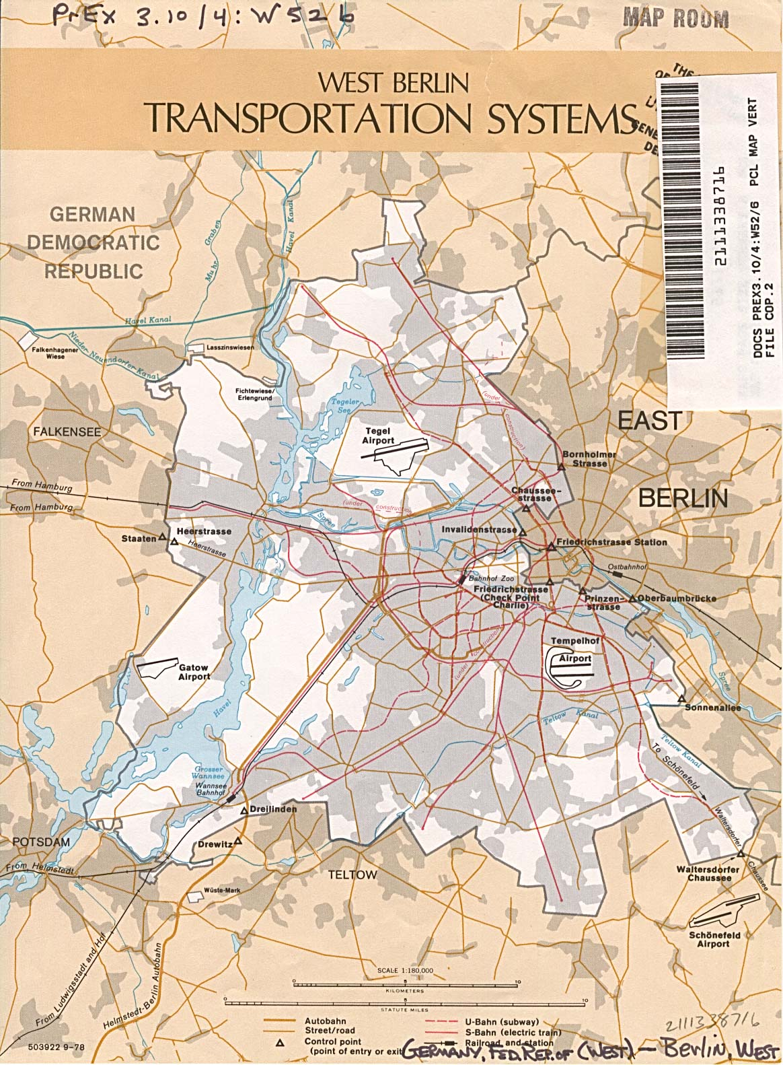
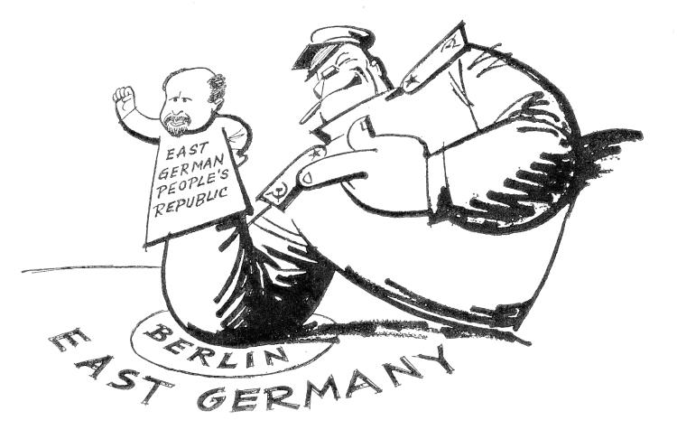
The Soviets blocked the roads
and rails. They tried to starve
the West Berliners into
submission.

Slide 34
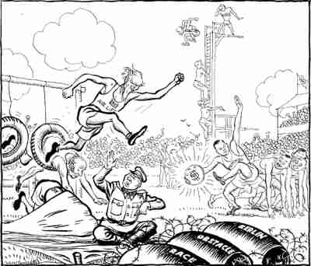
But an allied airlift parachuted
needed supplies and the
Soviets finally ended the blockade.
http://www.youtube.com/watch?v=fQ30Rgc5Prc
Time: 3:24 min.

Slide 35
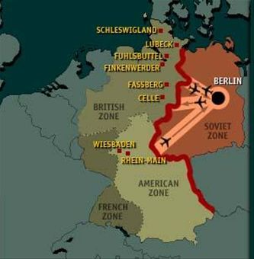

Slide 36
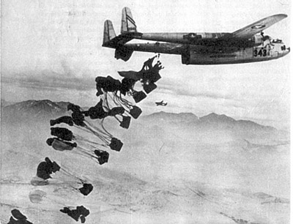

Slide 37
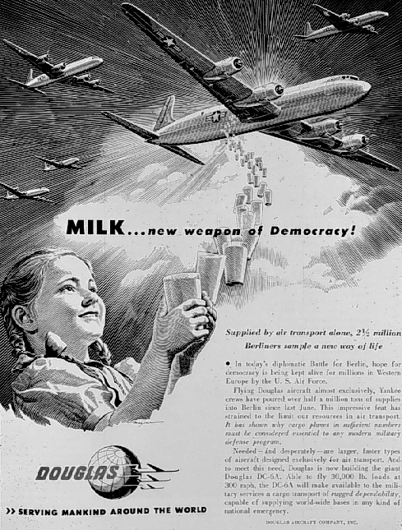

Slide 38
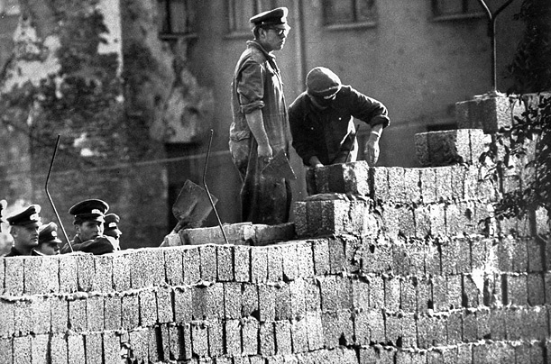
Notes:
One portion of the wall is being constructed

Slide 39
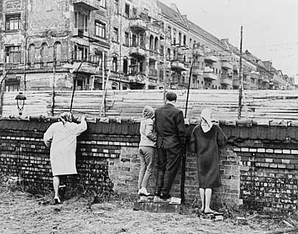
Notes:
People of West Berlin looking over the Wall

Slide 40
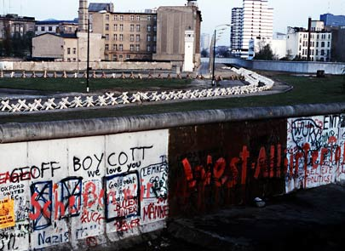
Notes:
West Berlin side of the Wall

Slide 41
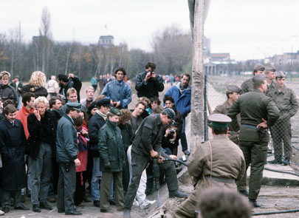

Slide 42
NATO
North Atlantic Treaty Organization
European and American countries make an alliance together to protect one another militarily in the event of an attack

Slide 43
Warsaw Pact
The Soviet Union retaliates by forming it’s own alliance with the satellite states surrounding the country

Slide 44
Yes, the Cold War changed
world history as tensions
between the superpowers
grew.

