Slide 1
The Ottoman Empire
In this lesson, students will be able to define the following terms:
Ottoman Turks
Istanbul
Suleiman the Magnificent
Cultural Diversity

Slide 2
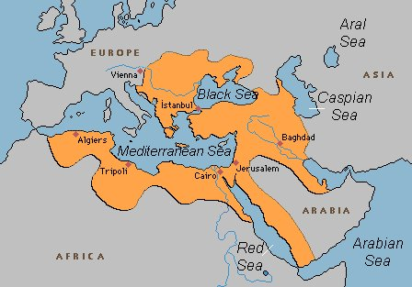
The Ottomans, a people from Central
Asia, became rulers of the Islamic
world in the 13th century. In 1453, they
conquered Constantinople.

Slide 3
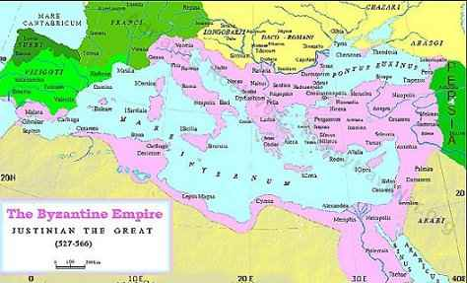
It is important to remember that
Constantinople was the capital of the
Byzantine Empire. It had a great
location for trade.

Slide 4
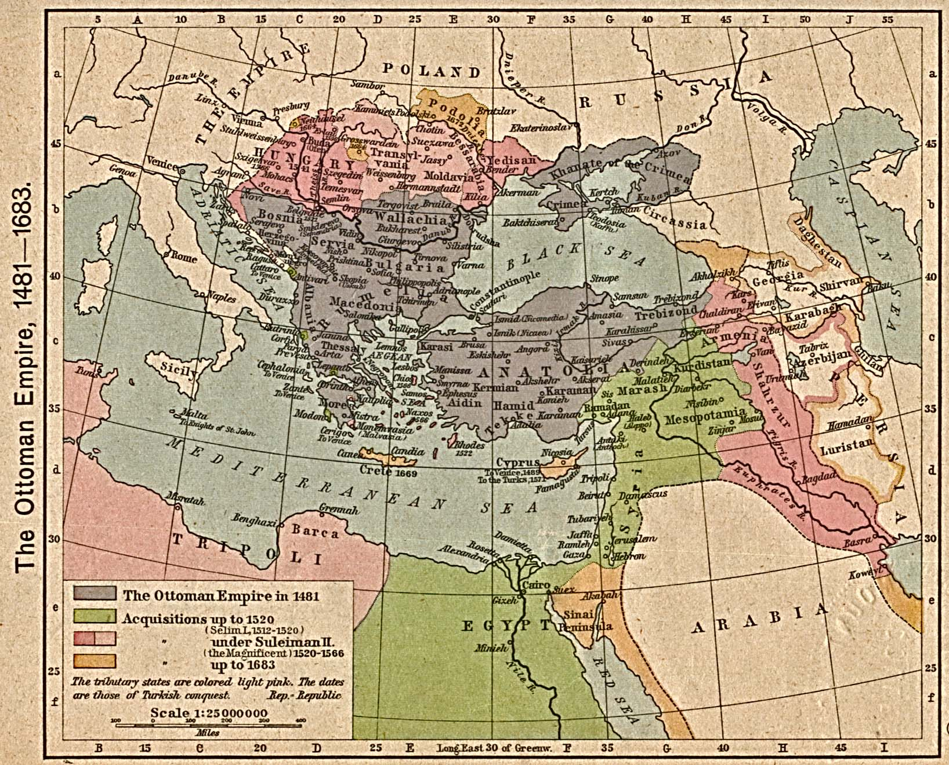
In 1453, the Ottomans conquered
Constantinople, the capital of the Byzantine
Empire.

Slide 5
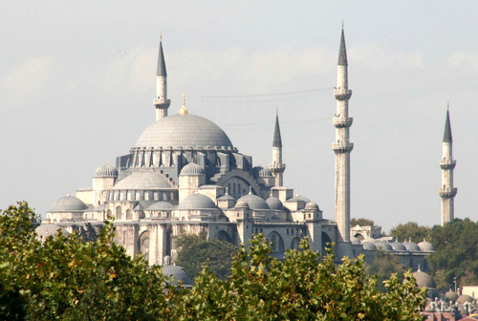
The Ottomans were Muslims. They
renamed Constantinople. The
Ottomans called the city, Istanbul.
It is still called Istanbul today.

Slide 6
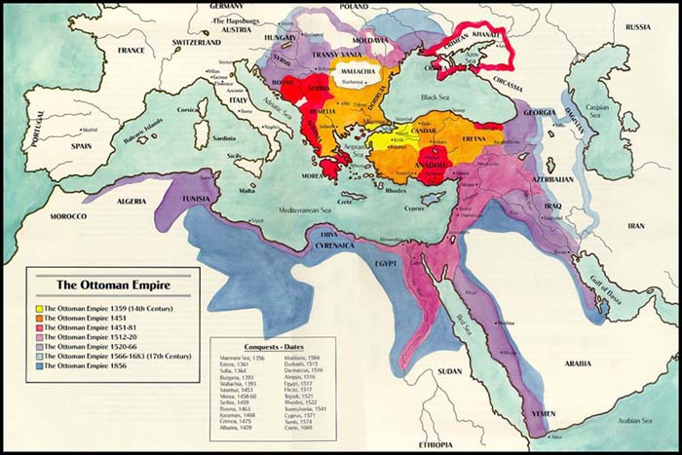
The Ottomans conquered most of the Muslim world, excluding Afghanistan
and Persia.

Slide 7
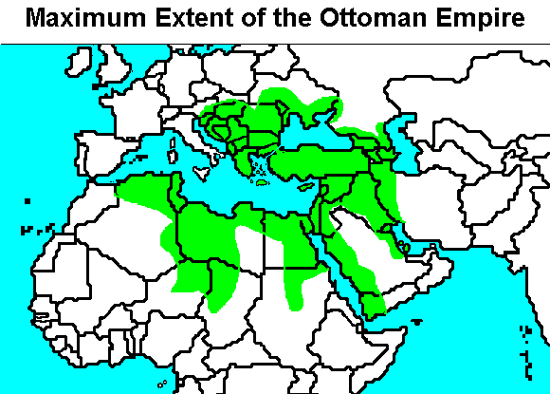
The Ottomans also conquered Egypt
and North Africa, reuniting most of
the Muslim world.

Slide 8
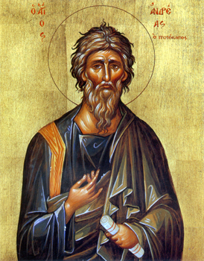
Like previous Muslim rulers, the Ottomans
recognized cultural diversity and allowed
Christians and Jews the right to worship.
Muslim rulers considered Christians and
Jews “People of the Book.”

Slide 9
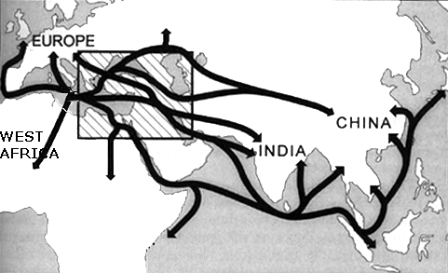
The Ottomans prospered due to their
great location for trade. However,
while the Ottomans were successful
for centuries, they eventually lost
territory to Europeans and their
technological advances.

Slide 10
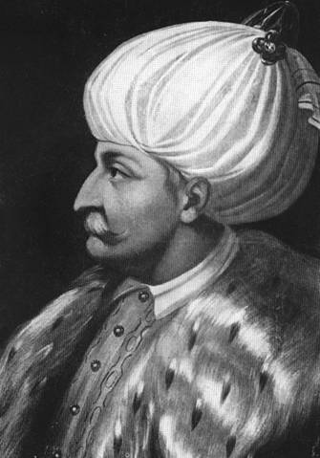
The greatest Ottoman sultan or ruler
was Suleiman the Magnificent. He
greatly expanded Ottoman territory.

Slide 11
Sultan
A Sultan is a ruler of a Muslim kingdom. This title is especially associated with the Ottoman Empire.
A Sultan was an all-powerful ruler.
The Sultan was similar to a European absolute monarch.

Slide 12
Diversity and Tolerance
There was great cultural diversity in the Ottoman Empire.
The Ottomans recognized cultural diversity by letting Christian and Jewish communities largely govern themselves.
The Ottomans did not force their religion on others.

Slide 13
Questions for Reflection:
Who were the Ottoman Turks and what did they do?
When did the Ottomans conquer Constantinople and how did the fall of Constantinople benefit the Ottomans?
What did the Ottomans rename Constantinople?
Who was Suleiman the Magnificent and what were his accomplishments?
How did the Ottomans treat their culturally diverse subjects? Explain your answer.

Slide 14
The Safavid Empire
In this lesson, students will be able to define the following terms:
Safavids
Shi’ites
Shah

Slide 15
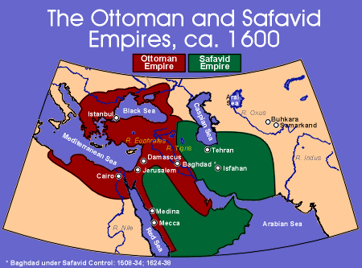
The Safavids (present-day Iranians)
created an empire in Persia in the
early 1500s, extending as far south
as the Persian Gulf.

Slide 16
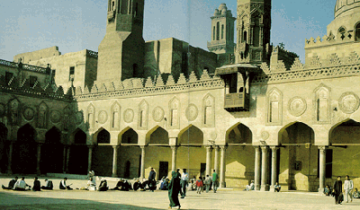
The Safavids were Shi’ite Muslims.
This made them hostile to the
Ottomans who followed the Sunni
branch of Islam. Though both were
Muslims, they differed regarding the
leadership of the community.

Slide 17
Shi’ite Muslims
There are two main branches of Islam: the Sunni branch and the Shi’ite branch.
The primary difference between these two branches concerns leadership of the Islamic community.
Sunni Muslims believe a capable Muslim can lead the community while Shi’ite Muslims believe leadership should be hereditary through Muhammad’s son-in-law.

Slide 18
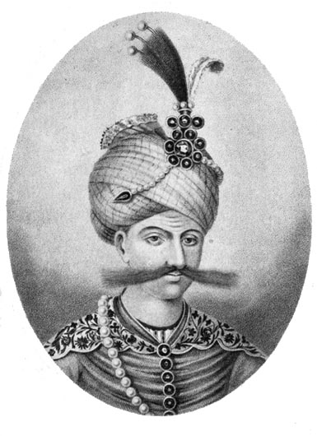
Safavid rulers, known as Shahs, used
their large armies to maintain control
of their empire.

Slide 19
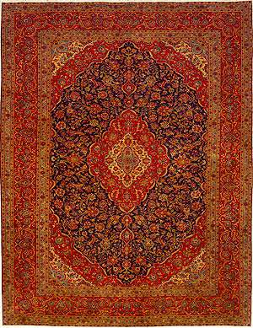
The production of beautiful rugs and
miniature paintings flourished. As
a result, trade also flourished.

Slide 20
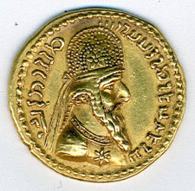
Literature, medicine, and the study
of astronomy also thrived in the
Safavid era.
However, high taxes and continuous
warfare with the Ottomans gradually
weakened the Safavids.

Slide 21
Safavid Decline
However, high taxes and continuous warfare with the Ottoman Empire weakened the Safavids.
In 1722, the Safavid Empire was conquered by neighboring Afghanistan.
From 1501-1722, the Safavids ruled Persia.

Slide 22
Questions for Reflection:
Who were the Safavids?
Why were the Safavids in conflict with the Ottomans?
What is the primary difference between Sunni Muslims and Shi’ite Muslims?
Compare and contrasts Shahs and Sultans.
What factors led to the decline of the Safavid Empire?

Slide 23
Muslims and Mughals in India
In this lesson, students will be
able to define the following terms:
Sultanates
Mughals
Akbar the Great
Shah Jahan
Taj Mahal

Slide 24
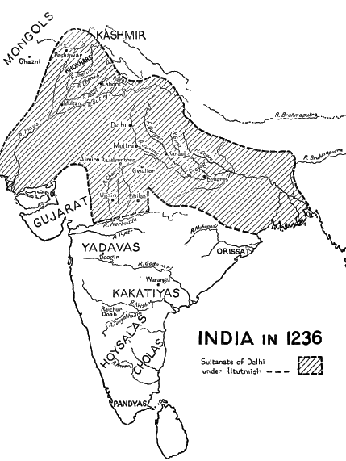
In the 11th and
12th centuries,
Muslims
invaded India
and established
Sultanates.

Slide 25
Sultanates
In the 11th and 12th centuries, Muslims invaded India and developed independent kingdoms in northern India known as Sultanates.
The most important Sultanate was established at Delhi.
The Delhi Sultanate ruled for 300 years.

Slide 26
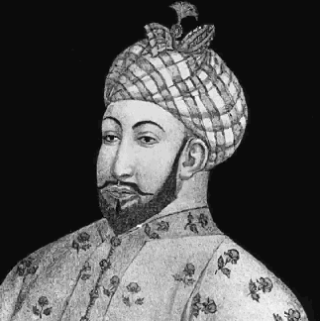
At the end of the 14th century,
the Delhi Sultanate was destroyed
by Tamerlane.

Slide 27
Tamerlane
Tamerlane and his soldiers invaded the Delhi Sultanate.
They destroyed the city of Delhi at the end of the 14th century.
Tamerlane was a descendant of the Mongols. He slaughtered the inhabitants of Delhi.

Slide 28
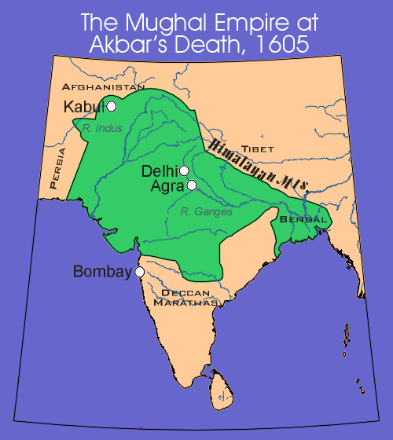
In 1526, the Mughal Empire was
founded.

Slide 29
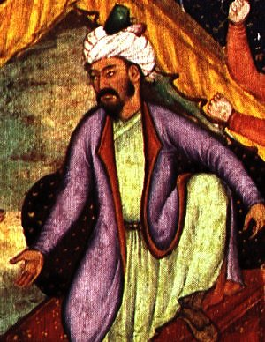
In 1526, a conqueror from Central Asia
attacked India. The conqueror’s name
was Babur and he established the Mughal Empire. The name Mughal
probably comes from Mongol.

Slide 30
Akbar the Great
The most famous Mughal ruler was Akbar the Great (1542-1605).
Akbar the Great promoted religious toleration throughout his Empire.
He was also a great patron of the arts.

Slide 31
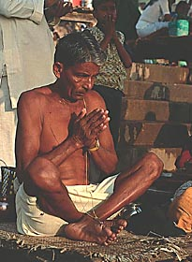
The majority of Indians are Hindus.
However, the Muslim ruler, Akbar the Great,
treated Hindus fairly and respectfully.

Slide 32
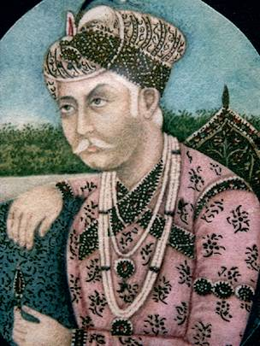
Akbar expanded the empire due to
his powerful army. Some of his soldiers
rode elephants while over 12,000
soldiers were horsemen.

Slide 33
By conquering
neighboring
states, Akbar
the Great
united northern
India under his
rule. He divided
his empire
into twelve
provinces to rule
it more effectively.

Slide 34
Shah Jahan
Akbar’s grandson, Shah Jahan (1628-1658), in contrast, showed little sympathy for Hindus.
Shah Jahan ordered the destruction of many Hindu temples.
During the reign of Shah Jahan, Hindus were persecuted.

Slide 35
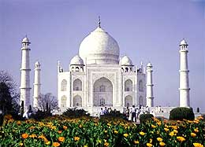
Shah Jahan ordered the building of
the Taj Mahal.

Slide 36
The Taj Mahal
Shah Jahan built many palaces, fortresses, and mosques to glorify his reign.
His most famous building was the Taj Mahal.
The Taj Mahal was built as a memorial for his beloved wife.

Slide 37
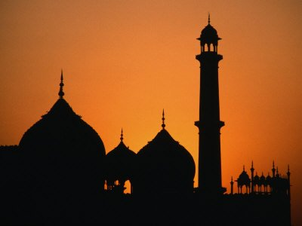
Many Hindus converted to Islam
under the reign of Shah Jahan.
While some people changed their
religion to avoid special taxes, others
converted to escape from the caste
system.

Slide 38
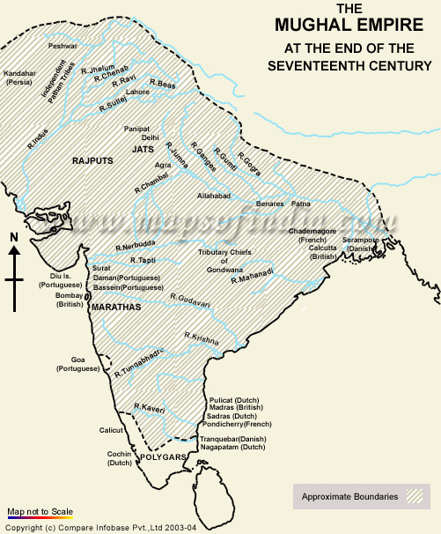
After the death of Shah Jahan, the
Mughal Empire began to weaken.

Slide 39
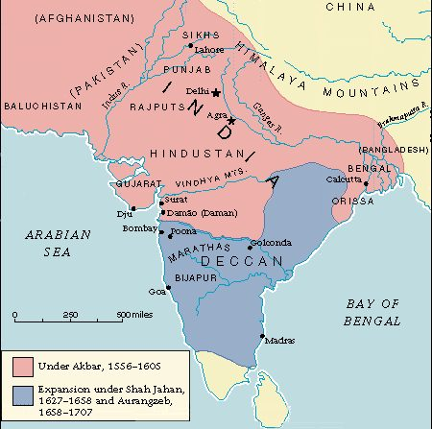
But the Mughal Empire changed India’s
history. Hindus and Muslims still grapple
with its legacy.

Slide 40
Questions:
Who was Babur and what did he do?
Why do many historians compare the Mauryan emperor, Asoka, and the Mughal emperor, Akbar?
Describe the reign of Akbar the Great.
Who was Shah Jahan and what did he do?
What are the religious differences between Hindus and Muslims?

Slide 41
Questions for Reflection:
What was the Delhi Sultanate and what happened to it?
Who were the Mughals?
Why was Akbar the Great considered a great ruler?
Compare and contrast Akbar the Great and Shah Jahan.
Why did Shah Jahan order the building of the Taj Mahal?

