Slide 1
Post-Classical
Test Review

Slide 2
What was the name of the city that became the new Roman capital? What was it’s name changed to? What religion develops in the Byzantine Empire?

Slide 3
What led to shift from Classics and Middle Ages?
MIDDLE AGES
OR MEDIEVAL TIMES
500-1500 AD
Present Day Western Civilization beginning with the Renaissance
Classical Times
of Greece and
Rome

Slide 4
In each aspect, give at least three characteristics of Middle Ages Europe
Social | Political | Economic

Slide 5
Events that led to…
Causes of Feudalism | Decline of Feudalism
• | •
• | •
• | •

Slide 6
Age of Faith: Who is the ultimate authority figure in Western Europe? (Not pictured)

Slide 7
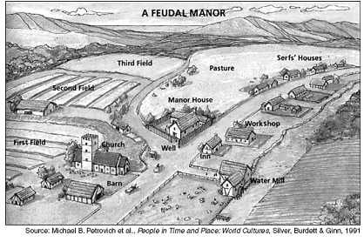
Give two qualities of a manor in Western Europe?

Slide 8
AGE OF
FAITH
Examples of
Social Control
Examples of
Economic Control
The Catholic Church had economic, social and political dominance during the European Middle Ages
What are some examples of how the church maintained their power and control??
Examples of
Political Control

Slide 9
Who is being crowned? What did he accomplish in order to receive this title? From this point forward ↑ what happens to the relationship between church and state, in Western Europe?

Slide 10
Basic Beliefs.. What can you tell about each religions’ impact on the Post-Classical era?
Catholicism | Eastern Orthodox | Islam
? | ? | ?

Slide 11
Confucius’ Impact on Post-Classical Asia??

Slide 12
What goods are being traded along these routes? Religion that diffuses with trade in this region?

Slide 13
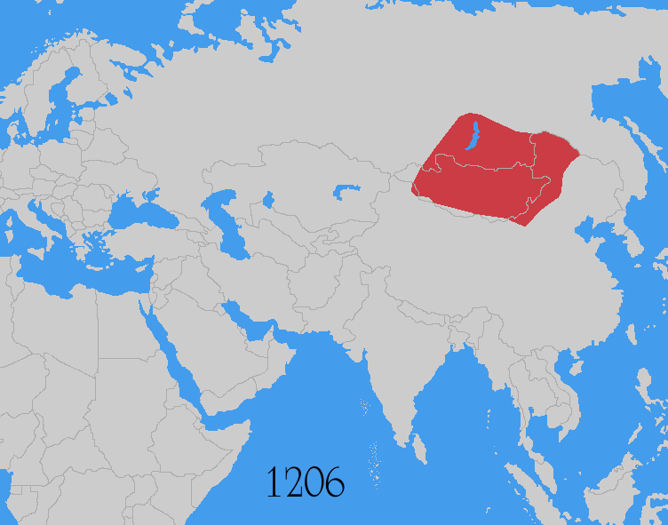
What were some of the advantages that the Mongols developed as they built the largest land empire in the history of the world?

