Slide 1
Please Get out your old review sheets
Neolithic Revolution & River Valley Civilizations
Classical Civilizations
Post Classical Civilizations
Middle Ages

Slide 2
Number your review sheet pages 1-12

Slide 3
What are the Causes and Effects of the Neolithic revolution ?
Fill in the box on page 1 of your review sheet, use your notes from the beginning of the year & your review sheet on the Neolithic revolution and River Valley Civilizations to assist you

Slide 4
What are the characteristics of Christianity, Islam & Judaism?
Fill this information in on page 6 of your review sheet using your Religions Chart from the beginning of the year/

Slide 5
What are the characteristics of Hinduism, Buddhism and Confucianism?
Use your religions chart to fill in this information on page 5 of your packet including the questions 1/2/3

Slide 6
What does SCAAR stand for?
Fill in the Chart on page 2 and provide examples
Utilize your Mesopotamia SCAAR chart to assist you with examples
Utilize your Notes on SCAAR to Assist you

Slide 7
What were the impacts that cods of laws like Justinian’s code & Hammurabi’s code ?
Fill in the question about Hammurabi’s code on page 4 of your review sheet. Use your Review sheet from Classical River &River Valley Civilizations

Slide 8
What is the Dynastic Cycle and which civilization was it important to?
Fill In page 9 of your review sheet
Utilize your Classical civilizations Packet on the ZHOU Dynasty to assist you
Utilize your Classical Civilizations test review sheet to assist you

Slide 9
Add to page 11 where you have space
Byzantine Empire Influences
Code of Law
Hagia Sophia Cathedral
Missionaries spread Eastern Orthodox Religion in Russia

Slide 10
What were the achievements of the Gupta civilizations?
Fill in this information on page 9 of your review sheet

Slide 11
What are the characteristics of a Golden Age?
Fill in this information on page 10 Question 3 of your review sheet and utilize the review sheet on post classical civilizations to assist you

Slide 12
What were the major affects of the Silk Road?
Fill in this information on page 10 in your review packet – utilize you review sheet on classical China and India

Slide 13
What are the technological achievements of the Tang & song Dynasties?
Fill in your review sheet on page 10 utilizing your review sheet on Post Classical Civilizations and Post Classical Vocab & Maps.

Slide 14
What were the advantages of the inventions during the Han Dynasty in China?
Add information onto Page 10 in space available of your review sheet and utilize your classical civilizations review sheet / Classical Civilizations packet to assist you

Slide 15
What are characteristics of the Fall of the Roman Empire and Han Dynasty?
Fill in the chart on Page 10 of your review Packet
Utilize the last page of your Classical Civilizations Test Review Sheet
Utilize page 187 from the text book to assist you

Slide 16
Who were the key players & what were the impacts of the Mongol invasions?
Fill in page 11 of your review sheet and use your post classical china/ India and Mongols review sheet

Slide 17
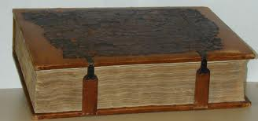
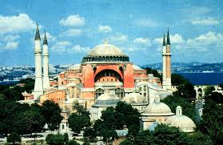
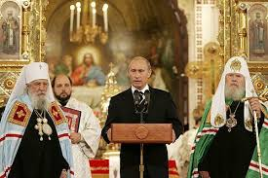
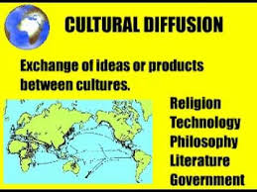
Byzantine Empire Influences
Code of Law
Hagia Sophia Cathedral
Missionaries spread Eastern Orthodox Religion in Russia

Slide 18
Why is the Gold- Salt trade significant for Ghana Mali & Songhai? How was the city of Timbuktu affected by it?
Answer this questions on page 11 of your review sheet using your review sheet from the Middle Ages Africa and Islam review sheet.

Slide 19
Why are the Middle Ages known as the Age of Faith?
Answer this question on page 12 of your review packet using information
Lay Investiture
Cannon Law
Sacraments
Excommunication
Interdict
Use Your Middle Ages test review & Middle Ages vocab and maps to assist you

Slide 20
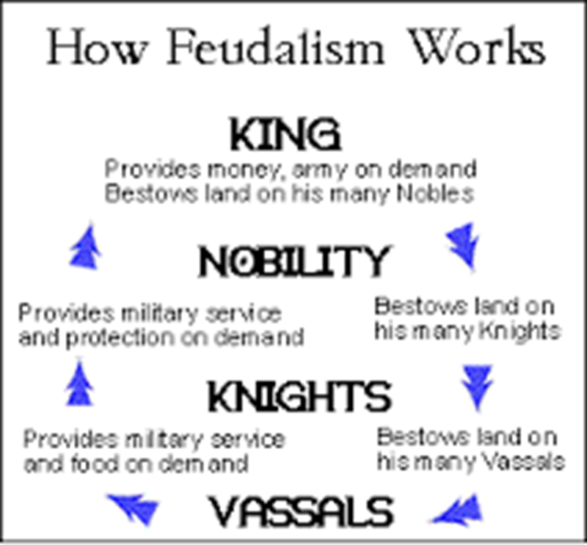
What are the characteristics associated with feudalism?
Fill in Page 12 of your review sheet
Utilize your Guided notes on the Middle Ages
Utilize your Review sheet on the Middle Ages to help fill in this Chart

Slide 21
Define the Hundred Years war / Black Death/ & Crusades
Fill in page 12 of your review packet
Utilize your Middle Ages guided Notes
Utilize your Middle Ages Test Review Sheet

Slide 22
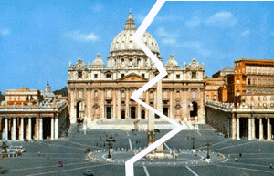
Describe the Characteristics of a Schism
Split in Catholic Church with two Popes
Caused many to question the authority of The Church

Slide 23
What types of advanced technology were introduced by classical civilizations?
Fill in information on pages 9-10 of your review sheet using your review from post classical civilizations India china and Mongols

