Slide 1
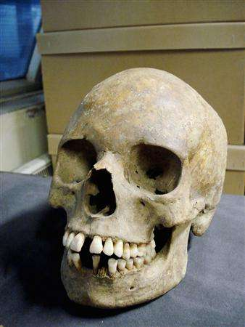
After the devastation
of the Bubonic
Plague,
Western
European
society
changed.

Slide 2
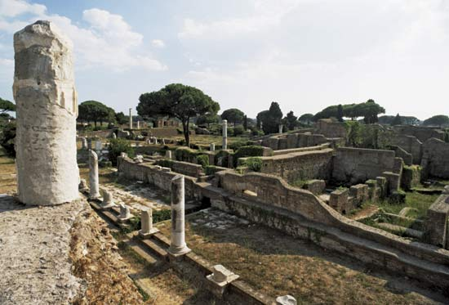
In Italy, people began to look to
the past, to the glories of early
civilizations.

Slide 3
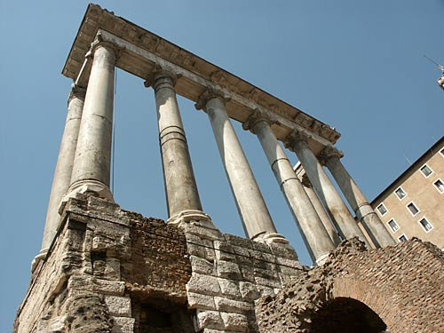
Before the Middle Ages, before
the Plague, there was the glory
of the ancient Greeks and Romans.

Slide 4
Renaissance thinkers believed that
the people of the Middle Ages were
ignorant.

Slide 5
The “Dark Ages”
Renaissance thinkers referred to the Middle Ages as the “Dark Ages”.
They believed that the “light of learning” had gone out in Europe at the fall of Rome.
Renaissance thinkers wanted to rediscover the ancient Greeks and Romans.

Slide 6
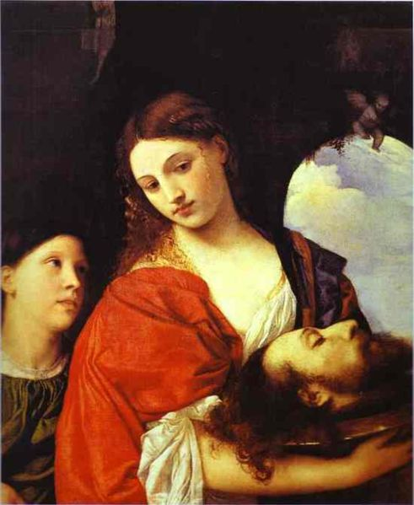
It was a
rebirth.
It was
the
Renaissance.
http://www.bing.com/videos/search?q=The+History+Channel+Renaissance&Form=VQFRVP#view=detail&mid=0730F2DDF171E41FBFD00730F2DDF171E41FBFD0

Slide 7
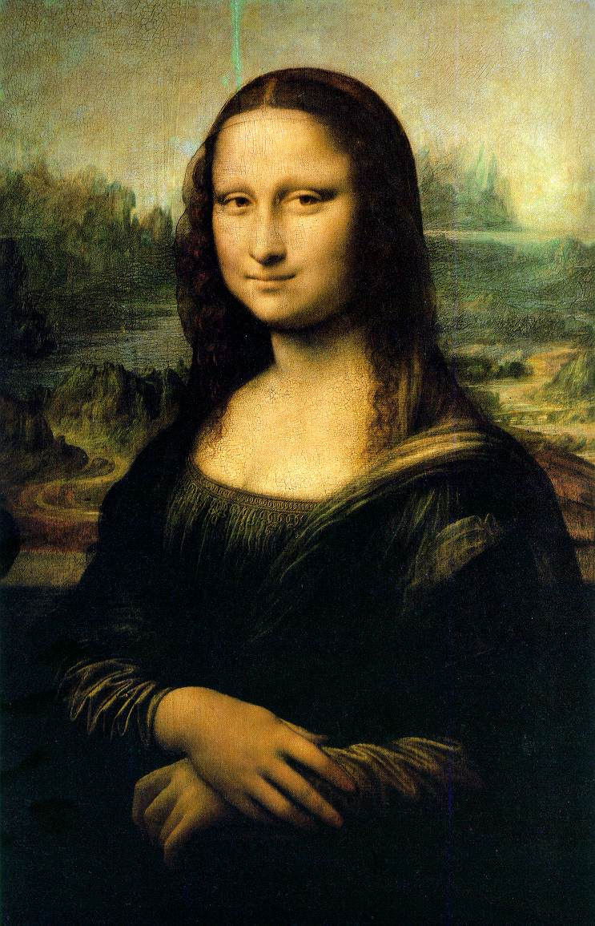
The Renaissance
began in a few
city-states in
northern Italy
around 1350 and
spread to other
countries.

Slide 8
The Renaissance
The Renaissance was a time of great artistic creativity.
A revolution in scientific thinking and art occurred during the Renaissance.
The Renaissance began in the 14th century in Italy and eventually spread to northern Europe.

Slide 9
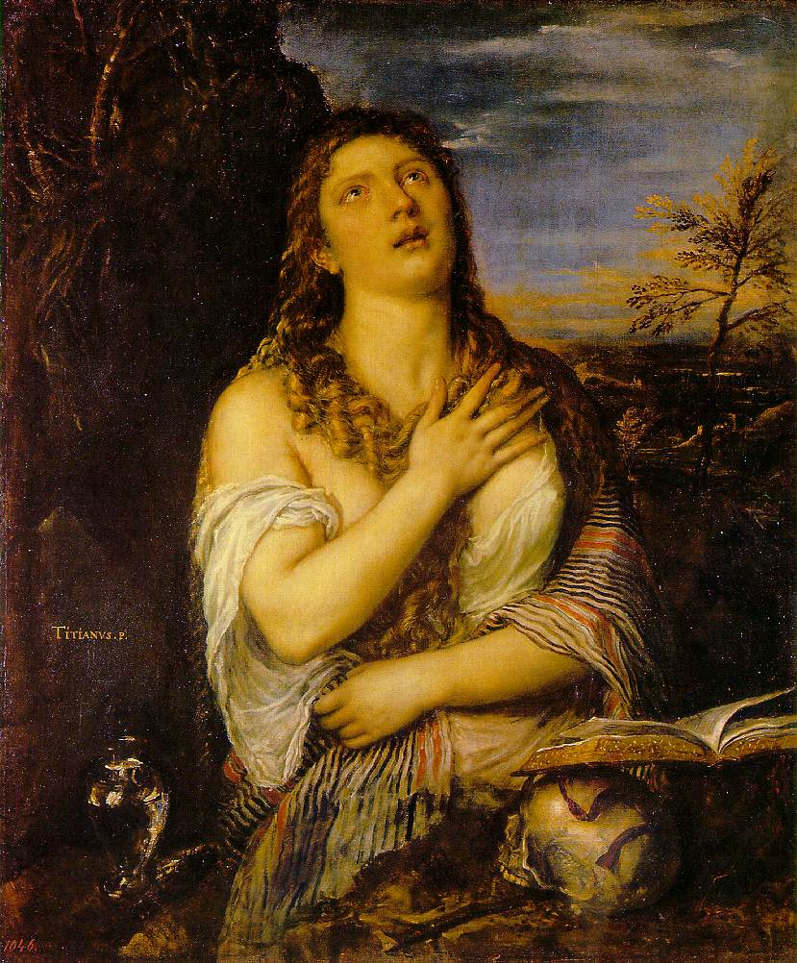
During the
Renaissance,
artists began
rendering
the world
in three
dimensions.

Slide 10
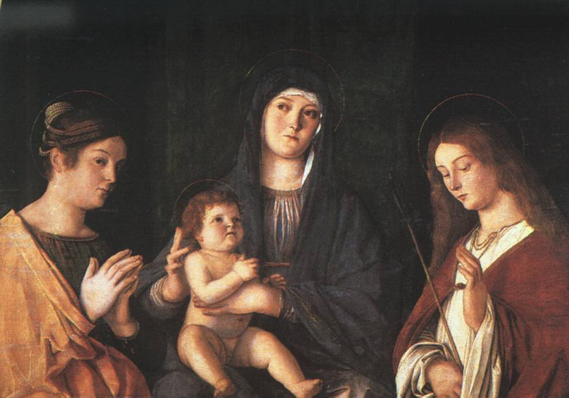
Painters sought realism in their
art.

Slide 11
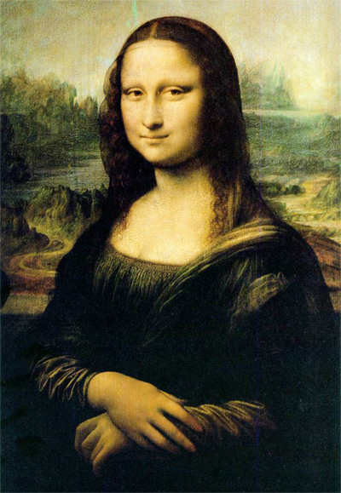
And why did the
Renaissance begin
in Italy?
Italy had
a great location
for trade.
It was king of
the Mediterranean
Sea.
It controlled
European trade
with Asia.

Slide 12
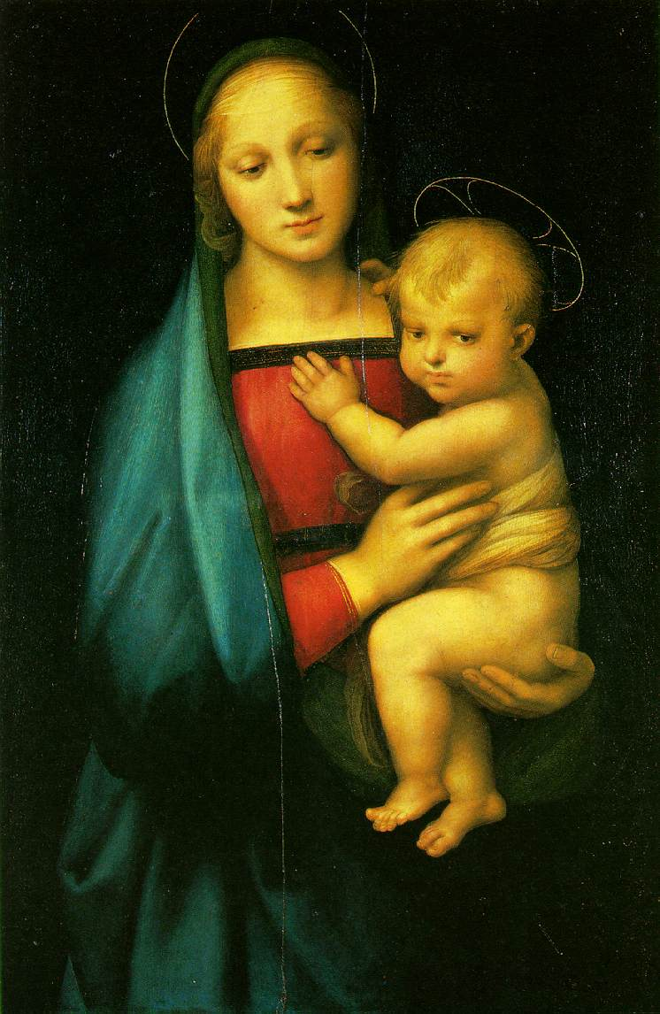
Wealth from
trade allowed
artists to
find wealthy
patrons to
commission
and sponsor
their work.

Slide 13
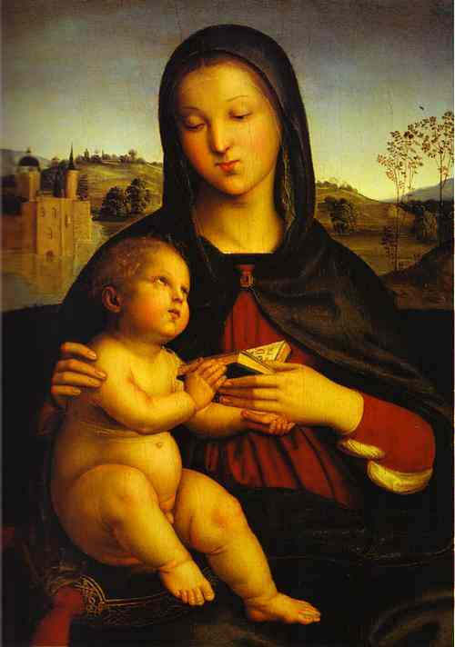
And so, with wealth
from trade, artists
found sponors
and used
perspective in art.
Perspective is
is the ability to create
a three
dimensional
appearance
on a two
dimensional surface.

Slide 14
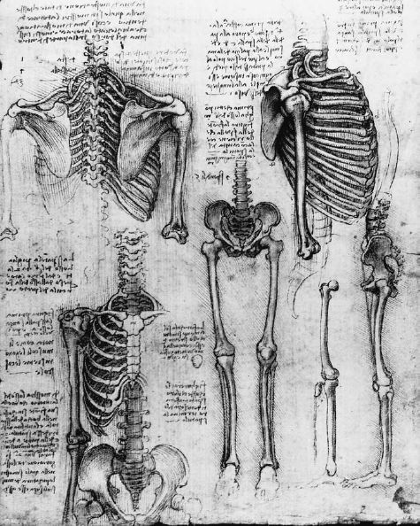
Renaissance
thinkers
wanted to
learn new
things, discover
new information.
They began
to question the
old authorities.

Slide 15
Rebirth
The word “Renaissance” means rebirth.
It was a time of rediscovery. Renaissance thinkers were increasingly interested in science and the arts. They were less interested in religious answers.
They also looked to past civilizations like the Greeks and Romans for inspiration.

Slide 16
Secularism
During the Renaissance, secularism became popular.
Secularism is a non-religious viewpoint.
Secularists look to scientific thinking for answers as opposed to religion.

Slide 17
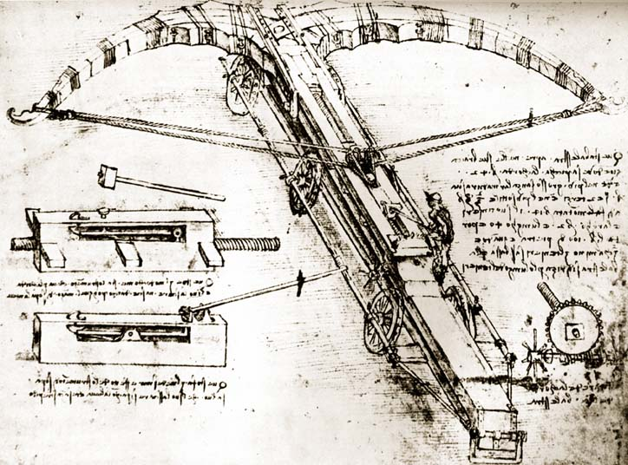
Secularists look to scientific thinking
for answers.

Slide 18
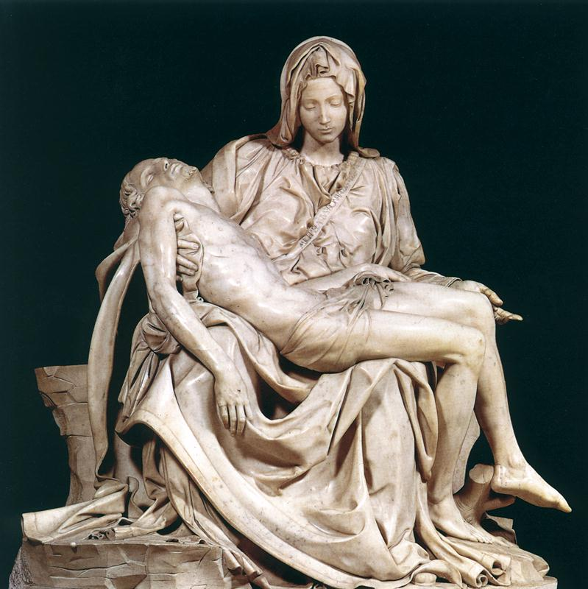
The rebirth
and rediscovery
of learning
of the
Renaissance
soon spread
to other
parts of Europe.

Slide 19
Humanism
During the Renaissance, humanism became popular.
Humanism is the belief that human actions, ideas, and works are important.
Humanists rediscovered the ancient Greeks and Romans.

Slide 20
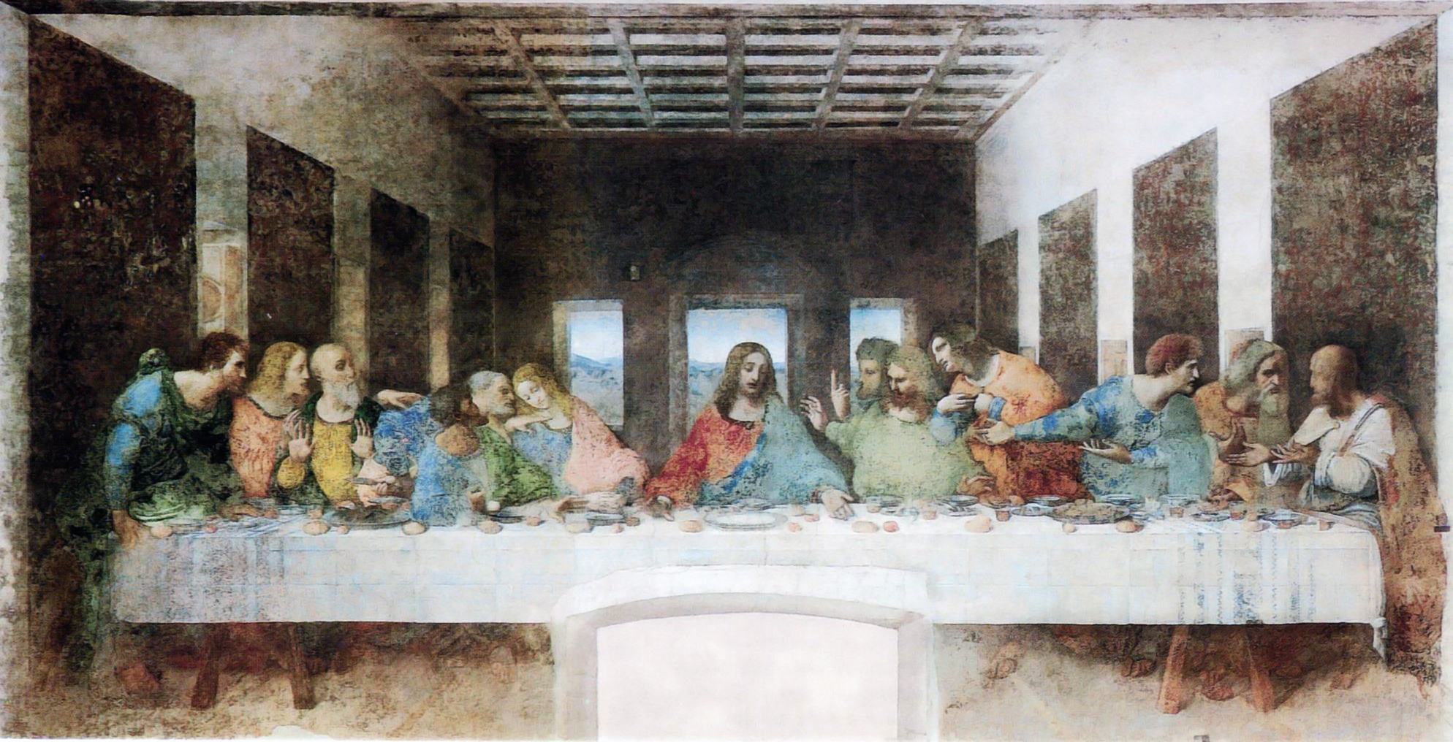
The Renaissance was a period of great
artistic creativity. Leonardo da Vinci
was one of the most famous artists of the
Renaissance.

Slide 21
Michelangelo
was another
famous
sculptor
and artist
of the
Renaissance.

Slide 22
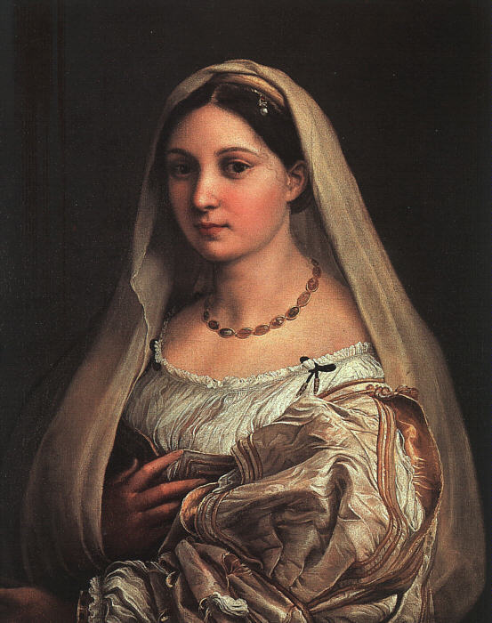
The artists of
the Renaissance
used perspective
in their works
to create
realism in
art.

Slide 23
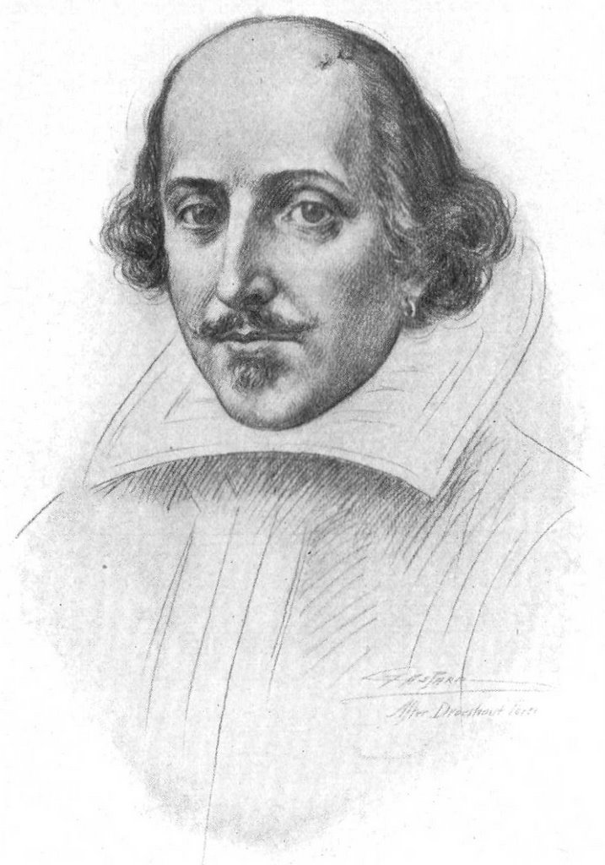
But it was not
only great
painting and
sculpture that was
produced during
the Renaissance.
It was also a time of
great literary works.
William Shakespeare
was a Renaissance
writer.

Slide 24
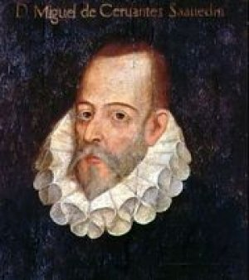
Miguel de Cervantes
was another great
writer of the
Renaissance.

Slide 25
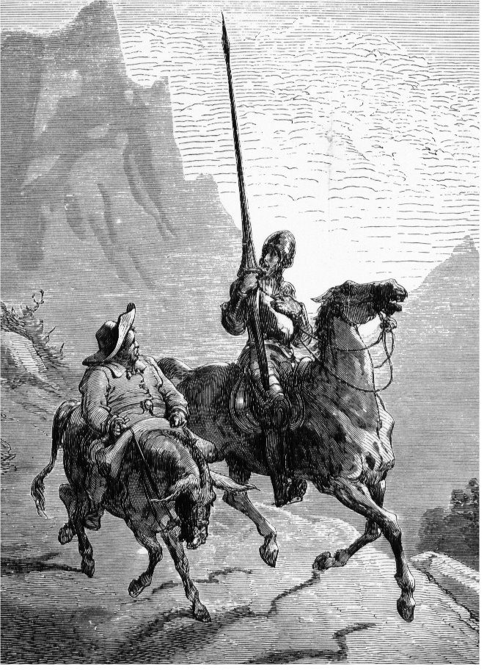
Don Quixote
was
a creation
of a
Renaissance
writer.
Part of the humor
of the story
is that the Middle
Ages have
ended.

Slide 26
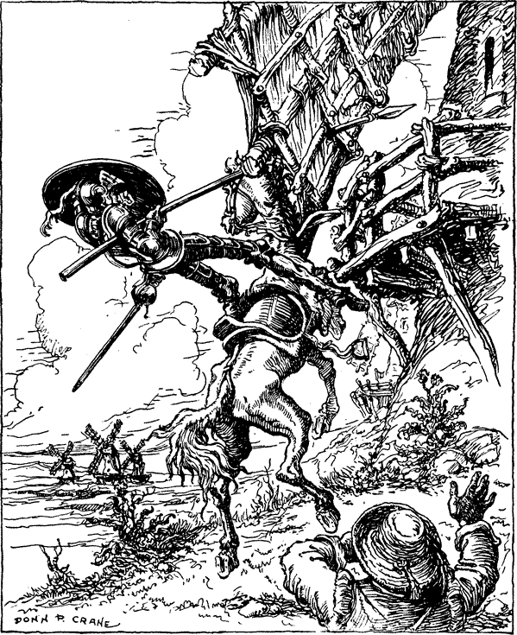
But not
for
Don
Quixote.

Slide 27
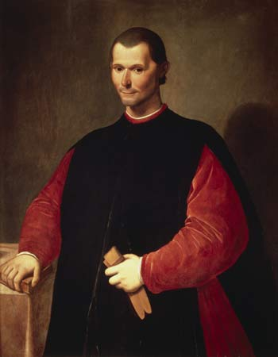
During the Renaissance,
great philosophers
produced thought-
provoking works.
Machiavelli was a
very famous philosopher
of the Renaissance.

Slide 28
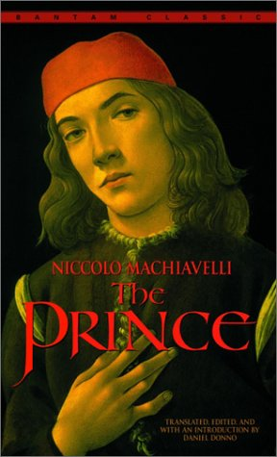
Machiavelli wrote “The Prince.”
Machiavelli believed that kings must
do whatever is necessary to maintain
their power. The ends justify the means.

Slide 29
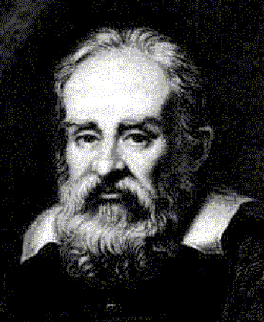
And of course,
there were
great scientists.
Men like Galileo
Galilei challenged
the authority of
the Catholic
Church by finding
answers in
science.

Slide 30
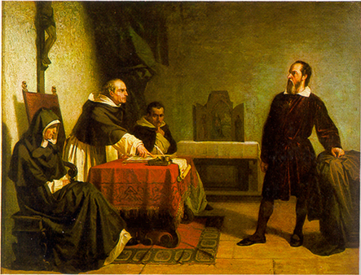
The Church even put Galileo on trial
for supporting the belief that the planets
revolved around the sun!

Slide 31
In contrast to Italy, which was comprised of city-states, Northern Europe had strong monarchs. (England, France)
2 reasons for the spread of Renaissance Ideas
1. Italian artists and writers migrated to Northern Europe.
2. Northern European artists who studied in Italy carried Renaissance ideas back.
Importance of German and Flemish painters and their focus on realism.

Slide 32
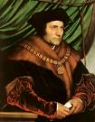
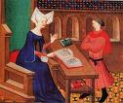
People in NE used Italian humanist ideas to examine the traditional teachings of the church.
Christian humanist movement focused on reforming society.
Thomas More tried to show a better model of society in his book Utopia. (1516)
Utopia a book about a place where greed, corruption, and war have been weeded out.
Christine de Pizan fought for women’s rights, especially the right for equal education.

Slide 33
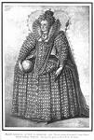
England and the Renaissance (Elizabethan Age)
By the mid 1550s Renaissance ideas had reached England.
Queen Elizabeth ruled from 1558 to 1603 and did much to support the development of English art and literature.
William Shakespeare emerged and is regarded as the greatest playwright of all time.
Shakespeare drew from classical works and displayed a deep understanding of human beings.

Slide 34
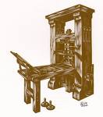
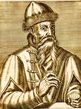
Printing Press…
Renaissance demand for knowledge, information, and books led to the creation of the printing press.
Johann Gutenberg developed the printing press in 1440.
Printing press made books readily available and cheap enough for people to afford.

Slide 35
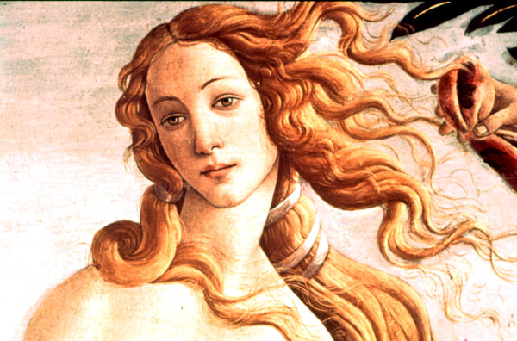
The Renaissance truly was a rebirth;
a rebirth of learning and questioning
and creativity.

Slide 36
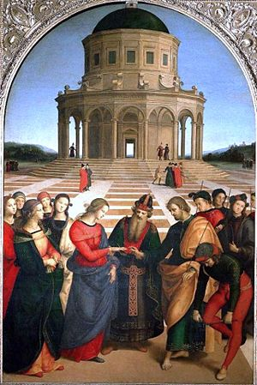
Renaissance works
of art, philosophy,
and science still
astound and
inspire us today.
Perhaps the people
of the modern world
truly are
children of
the Renaissance.

Slide 37
Questions for Reflection:
Where did the Renaissance begin?
What does the word “Renaissance” mean?
Why did Renaissance thinkers rediscover the ancient Greeks and Romans?
What were two significant beliefs during the Renaissance?
How did Renaissance thinkers differ from Medieval thinkers?

