Slide 1
Renaissance
Cypress Ranch World History 2014

Slide 2
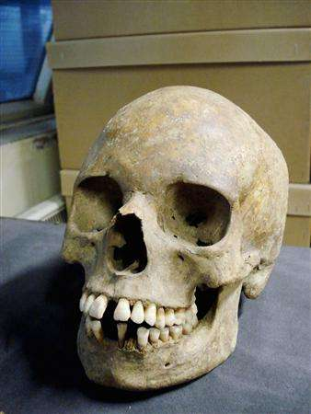
After the devastation
of the Bubonic
Plague,
Western
European
society
changed.

Slide 3
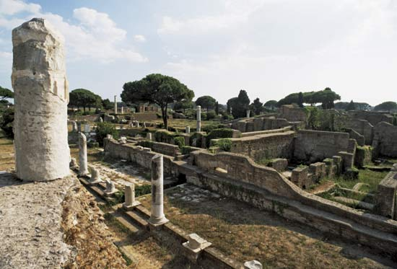
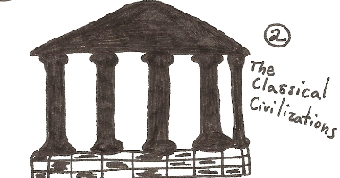
In Italy 1300 ce, people began to look to
the past, to the glories of early
civilizations.

Slide 4
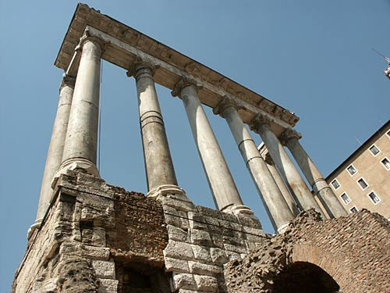
Before the Middle Ages, before
the Plague, there was the glory
of the ancient Greeks and Romans.

Slide 5
Renaissance thinkers believed that
the people of the Middle Ages were
ignorant.

Slide 6
The “Dark Ages”
Renaissance thinkers believed that the “light of learning” had gone out in Europe at the fall of Rome.
Renaissance thinkers wanted to rediscover the ancient Greeks and Romans.

Slide 7
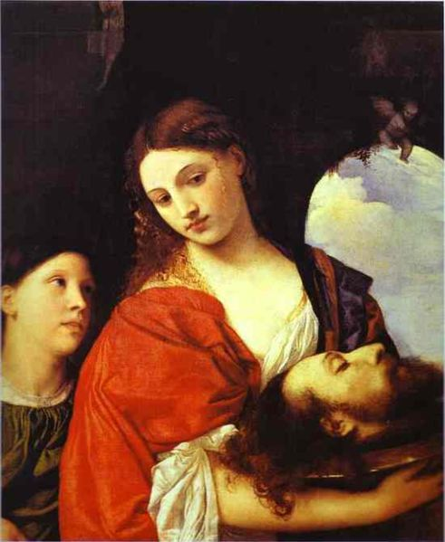
It was a
rebirth.
It was
the
Renaissance.
https://www.youtube.com/watch?v=0CRX_mqpzdU

Slide 8
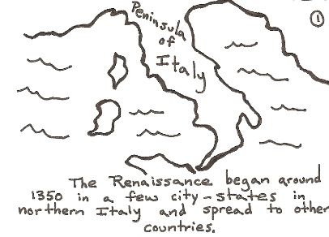
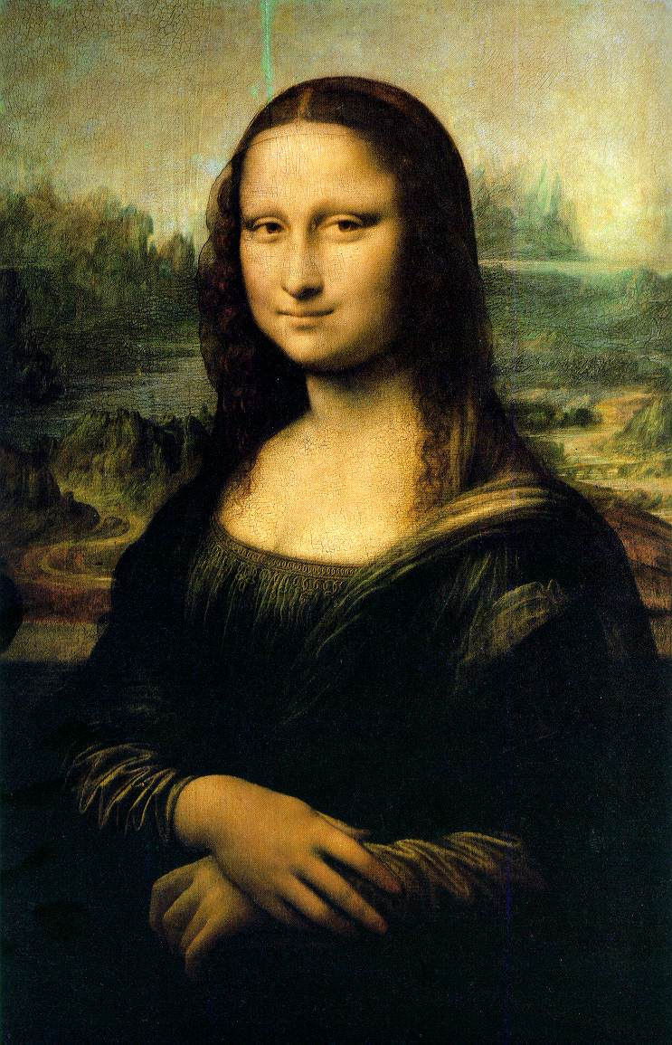

Slide 9
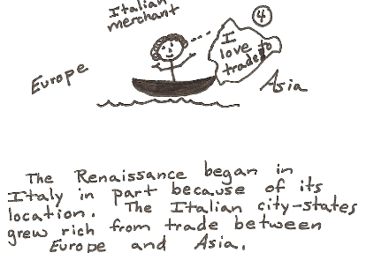

Slide 10
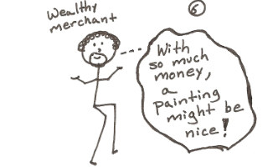
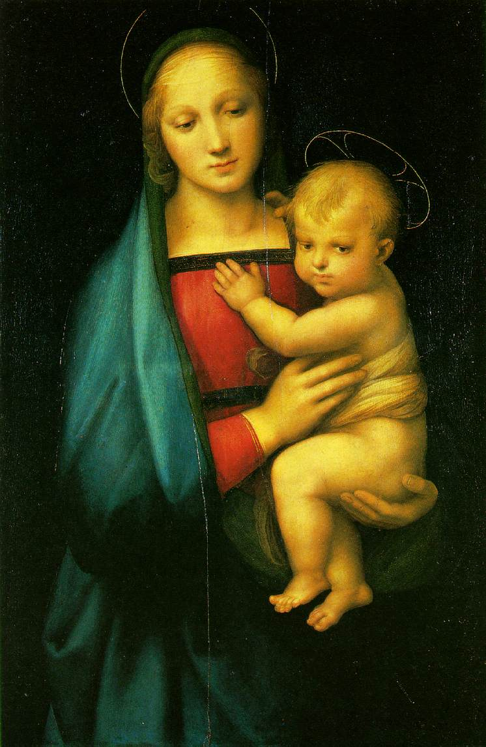
Wealth from
trade allowed
artists to
find wealthy
patrons to
commission
and sponsor
their work.

Slide 11
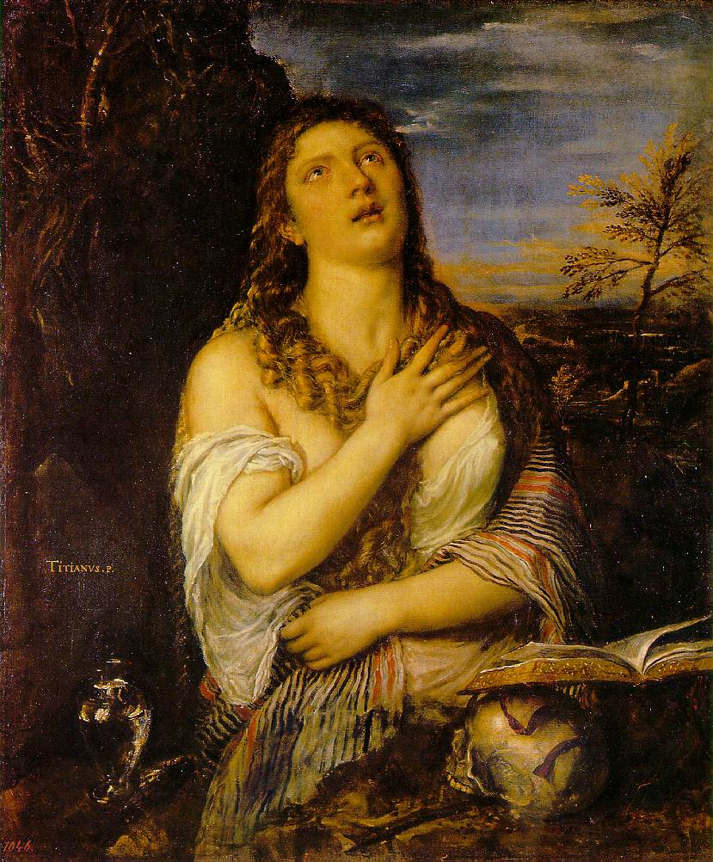
Perspective
During the
Renaissance,
artists began
rendering
the world
in three
dimensions.

Slide 12
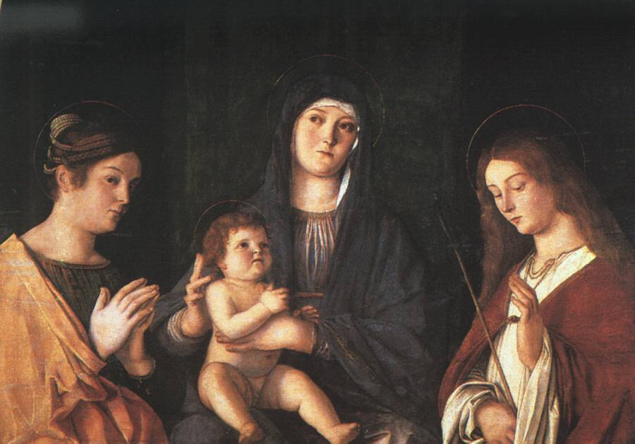
Painters sought realism in their
art. Reflected reality rather than
idealistic views

Slide 13
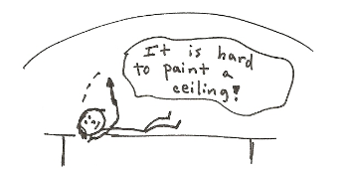
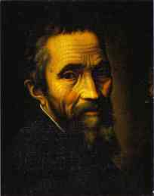
Italian painter, sculptor, architect, and poet whose artistic accomplishments exerted a tremendous influence on his contemporaries and on subsequent European art
MICHELANGELO

Slide 14
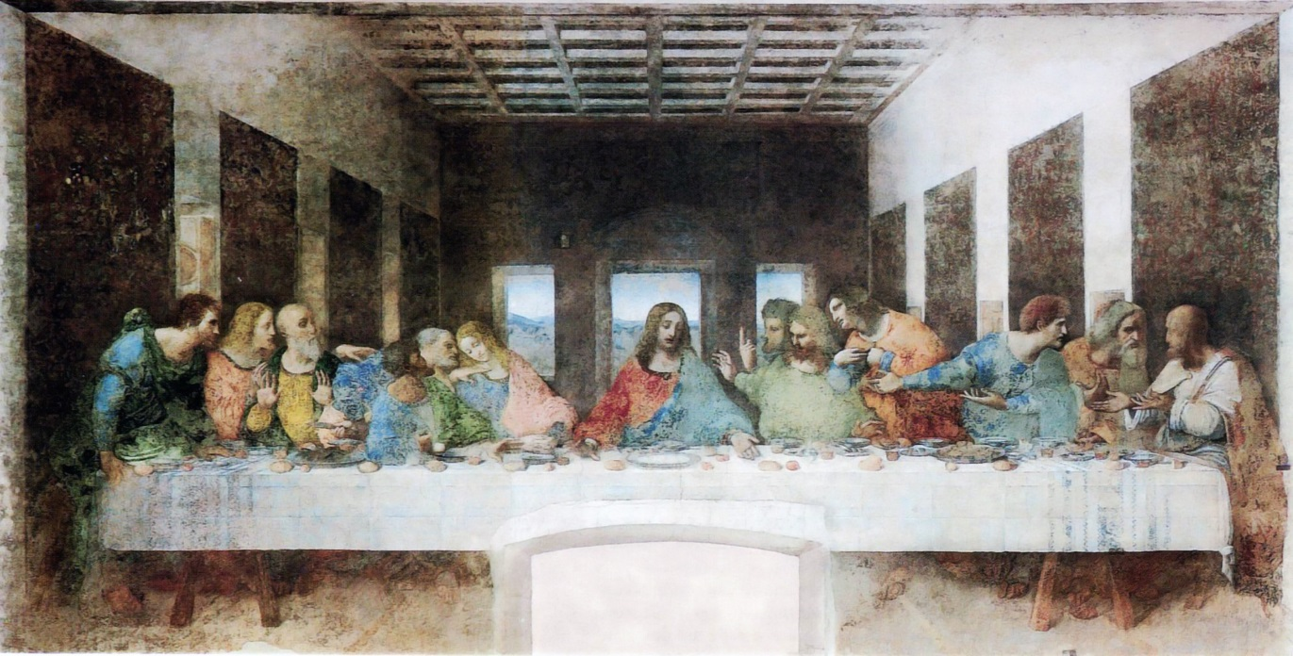
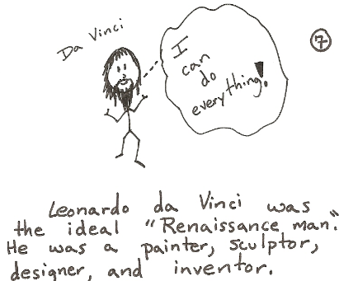
Leonardo da Vinci
was one of the most famous artists of the
Renaissance.

Slide 15
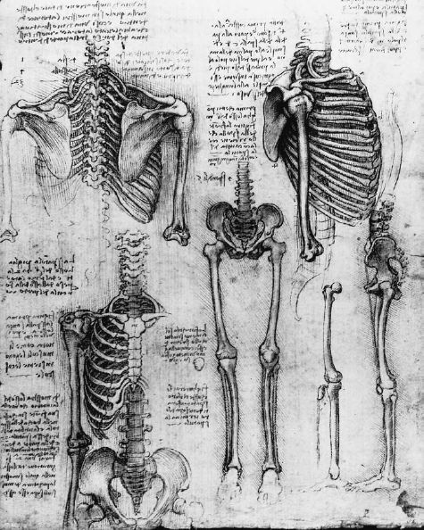
Renaissance
thinkers
wanted to
learn new
things, discover
new information.
They began
to question the
old authorities.

Slide 16
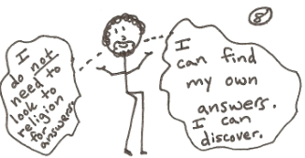
Secular I sm
During the Renaissance, secularism became popular.
Secularism is a non-religious viewpoint.
Secularists look to scientific thinking for answers as opposed to religion.

Slide 17
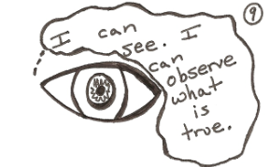
Humanism
During the Renaissance, humanism became popular.
Humanism is the belief that human actions, ideas, and works are important.

Slide 18
2 reasons for the spread of Renaissance Ideas
Italian artists and writers migrated to Northern Europe.
Northern European artists who studied in Italy carried Renaissance ideas back.

Slide 19
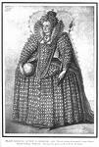
England and the Renaissance (Elizabethan Age)
By the mid 1550s Renaissance ideas had reached England.
Queen Elizabeth ruled from 1558 to 1603 and did much to support the development of English art and literature.

Slide 20
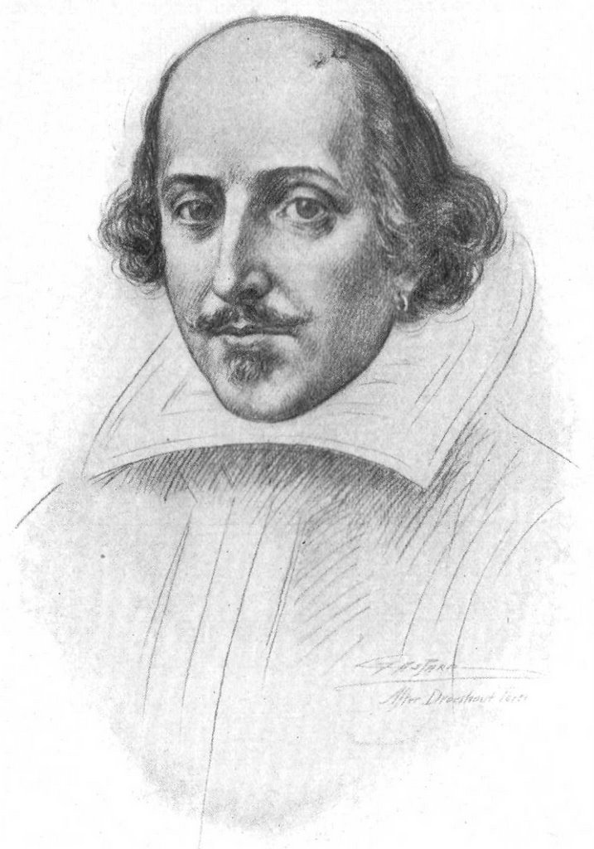
William Shakespeare emerged and is regarded as the greatest playwright of all time.
Shakespeare drew from classical works and displayed a deep understanding of human beings.

Slide 21
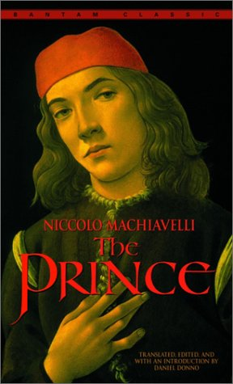
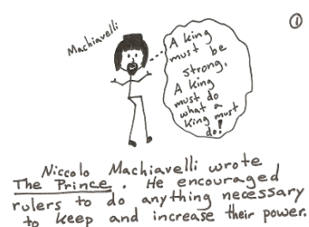
Machiavelli wrote “The Prince.”

Slide 22
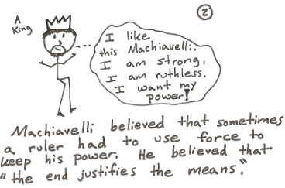

Slide 23
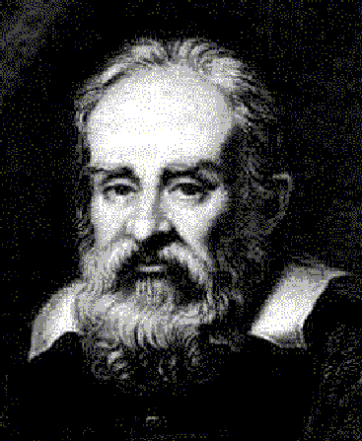
And of course,
there were
great scientists.
Men like Galileo
Galilei challenged
the authority of
the Catholic
Church by finding
answers in
science.

Slide 24
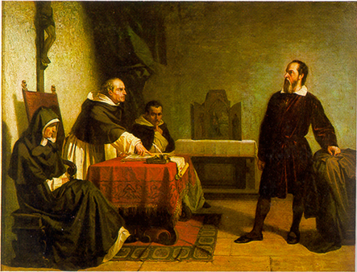
The Church even put Galileo on trial
for supporting the belief that the planets
revolved around the sun!

Slide 25
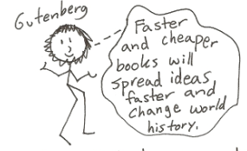
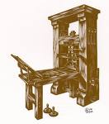
Renaissance demand for knowledge, information, and books led to the creation of the printing press.
Johann Gutenberg developed the printing press in 1440.
Printing press made books readily available and cheap enough for people to afford.

Slide 26
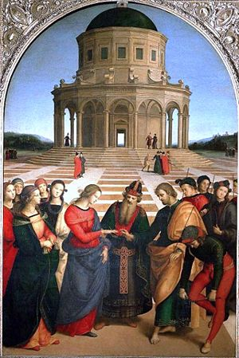
Renaissance works
of art, philosophy,
and science still
astound and
inspire us today.
Perhaps the people
of the modern world
truly are
children of
the Renaissance.

Slide 27
Questions for Reflection:
Where did the Renaissance begin?
What does the word “Renaissance” mean?
Why did Renaissance thinkers rediscover the ancient Greeks and Romans?
What were two significant beliefs during the Renaissance?
How did Renaissance thinkers differ from Medieval thinkers?

