Slide 1
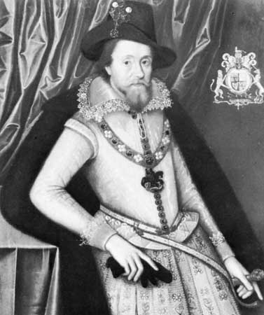
Sometimes a king is disliked. Sometimes the people are angry with their king.

Slide 2
James I ruled England from 1603-1625. Members of Parliament resented James because he made many requests for money.

Slide 3
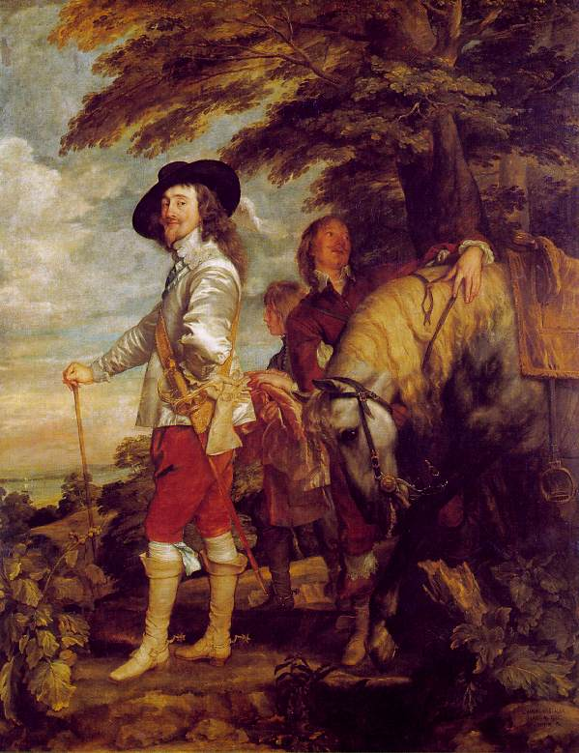
Under James’s son, Charles I, relations between king and Parliament became worse.

Slide 4
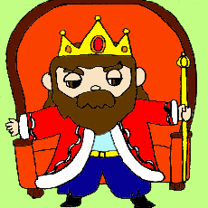
Like his father, Charles I believed in the divine right of king and royal absolutism.

Slide 5
When Parliament refused to give him money to build up his military forces, he ordered nobles to lend him money. Those who refused were sent to prison.

Slide 6
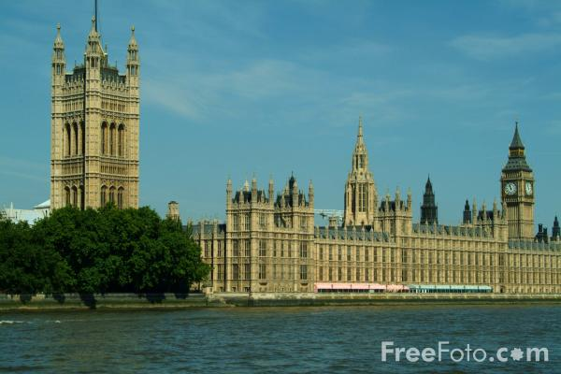
In 1628, Parliament agreed to give Charles the money he wanted if he signed the Petition of Right. This document prohibited the ruler from imposing taxes without the consent of Parliament.

Slide 7
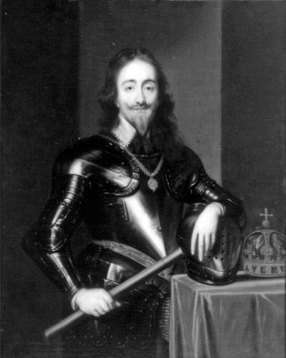
It also stated that no person could be sent to prison without having the charges against him or her made public.

Slide 8
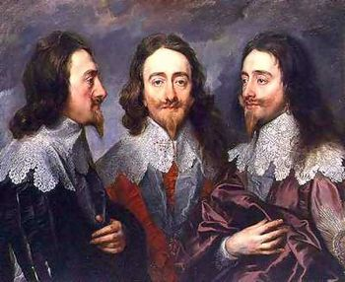
Charles agreed to these provisions but later ignored them. He secretly tried people in a special court called the Star Chamber.

Slide 9
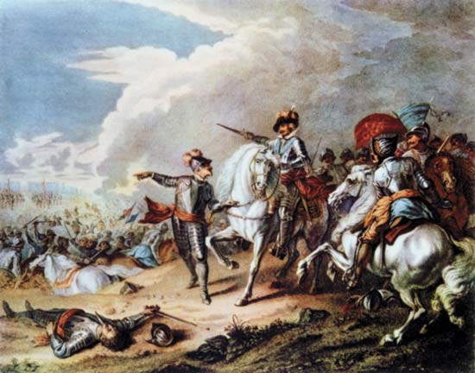
In 1642, Charles attempted to arrest a few leading members of Parliament. This action touched off a civil war.

Slide 10
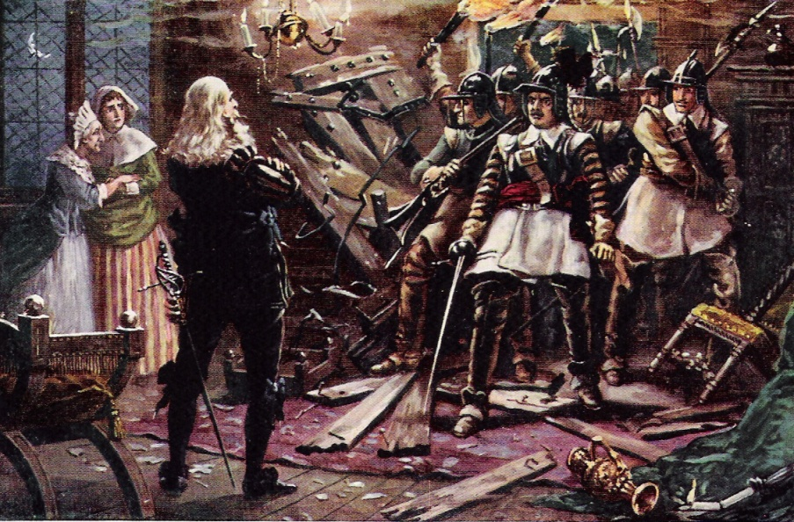
Those who fought for the king were called Royalists or Cavaliers. Those who fought for Parliament were known as Roundheads because they wore their hair in a short, bowl-shaped style.

Slide 11
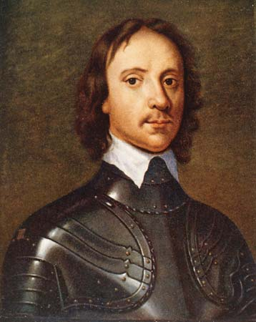
After 1643, Oliver Cromwell, a deeply religious Puritan, led the Roundhead forces to victory. By 1649, the king was beheaded.

Slide 12
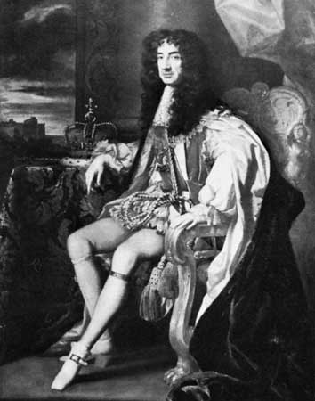
But Cromwell ruled as a dictator and closed all theaters and other places of public amusement. After his death, the monarchy was restored.

Slide 13
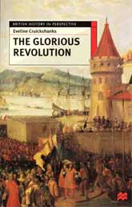
But when tensions grew between Parliament and the king again, a peaceful revolution settled things.

Slide 14
The Glorious Revolution of 1688 ended absolute monarchy in England. Limited monarchy became the permanent form of government. In 1689, the English Bill of Rights, made it clear that Parliament would have more power than the kings and queens of England.

