Slide 1
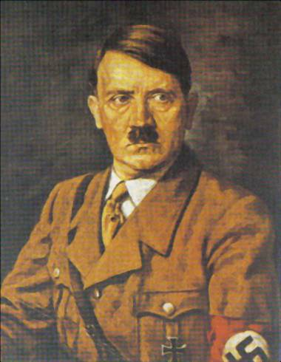
Rise of Hitler in Germany

Slide 2
Weimar Republic
In 1919, after centuries of totalitarian rule, the German nation established a republic. A constitution written at eh city of Weimar created the first attempt at democracy in Germany. From its beginning, the Weimar Republic was plagued by a series of problems. The new republic seemed doomed to fail from the beginning.
In the first place, Germany had no experience in running a democracy. This government was not efficient and could not fix the problems in Germany. Therefore, the people did not have confidence in the government.
In addition, the Weimar Republic signed the Treaty of Versailles at eh end of WWI. Most Germans believed that the treaty unfairly placed the total guild for the war on Germany. The treaty also demanded that Germany be harshly punished. The decline of Germany because identified with the republic.

Slide 3
Weimar Republic
Then in 1923, runaway inflation almost toppled the German economy. At one point, a bushel of potatoes cost a bushel of money, and the weekly salary of many Germans was worth only a streetcar ride. It was continually pressured to pay reparations of $30 billion as ordered by the Treaty of Versailles.
To make matters worse, in 1929 the Great Depression shook all of Europe an the United States. Unemployment increased to 3 million in March 1930 and 4.38 million by December of the same year. The German government was unable to deal with the growing economic distress. The political, social, and economic problems experience during the Weimar Republic paved the way for fear, chaos, and disorder across Germany.

Slide 4
Weimar Republic

Slide 5
Weimar Republic Questions
What type of government existed in Germany before the Weimar Republic?
What problems existed in Germany during the Weimar Republic?
How did the Germans feel about the Weimar Republic? What did they feel this way?
By examining the timeline, what events occurred during the years of the Weimar Republic?
How might the problems with the government lead to the rise of Hitler as dictator in Germany?

Slide 6
Treaty of Versailles
The League of Nations was formed.
Germany accepts sole responsibility for causing WWI.
Germany territorial losses: In Europe, Germany lost about 25,000 square miles with some six million inhabitants. She lost all her Pacific Islands and all her spheres of influence and colonies in Asia and Africa.

Slide 7
Treaty of Versailles
Military clauses affecting Germany:
The Rhineland was demilitarized
Germany army reduced to 100,000 men
Navy restricted to 36 vessels of various defensive types; submarines forbidden
Air force prohibited, all planes destroyed
Large guns prohibited and small guns limited
Restrictions placed on the production of armaments, and their support and import prohibited

Slide 8
Treaty of Versailles
Germany had to pay huge reparations to the Allies, mainly in kind, for property destroyed in occupied lands: ships destroyed, railway stock, automotive equipment, farm machinery, livestock, etc.

Slide 9
Treaty of Versailles Questions
Summarize the four provision of the Treaty of Versailles that directly impacted Germany. Explain the effect that each provision had on Germany. (Be specific!)

Slide 10
Treaty of Versailles Questions
Describe how the Germans felt about the Treaty?
Who do you think the Germans blamed for the Treaty? Explain.
How might the effects of the Treaty of Versailles on Germany lead to the rise of Hitler?
If you were living in Germany after the signing of the Treaty of Versailles, how might your life be effected? Be specific!

Slide 11
German Economy After WWI

Slide 12
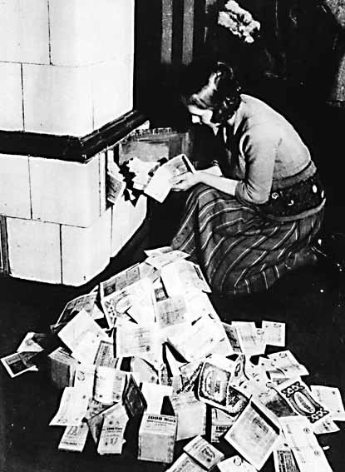
German Economy After WWI

Slide 13
German Economy After WWI Questions
Describe the economic situation in Germany after WW1. Give examples.
Explain the graph of German unemployment. What happened to unemployment in Germany from 1928-1933?
Examine the picture of the woman burning money. Why do you suppose she is using money to start a fire?
What happened to the value of the Mark in the years following WW1?

Slide 14
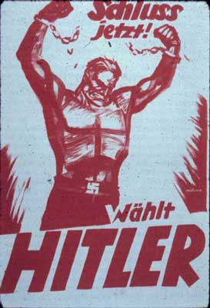
Propaganda
“End It Now”
“Vote Hitler”

Slide 15
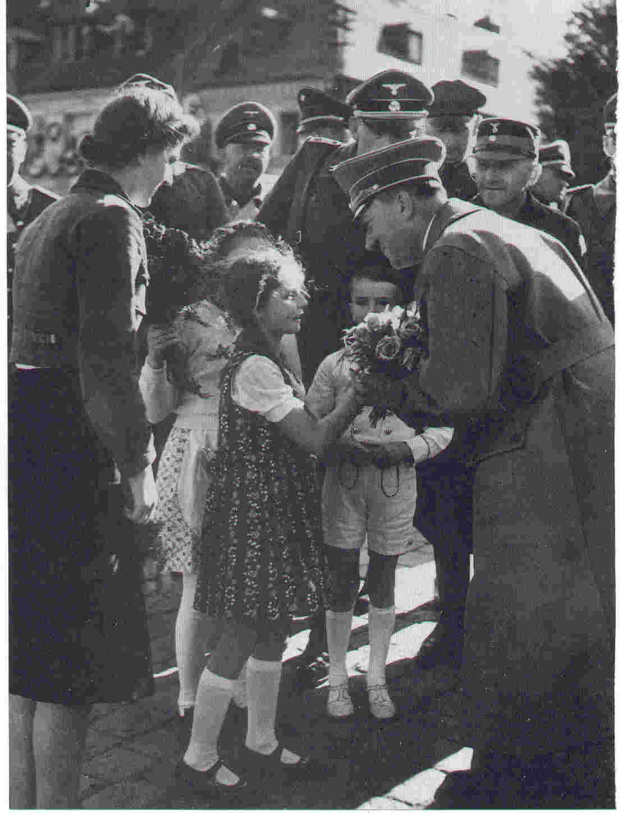
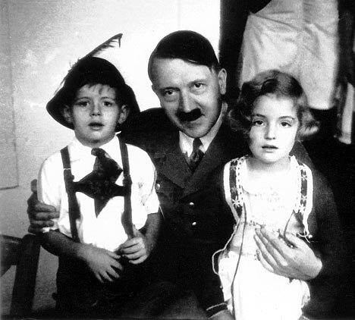
Propaganda

Slide 16
Propaganda Questions
How is the Nazi party portrayed in the propaganda poster? Why do you think the Nazis wanted to convey this image to the German people?
What might the Nazis have been referring to in the phase “end it now”?
What do you think the broken chains represent in the poster?
Do you think this was a successful election poster? Why or why not?

Slide 17
Propaganda Questions
Examine the pictures of Hitler. What image is the photographer trying to portray?
Why did the photographer use children for the picture?
How might the use of propaganda lead to the rise of Hitler?

Slide 18
Famous Quotes
Adolf Hitler to thee alone we are bound. In this hour we would renew our solemn vow; in this world we believe in Adolf Hitler alone. We believe that National Socialism is the sole faith to make our People blessed. We believe that there is Lord God in heaven, who has made us, who leads us, who guides us and who visibly blesses us. And we believe that this Lord God has sent us Adolf Hitler, that Germany might be established for all eternity.
-Schulungsbrief, April 1937. Bibl. 1, 35, p. 222 Nathaniel Micklem, National Socialism and the Roman Catholic Church, OUP 1939

Slide 19
Famous Quotes
He who serves our Fuhrer, Adolf Hitler, serves Germany and he who serves Germany, serves God.
-Baldur von Schirach (speech to Hitler Youth, 25 July 1936)
It is only one or two exceptional points that Christ and Hitler stand comparison, for Hitler is far too big a man to be compared with one so petty.
Julious Streicher, one of the most senior Nazis, in a speech at a discussion organized by the German Acadmy of Education in Munich. July 19-26, 1935.

Slide 20
Famous Quotes Questions
Why do you suppose the people compared Hitler to God?
What feeling might this create in the German people about Hitler and the Nazi party?

