Slide 1
Mapping the Expansion of the Roman Empire
Cypress Ranch High School
World History

Slide 2
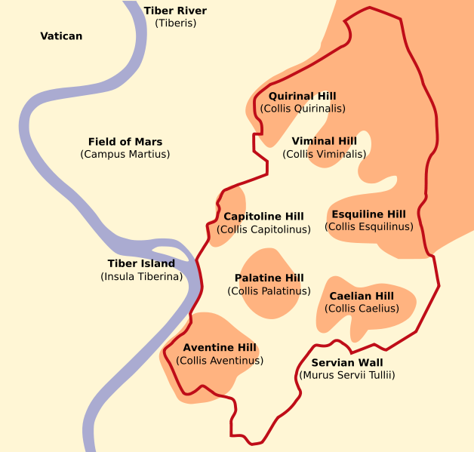
Geography of Rome
1
Why would this geographic location be an advantage?
https://www.youtube.com/watch?v=vM97-RYetbk

Slide 3
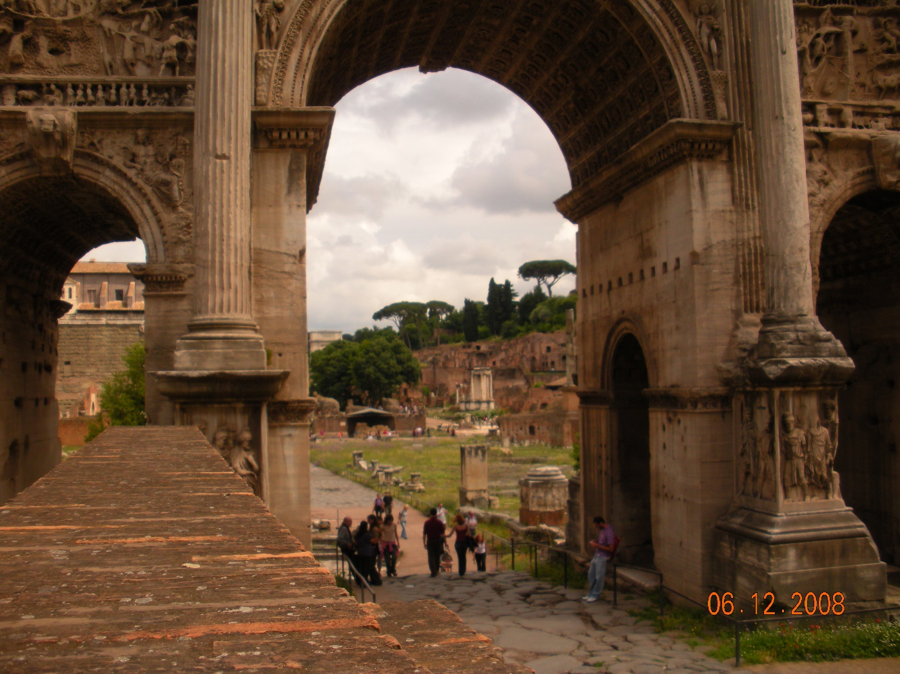
Rome : What factors led to the decline of the Roman Republic and the Rise of the Roman Empire?

Slide 4
Early History
1
Roman Republic:
Rome grew from a small village to an empire.
Rome transitioned from monarchy to aristocracy to a republic, but ended in an imperial form of government
Rome preserved much of Greek art, philosophy, religion, and drama.

Slide 5
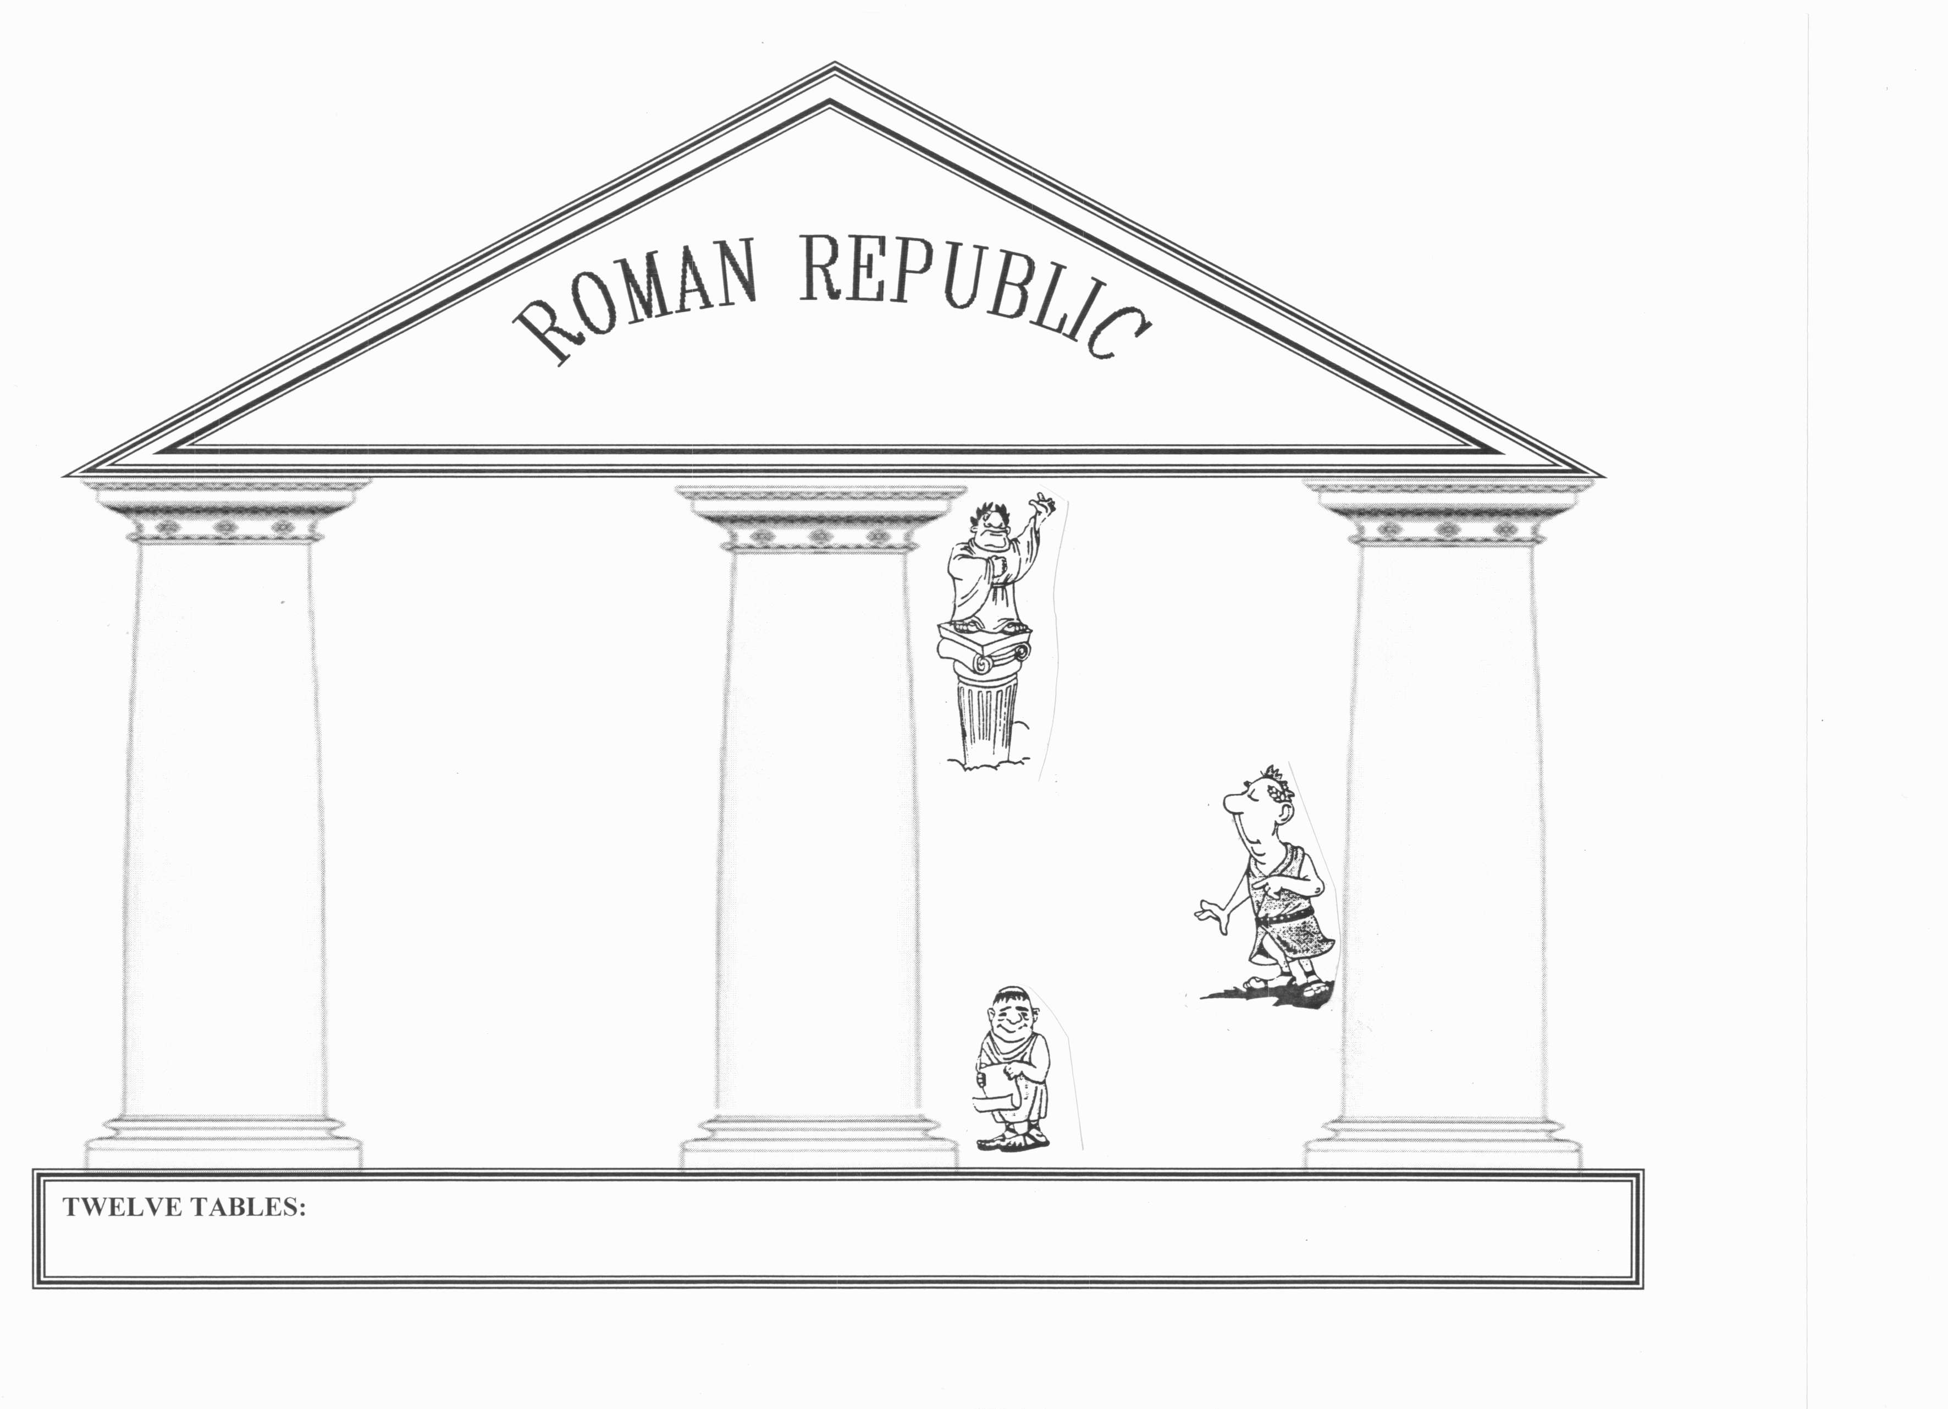
https://www.youtube.com/watch?v=-I5r-6wW2-o
EXECUTIVE
LEGISLATIVE
JUDICIAL
Senate
Praetors
Consuls
DICTATOR
CenturiateAssembly
Veto Power
Tribal Assembly
Take Notes on pages 2/3

Slide 6
Structure of the Republic
EXECUTIVE
LEGISLATIVE
Patricians
JUDICIAL
Dictator
assigned to be in charge in the event of a war for six months
Senate
Landholding upper-class; make up Senate.
Praetors
300 members-for life
8 judges chosen by Centuriate Assembly for 1 year.
Consuls
Centuriate Assembly
Plebeians
2 patricians elected for 1 year.
All citizen soldiers – for life; select consuls and make laws.
Farmers, merchants, artisans, traders.
Tribal Assembly
Veto Power
Citizens group by where they live; elect tribunes and make laws.
Slaves
Consuls could overrule the other’s decisions.
People captured during war; worked on latifundias – large estates.
Written law code that established the idea that all free citizens had a right to the protection of the law.

