Slide 2
Mapping the Expansion of the Roman Empire
Cypress Ranch High School
World History

Slide 3
The Expansion of the Roman Republic : Hmmm…..Horses vs. Elephants The Battle of Zama in the Punic Wars
https://www.youtube.com/watch?v=Sc6kLC6qPhw
Add Notes to Page 2

Slide 4
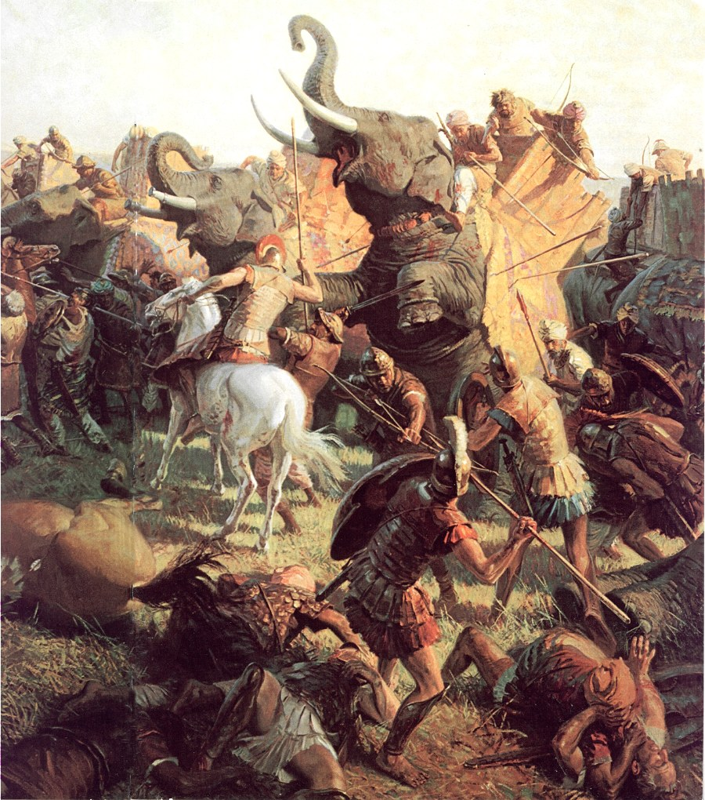
CLICK ON PICTURE TO PLAY PUNIC WARS

Slide 6
Expansion of the Roman Republic:
Romans conquered all of Italy by 275 BC
Expansion throughout Italian peninsula brings the Romans into conflict with Carthage over Sicily
Punic Wars – 120 Years
Rome acquires territory after each successive series of battles
Hannibal defeated at Zama, Carthage loses its territories to Rome
By 146 BC Rome rules the Mediterranean

