Slide 2
Mapping the Expansion of the Roman Empire
Cypress Ranch High School
World History

Slide 3
Power of Rome is at its peak for 200 years

Slide 4
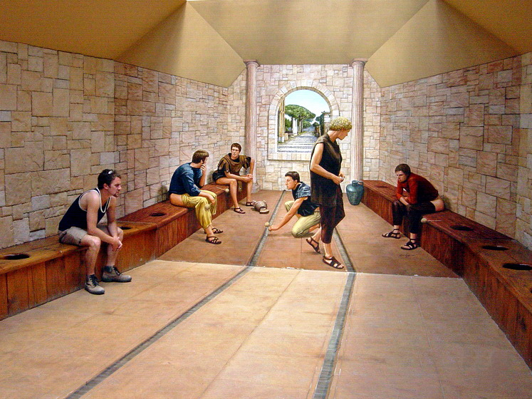
Yeah, that’s it! Now what is a “sponge on a stick”?
It’s a TOILET!!!! The guy on the left closest to the front is a real tourist (not going potty). The others are part of a painting.

Slide 5
The Roman Empire: Daily Life Read in your packet and Complete questions / graphic organizer
5
6
7

Slide 6
The Roman Empire: Five Good Emperors Rome had some good emperors and some not so good emperors

Slide 7
The Roman Empire
Five Good Emperors ruled from 96 to 180 AD
Nerva – began adoption of heir
Trajan – empire reached it height in 117 AD
Hadrian – reorganized bureaucracy
Antoninus Pius – peace and prosperity
Marcus Aurelius – height of economic prosperity; defeated invaders and wrote philosophy.

Slide 8
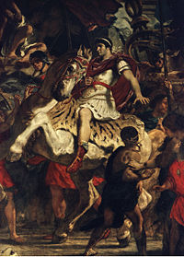

Slide 9
The Roman Empire: Gladiatorial Games

Slide 10
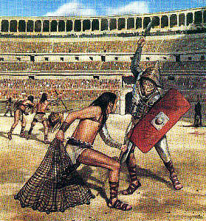

Slide 11
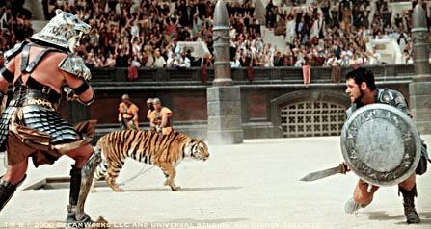

Slide 12
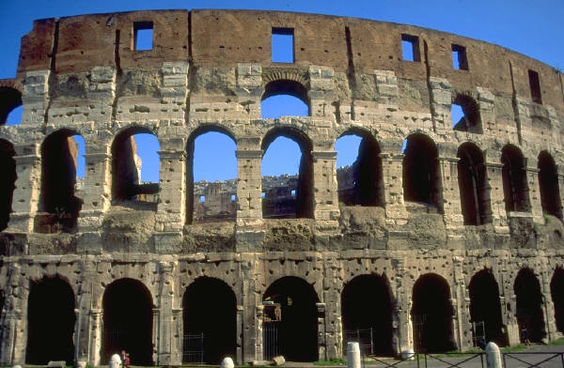
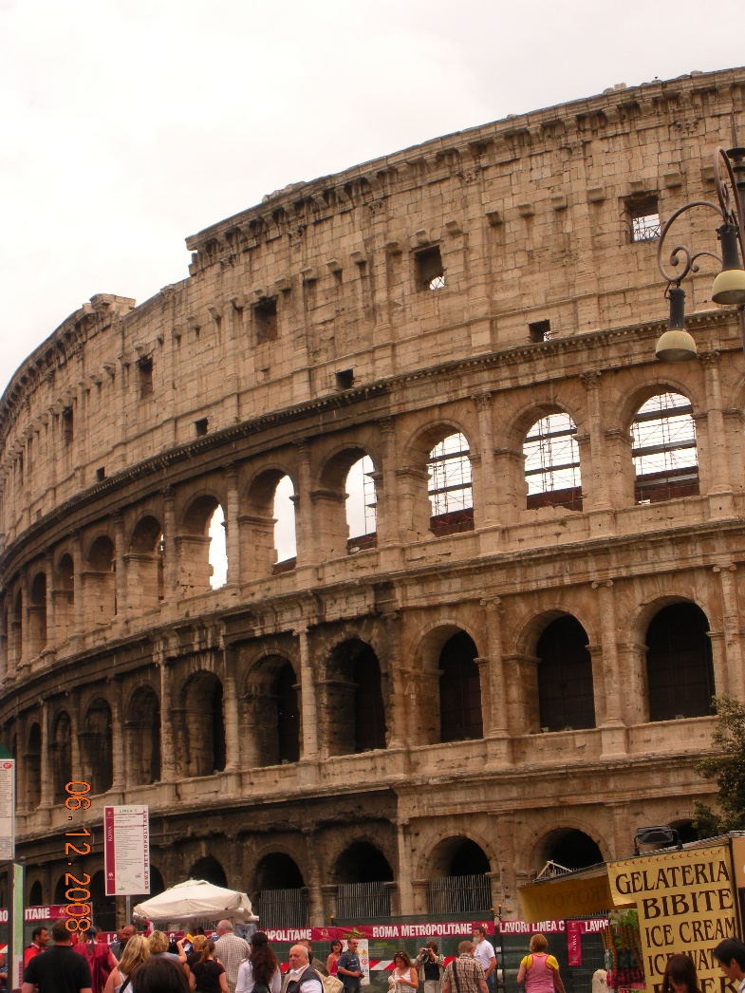
The Coliseum – Gladiators fought there.
Internally, the gladiatorial games signify Rome’s decline. Used to distract and control the people.

Slide 13
The Roman Empire
Government also used free games, races, mock battles as well as Gladiator contests to distract and control the masses.
Civil war breaks out after 186 AD-emperors lost control
Empire too large to manage – Diocletian divides it in two
Barbarians attacked the Roman Empire from many sides

Slide 14
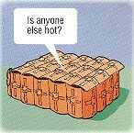

Slide 15
Imperial Rome & Religion
9

