Slide 2
Mapping the Expansion of the Roman Empire
Cypress Ranch High School
World History

Slide 3
Imperial Rome & Religion
9

Slide 4
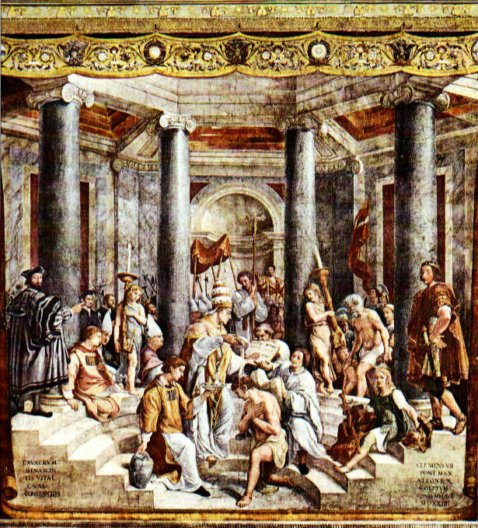

Slide 5
How did Christianity Rise and then Spread to become the official Religion of the Roman Empire?

Slide 6
Christianity & the Roman Empire
Factors that allowed for spread of Christianity because made travel & exchange of ideas safe (Jesus sent missionaries--Apostle Paul)
Pax Romana
Roman road systems
Common language (Greek & Latin)
Religion welcomed all converts (universality made it more than just a local religion)

Slide 7
Imperial Rome & Religion
Christianity begins to spread throughout the Roman empire
WHY IS CHRISTIANITY APPEALING TO ROMANS?
Christians refusal to worship Roman gods seen as a threat to Roman authority
RESULT→ Christians were exiled, imprisoned & executed
Despite the persecutions, Christianity continues to grow (1 million by late 3rd century)
313 A.D. Emperor Constantine legalizes Christianity throughout the empire → Edict of Milan

Slide 8
Jewish Diaspora
Jewish Zealots rebel against Rome which results in the Roman destruction of the Temple in 70 A.D. (western wall is all that remained)
Although the Jewish religion survives, the political state ceases to exist when most Jews are driven from their homeland→ DIASPORA

